Slide 1


Project Name
SGGS VEHICLE TRACKER
A Platform for Vehicle Tracking
Team Members
Vaibhav N. Lanjewar (2021BIT023)
Rohan R. Nachane (2021BIT025)
Project Guide: Dr.Arati Manjramkar
Department of Information Technology
Final Year
2024-2025
Shri Guru Gobind Singhji Institute of Engineering and Technology (SGGSIET), Nanded
13/05/2025
SGGSIET, Nanded
1

Slide 2
Table Cf Content
Introduction
Objective
Work Flow
Hardware Component used
Tech Stack
Distance formula
Application
Limitation
Future Scope
Conclusion
13/05/2025
SGGSIET, Nanded
2

Slide 3
Introduction
Vehicle Tracking System uses GPS to track vehicles in real time.
Helps users monitor bus location, speed, and ETA.
GPS Module for location data
ESP Module for communication
Firebase for real-time database
Leaflet.js for map display
Haversine formula for distance calculation
13/05/2025
SGGSIET, Nanded
3

Slide 4
Objective
Track SGGS college buses in real time.
Help students/staff reduce waiting time.
Save time
Develop an IoT-enabled live tracking system.
13/05/2025
SGGSIET, Nanded
4

Slide 5
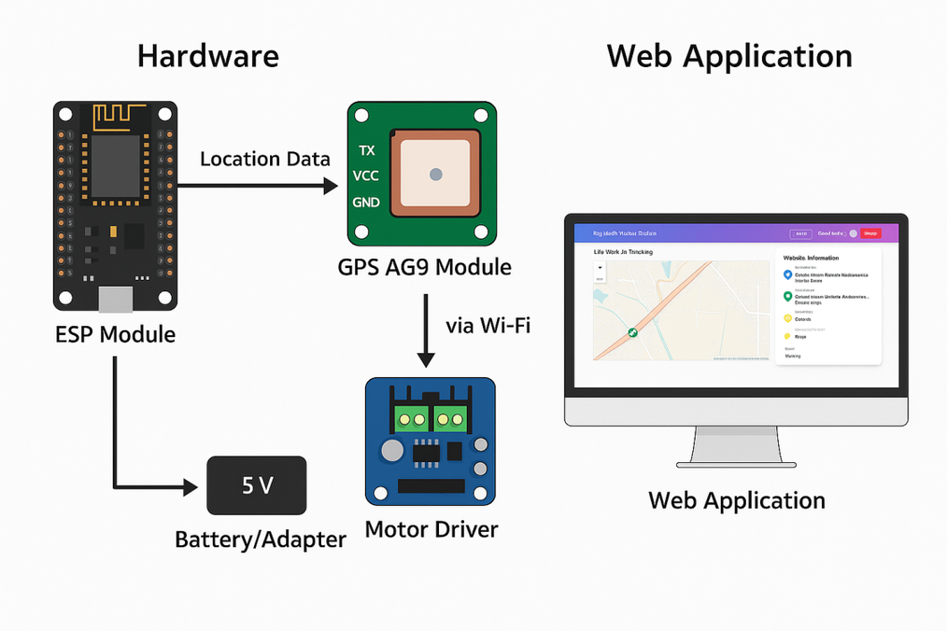
Work Flow
GPS collects location data.
ESP sends data to Firebase.
Firebase updates the real-time database.
Web app fetches & shows location on map.
We haveEnable call/SMS alerts toggle .
13/05/2025
SGGSIET, Nanded
5

Slide 6
Hardware Components Used
ESP8266 NodeMCU – for processing & Wi-Fi
A9G GPS Module – provides location
Motor Driver – Used to Transform the Voltage from 12v to 5v
Battery/Adapter – power supply
13/05/2025
SGGSIET, Nanded
6

Slide 7
Tech Stack
HTML, CSS, JavaScript – Web frontend
Tailwind CSS, Bootstrap – UI styling
Firebase – Authentication & Realtime DB
Leaflet.js – Interactive live map
13/05/2025
SGGSIET, Nanded
7

Slide 8
Distance Calculation – Haversine Formula
a = sin²(Δφ/2) + cos(φ1) × cos(φ2) × sin²(Δλ/2)
c = 2 × atan2(√a, √(1−a))
d = R × c
Used to calculate distance between user and bus.
Where,
R is the radius of the sphere (Earth), typically 6371 km.
Δφ is the difference in latitudes.
Δλ is the difference in longitudes.
φ1 and φ2 are the latitudes of the two points.
c is the angular distance in radians.
d is the distance in the same units as R (e.g., kilometers).
13/05/2025
SGGSIET, Nanded
8

Slide 9
Applications
Live tracking of SGGS buses.
Helps to avoid delays and confusion.
Emergency Services (Ambulance/Fire Trucks/Police).
Public Transport Systems like train/buses.
Rental Car Services (e.g.,Ola, Uber).
School Bus Safety Monitoring
Military and Defense Vehicle Tracking.
13/05/2025
SGGSIET, Nanded
9

Slide 10
Limitations
Requires constant GPS and internet signal.
Hardware needs proper power supply.
Firebase has free usage limits.
SIM-based communication may cost extra.
To track realtime cordinates , require open space.
13/05/2025
SGGSIET, Nanded
10

Slide 11
Future Scope
Mobile app version for Android/iOS.
AI-based route prediction.
Adding bus schedule.
13/05/2025
SGGSIET, Nanded
11

Slide 12
Conclusion
SGGS Vehicle Tracking is Practical System.
Combines IoT hardware(like ESP,GPS) and a responsive web app.
Provides real-time vehicle location updates to students and staff.
Reduces waiting time, improves coordination, and saves fuel and time.
Enhances transport safety and user convenience with accurate live data.
This is how, save time of students and the staff.
13/05/2025
SGGSIET, Nanded
12

Slide 13
THANK YOU !
13/05/2025
SGGSIET, Nanded
12

