Slide 1
Cloud-Based Online Voting System Using AWS & DevOps
Team Members:
Vaibhav S. Mungal (82)
Department: Computer Science & Engineering
Academic Year: 2025–26

Slide 2
Introduction
Our project is a Cloud-Based Online Voting System. The main purpose of this project is to allow users to register, authenticate themselves, cast their vote online, and view election results.
The application is developed using web technologies and deployed in a cloud environment. The system provides a faster and more accessible voting process compared with traditional paper-based voting.
In the updated deployment, we have containerized the application using Docker and deployed the container using Kubernetes.

Slide 3
Problem Definition
Traditional paper-based voting suffers from several major issues:
Requires physical presence of voters
Long queues and time-consuming process
Manual counting leads to errors
Risk of data tampering or manipulation
High cost for printing and staff
Low accessibility for remote voters
To solve these challenges, a secure, cloud-based online voting system is needed that allows users to participate in elections digitally and safely.

Slide 4
Objectives Achieved
The main objectives of the cloud-based online voting system are:
Develop a secure online voting platform.
Provide voter registration and authentication.
Implement one-user-one-vote functionality.
Generate election results automatically.
Reduce manual counting.
Deploy the application in a cloud environment.
Containerize the application using Docker.
Deploy the containerized application using Kubernetes.

Slide 5
Scope of the Project
The online voting system can be used in:
Colleges & Universities
Schools
Clubs & Communities
Classroom Elections
Organizations & Committees

Slide 6
Technologies Used
Frontend: HTML, CSS, JavaScript
Backend: PHP
Database: MySQL
Cloud Platform: AWS EC2
Version Control: Git/GitHub
Deployment technologies
Containerization
Docker
Container Registry
Docker Hub
Container Orchestration
Kubernetes
Kubernetes resources

Slide 7
Implementation
First, we developed the application using HTML, CSS, JavaScript, PHP and MySQL.
We implemented voter registration and login functionality. We also created an admin dashboard for managing voters, candidates and elections.
The voting module implements the one-user-one-vote rule.
MySQL is used to store voter, candidate and voting information.
After completing the application, we containerized the PHP application using Docker.
We created a Docker image and pushed that image to Docker Hub.
Kubernetes then uses that Docker image to create application Pods through a Kubernetes Deployment.
Finally, we use a Kubernetes Service to provide network access to the application.

Slide 8
Testing and Validation
Conducted functional testing on all modules, including voter registration, login, candidate management, vote casting, and result generation.
Verified secure user authentication to ensure only authorized users could access the system.
Tested the one-user-one-vote mechanism to prevent duplicate voting.
Validated database operations for accurate storage and retrieval of voter and candidate information.
Successfully passed all test cases, confirming the system's functionality, security, and performance.

Slide 9
FINAL OUTPUT
Users can register and log in securely through the web application.
Voters can cast their votes online from any location using an internet connection.
The system successfully enforces the one-user-one-vote policy and prevents duplicate voting.
Administrators can add, update, and manage candidates through the admin panel.
Votes are securely stored in the MySQL database and processed accurately.
Election results are generated automatically and displayed in real time.
The system reduces manual effort, eliminates paper-based processes, and improves election transparency.

Slide 10
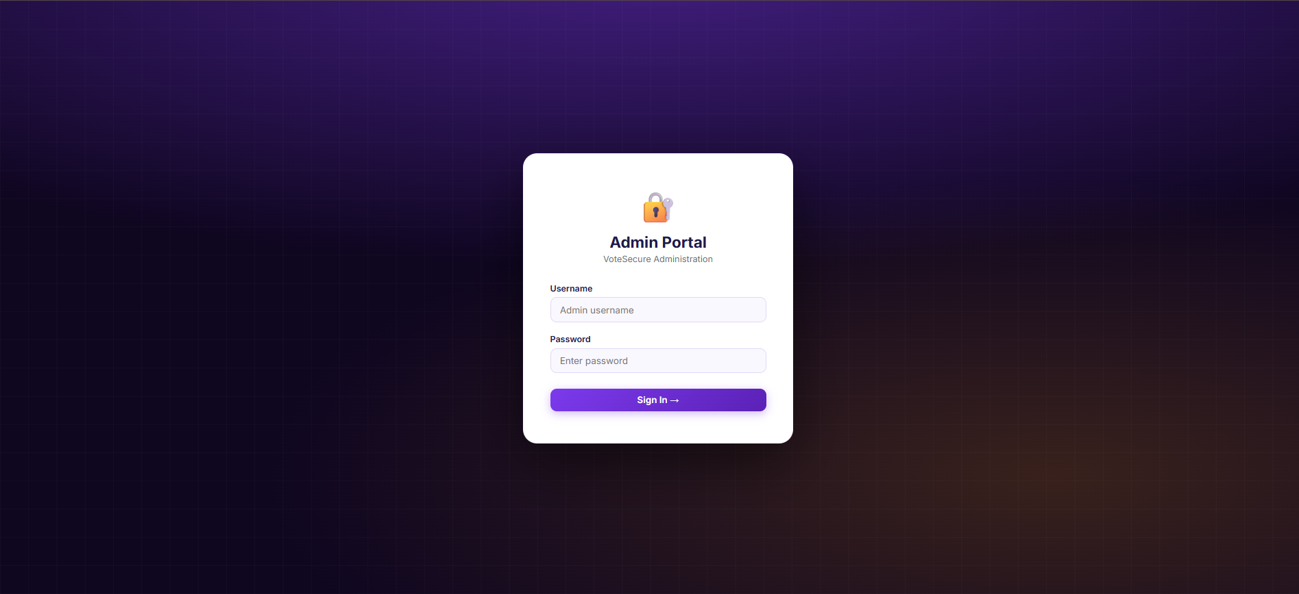
Admin Login Portal

Slide 11
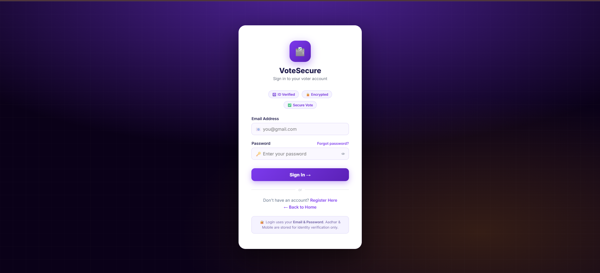
User Login Portal

Slide 12
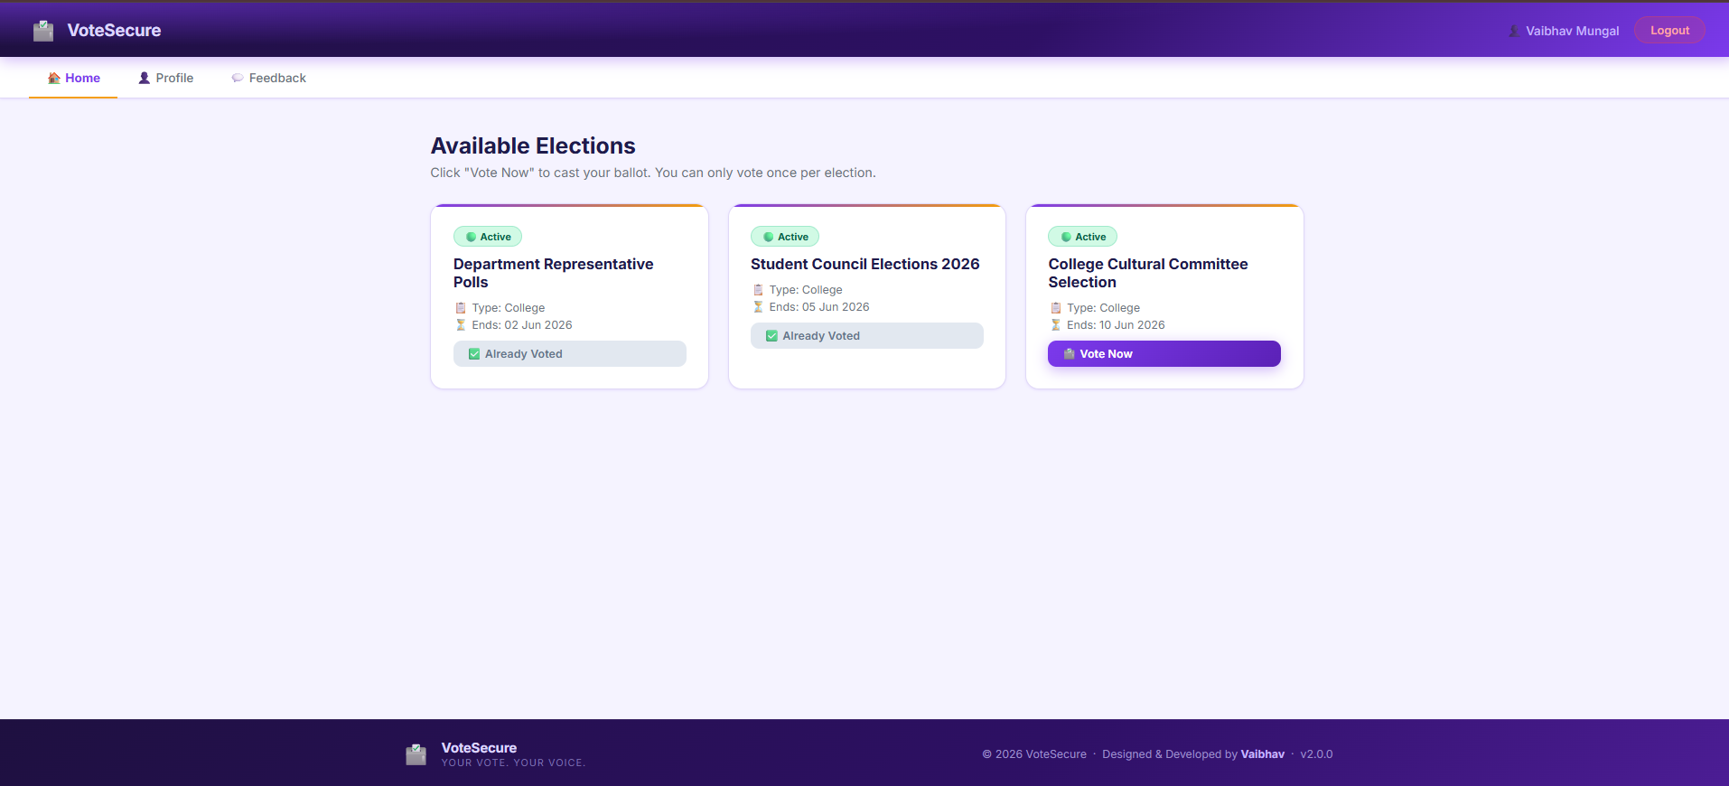
Voter Dashboard – Available Election

Slide 13
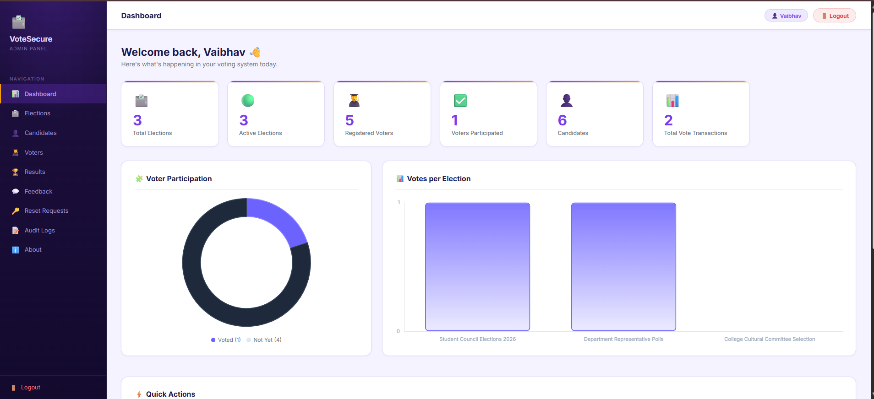
Admin Dashboard of Online Voting System

Slide 14
Future Scope
OTP-based login
Biometric authentication
Blockchain for vote security
Mobile app version

Slide 15
Kubernetes Deployment Architecture
Docker image from Docker Hub deployed as Pods inside the Kubernetes cluster
Developer
GitHub
Docker Image
Docker Hub
Kubernetes
Cluster
Deployment
Pod 1
Pod 2
Service
Deployment
Pods
Service
Maintains desired Pod state and manages application updates.
Run the containerized PHP application using the Docker image.
Provides stable access to Pods and forwards requests to available Pods.
VoteSecure • Kubernetes Deployment • 20

Slide 16
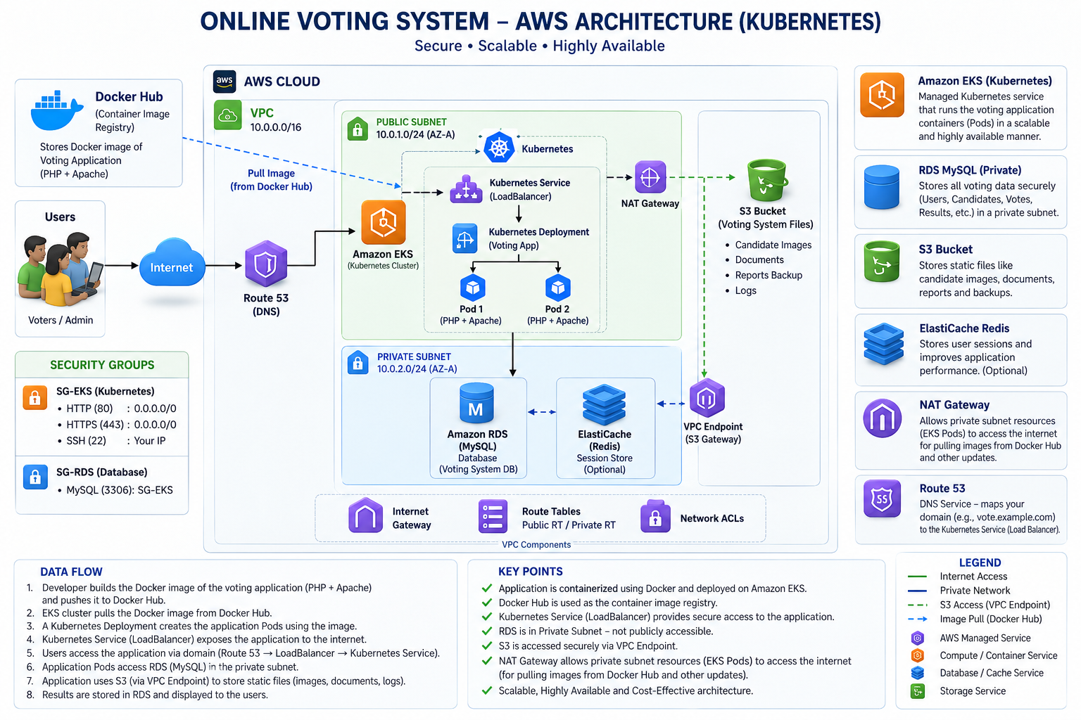

Slide 17
Kubernetes Components Used for Deployment
Production-grade multi-tier architecture deployed in 'votesecure' namespace
Namespace: votesecure
ConfigMap & Secret
MySQL 8.0 Deployment
Dedicated Kubernetes namespace providing isolation, RBAC security, resource quotas, and clean workload separation.
Decouples configuration (DB_HOST, DB_NAME) and encrypted credentials (DB_USER, DB_PASSWORD) from application container images.
Containerized database instance with PersistentVolumeClaim storage, automated schema initialization, and isolated storage volume.
ClusterIP Service (3306)
App Deployment (2 Replicas)
LoadBalancer Service (80)
Provides secure internal DNS endpoint (mysql-service:3306) allowing application pods to query the database with zero internet exposure.
Runs PHP 8.2 + Apache application pods with zero-downtime rolling update (maxSurge: 1) and continuous /health.php readiness probes.
Provisions an AWS Elastic Load Balancer (ELB) mapping public HTTP traffic on Port 80 directly to healthy container pods across AZs.
VoteSecure • Kubernetes Architecture • 21

Slide 18
Kubernetes Deployment & Orchestration Flow
Production rollout lifecycle from containerization to live traffic routing
01
Container Packaging
02
Registry Distribution
03
EKS Cluster Connect
Multi-stage Docker build packages PHP 8.2 & Apache with production-grade security flags and Apache configs.
Semantic image tagging and push to Docker Hub repository (vaibhavmungal/votesecure-app).
Authenticate kubectl securely with AWS CLI using: aws eks update-kubeconfig --name votesecure-cluster.
04
Declarative Rollout
05
Zero-Downtime Rollout
06
Health Probe Verify
Apply manifest: kubectl apply -f k8s/votesecure.yaml across Namespace, Secrets, ConfigMap, DB & App.
Kubernetes handles rolling update (maxSurge: 1, maxUnavailable: 0) ensuring zero vote loss during updates.
Automated readiness probe checks /health.php; AWS ELB routes traffic only to validated healthy pods.
VoteSecure • Kubernetes Deployment • 22

Slide 19
Jenkins CI/CD & DevSecOps Pipeline
End-to-end continuous integration, vulnerability scanning, and automated delivery workflow
Stage 1: SCM Checkout
Stage 2: Syntax Linting
Stage 3: Docker Build & Tag
Polls GitHub repository every 60s; triggers declarative pipeline immediately upon commit to main branch.
Automated pre-flight syntax validation (php -l) verifies code integrity before building, preventing broken deployments.
Builds production container image and applies unique semantic tags using Jenkins ${BUILD_NUMBER} for complete traceability.
Stage 4: DevSecOps Trivy Scan
Stage 5: Secure Hub Push
Stage 6: Zero-Downtime Deploy
Trivy scanner checks container filesystem for CVEs, generating audit reports and failing build on CRITICAL severity.
Pushes scanned, verified container image to Docker Hub repository (vaibhavmungal/votesecure-app) via Jenkins credentials.
Executes zero-downtime rolling update on Amazon EKS cluster and validates deployment using /health.php smoke test.
VoteSecure • DevOps & CI/CD Pipeline • 23

Slide 20
Network Architecture & Port Governance
Enterprise network segregation, security groups, and zero-conflict allocation
Port 80 (Production HTTP)
Port 8080 (Dedicated Jenkins)
Port 8085 (Docker Compose)
AWS Elastic Load Balancer (ELB) receives public voter traffic and routes to healthy Kubernetes App Pods across AZs.
Dedicated strictly to Jenkins CI/CD automation server; eliminates port collisions with application web traffic.
Isolated local development port mapping host 8085 -> container 80 for seamless local multi-tier testing.
Port 3306 (MySQL Database)
AWS Security Groups
Health Probe Endpoint
Bound strictly to internal cluster network (mysql-service:3306); completely blocked from external public access.
SG-EKS permits HTTP/HTTPS inbound from internet; SG-RDS restricts MySQL ingress strictly to SG-EKS nodes.
Dedicated /health.php endpoint returning JSON status for automated Kubernetes liveness/readiness self-healing.
VoteSecure • Network & Security • 24

Slide 21
Technologies Used
Comprehensive full-stack application, cloud infrastructure, and DevSecOps tooling
Application Layer
Database Layer
AWS Cloud Platform
HTML5 • CSS3 • JavaScript
PHP 8.2 • Apache Web Server
MySQL 8.0 Relational DB
PersistentVolumeClaim (PVC)
Decoupled Secrets & ConfigMap
Amazon EKS • AWS ELB
VPC • Public/Private Subnets
Internet Gateway • NAT Gateway
Container Orchestration
CI/CD & Security
IaC & Tooling
Docker • Docker Hub
Kubernetes (K8s) Manifests
Namespace: votesecure
Jenkins Declarative Pipeline
Trivy Vulnerability Scanner
Git • GitHub Webhooks
Terraform Modules (VPC, EKS)
kubectl CLI • AWS CLI
Health Check Probes (/health.php)
Automated DevSecOps Delivery Stack
Code → Jenkins CI/CD → Trivy Scan → Docker Hub → Amazon EKS → AWS ELB (Port 80) → Voters
VoteSecure • Technologies Used • 25

Slide 22
Results & Project Achievements
Successfully deployed the VoteSecure voting platform on AWS using Amazon EKS container orchestration.
Implemented an automated Jenkins CI/CD pipeline reducing deployment lifecycle to minutes with zero manual errors.
Integrated DevSecOps with automated Trivy vulnerability scanning, enforcing a strict zero-critical-CVE policy.
Completely eliminated port collisions through strict port governance (Port 80 Production, 8080 Jenkins, 8085 Local).
Achieved zero-downtime rolling updates (maxSurge: 1, maxUnavailable: 0) and self-healing with /health.php probes.
Secured database tier with MySQL 8.0 isolated in private network with internal ClusterIP DNS resolution.

Slide 23
CONCLUSION & SUMMARY
Developed a secure, cloud-based Online Voting System with voter authentication, candidate management, one-user-one-vote enforcement, and automated real-time tallying.
Modernized the architecture from a monolithic server setup into an enterprise-grade containerized microservices ecosystem running on Amazon Elastic Kubernetes Service (EKS).
Automated the software delivery lifecycle using a declarative Jenkins CI/CD pipeline, incorporating Trivy container security scans and automated Docker Hub distribution.
Solved real-world DevOps challenges including database persistence, network port conflicts, credential separation via Kubernetes Secrets, and zero-downtime rolling releases.
The project successfully demonstrates end-to-end cloud engineering, DevSecOps automation, and high-availability application hosting on Amazon Web Services.

