Slide 1
ITIL® 2011 Foundation Certification Course
Overview of ITIL® 2011
ITIL® is a registered trade mark of AXELOS Limited
IT Infrastructure Library is a registered trade mark of AXELOS Limited
AXELOS® is a trade mark of AXELOS Limited
Version 2.0

Slide 2
Course Objectives
Explain the practice of Service Management
Describe Service Lifecycle
Identify key principles and models of ITIL® 2011
Define generic concepts in ITIL® 2011
Discuss the processes, roles and functions in ITIL® 2011
After completing this course, you will be able to:

Slide 3
Introduction to ITIL
ITIL® is a set of publications focusing on the best practices followed in IT Service Management.
Facts related to ITIL®:
ITIL® was published between 1989 and 1995 by Her Majesty’s Stationery Office or HMSO, in the UK, on behalf of the Central Computer and Telecommunications Agency.
ITIL® v2 was published as a set of revised books between 2000 and 2004.
In 2007, ITIL® v2 was superseded by an enhanced and consolidated ITIL® v3, consisting of five core books covering the service lifecycle.
In July 2011, ITIL® v3 was upgraded to ITIL® 2011 with some changes in the processes. ITIL® 2011 has introduced a clearly defined set of strategic processes, which includes Strategy Management for IT services and Business Relationship Management.

Slide 4
Overview of ITIL®
What is ITIL® ?
A set of publications for Best practices in IT service Management.
Why ITIL® ?
Focuses on descriptive guidance on IT Service Management that’s easily adapted.
Emphasizes Quality Management approach, standards
ITIL® goals
Consistent, comprehensive, hygienic set of Best-Practice
Platform independent discussion of processes
Common Language, Standardized vocabulary
Flexible framework, adaptable to different IT environments.

Slide 5
Why ITIL® Is Successful
ITIL® embraces a practical approach to service management—do what works. And what works is adapting a common framework of practices that unite all areas of IT service provision towards a single aim—that of delivering value to the business.
The following list defines the key characteristics of ITIL® that contribute to its global success:
Vendor-neutral: ITIL® service management practices are applicable in any IT organisation because they are not based on any particular technology platform or industry type. ITIL is owned by the UK government and is not tied to any commercial proprietary practice or solution.
Non-prescriptive: ITIL® offers robust, mature and time-tested practices that have applicability to all types of service organisation. It continues to be useful and relevant in public and private sectors, internal and external service providers, small, medium and large enterprises, and within any technical environment. Organisations should adopt ITIL® and adapt it to meet the needs of the IT organisation and their customers.
Best practice: ITIL® represents the learning experiences and thought leadership of the world’s best-in-class service providers.

Slide 6
Why ITIL® Is Successful (contd.)
ITIL® is successful because it describes practices that enable organisations to deliver benefits, return on investment and sustained success. ITIL® is adopted by organisations to enable them to:
deliver value for customers through services;
integrate the strategy for services with the business strategy and customer needs;
measure, monitor and optimise IT services and service provider performance;
manage the IT investment and budget;
manage risk;
manage knowledge;
manage capabilities and resources to deliver services effectively and efficiently;
enable adoption of a standard approach to service management across the enterprise;
change the organisational culture to support the achievement of sustained success;
improve the interaction and relationship with customers;
coordinate the delivery of goods and services across the value network; and
optimise and reduce costs.

Slide 7
ITIL® 2011 Components
Wider Complementary Portfolio
Official Portfolio
Web based complementary
products e.g.
case studies
Cabinet Office-Derived Products
Third party material:
Trademark Licensed
Core Cabinet Office
Introductions; Pocketbooks, Study guides; translated material
Third party material:
Crown Copyright (OPSI) reuse licensed
manual; glossary; syllabus
Official Publisher
complementary material
Official Accreditor
complementary material
Other third party complementary products
© Crown Copyright 2011. Reproduced under licence from AXELOS.

Slide 8
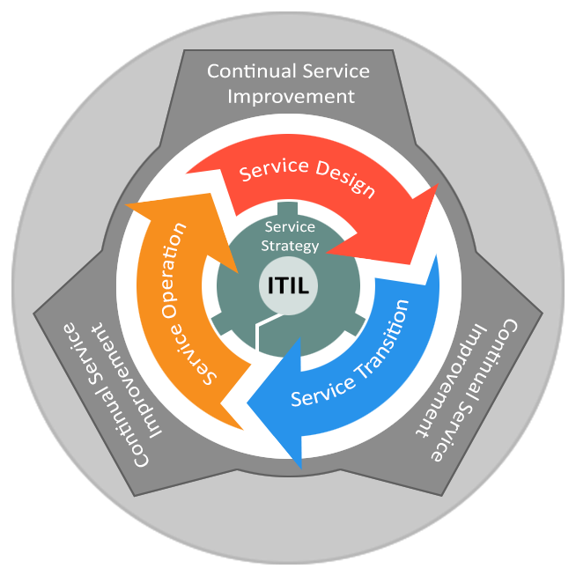
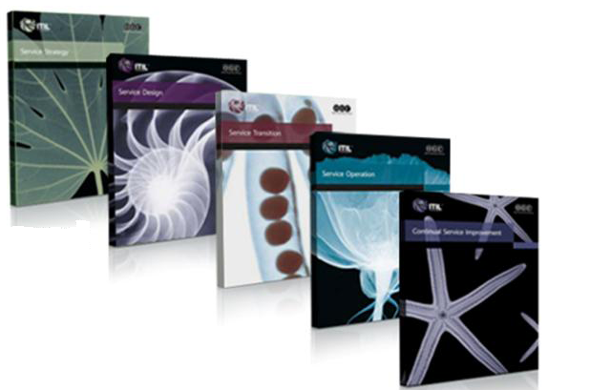
ITIL® Core Publications
Complementary Publications
Each lifecycle phase of ITIL® 2011 core is
represented by a Volume in the library
Service Strategy
Service Design
Service Transition
Service Operation
Continual Service Improvement
Web Support Services
© Crown Copyright 2011. Reproduced under licence from AXELOS.

Slide 9
ITIL® 2011 Qualification Scheme: Credits System
ITIL Master
Lifecycle Modules
Service Strategy
Service Design
Service Transition
Service Operation
Continual Service Improvement
ITIL Expert
5
Managing Across the Lifecycle
5
+
3
3
3
3
3
4
4
4
4
SS
SD
ST
SO
CSI
OSA
PPO
RCV
SOA
Capability Modules
Operational Support and Analysis (OSA)
Planning Protection & Optimisation (PPO)
Release Control and Validation (RCV)
Service Offerings & Agreements (SOA)
Lifecycle Modules
Capability Modules
2
ITIL Foundation (or earlier version of Foundation + Bridge)
+
©APM Group — The Accreditor Limited 2011
http://www.itil-officialsite.com/Qualifications/ITILQualificationScheme.aspx

Slide 10
Course Agenda
ITIL Course Agenda
Learning Unit 1: Introduction to Service Management Lifecycle Principles of Service Management, Processes, The ITIL® Service Lifecycle
Learning Unit 2: Service Strategy Concepts and Models, Processes
Learning Unit 3: Service Design Concepts and Models, Key Principles, Processes
Learning Unit 4: Service Transition Concepts and Models, Key Principles, Processes
Learning Unit 5: Service Operations Concepts and Models, Key Principles, Processes and Functions
Learning Unit 6: Continual Service Improvement Concepts and Models, Key Principles, Processes
Learning Unit 7 : Summary and Exam Preparation Review of Key Concepts and Practice Exam

Slide 11
Exam Details
Type | Online, Multiple choice, 40 questions. The questions are selected from the full ITIL® Foundation in IT Service Management examination question bank.
Duration | Maximum 60 minutes. Candidates sitting the examination in a language other than their native language have a maximum of 75 minutes
Supervised | Yes
Open Book | No
Pass Score | 65% (26 out of 40)
Where? | AEC (Authorised Examination Centre)

