Slide 1
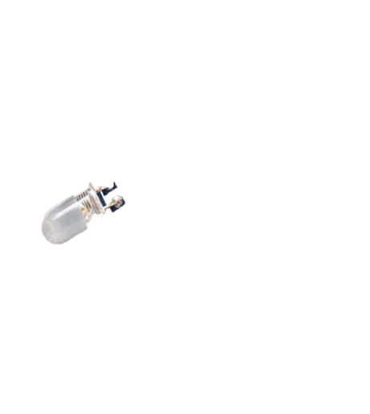
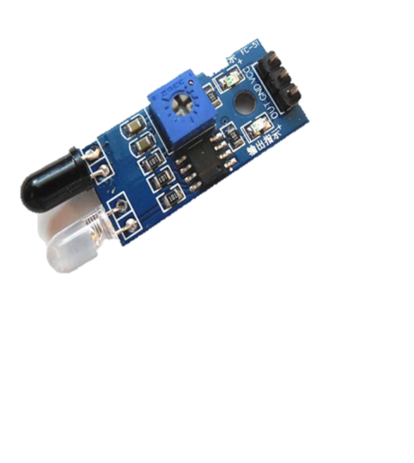
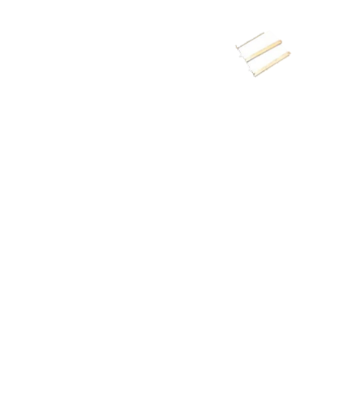
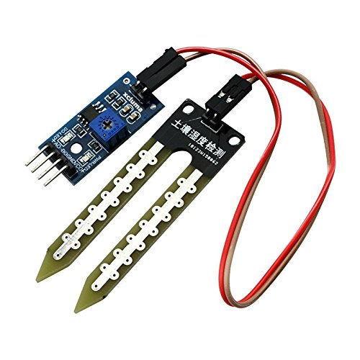
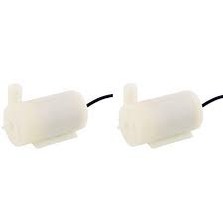
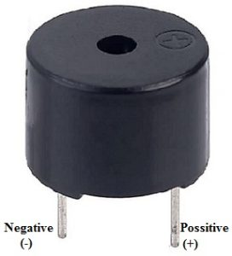
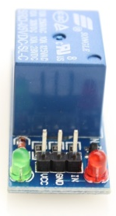
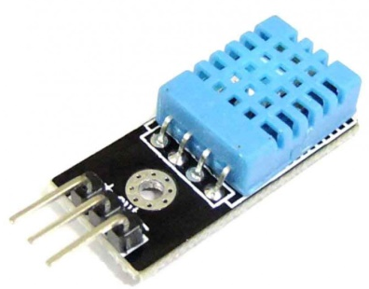
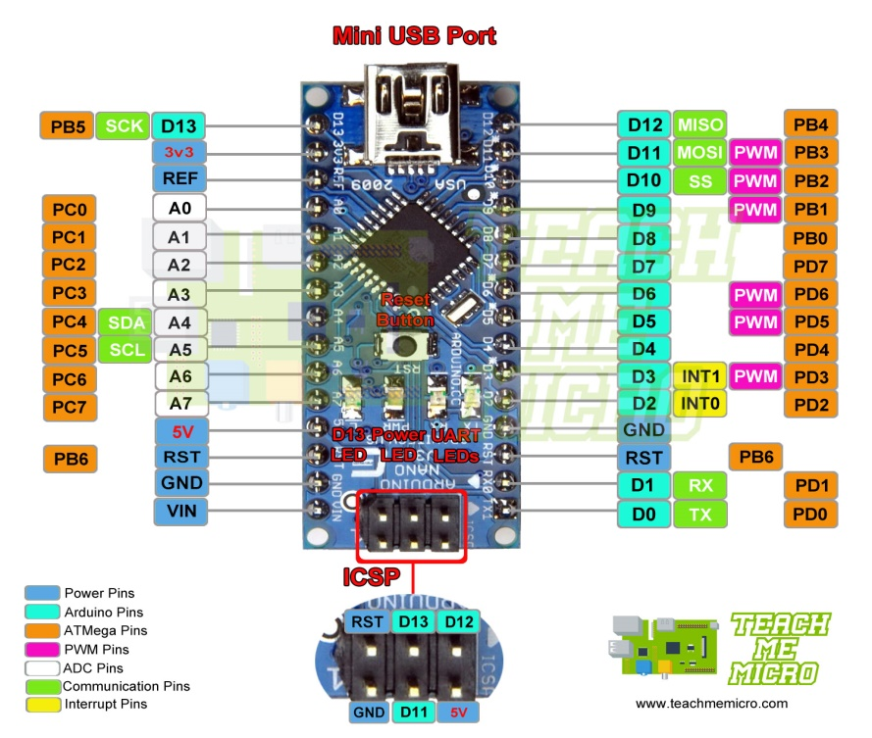
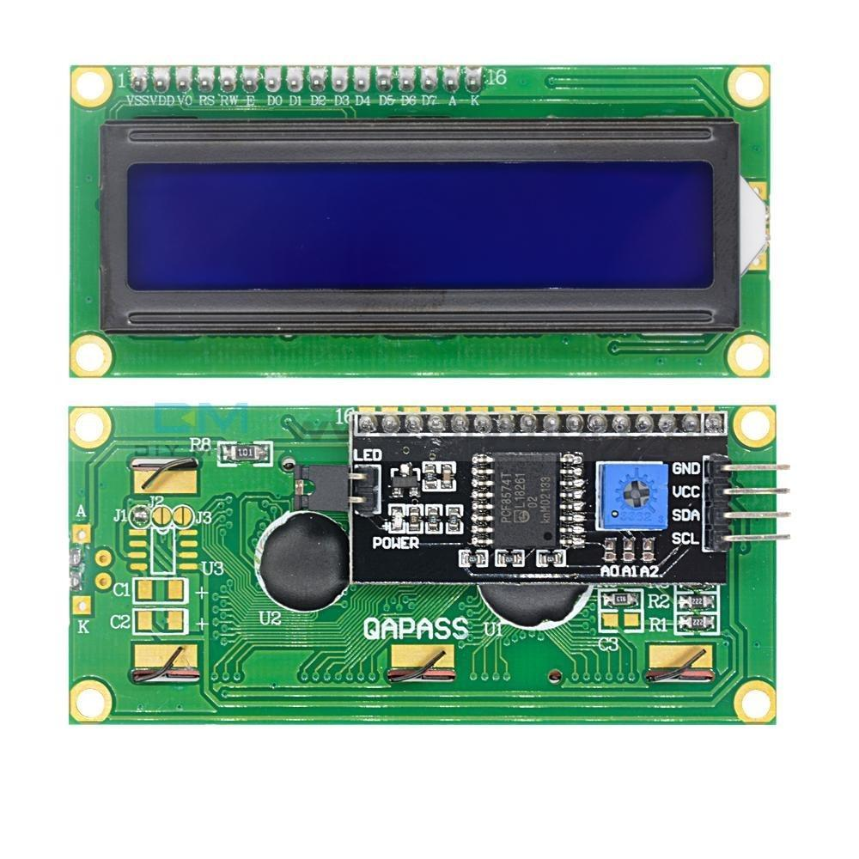
Smart Farming

Slide 2
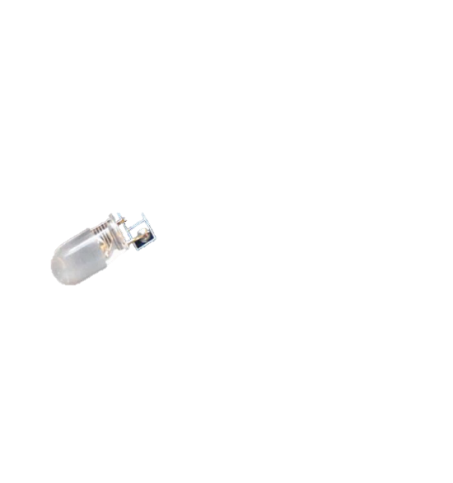
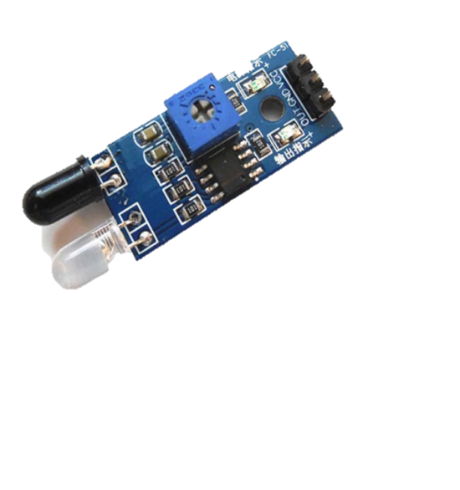
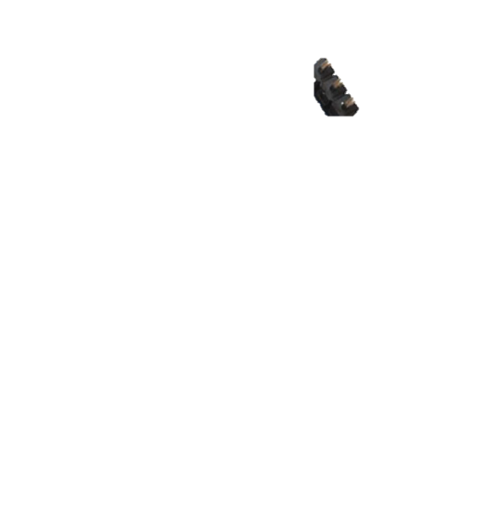

Interfacing IR and Buzzer with Arduino Nano

Slide 3

Interfacing Humidity and temperature with Arduino Nano

Slide 4

Interfacing Sol Moisture and LCD with Arduino Nano

Slide 5
Power Supply
Arduino Nano
Soil Moisture Sensor
LCD
IR Sensor
Buzzer
Humidity Sensor
Relay
Temperature Sensor
Motor
Output Devices
Micro Controller
Input Devices

Slide 6
Hardware Requirement:
Micro Controller : Arduino Nano : 1
Soil Moisture Sensor : 1
Humidity Sensor : 1
Temperature Sensor : 1
Relay : 1
Motor : 1
Buzzer : 1
LCD(Liquid Crystal Display) : 1
I2C LCD Driver : 1
Power Connector : 1
5V battery : 1
PCB and connecting cables
Software Requirement:
IDE : Arduino IDE
MC Programming Language : C
Additional Library: EduIntro.h, Wire.h, LiquidCrystal_I2C.h

