Slide 1
Power Supply
LED High
ESP 8266 Node MCU
LDR
LED Low
Buzzer
Ultrasonic Sensor
LCD ( voltage Display)
Battery Voltage Regulator
LCD( Light Intensity and Distance Display)
Battery Voltage
Output Devices
Micro Controller
Input Devices

Slide 2
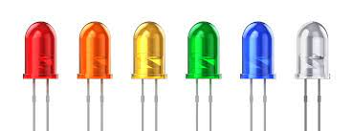
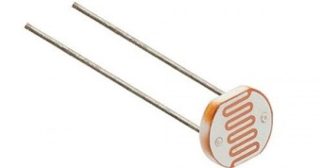
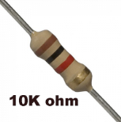
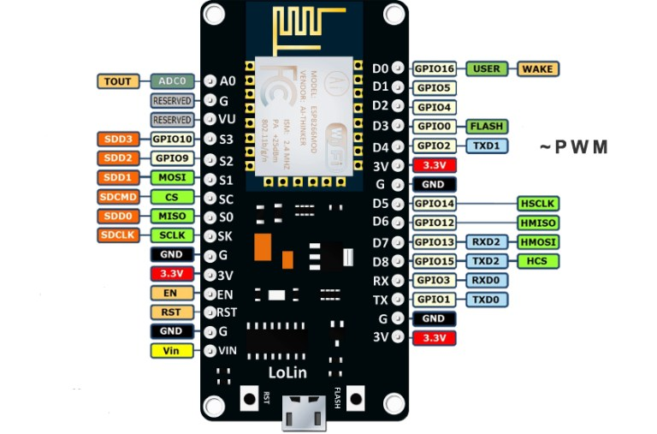
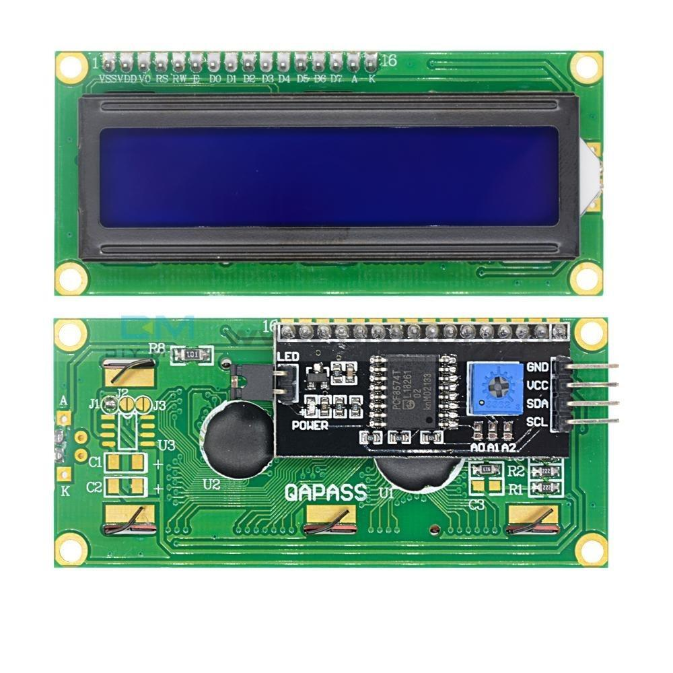
Interfacing ESP8266 and LDR for automatic headlight control

Slide 3
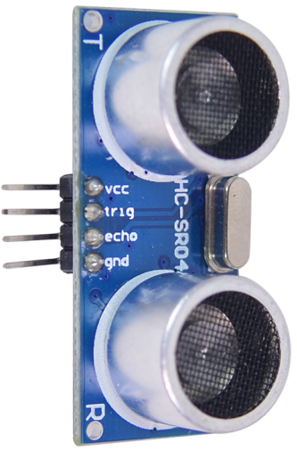
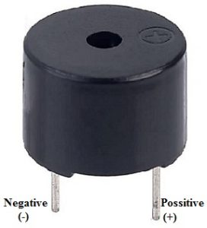
Interfacing ESP8266, Ultrasonic and Buzzer for distance measurement and notification

Slide 4
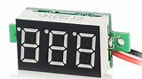
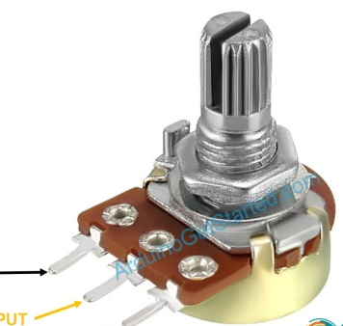
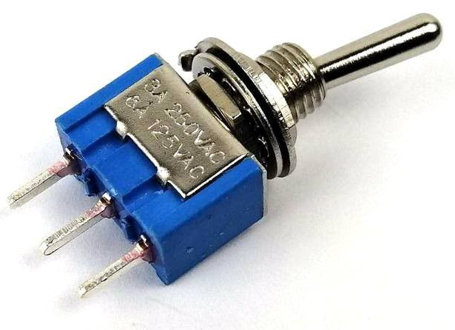
Interfacing ESP8266 with voltmeter for car battery voltage monitoring
Regulator
External Battery Connector
External
Voltage
Internal Voltage

Slide 5



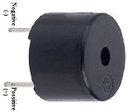
Smart car monitoring System

Slide 6
Hardware Requirement:
Micro Controller : ESP8266 Node MCU : 1
Ultrasonic Sensor : 1
Buzzer : 1
LDR(Light dependent resistor) : 1
Resistor (10 ohm) : 1
LED(Light emitting Diode) : 2
Voltmeter : 1
Potentiometer : 1
Switch : 1
LCD(Liquid Crystal Display) : 1
I2C LCD Driver : 1
Power Connector : 1
5V battery : 1
PCB and connecting cables
Software Requirement:
IDE : Arduino IDE
MC Programming Language : C
Additional Library: Wire.h, LiquidCrystal_I2C.h

Slide 7

