Slide 1
Power Supply
LPG Gas Sensor
ESP8266 Node MCU
Relay
LCD
9V Fan
LED
Buzzer

Slide 2
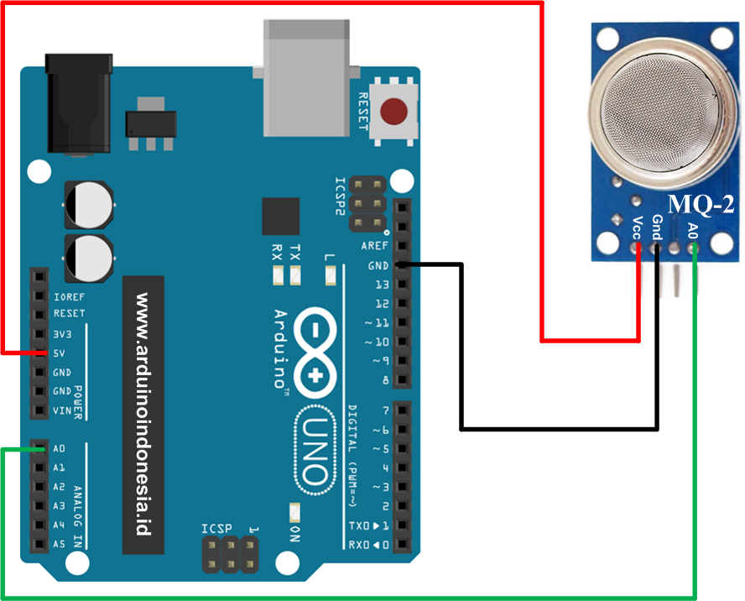
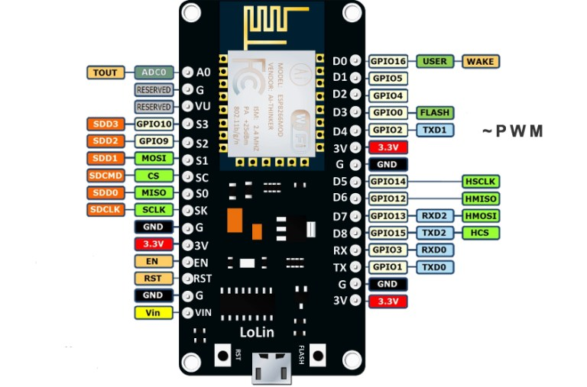
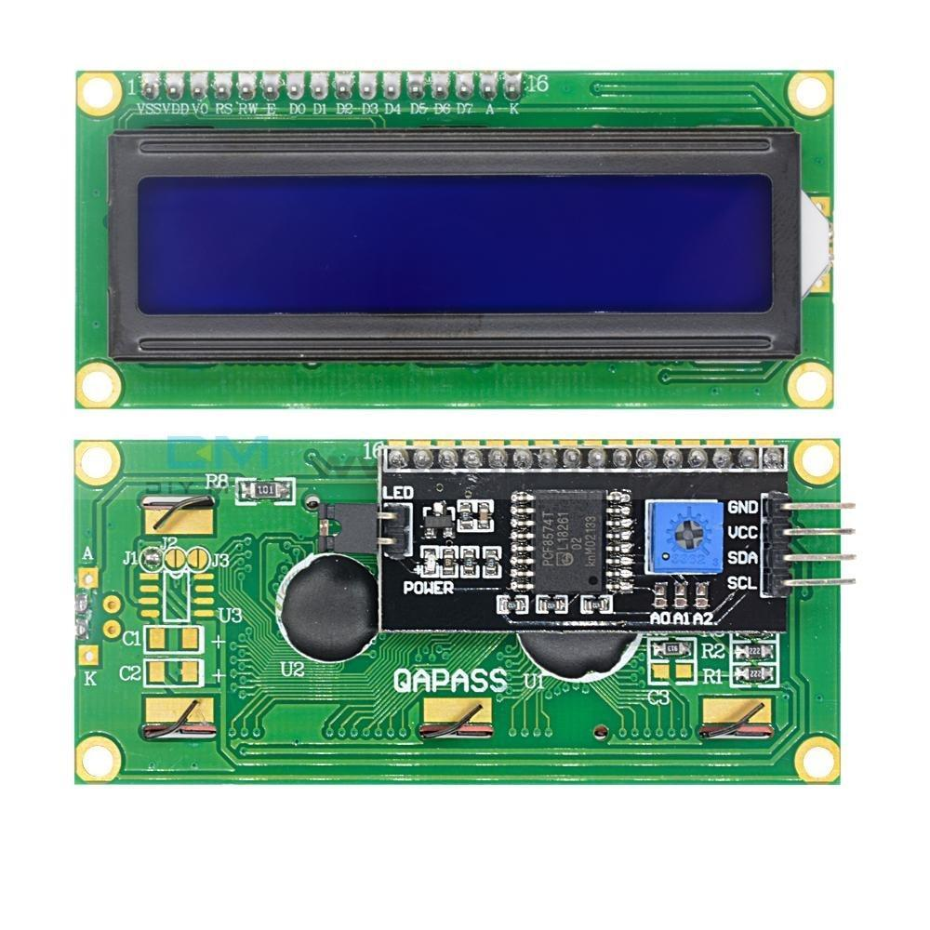
Interfacing LPG sensor with LCD and ESP8266

Slide 3
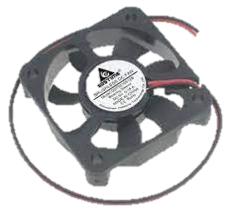
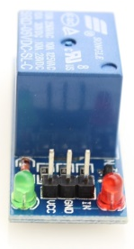
Interfacing LPG sensor with Relay, DC fan and ESP8266

Slide 4

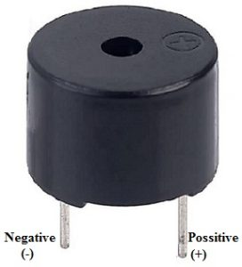
Interfacing LPG sensor with Buzzer, LED and ESP8266

Slide 5

LPG Gas leakage Monitoring System

Slide 6
Hardware Requirement:
Micro Controller : ESP8266 : 1
MQ2 LPG Sensor : 1
LED(Light emitting Diode) : 2
LCD(Liquid Crystal Display) : 1
I2C LCD Driver : 1
DC Fan : 1
Buzzer : 1
Power Connector : 1
Relay : 1
Battery : 1
PCB and connecting cables
Software Requirement:
IDE : Arduino IDE
MC Programming Language : C
Additional Library: MQ2.h, Wire.h, LiquidCrystal_I2C.h

