Slide 1
IITM Online B.Sc Degree Program
BDM Capstone Project
21F1003880
Vaidehi Agarwal
March 2022

Slide 2
About the business and Data Collection
The shop is wholesale supply of PVC pipes and fittings, Steel Tubes and Sanitary ware.
It is located in main market area of Sahibabad, Ghaziabad, U.P.
The data was collected over a period of one month.
There were more than 400 items of pipes, fittings, tubes, sanitary ware. Quantity of these items were available in voluminous bill books only, which was illegible and difficult to understand without continuous help of their staff. They were not in position to spare their staff for such long period.
Data was collected in currency form from various financial documents e.g. documents prepared for GST, I-Tax, bills etc..

Slide 3
Data extraction and Cleaning
Daily Sales and purchase data of three broad categories, PVC Pipes & Fittings, Sanitary ware, Steel Tubes, were extracted form from various financial documents.
Sales and Purchase data were feed in Excel workbook and checked with respect to daily opening and closing balance. If any mismatch found is clarified from their staff.
These data were processed in excel to understand total and item wise revenue & profit tends, revenues generated from sales to 103 firms, weekly revenue trend, day-wise revenue trend within a week, daily closing stock amount trend, fast/slow moving items.

Slide 4
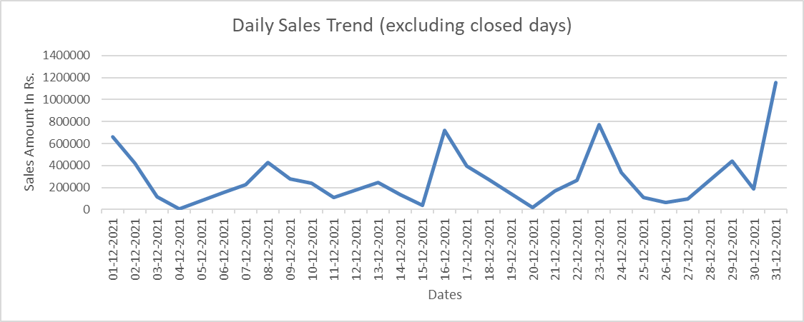
Data Analysis

Slide 5
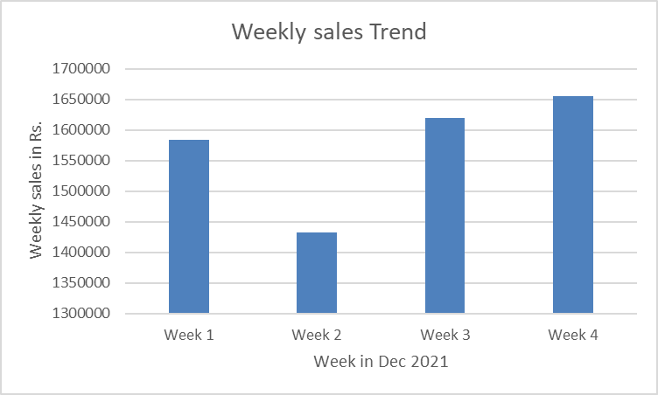
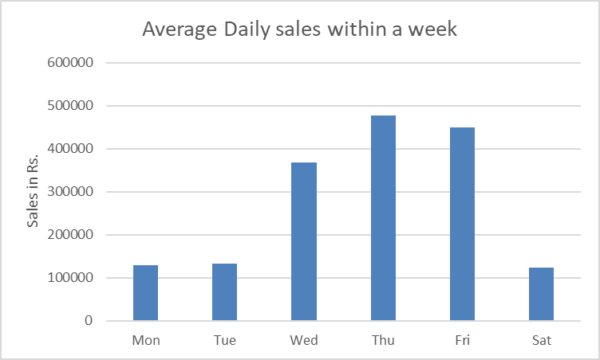
Data Analysis

Slide 6
Observation and Recommendation
Revenue related:
4 humps in Daily Sales trends of one month period were observed. To figure out the reason of these humps, week wise sales data was analysed. Weekly revenues were more or less same for all the four week.
Further, week day wise average revenue data were observed. It is found that sale is high on mid week days.
On discussion with the shop’s staff regarding high sales on mid week days, It is pointed out that bulk supplies were being sent on mid week days to reduce the local transportation, casual labour charges.

Slide 7
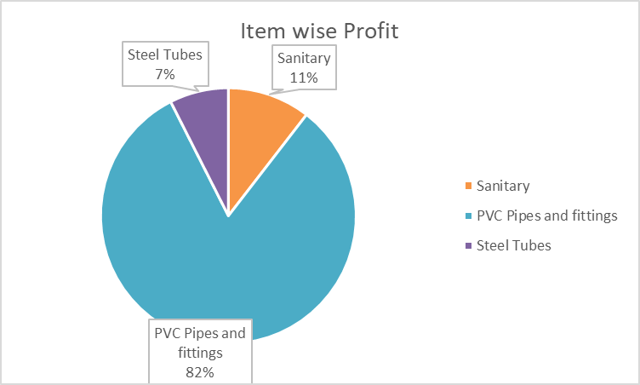
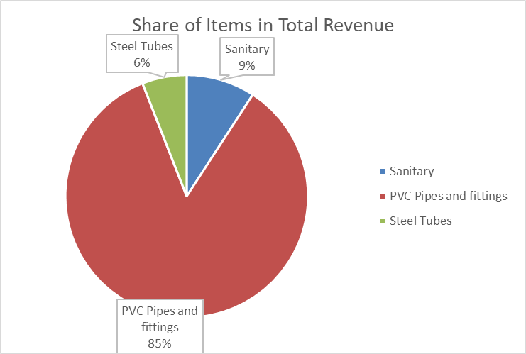
Data Analysis

Slide 8
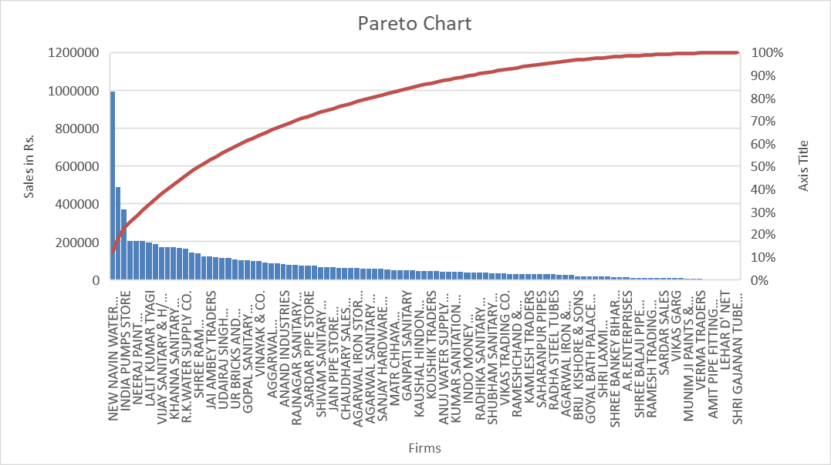
Data Analysis

Slide 9
Observation and Recommendation
Pareto Chart of Sales to Firms related:
Following is observed in Pareto Chart:
Total revenue from top 3 firms: 23%
Total revenue from top 10% firms: 40%
Total revenue from top 20% firms: 58%
80% revenue comes from 42% firms
It is advised to contact fresh larger firms or try to increase supply of top 20% firms or both, as the scope of increasing sale is observed through 80-20 Pareto rule.

Slide 10
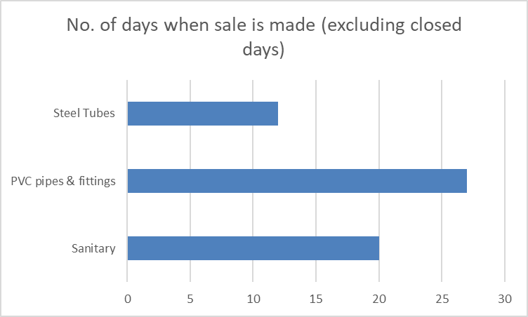
Data Analysis

Slide 11
Observation and Recommendation
Fast/ Slow moving items:
After observing number of days of sales for each category of items, it can be observed that PVC pipes and fittings is fast moving which is daily in demand. Sanitary ware is medium pace demanded category of items with 74% days in demand and Steel Tubes are slow moving with 44% days in demand.

Slide 12
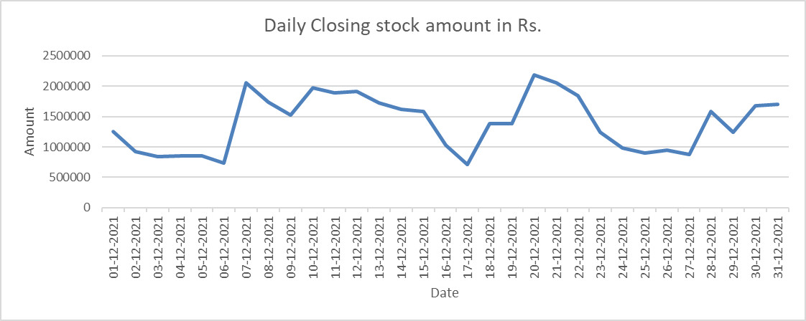
Data Analysis
21,85,702
14,69,491
7,16,211

Slide 13
Observation and Recommendation
Warehouse related:
Maximum daily closing stock is 3 times the minimum stock, this indicates that the curve has scope of smoothening.
It was suggested that the stock may be purchased at shorter interval regularly and in small quantities. It will reduce cash blocking as well as requirement of warehouse area.
On further discussion, it is pointed out multiple handling and transporting will be required to implement this recommendation.
Detailed cost analysis is required to check the extent to which this recommendation could be implemented. For this new data set such as labor cost, labor efficiency, cost effective transportation charges and volume etc. is required.

