Slide 1
How factors affect House Prices in US
Submitted by Vaidehi Lehekar
Dataset sources: https://data.worldbank.org/country/united-states
https://fred.stlouisfed.org/series/HOUST

Slide 2
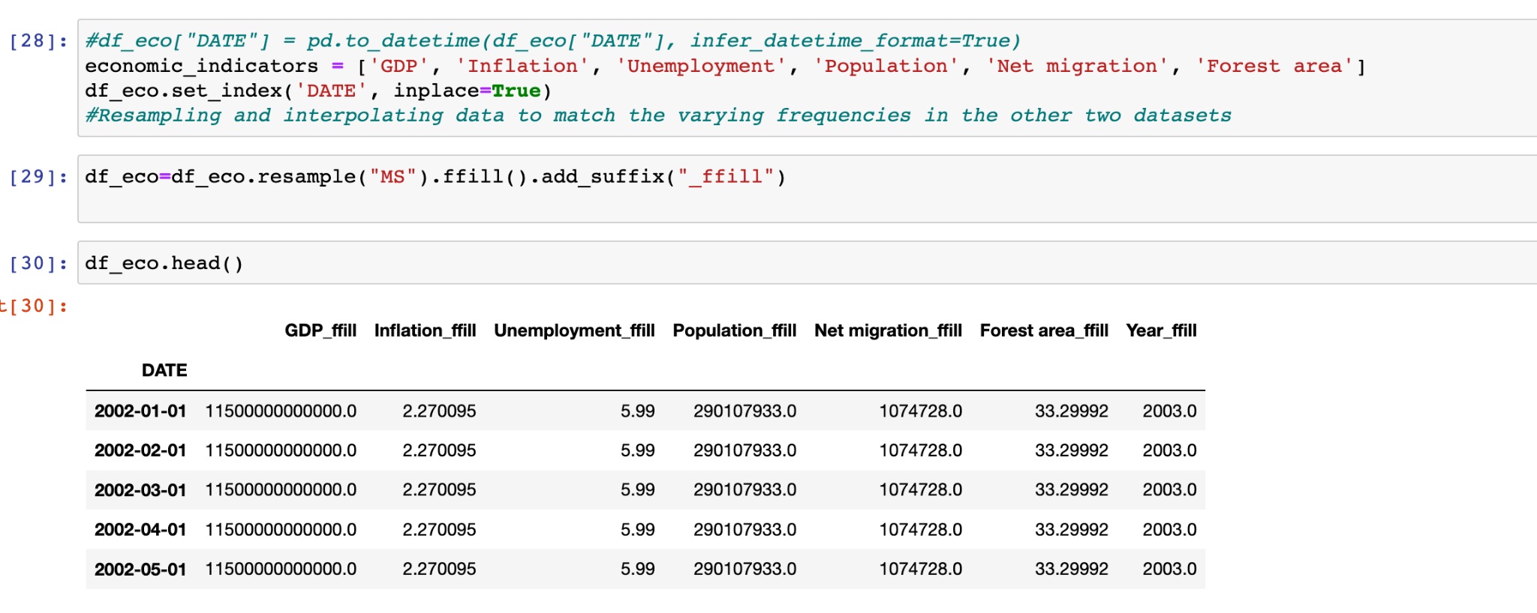
Data collection:
Factors Chosen: ‘Date', 'GDP', 'Inflation , 'Unemployment', 'Population', 'Net migration', 'Forest area', Millions of Dollars Spent of House building Supplies.
Step 1: Deleting unnecessary columns from the csv files and grouping as much data as possible.
Step 2: Checking for frequency. We need the frequency of the data to be “monthly”.
So, I performed resampling based on the HPI in the CSUSHPISA.csv

Slide 3
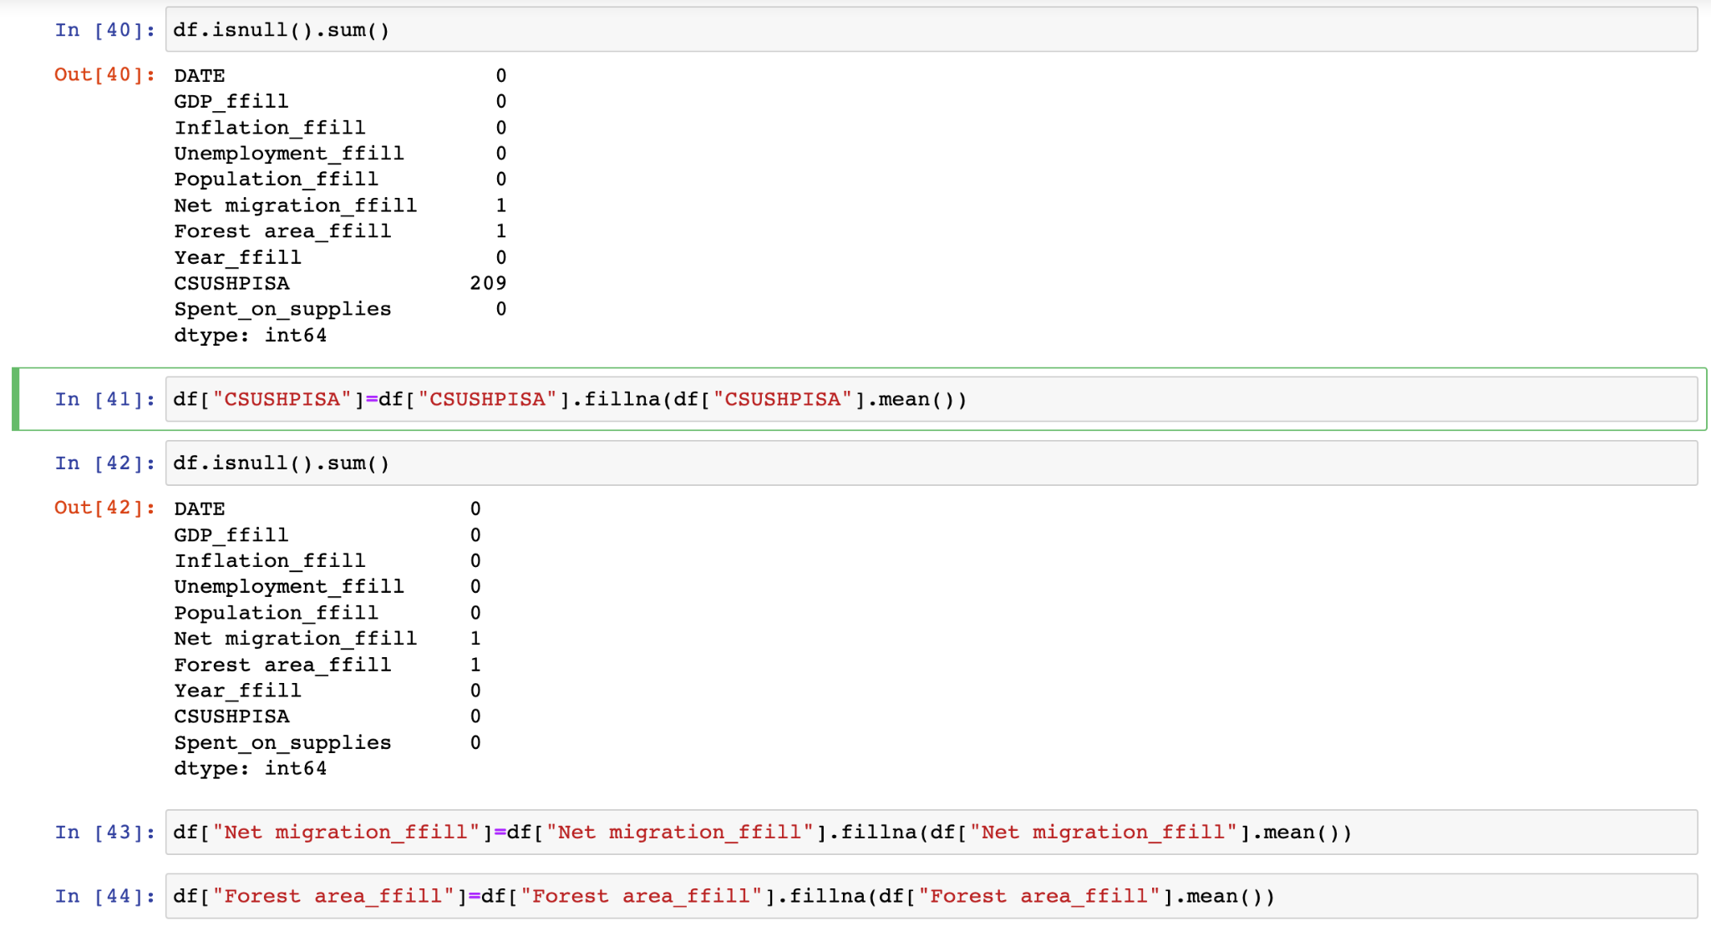
Data Cleaning
Step 1: Merging all the data in one dataset (df)
Step 2: Checking for null values and replacing them by mean values

Slide 4
Visualisation plots:
Step 1: Box Plots for Outlier Analysis
Step 2: EDA : Univariate and Multivariate Analysis (Refer to the Python notebook for plots)
Outcomes:
Net migration of people has a direct connection to HPI. Maximum net migration showed the most HPI
Government spent maximum amount of money on Housing supplies in the year 2006.
The year most amount of money was spent of supplies was the year HPI was the highest.
Correlation heatmap shows no or very less correlation between the variables and the target variables

Slide 5
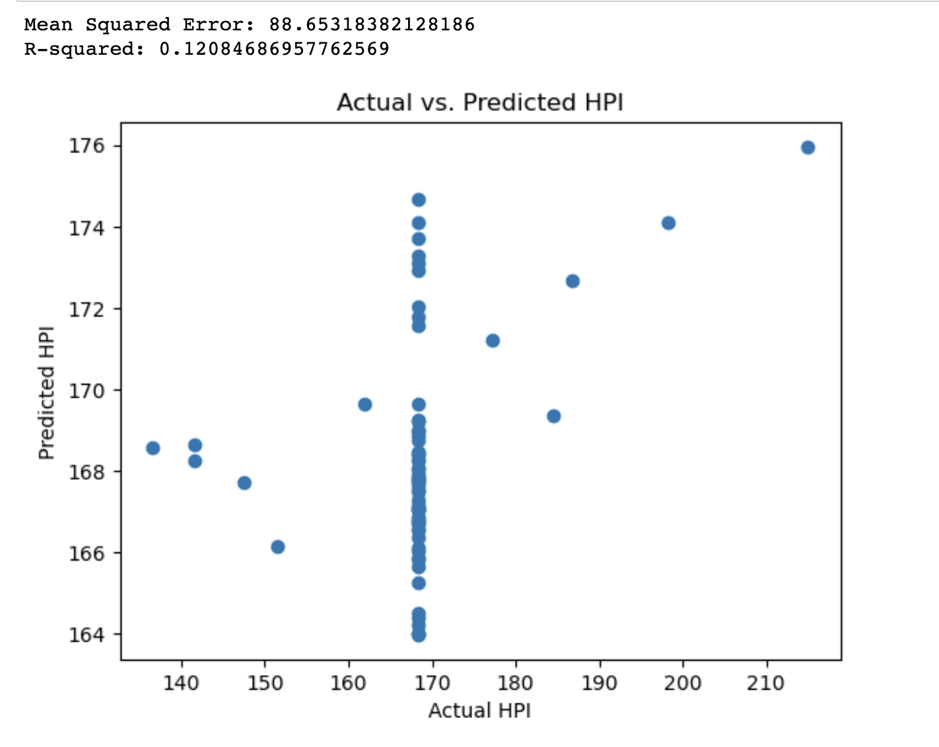
Model building
Linear Regression:

Slide 6
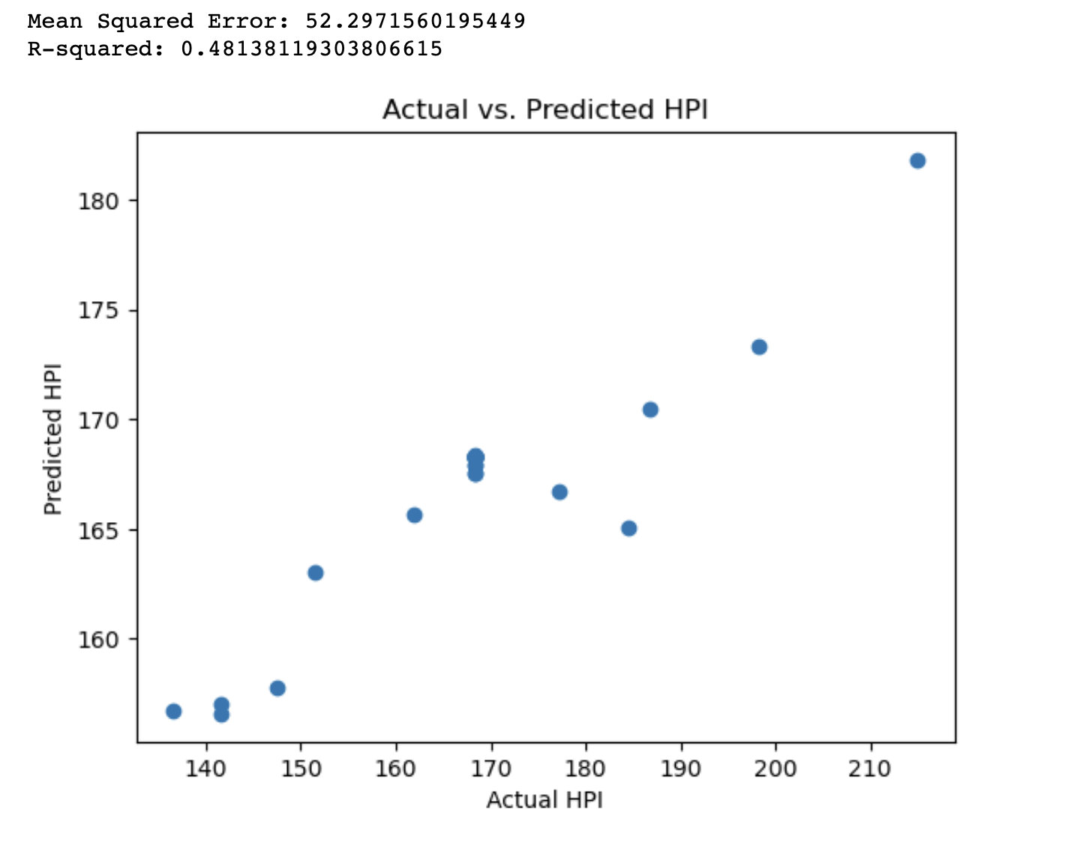
RandomForestRegressor
Least Mean Squared error among the models built in the jupyter notebook.
Final model: RandomForestRegressor

