Slide 1

Project Title - Seasonal Agriculture Performance Analysis
Student Name : Vaidehi Sudhir Kingaonkar
College Name- Pune District Education Association’s College of Engineering, Manjari Bk., Hadapsar, Pune
AICTE STU ID : STU6a64ebf7392ac1784998903

Slide 2

PROBLEM STATEMENT
Agricultural performance is influenced by seasonal variations in environmental conditions, resource availability and market conditions. This project analyzes the given agricultural dataset to investigate how performance differs across the Kharif, Rabi and Zaid seasons, and to identify meaningful patterns, trends and relationships within the data.

Slide 3
Project Description Data analytics project analyzing seasonal agricultural performance (Kharif, Rabi, Zaid) across Indian farms — yield, cost, profit, and resource usage trends using Python, Pandas, and Seaborn.

Slide 4

WHO ARE THE END USERS?
Farmers — to decide which season and crop gives better yield and profit Agricultural policymakers / government bodies — to plan seasonal support, subsidies, or resource allocation by region Agri-business and supply chain companies — to forecast production and plan procurement by season Researchers and agricultural scientists — to study seasonal patterns and environmental impact on farming Banks and insurance providers — to assess seasonal risk before offering farm loans or crop insurance NGOs / agricultural extension workers — to guide farmers on best practices region-wise and season-wise

Slide 5

Technology Used
Python — core programming language for the analysis
Pandas — data loading, cleaning, and manipulation
NumPy — numerical operations
Matplotlib — data visualization (charts, plots)
Seaborn — statistical visualizations (boxplots, heatmaps)
SciPy — statistical testing (ANOVA)
Google Colab — cloud-based notebook environment for coding and execution
GitHub — version control and project hosting

Slide 6
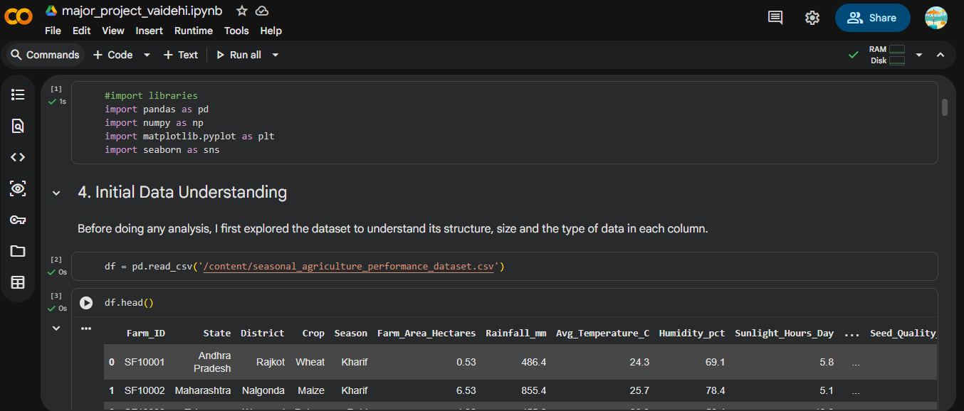
RESULTS

Slide 7
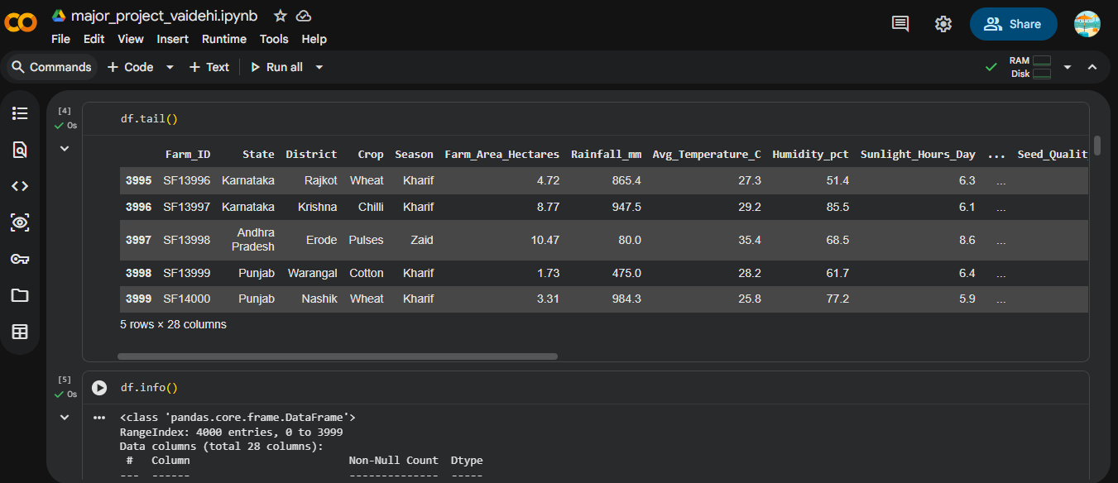
RESULTS

Slide 8
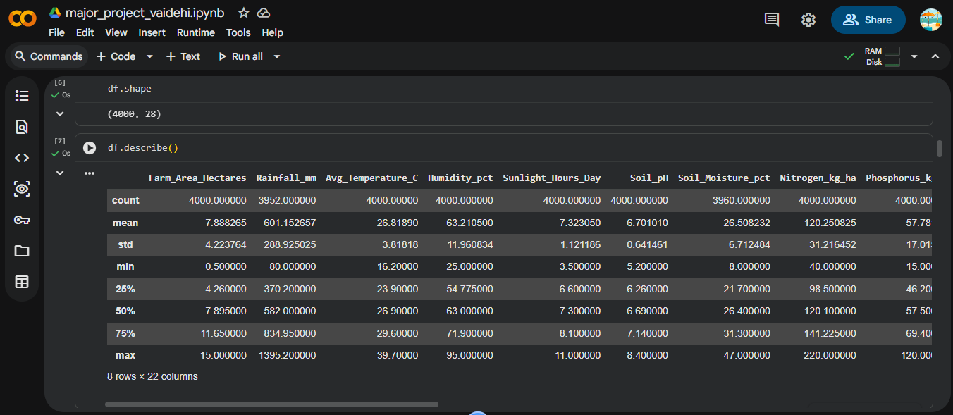
RESULTS

Slide 9
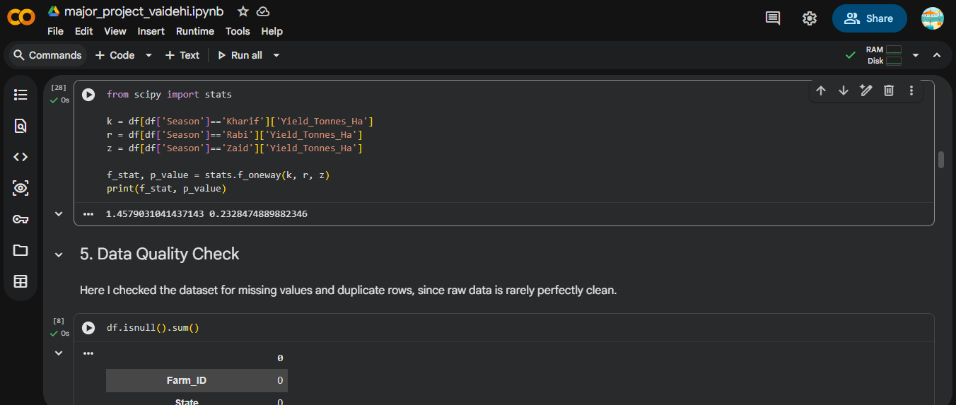
RESULTS

Slide 10
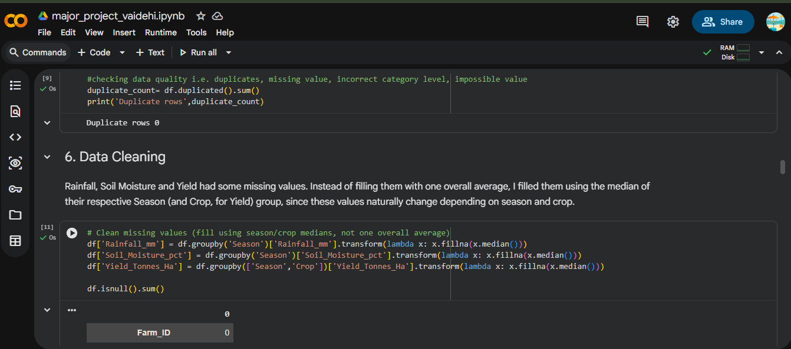
RESULTS

Slide 11
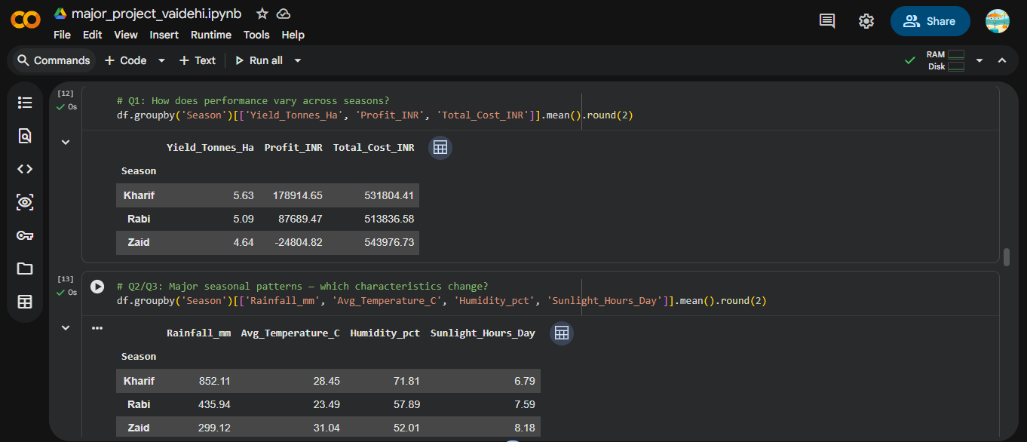
RESULTS

Slide 12
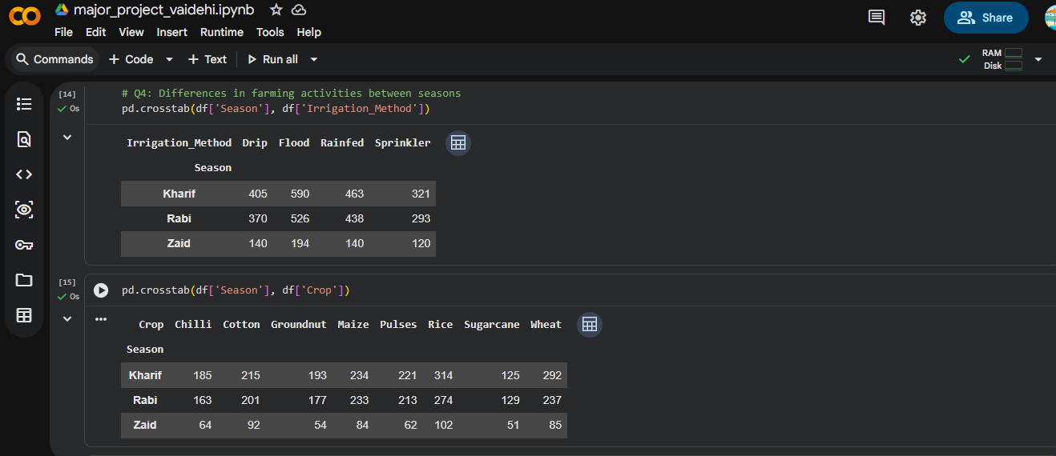
RESULTS

Slide 13
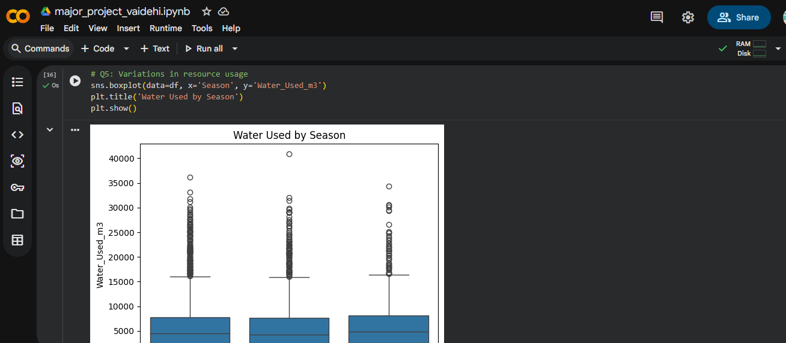
RESULTS

Slide 14
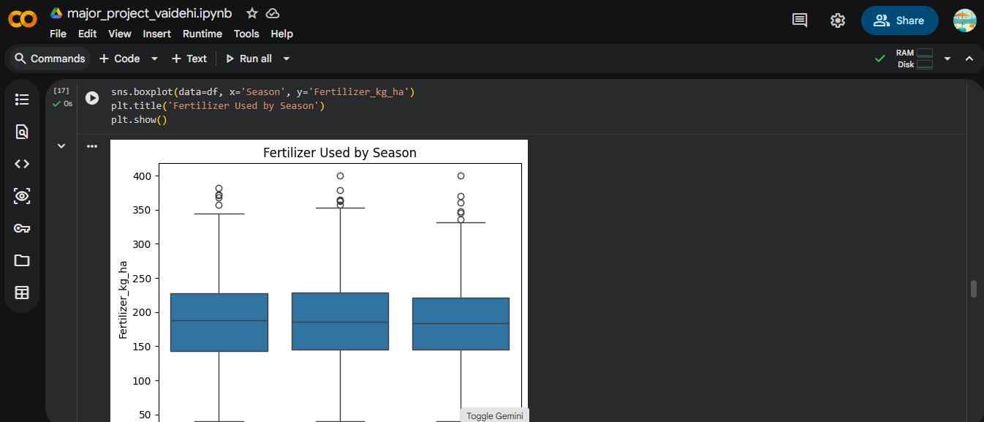
RESULTS

Slide 15
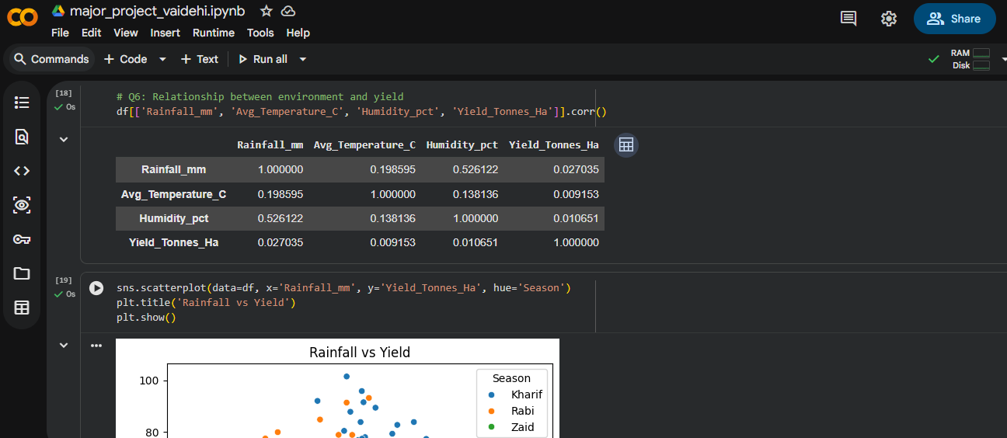
RESULTS

Slide 16
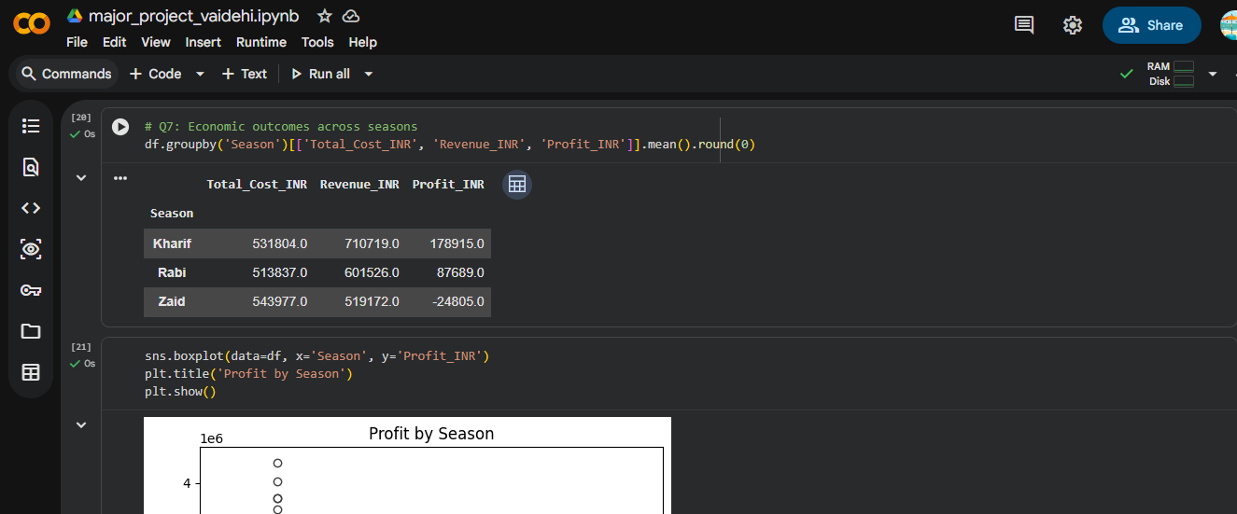
RESULTS

Slide 17
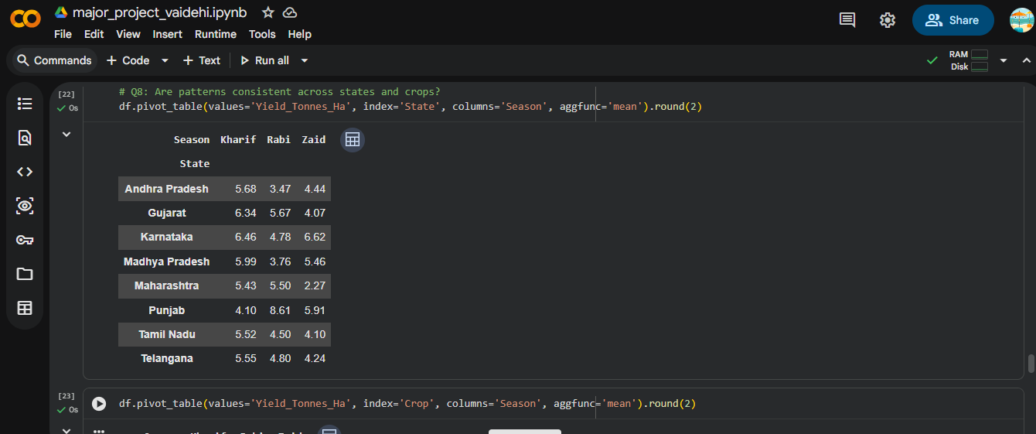
RESULTS

Slide 18
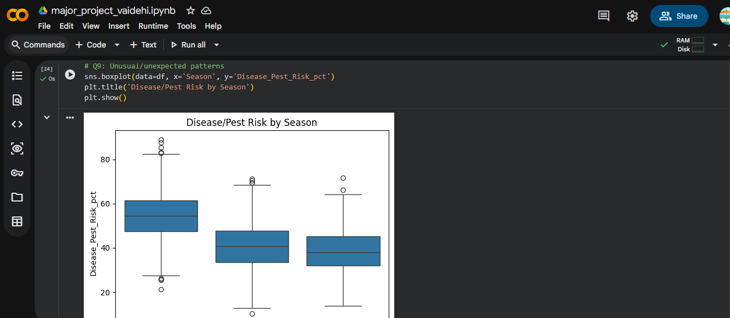
RESULTS

Slide 19
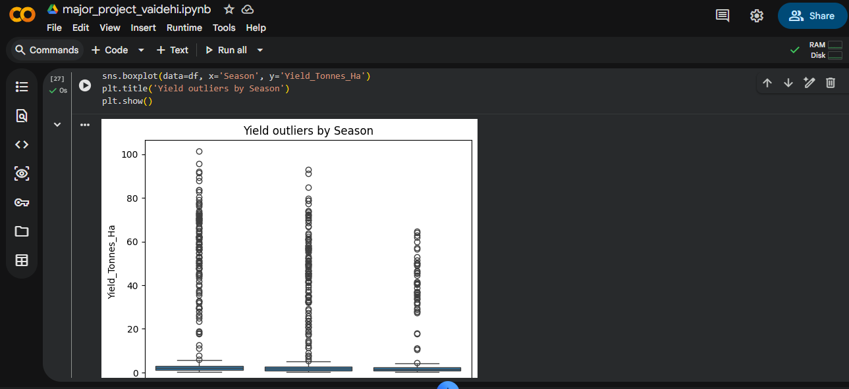
RESULTS

Slide 20
Future scope Apply machine learning models to predict yield or profit based on season, crop, and environmental factors Build an interactive dashboard (Power BI / Tableau) for real-time seasonal monitoring Include real-time weather and satellite data for more accurate seasonal forecasting Extend the analysis to more regions/states and longer time periods for deeper trend detection Study the impact of climate change on long-term seasonal agricultural performance Integrate market price forecasting to help farmers time their sales better Develop a mobile app for farmers to get season-wise crop and resource recommendations

Slide 21
GitHub Link
https://github.com/Vaidehikings/seasonal-agriculture-performance-analysis.git

Slide 22

VOIS Course completion certificate - Course name- Data Visualization

Slide 23
Thank you
.
.

