Slide 1


We hereby declare that this project work
entitled ”Chatbot about Book recommendation (The Bookbee)” has been prepared by us during our Summer Training of A.I. and D.L. course prescribed by our college under the guidance of our Trainer.
We ensured you that this project has not previously been submitted for assessment and that we have not copied in part and we have identified and declared all possible conflicts that we may have, and all the raw data that we have used in this project is from authentic sites and sources
Signed

Slide 2


This is to certify that the project is titled The BookBee. This project is submitted by ……… (your name). By A.D.G.I.T.M. in fulfillment of the requirements for Summer Training.
This project was an authentic work done by him under my supervision and guidance.
This project has not been submitted to any other institution.
Date: Teacher A.D.G.I.T.M.

Slide 3

We would like to thank Mr. Himanshu, our Trainer during Training, and our Director sir for their moral support and guidance in completing our project A sincere thanks to our college for proving us a great platform(IBM Learning). It was a great learning experience for all of us.
We would like to take this opportunity to express our gratitude to all of our group members Isha Bansal, Vaidehi Patel, Vishal Yadav, Shruti Negi and Priyansh Singh Boura. The project would not have been successful without our cooperation and input.
Regards……...

Slide 4


Chatbots, or conversational interfaces as they are also known, present a new way for individuals to interact with computer systems. Traditionally, to get a question answered by a software program involved using a search engine, or filling out a form. A chatbot allows a user to simply ask questions in the same manner that they would address a human. Similarly Our Chatbot is specially desgined for the book details. With the chatbot as a recommendation tool, users can search by book categories, book list, and a list of main characters

Slide 5



The Bookbee systems is used for the purpose of suggesting the different genres of books, novels, short stories etc, to purchase or to see. They direct users towards those items which can meet their needs through cutting down large database of Information. This chatbot solves the problem of data scarcity problem by combining the collaborative- based filtering to achieve better performance.
Our main aim is to provide the basic yet powerful chatbot which can provide the essence of the physical book recommendation system

Slide 6



The motivation for doing this project was primarily an interest in undertaking a challenging project in this area of field. The opportunity to learn about a new area of computing not covered in lectures was appealing and this will surely help us in our further development.

Slide 7



Nowadays Technology has come into a human’s life. For example, in the past telephone was only used for calling in and out and we had to go for a calling booth but nowadays everyone has a cell phone in the similar way now people want everything in a control and feasible way with the comfortable environment.
So It is very difficult to find any information which is true and authentic , to overcome this we need a source which saves time, have proactive customer interaction.

Slide 8



The objective of this project is to recommend books, novels, romance, fiction and non fiction, biography and short stories to those who are interested via the website named TheBookBee.com. The website has a chatbot function to answer a set of predefined questions. Users can review the book by leaving their comments on the books information page .
With the chatbot as a recommendation tool, users can search by book categories, book list, and a list of main characters. Also they can ask their queries and explore the chatbot

Slide 9



The objective of the Feasible study is to determine
whether
or not the proposed system is feasible. The tests of
feasibility have been carried out following.
TECHNICAL FEASIBILITY
It is evident that the necessary hardware and software are available for development and implementation of the proposed system. Hence, the solution is technically feasible.

Slide 10

ECONOMICAL FEASIBILITY
The system development costs will be significant. So the proposed system
is economically feasible.
OPERATIONAL FEASIBILITY
It is a standard that ensures interoperability to the benefit of the public both in terms of cost and service quality. The proposed system is acceptable to users. So the proposed system is operationally feasible.

Slide 11


Book Store Recommendation System is the web application to automate all kinds of operations in the book shop. That means a shop which has the type system which provides the facility to the customers of the shop to surf and explore the books from the shop without any complexity.
Recommendation systems propose products to the users which are most relevant to that particular user. One of the most powerful methods for increasing benefit and retaining customers is a recommendation framework, which can recommend books that are of interest to the customer.
Chatbot use is on the rise in business and consumer markets. As chatbots improve, consumers have less to quarrel about while interacting with them. Between advanced technology and a societal transition to more passive, text-based communication, chatbots help fill a niche that phone calls used to fill.

Slide 12

We can view all types of book by a single click
Economically offer 24/7 Service
Improve Customer Satisfaction
Reach a Younger Demographic
Reduce Costs
Provide true knowledge on the basis of facts
Time Saving

Slide 13
Book bee .org works to connect readers with independent booksellers all over the world.
We believe local bookstores are essential community hubs that foster culture, curiosity, and a love of reading, and we're committed to helping them thrive.
Every purchase on the site financially supports independent bookstores. Our platform gives independent bookstores tools to compete online and financial support to help them maintain their presence in local communities.

Slide 14



Slide 15



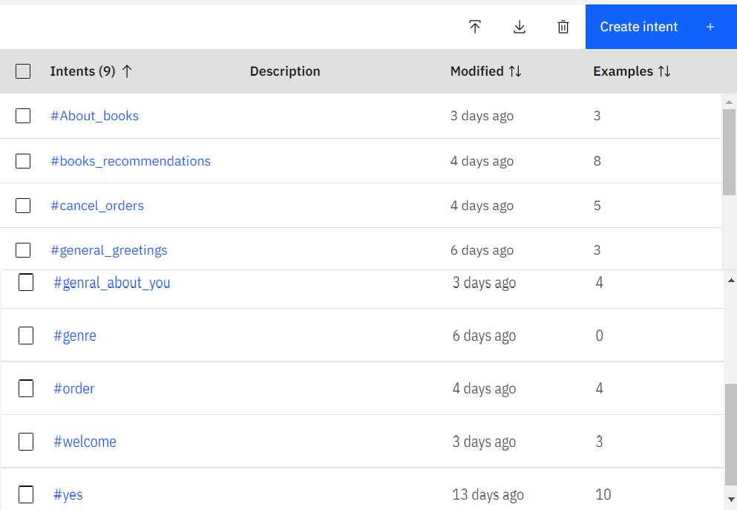

Slide 16



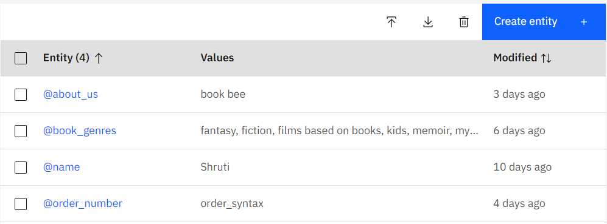

Slide 17


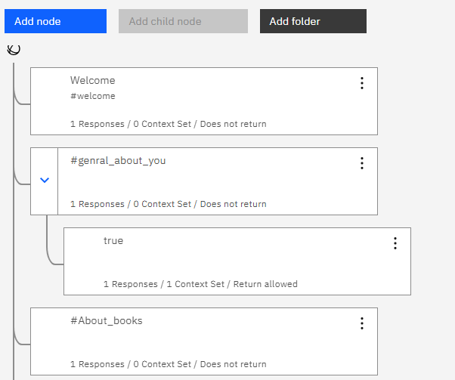

Slide 18
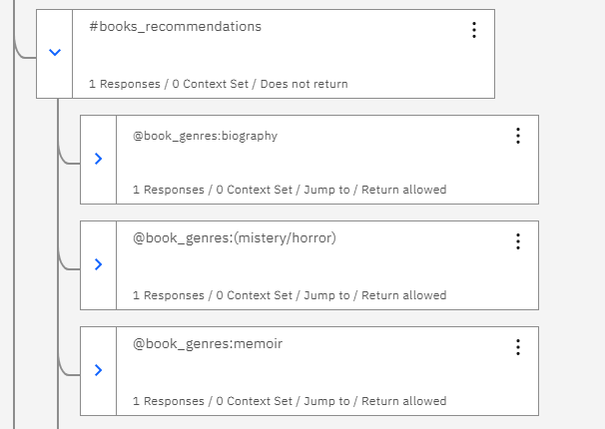

Slide 19
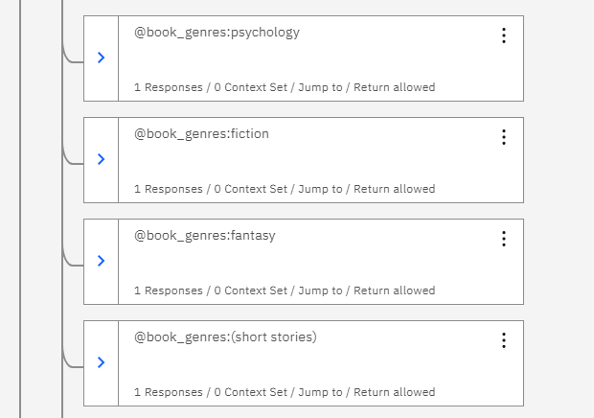

Slide 20
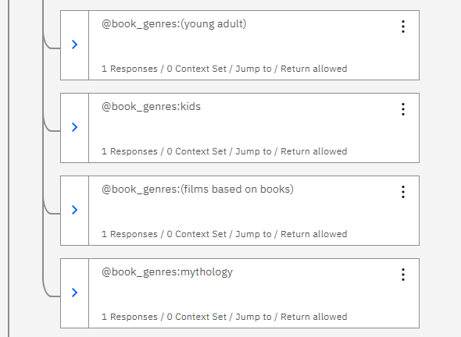

Slide 21
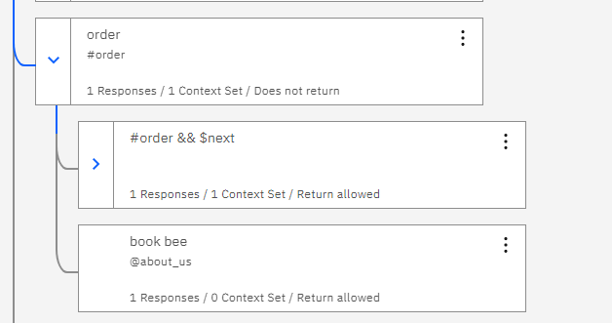
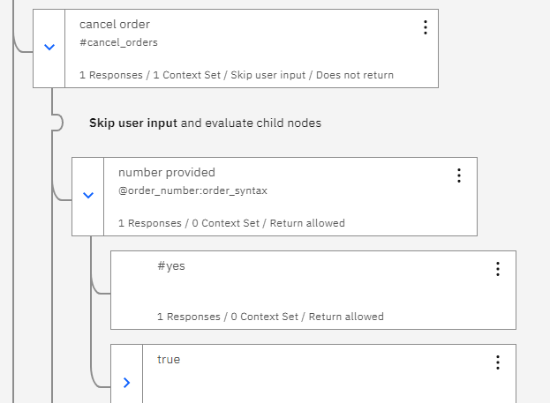

Slide 22
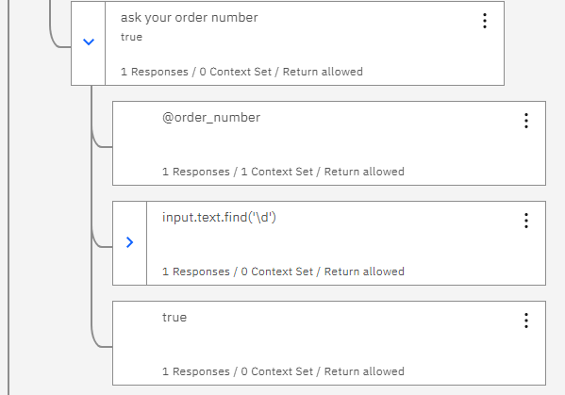
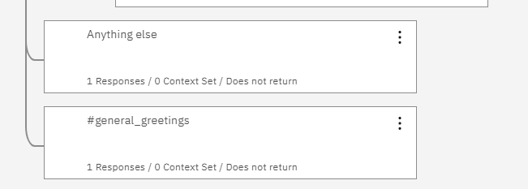

Slide 23


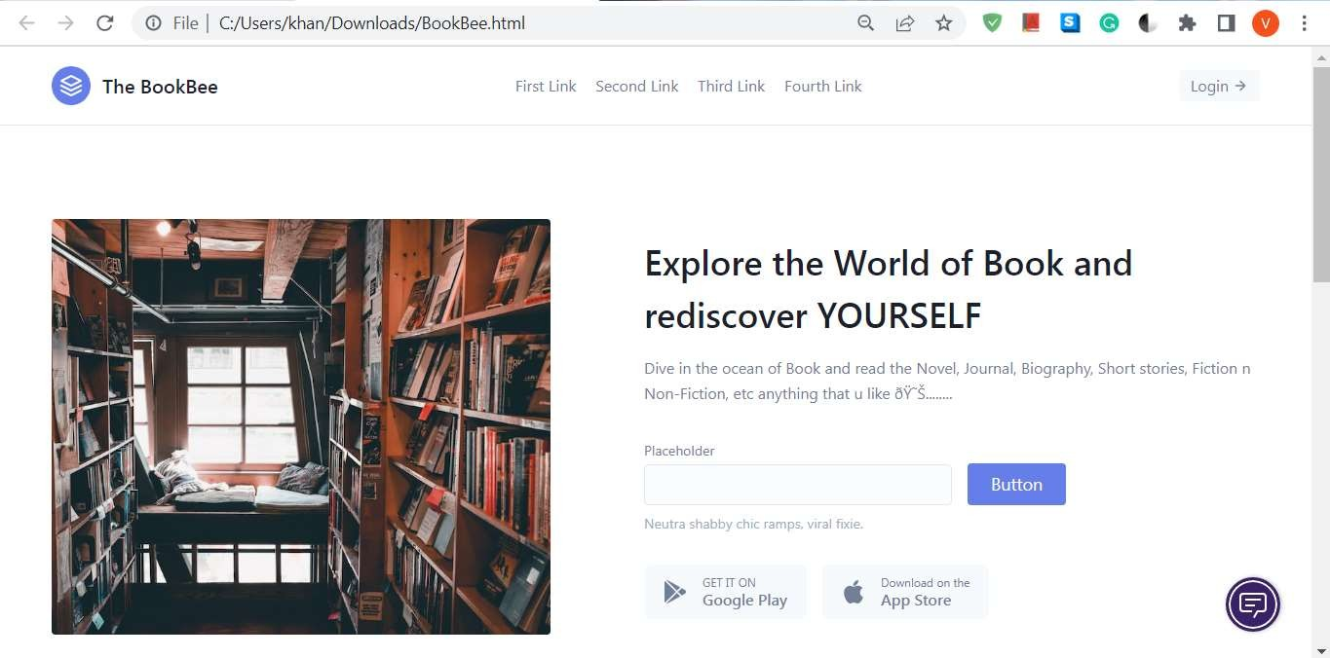

Slide 24
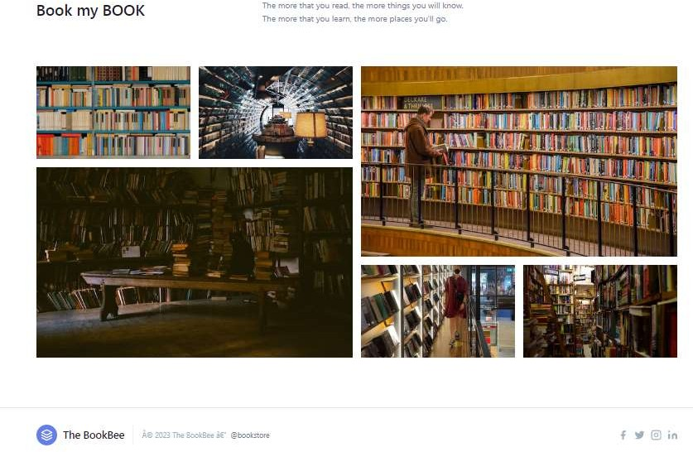

Slide 25


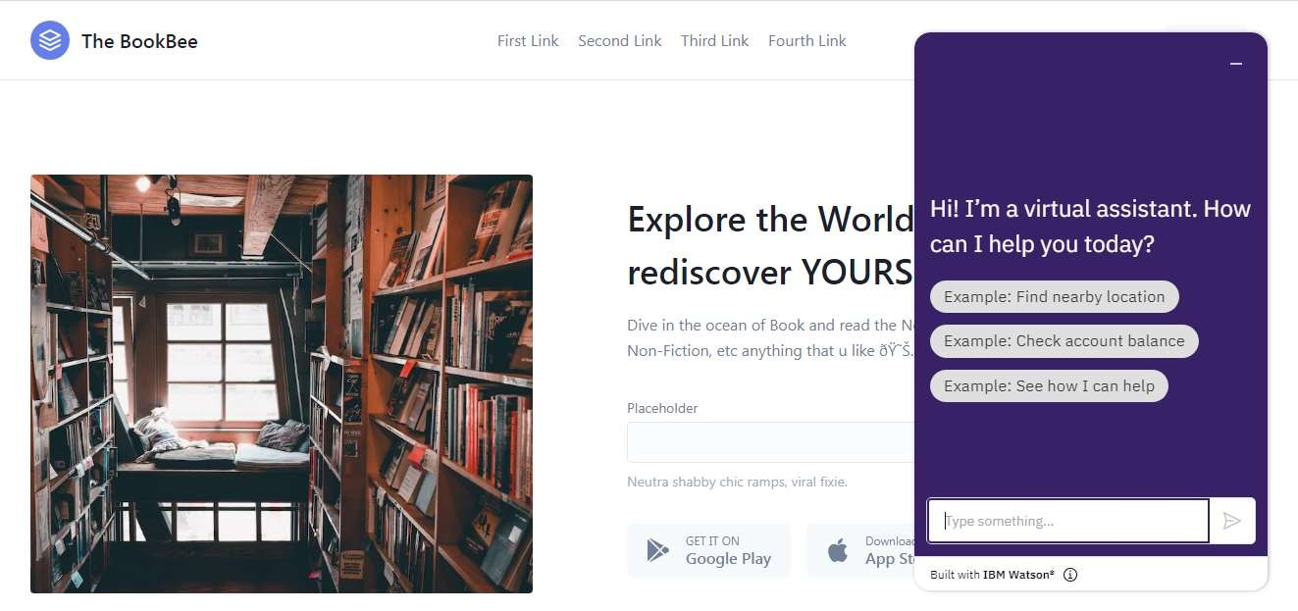

Slide 26
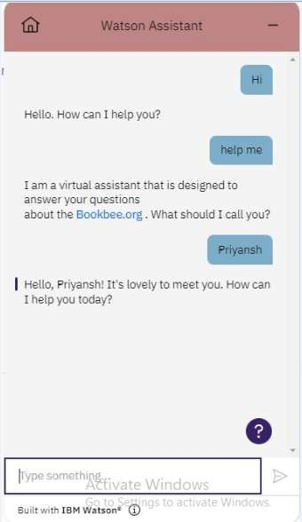
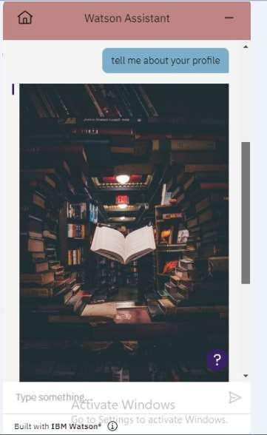

Slide 27
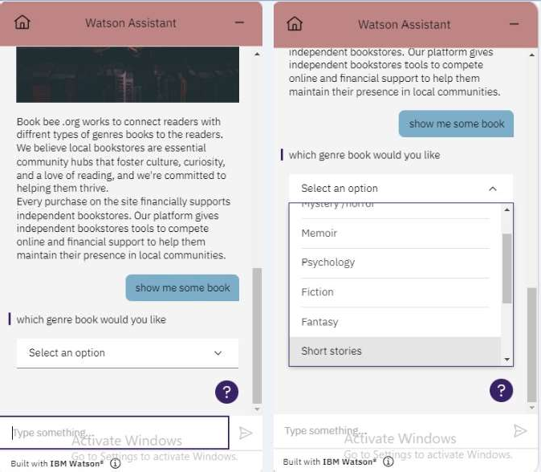

Slide 28
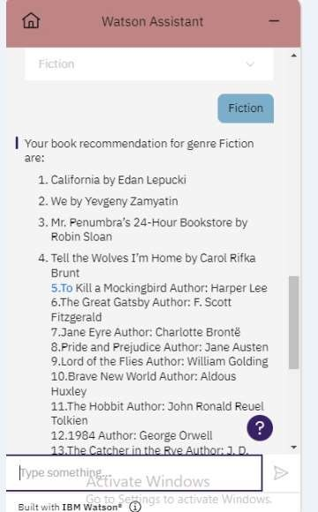
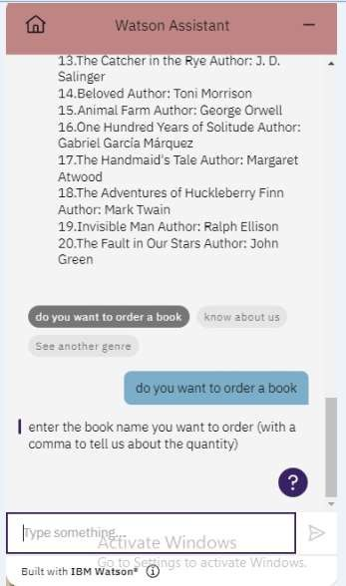

Slide 29
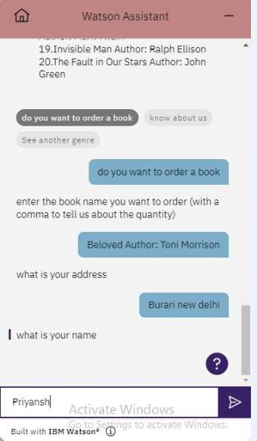
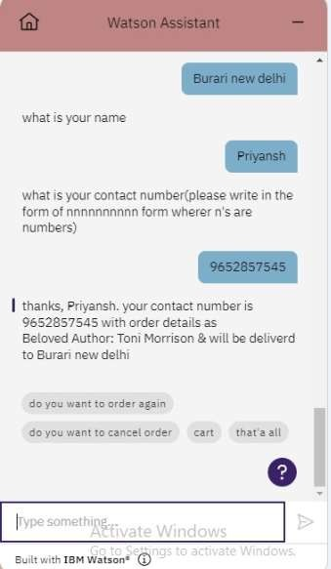

Slide 30
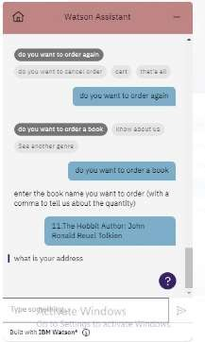
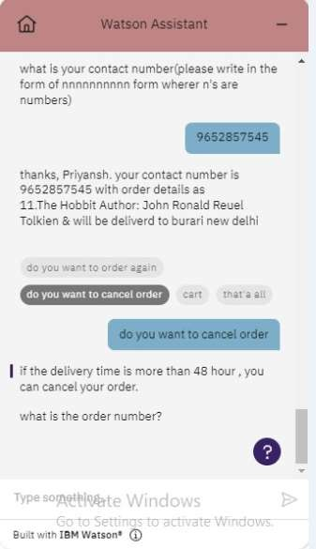

Slide 31
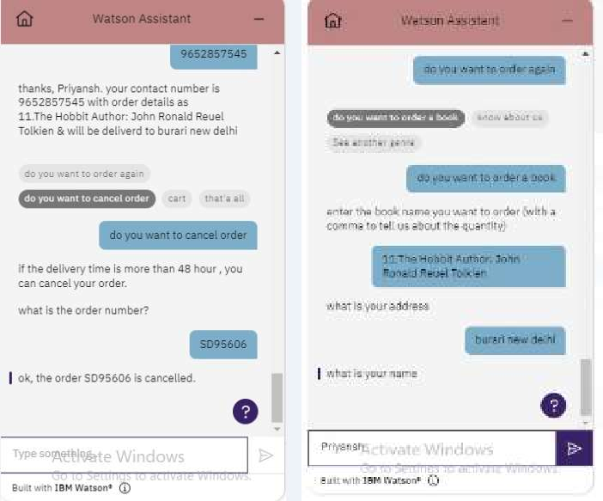

Slide 32
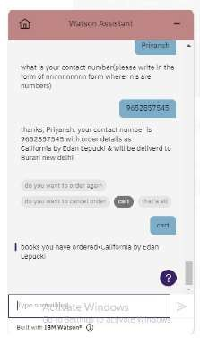
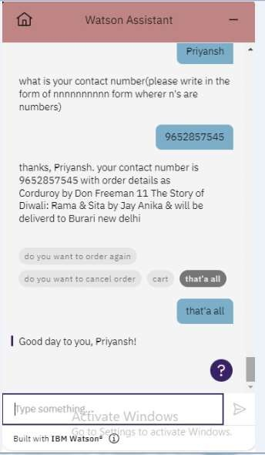

Slide 33


We came to the result that this project is perfectly working and create an online book store chat bot that allows users to chat and search/purchase a book based on title, author and subject. The selected books are displayed in a tabular format and the user can order their books online or cancel their order according to their wishes
And most importantly it solve the main purpose of a recommendation system that is it will suggest items to users easily making their life easier. Today the quantity of facts with inside the net increase very hastily and those want few instruments to seek out and access appropriate data and we can say that we are completely successful in this.

Slide 34

This project has been designed to stimulate the working of an actual book recommendation system.
From this we came to the conclusion that The Book Bee is a online chatbot application running on the website where the user can explore the different types of book with the different genres available and they can a diiferent types of question and surely they will get the prestored answer, also they can place their order and also cancel it

Slide 35

There are so many work related to the Book Recommendation Chatbot, the top most topics are various types of chatbot like the chatebot on Restaurant, the chatbot on medical field, the Travelling chatbot etc.
The online bookstore and the book genre query, The online Library are also the related work of our application

Slide 36



The scope of The Book Bee is extensive and far-reaching. Online marketing is cost effective and measurable compared to all other marketing strategies. It benefits both customers and marketers simultaneously. Customers can shop products 24 hours a day from anywhere in the world and interact with sellers to find the product or service information they desire. It also affects the operation of companies and organizations. Companies have changed their traditional business strategies into online marketing and
have become full-fledged service providers with the facility to offer a full range of e-commerce products to suit customer needs and taste at any time.
The future of chatbots is transforming the way businesses interact with their customers. From handling customer inquiries and offering real-time support to providing personalized product recommendations, chatbots are becoming increasingly important for all types of businesses in the digital age

Slide 37





The project would not have been successful without our
cooperation and input. Everyone did their best in this…….. But we divided the project in two parts first one is chatbot making and other one is webpage making, so first group consists of
Isha Bansal(05415602821) :- Book store information's and Cancel
order
Vaidehi Patel(05015602821) :- Greeeting/Closure and Order
placeement
Vishal Yadav(04315602821) :- Documentation work and Book
Genres
And in the second group
Priyansh Singh Boura(05215602821) and
Shruti Negi (03715602821) :- Website/Webpage and chatbot integration

Slide 38


