Slide 1

OLD VEHICLE PRICE PREDICTION USING LSTM rnn
FINAL YEAR PROJECT REVIEW PHAZE – II
Review - 1
Batch : 2019-2023
Group No : 11
17th February 2023
Supervised by:
Dr. Sibesh Lodh
CSE Department
NIT Nagaland
Presented by:
Vaidh Prakash Singh(2019105223)
Metmei A (2019105209)
B.Tech,CSE Department

Slide 2
contents
Objectives
List of previous reviews
Model-Algorithm used
Novelty of the model
Work done
Further work

Slide 3
OBJECTIVES
PRIMARY
Primary objective is to create a Model to predict the old Vehicle price prediction based on several factors using LSTM RNN(long short Term Memory Recurrent Neural Network)
SECONDARY
Secondary Objective is to create a Django based website using Html, Css, Java Script as a portal where someone can list their car and the price they ask for the vehicle; our model will work only for the premium clients to show the actual price predicted by our model.

Slide 4
PREVIOUS REVIEWS
1. In the first review we proposed our model.
2. Understand what are the limitations of the traditional machine learning techniques.
3. Understand LSTMs and its It's research papers
4. Demonstrated an overview of our Project.
5. Data Preprocessing.
6. Data Visualization.

Slide 5
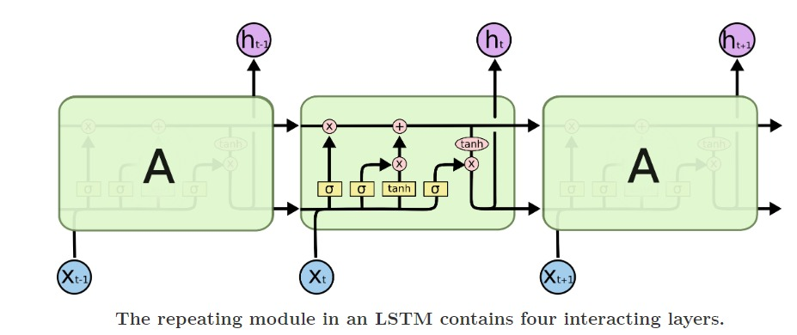
LSTM (Long Short Term Memory networks)
Usually just called “LSTMs” – are a special kind of RNN, capable of learning long-term dependencies. They were introduced by Hochreiter & Schmidhuber (1997), and were refined and popularized by many people in following work.1 They work tremendously well on a large variety of problems, and are now widely used.

Slide 6
PROPOSED MODEL
DATA
API
(Application programming interface)
LSTM MODEL
Pre-processing of data
Training
MODEL
FRONTEND
WEB SERVER BACKEND
DATABASE

Slide 7
NOVELITY OF MODEL
1. LSTMs is a advanced version of RNN.
2. RNN cannot remember up to large distance so to use LSTMs for the project.
3. Treating the dataset as sequential data and predicting the values as time series forecasting for better accuracy.
4. The dataset will sorted based on the year of car sold, to catch the change in trend for the selling of data.

Slide 8
WORK DONE
Created Model Architecture with LSTMs for the input and hidden Layer.
Give the model a dataset like the time series data such that it can 30 previous records.
Done with the architecture of the web application.

Slide 9
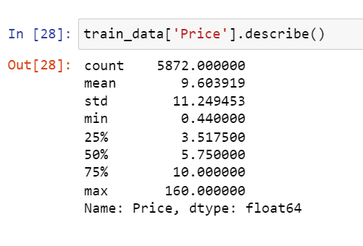
DATA PRE-PROCESSING
Finding and dropping rows consisting of null values
​Initially there were 6019 records consisting of 14 attributes
​After data pre-processing the 5872 records remains for training and evaluating.

Slide 10
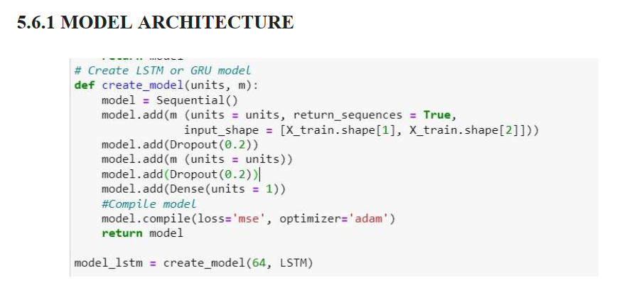
MODEL ARCHITECTURE
Model Architecture Comprises of following Layers
Input Layer consisting of LSTMs ANN Consisting of 30 Nodes
Hidden Layer Consisting of LSTMs ANN with 64 nodes
Output Layer Contain Single node

Slide 11

RESULT OF MODEL USING LSTMS:
We Got the best accuracy with the LSTMs models and it is given below

Slide 12
High Level Architecture of web application :
MODEL
API Response
API calls
DATA BASE
BACKEND
MySql Database
Python Backend
FRONTEND

Slide 13
Functionality of the website :
MODEL
SEE LISTED CARS
SEE THE TREND IN THE PRICE
WEBSITE
USER
LIST THEIR OWN CAR FOR SELLING
SEE THE TREND ON A PARTICULAR VEHICLE
BUY CARS

Slide 14
Databases and tables Needed
Database 1 : Login details of the user which can uniquely identify and differentiate each user.
Database 2 : Images , Description, Car names , cost and many more attributes for the car.
Connecting the database 1 and database 2 to map the users with their cars.
A predict function for the users to predict the price when the enter the details of the vehichles.

Slide 15
CONNECTION OF Web backend with the ML Model API :
Creating an API for the ML Model for the communication with the server backend.
Using PICKLE for saving and reusing the model when needed.
Connecting the model API with Django backend.
Feeding the model again when in deployment whenever any new details of care sale is found.

Slide 16
FURTHER WORK
Develop a web application for the user interface.
Connect the backend of application with the database.
Connect the backend of the application with the ML Model through API calls.​
To test the Web application for such that it doesn’t crash or showing any error.

Slide 17
REFERENCES
RNN : https://towardsdatascience.com/recurrent-neural-networks-by-example-in-python-ffd204f99470
ANN : https://www.researchgate.net/publication/5847739_Introduction_to_artificial_neural_networks
Machine Learninng : https://www.ibm.com/cloud/learn/machine-learning
Deep Learning : https://machinelearningmastery.com/what-is-deep-learning/
NLP : https://www.ibm.com/cloud/learn/natural-language-processing

Slide 18
REFERENCES
Decision - tree : https://scikit-learn.org/stable/modules/generated/sklearn.tree.DecisionTreeClassifier.html
Random - Forest : https://scikit-learn.org/stable/modules/generated/sklearn.tree.DecisionTreeClassifier.html
Understanding LSTM : https://colah.github.io/posts/2015-08-Understanding-LSTMs/
LSTMs : https://www.researchgate.net/publication/13853244_Long_Short-term_Memory
Linear Regression : https://scikit-learn.org/stable/modules/generated/sklearn.linear_model.LinearRegression.html

Slide 19
THANK YOU

