Slide 1

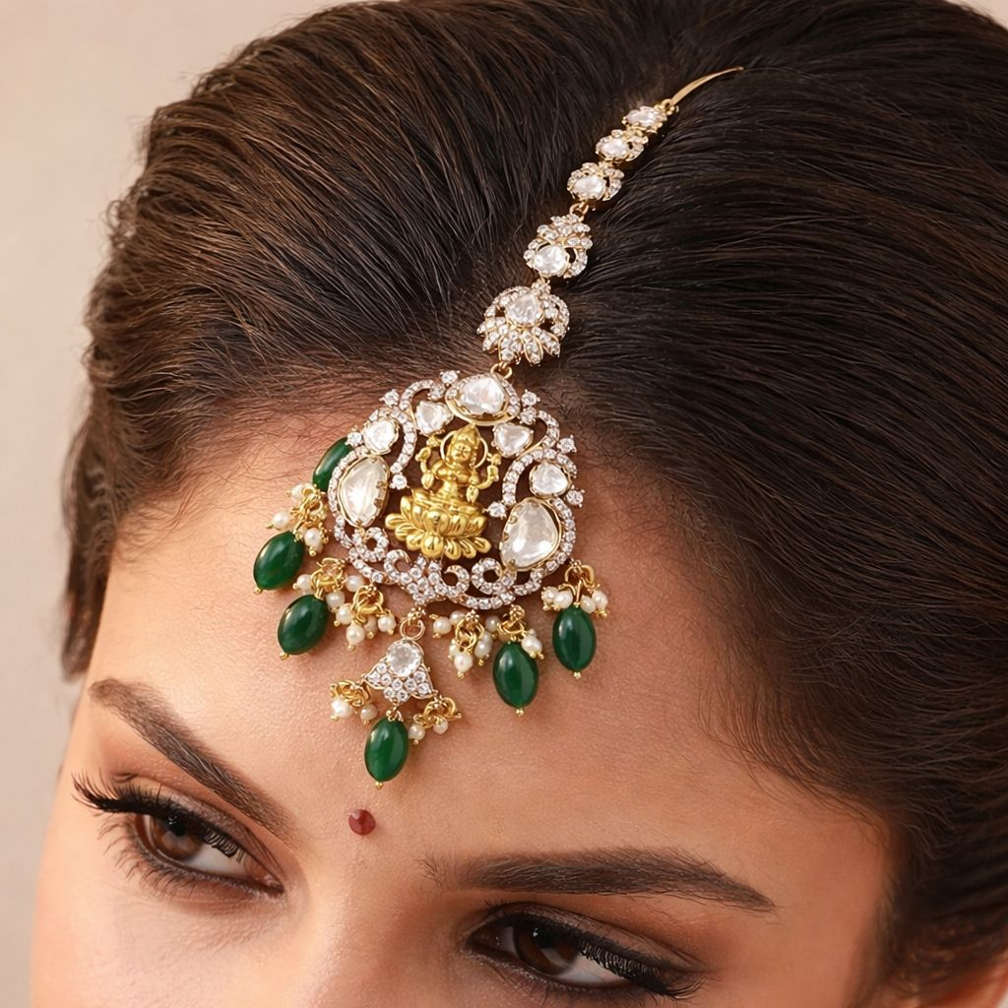
AI-Native Marketplace for Jewelry in India
A trusted multi-seller platform for metal, diamond, and gemstone jewelry, personalized through outfit-led AI styling recommendations.
Premium commerce. Personalized by AI.
Confidential | VAIDHURYA
Notes:
Open by positioning VAIDHURYA as a premium, AI-native marketplace rather than a generic e-commerce site.
[Sources]
- Repository README: VAIDHURYA Commerce Architecture.
- Founder guidance from the working session: India jewelry market is fragmented and unorganized; team includes Venkatesha DP and Rishitha Adari.

Slide 2

PROBLEM + SOLUTION
02 / 09
Fragmented Market, Personalized Opportunity
India's jewelry market is still trust-heavy, fragmented, and difficult to personalize online.
Buyer Pain
Seller Pain
VAIDHURYA
Discovery is inconsistent across
metal, diamond, and gemstone
categories, and shoppers
struggle to match jewelry to
outfit, occasion, and budget.
Independent sellers have limited
digital visibility, uneven
merchandising, and high customer
acquisition friction in a market
still led by offline trust.
A trusted multi-seller
marketplace that combines
premium commerce with AI-led
recommendations tailored to
dress, style, occasion, and
spend.
Confidential | VAIDHURYA
Notes:
Use this slide to frame the problem as both a discovery problem and a trust problem, then position VAIDHURYA as the organizing layer.
[Sources]
- Founder guidance from the working session: India jewelry market is fragmented and unorganized; team includes Venkatesha DP and Rishitha Adari.

Slide 3

AGENTIC EDGE
03 / 09
What Makes VAIDHURYA Agentic
The platform does more than search inventory; it interprets intent and curates the best next action.
Understands
Matches
Learns
A customer uploads a dress photo
and the system reads color,
silhouette, neckline, occasion,
and aesthetic cues.
Those signals map to category,
metal tone, stone palette,
design language, and price band
across seller inventory.
Clicks, saves, purchases, and
repeat behavior sharpen
recommendations for shoppers
while improving marketplace
merchandising.
Confidential | VAIDHURYA
Notes:
Keep the word agentic concrete by describing how the system understands, decides, and improves over time.
[Sources]
- Founder guidance from the working session: India jewelry market is fragmented and unorganized; team includes Venkatesha DP and Rishitha Adari.

Slide 4

PRODUCT OVERVIEW
04 / 09
Full-Stack Product Experience
VAIDHURYA connects premium storefront design, multi-seller commerce, and AI styling in one buyer journey.
Seller Onboarding
Buyer Discovery
AI Styling Flow
Sellers register, manage
listings, and showcase metal,
diamond, and gemstone
collections with trust-rich
product detail.
Customers browse by category,
occasion, material, style, and
budget while discovering
certified, premium presentation.
Upload a dress photo, receive
curated recommendations, compare
options, and move into cart,
checkout, and order tracking.
Confidential | VAIDHURYA
Notes:
This slide should make the buyer and seller loop feel operational, not conceptual.
[Sources]
- Repository README: VAIDHURYA Commerce Architecture.
- Repository docs: architecture-overview.md.
- Repository docs: commerce-flows.md.

Slide 5
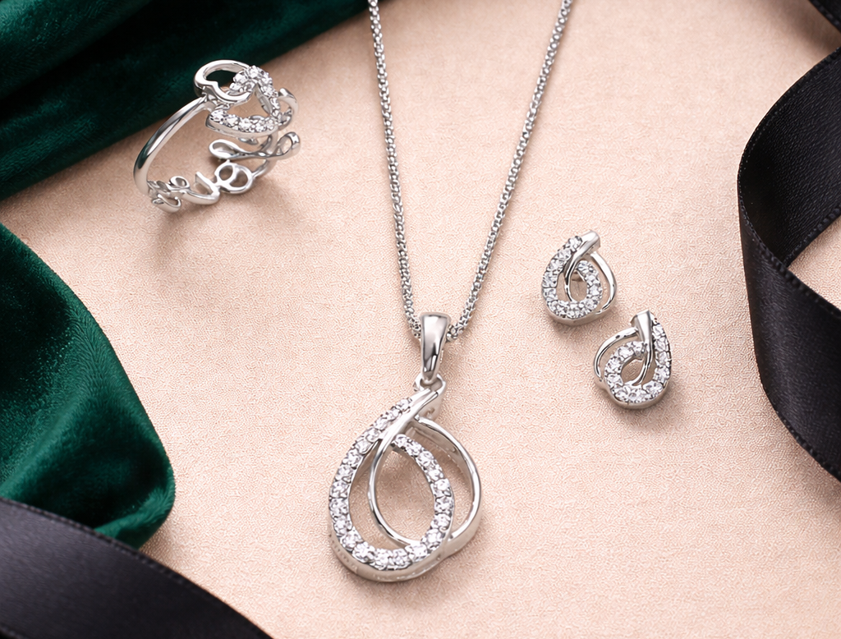
TRACTION
05 / 09
Current Traction and Readiness
The company is positioned as an early-stage build with a clear product thesis and fundraising-ready narrative.
MVP
EARLY
READY
Product concept and premium commerce foundation are already defined.
Validation is focused on seller onboarding, buyer experience, and styling fit.
Investor outreach can center on product clarity, AI differentiation, and category timing.
Product readiness
Validation stage
Investor readiness
Confidential | VAIDHURYA
Notes:
This is intentionally framed without invented GMV or user metrics. Replace with real numbers when available.
[Sources]
- Repository README: VAIDHURYA Commerce Architecture.
- Deck framing uses placeholders for traction and fundraising details where numeric inputs were not provided.

Slide 6
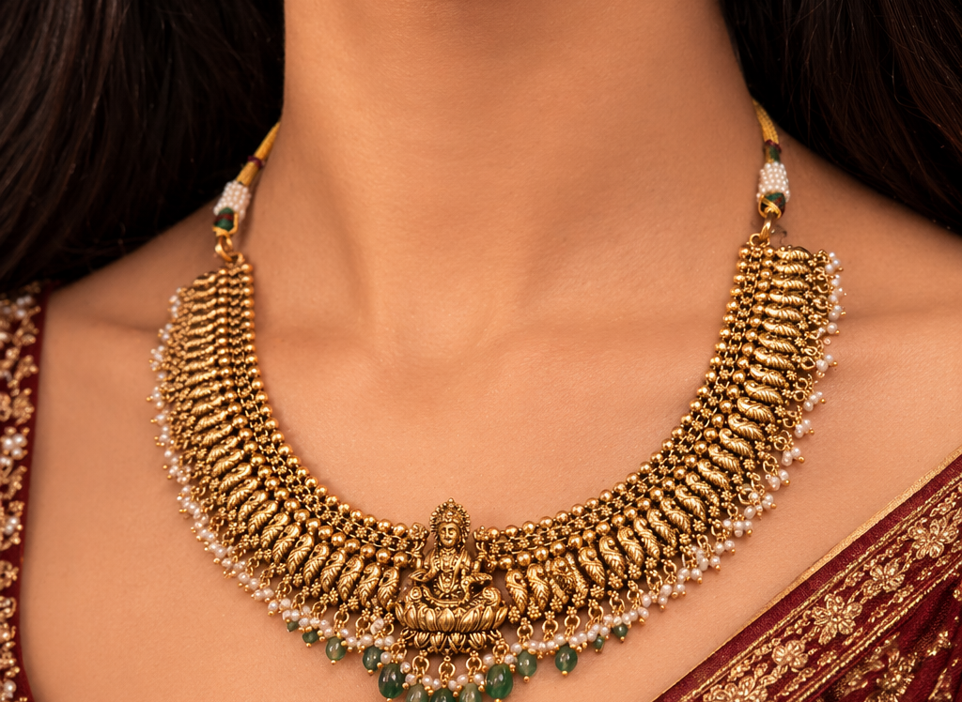
TEAM
06 / 09
Built by Founders Focused on Premium Commerce
The founding team is shaping VAIDHURYA at the intersection of jewelry commerce, AI-led personalization, and marketplace execution.
Venkatesha DP
Rishitha Adari
Why This Team
Co-founder driving product
vision, marketplace execution,
and the customer experience
needed to modernize jewelry
buying in India.
Co-founder shaping brand
direction, business build-out,
and the premium trust layer
needed to attract sellers and
shoppers.
Execution-first founders
building a trusted commerce
brand with AI-native
personalization as the product
differentiator.
Confidential | VAIDHURYA
Notes:
If fuller bios become available, replace these summaries with sharper credibility points.
[Sources]
- Founder guidance from the working session: India jewelry market is fragmented and unorganized; team includes Venkatesha DP and Rishitha Adari.

Slide 7
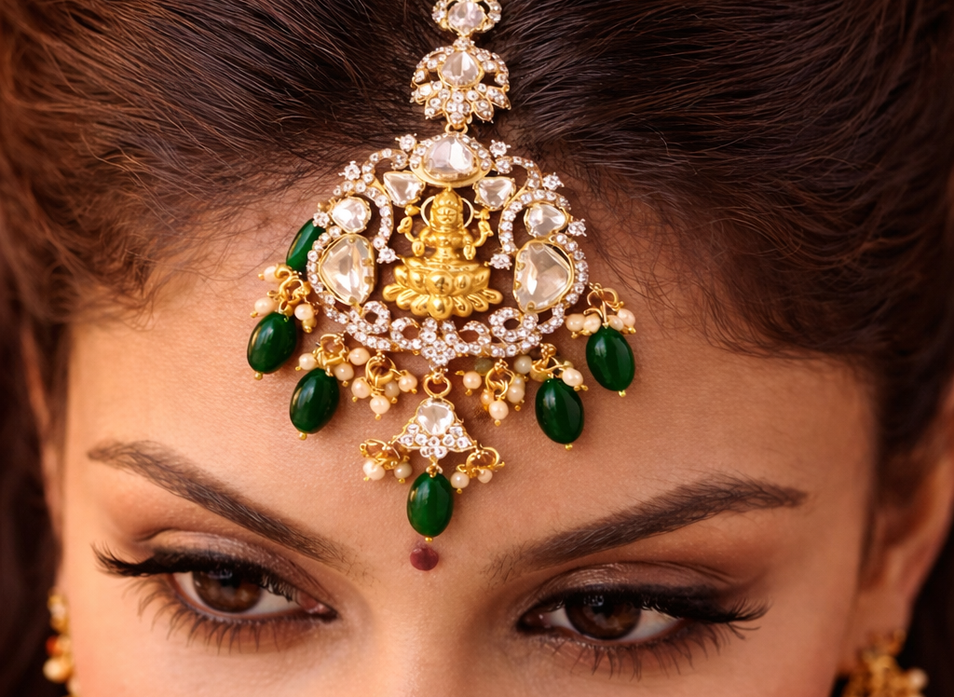
BUSINESS MODEL
07 / 09
Multiple Monetization Layers
VAIDHURYA is structured to capture transaction revenue, recurring seller revenue, and platform service upside.
Marketplace Take Rate
Seller Revenue
Value-Added Services
Commission on every completed
transaction across metal,
diamond, and gemstone jewelry
sold on the platform.
Premium storefront plans,
merchandising tools, and
optional visibility boosts
create recurring platform
revenue.
Catalog support, certification
assistance, content creation,
and future logistics enablement
deepen monetization over time.
Confidential | VAIDHURYA
Notes:
Use this to show the model is deeper than just commission revenue.
[Sources]
- Repository README: VAIDHURYA Commerce Architecture.
- Repository docs: commerce-flows.md.
- Founder guidance from the working session: India jewelry market is fragmented and unorganized; team includes Venkatesha DP and Rishitha Adari.

Slide 8

TECH STACK
08 / 09
Built for Scale with Claude and AWS
The platform combines premium commerce infrastructure with an AI layer designed for personalization and operational leverage.
Commerce Core
Claude + AI
AWS Backbone
Next.js and React power a
premium storefront, seller
workflows, cart, checkout,
tracking, and content-managed
merchandising.
Claude is planned for catalog
enrichment, listing assistance,
style reasoning, and support
workflows around
personalization.
AWS supports storage, compute,
scalability, and orchestration
for uploads, media,
recommendation flows, and
platform operations.
Confidential | VAIDHURYA
Notes:
Keep the technology story practical and outcome-oriented rather than overly technical.
[Sources]
- Repository README: VAIDHURYA Commerce Architecture.
- Repository docs: architecture-overview.md.
- Repository docs: commerce-flows.md.

Slide 9
FUNDRAISING
09 / 09
Fundraising Status
Capital will accelerate product development, AI recommendations, seller acquisition, and marketplace launch readiness.
PRE-SEED
AI + GTM
V1 LAUNCH
Fundraising stage focused on building the category-defining jewelry marketplace.
Primary use of funds across product, recommendation engine, seller onboarding, and customer growth.
Next milestone: launch with live sellers and an outfit-led recommendation experience.
Open investor conversations
Use of funds
Execution milestone
Confidential | VAIDHURYA
Notes:
Replace the pre-seed placeholder with the exact amount and instrument before circulating to investors.
[Sources]
- Deck framing uses placeholders for traction and fundraising details where numeric inputs were not provided.
- Founder guidance from the working session: India jewelry market is fragmented and unorganized; team includes Venkatesha DP and Rishitha Adari.

