Slide 1
Hadoop
Part 1

Slide 2
Agenda
Hadoop Ecosystem
Services
key ideas
Architecture
Usage Patterns
Tuning Parameters

Slide 3
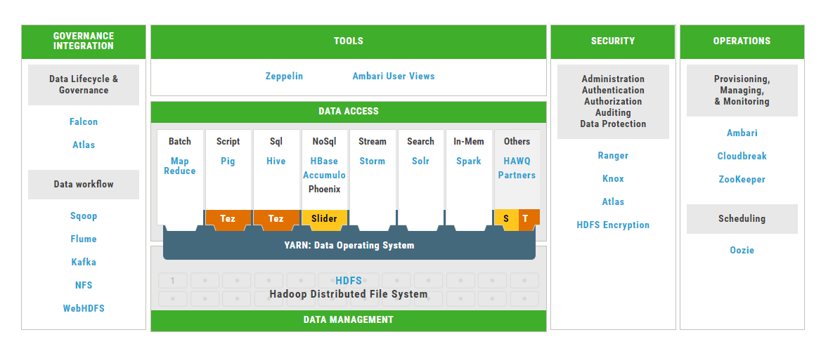
Hadoop Ecosystem
Notes:
http://hortonworks.com/products/data-center/hdp/
https://slider.incubator.apache.org/design/architecture.html
Broad categories – access, integration, operations, tools
Accumulo
A sorted, distributed key-value store with cell-based access control. Accumulo is a low-latency, large table data storage and retrieval system with cell-level security. Accumulo is based on Google’s Bigtable and it runs on YARN, the data operating system of Hadoop. YARN provides visualization and analysis applications predictable access to data in Accumulo.
Slider
Slider is a YARN application to deploy non-YARN-enabled applications in a YARN cluster Slider consists of a YARN application master, the "Slider AM", and a client application which communicates with YARN and the Slider AM via remote procedure calls and/or REST requests. The client application offers command line access as well as low-level API access for test purposes The deployed application must be a program that can be run across a pool of YARN-managed servers, dynamically locating its peers. It is not Slider's responsibility to configure up the peer servers, apart from some initial application-specific application instance configuration.
HAWQ –
HAWQ is a Hadoop native SQL query engine that combines the key technological advantages of MPP database with the scalability and convenience of Hadoop. HAWQ reads data from and writes data to HDFS natively.
Robust ANSI SQL compliance: SQL-92, SQL-99, SQL-2003, OLAP extension
Full transaction capability and consistency guarantee: ACID
Standard connectivity: JDBC/ODBC
Hadoop Native: from storage (HDFS), resource management (YARN) to deployment (Ambari).
Support for most third party tools: Tableau, SAS et al.

Slide 4
Ecosystem – Key Services
HDFS
YARN ( vs Mesos)
MR ( vs Tez)
Hive
Zookeeper
Kafka

Slide 5
HDFS – Key Ideas
Distributed
Divide files into big blocks and distribute across the cluster
Replication
Store multiple replicas of each block for reliability. Enables fault-tolerance.
Write Once, Read Many times (WORM)
Blocks are immutable
Data locality
Programs can find replicas for each block and gain data locality
Notes:
Paper: http://static.googleusercontent.com/media/research.google.com/en//archive/gfs-sosp2003.pdf
Immutable --- no random writes yet, vi hdfs://file isn’t yet there
DataNodes handle read and write requests i.e. a HDFS client directly talks to datanodes

Slide 6

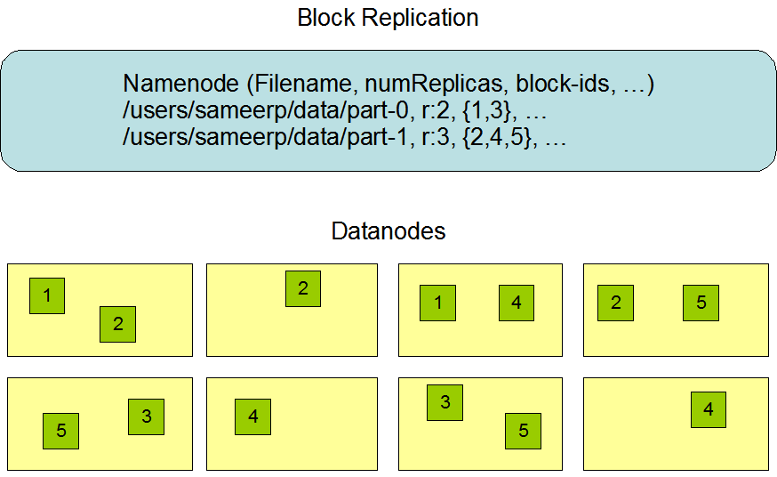
HDFS - Architecture
Notes:
https://hadoop.apache.org/docs/r2.7.2/hadoop-project-dist/hadoop-hdfs/HdfsDesign.html

Slide 7
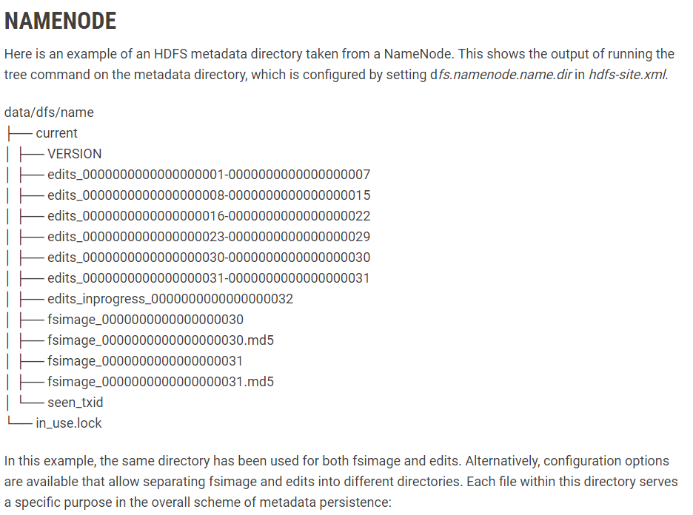
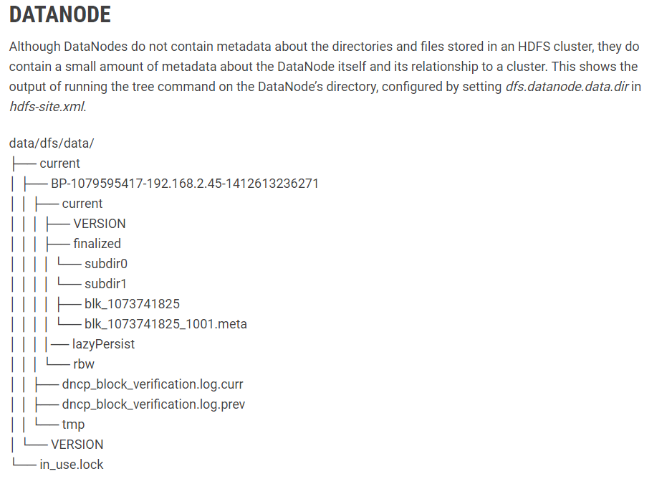
HDFS - Metadata
Notes:
http://hortonworks.com/blog/hdfs-metadata-directories-explained/
fsimage – An fsimage file contains the complete state of the file system at a point in time. Every file system modification is assigned a unique, monotonically increasing transaction ID. An fsimage file represents the file system state after all modifications up to a specific transaction ID.
edits – An edits file is a log that lists each file system change (file creation, deletion or modification) that was made after the most recent fsimage.
Namenode - in_use.lock – This is a lock file held by the NameNode process, used to prevent multiple NameNode processes from starting up and concurrently modifying the directory.
Datanode - in_use.lock – This is a lock file held by the DataNode process, used to prevent multiple DataNode processes from starting up and concurrently modifying the directory.

Slide 8
YARN – Key Ideas
Separation of Concerns
Resource Management, Job Scheduling / Monitoring.
Schedulers and Queues
Shared Clusters
Locality awareness
Rack, File -to-block map
Support for diverse programming models
Notes:
http://hadoop.apache.org/docs/current/hadoop-yarn/hadoop-yarn-site/YARN.html
The fundamental idea of YARN is to split up the functionalities of resource management and job scheduling/monitoring into separate daemons. The idea is to have a global ResourceManager (RM) and per-application ApplicationMaster (AM). An application is either a single job or a DAG of jobs.
The ResourceManager and the NodeManager form the data-computation framework. The ResourceManager is the ultimate authority that arbitrates resources among all the applications in the system. The NodeManager is the per-machine framework agent who is responsible for containers, monitoring their resource usage (cpu, memory, disk, network) and reporting the same to the ResourceManager/Scheduler.
The per-application ApplicationMaster is, in effect, a framework specific library and is tasked with negotiating resources from the ResourceManager and working with the NodeManager(s) to execute and monitor the tasks.
http://web.eecs.umich.edu/~mosharaf/Readings/YARN.pdf
A shared cluster that allows cluster to execute any distributed workload vs purpose built clusters for one/few types of Workloads ex: Vertica

Slide 9
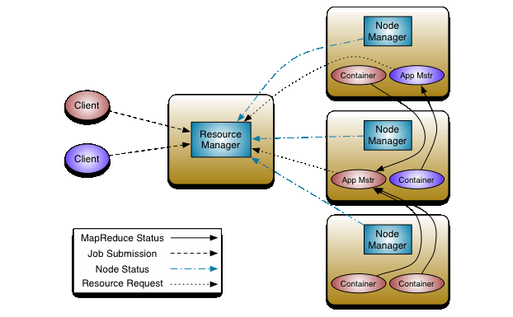
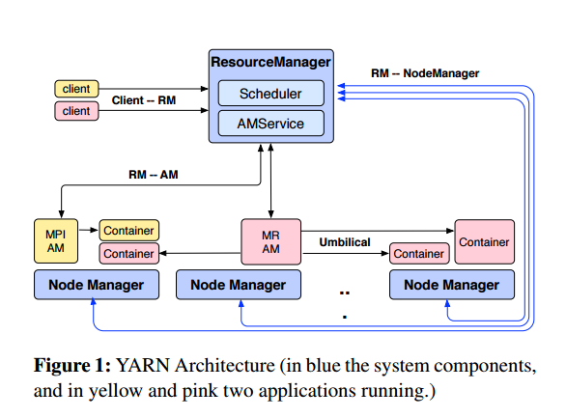
YARN Architecture
Notes:
The ResourceManager has two main components:
Scheduler and
ApplicationsManager.
The Scheduler is responsible for allocating resources to applications.
The Scheduler is pure scheduler, it performs no monitoring or tracking of status for the application. Also, it offers no guarantees about restarting failed tasks either due to application failure or hardware failures. The Scheduler performs its scheduling function based the resource requirements of the applications; it does so based on the abstract notion of a resource Container which incorporates elements such as memory, cpu, disk, network etc.
The Scheduler has a pluggable policy which is responsible for partitioning the cluster resources among the various queues, applications etc. CapacityScheduler and the FairScheduler would be some examples of plug-ins.
The ApplicationsManager is responsible for accepting job-submissions, negotiating the first container for executing the application specific ApplicationMaster and provides the service for restarting the ApplicationMaster container on failure. The per-application ApplicationMaster has the responsibility of negotiating appropriate resource containers from the Scheduler, tracking their status and monitoring for progress.

Slide 10
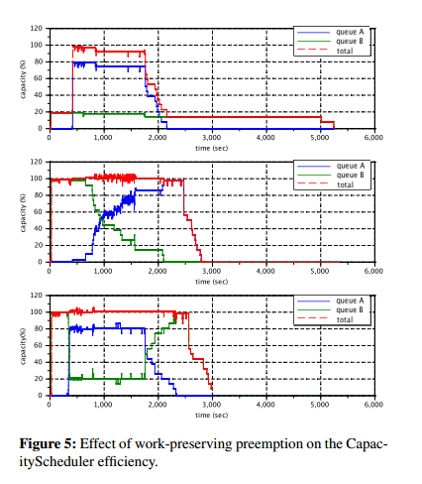
YARN – Schedulers and Queues
Notes:
http://web.eecs.umich.edu/~mosharaf/Readings/YARN.pdf
From paper - “We ran experiments on a small (10 machine) cluster, to highlight the potential impact of work-preserving preemption. The cluster runs CapacityScheduler, configured with two queues A and B, respectively entitled to 80% and 20% of the capacity. A MapReduce job is submitted in the smaller queue B, and after a few minutes another MapReduce job is submitted in the larger queue A. In the graph, we show the capacity assigned to each queue under three configurations: 1) no capacity is offered to a queue beyond its guarantee (fixed capacity) 2) queues may consume 100% of the cluster capacity, but no preemption is performed, and 3) queues may consume 100% of the cluster capacity, but containers may be preempted. Workpreserving preemption allows the scheduler to overcommit resources for queue B without worrying about starving applications in queue A. When applications in queue A request resources, the scheduler issues preemption requests, which are serviced by the ApplicationMaster by checkpointing its tasks and yielding containers. This allows queue A to obtain all its guaranteed capacity (80% of cluster) in a few seconds, as opposed to case (2) in which the capacity rebalancing takes about 20 minutes. Finally, since the preemption we use is checkpoint-based and does not waste work, the job running in B can restart tasks from where they left off, and it does so efficiently”

Slide 11
MapReduce – Key Ideas
It is a parallel programming model
Key Interfaces/steps
Map
Combine, Partition, Shuffle & Sort
Reduce
Counters
Backup tasks for stragglers
Notes:
http://static.googleusercontent.com/media/research.google.com/en//archive/mapreduce-osdi04.pdf
The users of MapReduce specify the number of reduce tasks/output files that they desire (R).
Partitioning
Data gets partitioned across reducer tasks using a partitioning function on the intermediate key. A default partitioning function is provided that uses hashing (e.g. “hash(key) mod R”).
In some cases, however, it is useful to partition data by some other function of the key. For example, sometimes the output keys are URLs, and we want all entries for a single host to end up in the same output file. To support situations like this, the user of the MapReduce library can provide a special partitioning function. For example, using “hash(Hostname(urlkey)) mod R” as the partitioning function causes all URLs from the same host to end up in the same output file.

Slide 12
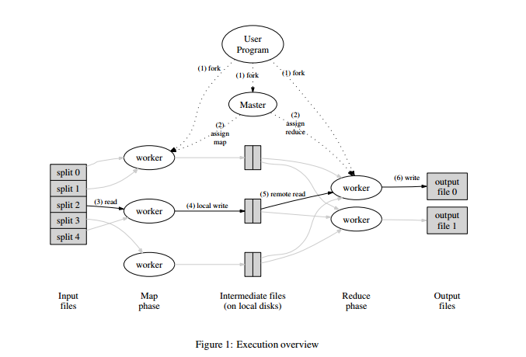
MapReduce - Execution
Notes:
http://static.googleusercontent.com/media/research.google.com/en//archive/mapreduce-osdi04.pdf

Slide 13
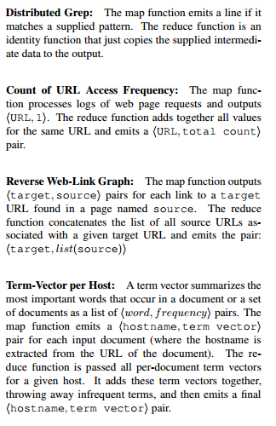
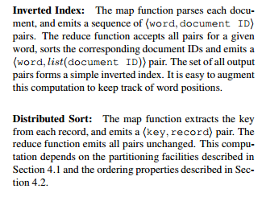
MapReduce - Examples
Notes:
WordCount Example
Pictures taken from paper - http://static.googleusercontent.com/media/research.google.com/en//archive/mapreduce-osdi04.pdf

Slide 14
Tez – Key Ideas
Expressiveness of DAG
Dynamically adapting the execution
Runtime graph re-configuration
Automatic Partition cardinality estimation
Scheduling Optimizations
Container re-use and Session
Avoid re-computing
Notes:
Paper: http://dl.acm.org/citation.cfm?id=2742790
Dynamically adapting the execution
Runtime graph re-configuration
Automatic Partition cardinality estimation (number of reducers can be tuned at runtime based on number of partitions and/or other parameters)
Scheduling Optimizations (some tasks within a vertex can be started early e.g. In Shuffle operation mentioned above )
Avoid re-computing through in-memory cache of intermediate results e.g. avoid re-building and re-broadcast of smaller tables in hive map-joins
Other ideas
Data Source Initializer
Hive dynamic partition pruning
Speculation
Speculative additional processing tasks running on Straggler

Slide 15
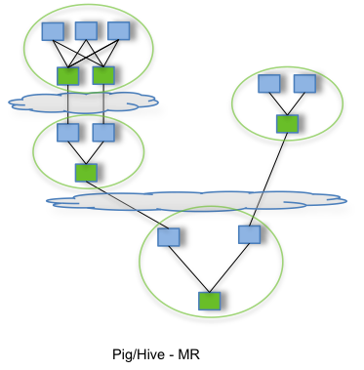
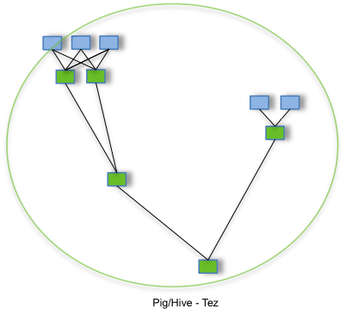
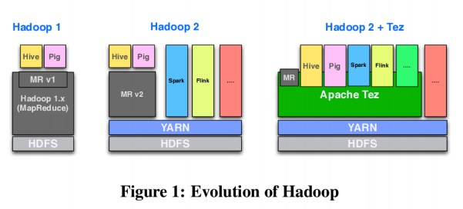
Tez – Key Ideas
Notes:
Paper: http://dl.acm.org/citation.cfm?id=2742790

Slide 16
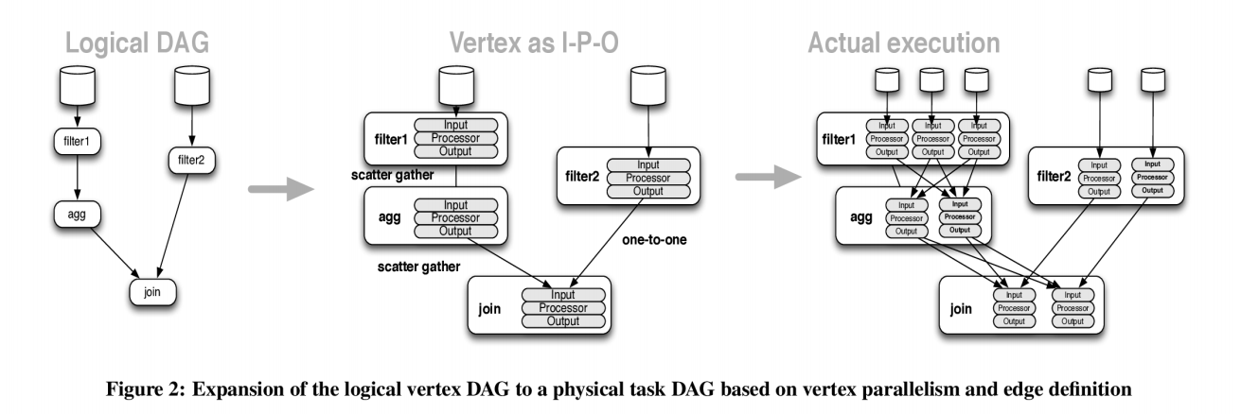
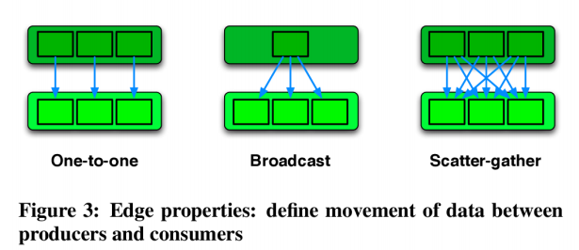
Tez – DAG

Slide 17
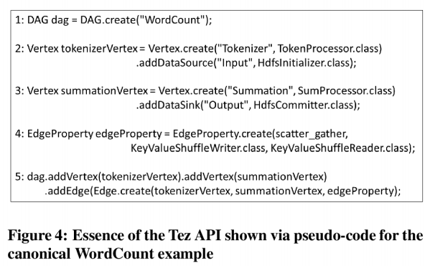
Tez – API
Notes:
Paper: http://dl.acm.org/citation.cfm?id=2742790

Slide 18
Hive – Key Ideas
Segregation of Concerns
Query – parsing, planning, execution & storage handling with serdes
SQL
ORC (Optimized Row Columnar) – File Format
CBO (Cost based Optimizer)
Notes:
SQL
Complex data types
User Defined – functions, table-generating functions, aggregation functions - https://cwiki.apache.org/confluence/display/Hive/LanguageManual+UDF
Windowing functions - https://cwiki.apache.org/confluence/display/Hive/LanguageManual+WindowingAndAnalytics

Slide 19
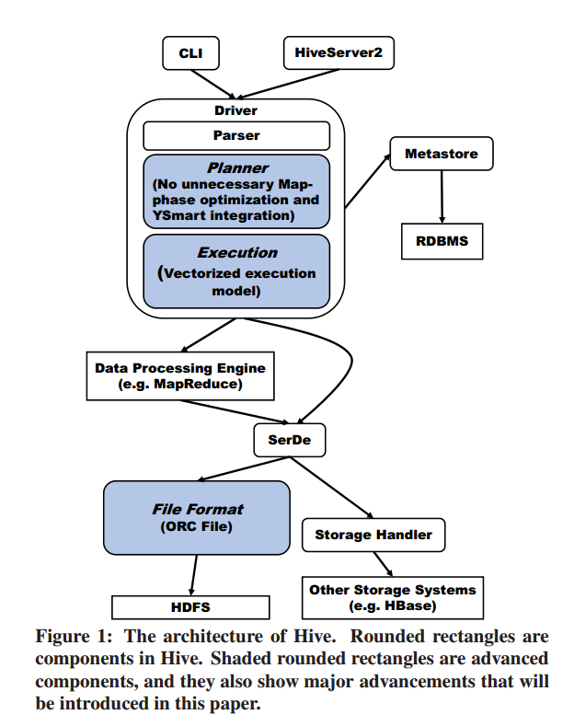
Hive – Architecture

Slide 20
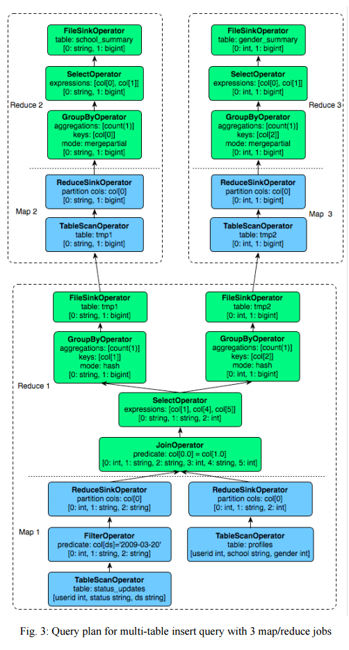
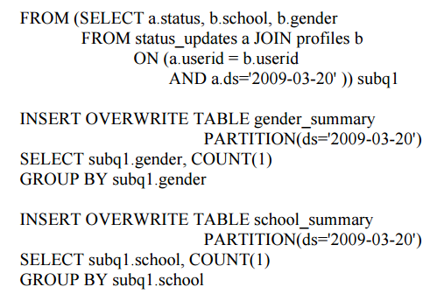
Hive – Query & Plan
Notes:
https://cwiki.apache.org/confluence/display/Hive/Tutorial#Tutorial-MultiTable/FileInserts

Slide 21
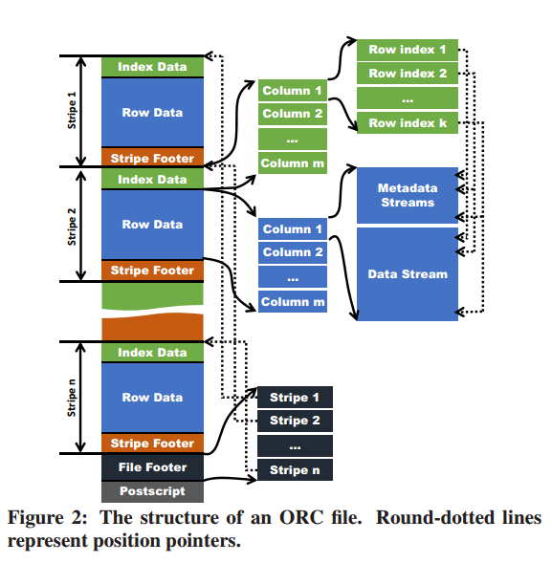
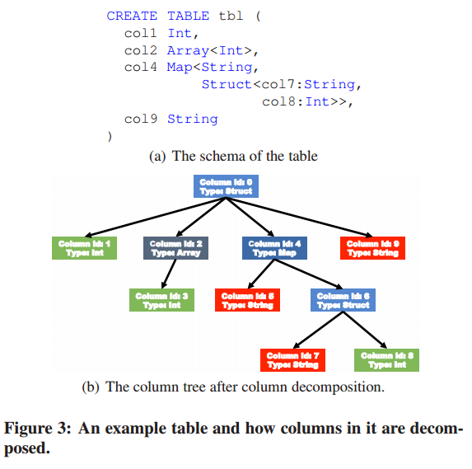
Hive – ORC
Notes:
Actual data of a leaf column are stored in a data stream. To facilitate the reader of an ORC file, the metadata of a column are also stored in metadata streams. In the column tree, internal columns (internal nodes in tree) are used to record metadata, e.g. the length of an array and so they will not have data streams.
Data values of a column are logically broken down into multiple index groups each with a fixed number of values (configurable with a default of 10000).
Sparse Indexes
Data Statistics - Used to avoid reading unnecessary data from the HDFS. They are created while writing an ORC file. Ex: number of values, the minimum value, the maximum value, the sum, and the length. In ORC File. Data statistics have three levels.
File level statistics (recorded at the end of this file) - used in query optimizations, and they are also used to answer simple aggregation queries.
Stripe level statistics for every column - used to analyze which stripes are needed to evaluate a query, unneeded stripes will not be read from HDFS.
Inside a stripe statistics are recorded for every index group, unnecessary index groups will not be read from HDFS. (An index group containing a small number of values can provide more fine-grained statistics about a column. However, the size of data statistics will increase. )
Position Pointers - When reading an ORC file, the reader needs to know two kinds of positions to perform efficient data reading operations.
Because an ORC file can contain multiple stripes and a HDFS block can contain multiple stripes -- To efficiently locate the starting point of a stripe, position pointers of stripes are needed. Those pointers are stored in the file footer of an ORC file (round-dotted lines pointing to starting points of stripes).
Because a column in a stripe has multiple logical index groups -- the starting points of every index group in metadata streams and data streams are needed (round-dotted lines pointing to the metadata stream and data stream represent this kind of position pointers).
ORC enables Vectorized query execution streamlines operations by processing a block of 1024 (configurable) rows at a time (instead of 1 row at a time)

Slide 22
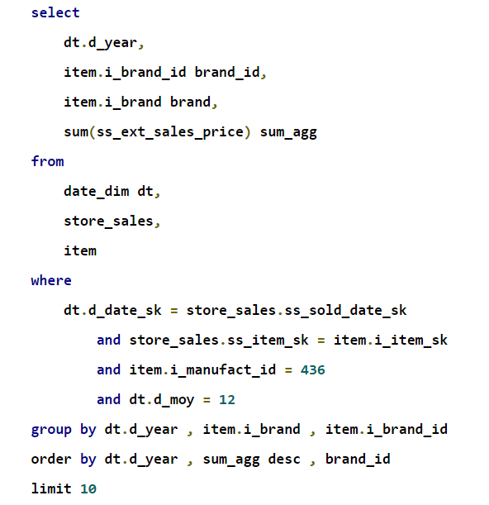
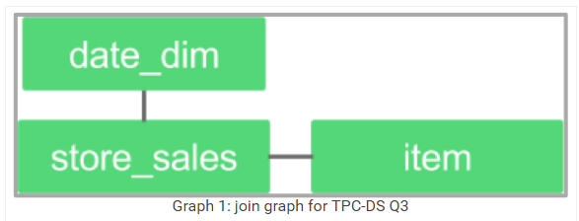
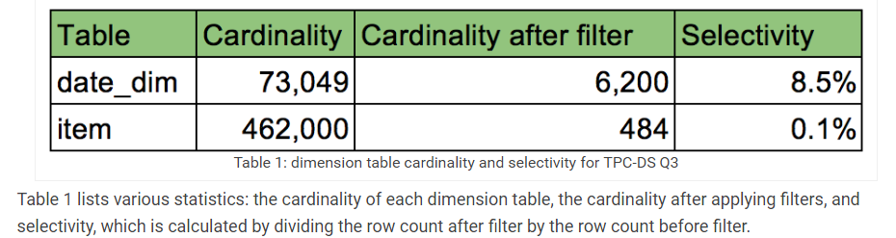
Hive – CBO
Notes:
http://hortonworks.com/blog/hive-0-14-cost-based-optimizer-cbo-technical-overview/

Slide 23
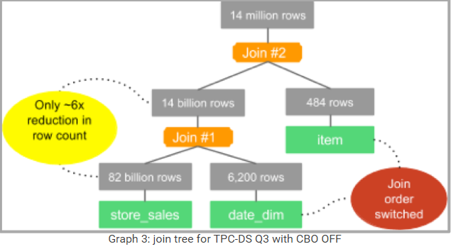
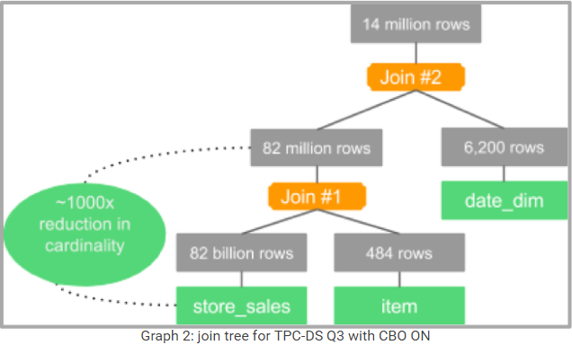
Hive – CBO
Notes:
http://hortonworks.com/blog/hive-0-14-cost-based-optimizer-cbo-technical-overview/

Slide 24
Zookeeper – Key Ideas
It is a wait-free coordination service
Ordering guarantees:
Linearizable writes: all requests that update the state of zookeeper are serializable and respect precedence;
FIFO client order: all requests from a given client are executed in the order that they were sent by the client.
Atomic Broadcast
Replicated database (a copy is held in-memory)
A key/value table with hierarchical keys (namespace like a filesystem)
Notes:
http://static.cs.brown.edu/courses/cs227/archives/2012/papers/replication/hunt.pdf
Atomic Broadcast
All requests that update ZooKeeper state are forwarded to the leader.
The leader executes the request and broadcasts the change through Zab (an atomic broadcast protocol). The server that receives the client request responds to the client when it delivers the corresponding state change.
Zab uses by default simple majority quorums to decide on a proposal, so Zab and thus ZooKeeper can only work if a majority of servers are correct (i.e., with 2f + 1 server we can tolerate f failures).
TCP is used for transport so that message order is maintained by the network, which allows simpler implementation

Slide 25
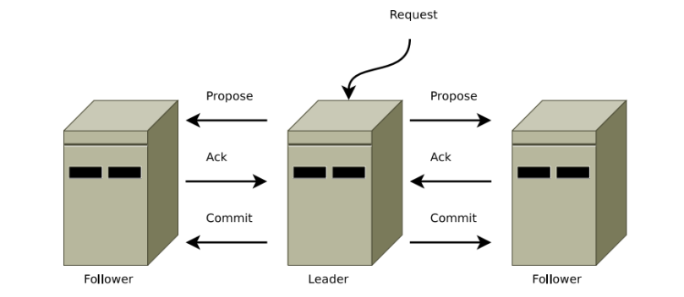
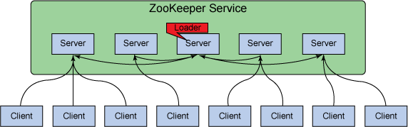
Zookeeper – Architecture and Zab
Notes:
Zab
The protocol used while the atomic broadcast service is operational is called broadcast mode.
It resembles a simple a two-phase commit : a leader proposes a request, collects votes, and finally commits. The two-phase commit protocol is simplified as there are no aborts; followers either acknowledge the leader’s proposal or they abandon the leader. The lack of aborts also mean that leader can commit once a quorum of servers ack the proposal rather than waiting for all servers to respond.
The broadcast protocol uses FIFO (TCP) channels for all communications. By using FIFO channels, preserving the ordering guarantees becomes very easy. Messages are delivered in order through FIFO channels; as long as messages are processed as they are received, order is preserved.
The simplified two phase commit by itself cannot handle leader failures, so there is add recovery mode to handle leader failures.

Slide 26
Zookeeper – Client API
create
delete
exists
getData
setData
getChildren
sync
Notes:
create(path, data, flags):
Creates a znode with path name path, stores data[] in it, and returns the name of the new znode. flags enables a client to select the type of znode: regular, ephemeral, and set the sequential flag;
delete(path, version):
Deletes the znode path if that znode is at the expected version;
exists(path, watch):
Returns true if the znode with path name path exists, and returns false otherwise. The watch flag enables a client to set a 3 watch on the znode;
getData(path, watch):
Returns the data and meta-data, such as version information, associated with the znode. The watch flag works in the same way as it does for exists(), except that ZooKeeper does not set the watch if the znode does not exist;
setData(path, data, version):
Writes data[] to znode path if the version number is the current version of the znode;
getChildren(path, watch):
Returns the set of names of the children of a znode;
sync(path):
Waits for all updates pending at the start of the operation to propagate to the server that the client is connected to. The path is currently ignored.

Slide 27
Zookeeper – Synchronization Primitives
ZooKeeper API is used to implement more powerful primitives, the ZooKeeper service knows nothing them since they are entirely implemented at the client using its API. Some examples are
Configuration Management
Rendezvous
Group Membership
Locks
Simple locks
Simple Locks without Herd Effect
Read/Write locks
Double Barrier
Notes:
Configuration Management
configuration is stored in a znode, zc. Processes start up with the full pathname of zc. Starting processes obtain their configuration by reading zc with the watch flag set to true. If the configuration in zc is ever updated, the processes are notified and read the new configuration, again setting the watch flag to true. Note that in this scheme, as in most others that use watches, watches are used to make sure that a process has the most recent information. For example, if a process watching zc is notified of a change to zc and before it can issue a read for zc there are three more changes to zc, the process does not receive three more notification events. This does not affect the behavior of the process, since those three events would have simply notified the process of something it already knows: the information it has for zc is stale.
Rendezvous
Sometimes in distributed systems, it is not always clear a priori what the final system configuration will look like. For example, a client may want to start a master process and several worker processes, but the starting processes is done by a scheduler, so the client does not know ahead of time information such as addresses and ports that it can give the worker processes to connect to the master. This scenario is handled using a rendezvous znode, zr, which is a node created by the client. The client passes the full pathname of zr as a startup parameter of the master and worker processes. When the master starts it fills in zr with information about addresses and ports it is using. When workers start, they read zr with watch set to true. If zr has not been filled in yet, the worker waits to be notified when zr is updated. If zr is an ephemeral node, master and worker processes can watch for zr to be deleted and clean themselves up when the client ends.

Slide 28
Zookeeper – Applications
Hadoop uses it for automatic fail-over of Hadoop HDFS Namenode and for the high availability of YARN ResourceManager.
HBase uses it for master election, lease management of region servers, and other communication between region servers.
Storm uses it for leader election, preserving most of its state(not files), leader discovery.
Spark uses it for leader election and some state storage
Kafka uses it for maintaining consumption relationship and other usecases like broker/consumer group membership
Solr uses it for leader election and centralized configuration.
Mesos uses it for fault-tolerant replicated master.
Neo4j uses ZooKeeper for write master selection and read slave coordination.
Cloudera Search uses ZooKeeper for centralized configuration management.
Notes:
https://cwiki.apache.org/confluence/display/KAFKA/Kafka+data+structures+in+Zookeeper
Kafka Zookeeper usecases
(1) detecting the addition and the removal of brokers and consumers,
(2) triggering a rebalance process in each consumer when the above events happen, and
(3) maintaining the consumption relationship and keeping track of the consumed offset of each partition
http://www.ibm.com/developerworks/library/bd-zookeeper/#resources
http://hortonworks.com/blog/fault-tolerant-nimbus-in-apache-storm/

Slide 29
Kafka – Key Ideas
Distributed Messaging System
Stateless broker
Partitioned topics
Consumer groups
Let consumers coordinate among themselves in a decentralized fashion using Zookeeper.
Guarantees at-least-once delivery.
Notes:
http://research.microsoft.com/en-us/um/people/srikanth/netdb11/netdb11papers/netdb11-final12.pdf
Stateless broker
the information about how much each consumer has consumed is not maintained by the broker, but by the consumer itself.
A consumer can deliberately rewind back to an old offset and re-consume data
Partitioned topics
Topics consist of one or more Partitions that are ordered, immutable sequences of messages.
Since writes to a partition are sequential, this design greatly reduces the number of hard disk seeks (with their resulting latency).
Consumer group
Each consumer group consists of one or more consumers that jointly consume a set of subscribed topics, i.e., each message is delivered to only one of the consumers within the group.
Different consumer groups each independently consume the full set of subscribed messages and no coordination is needed across consumer groups.
The consumers within the same group can be in different processes or on different machines.
A partition within a topic is the smallest unit of parallelism.
At any given time, all messages from one partition are consumed only by a single consumer within each consumer group.
Exactly once delivery typically requires two-phase commits and is not necessary for our applications

Slide 30
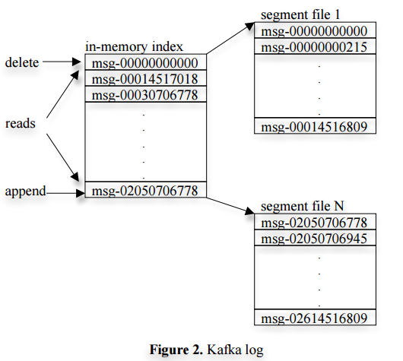
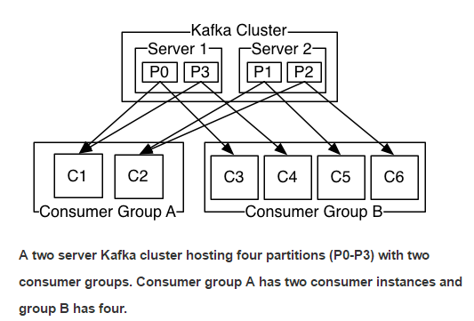
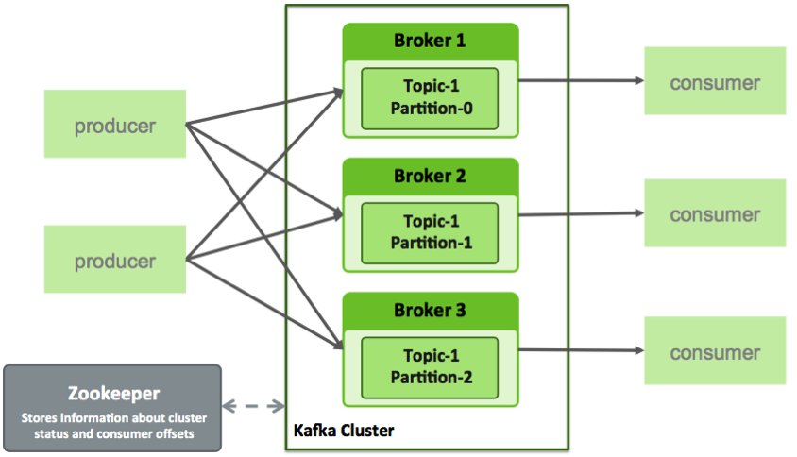
Kafka – Architecture
Notes:
Unlike typical messaging systems, a message stored in Kafka doesn’t have an explicit message id. Instead, each message is addressed by its logical offset in the log. This avoids the overhead of maintaining auxiliary, seek-intensive random-access index structures that map the message ids to the actual message locations. Message ids are increasing but not consecutive. To compute the id of the next message, Kafka adds the length of the current message to its id.
A consumer always consumes messages from a particular partition sequentially. If the consumer acknowledges a particular message offset, it implies that the consumer has received all messages prior to that offset in the partition. Under the covers, the consumer is issuing asynchronous pull requests to the broker to have a buffer of data ready for the application to consume.
Each client pull request contains the offset of the message from which the consumption begins and an acceptable number of bytes to fetch.
Each broker keeps in memory a sorted list of offsets, including the offset of the first message in every segment file.
The broker locates the segment file where the requested message resides by searching the offset list, and sends the data back to the consumer. After a consumer receives a message, it computes the offset of the next message to consume and uses it in the next pull request.

Slide 31
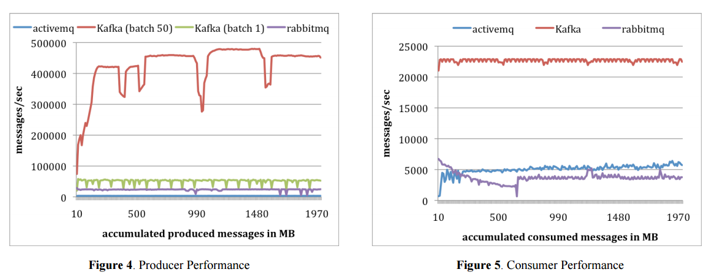
Kafka – Performance

Slide 32
Kafka – Examples
Message broker
Log aggregation
Operational Monitoring
Website activity tracking (original use case)
Stream processing (by itself)
External commit log
Notes:
https://kafka.apache.org/documentation.html#uses
External commit log
The log helps replicate data between nodes and acts as a re-syncing mechanism for failed nodes to restore their data.

Slide 33
APPENDIX

Slide 34
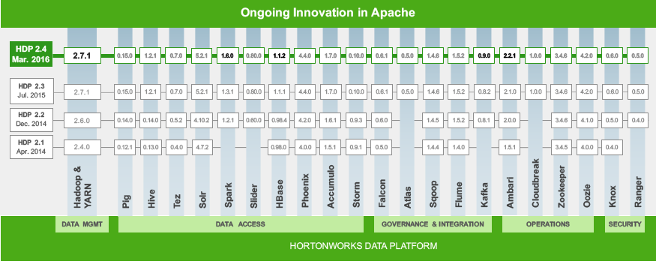
Hadoop – HDP –Timeline

Slide 35
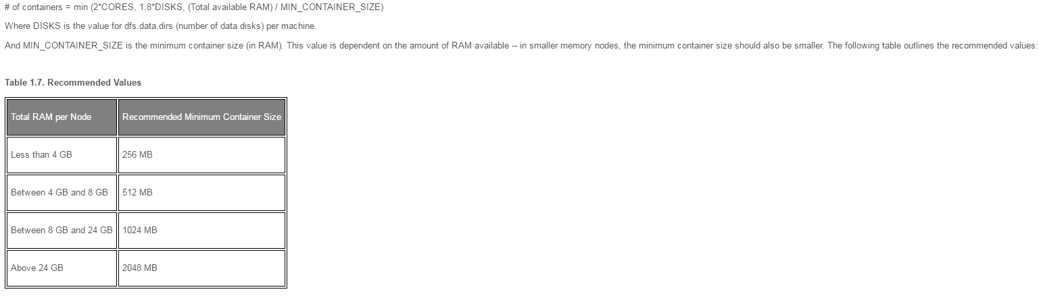
YARN - Tuning – Memory Configurations
Notes:
http://docs.hortonworks.com/HDPDocuments/HDP2/HDP-2.4.2/bk_installing_manually_book/content/determine-hdp-memory-config.html
Run the YARN Utility Script
Reserved Memory Recommendations
Determine the maximum number of containers allowed per node
Determine the amount of RAM per container

Slide 36
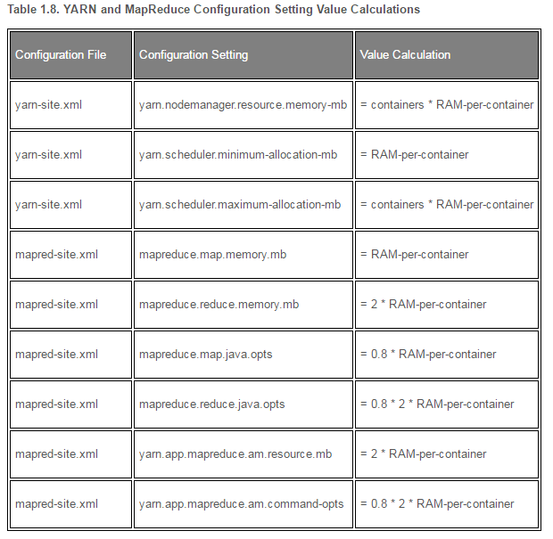
YARN - Tuning – Memory Configurations

Slide 37
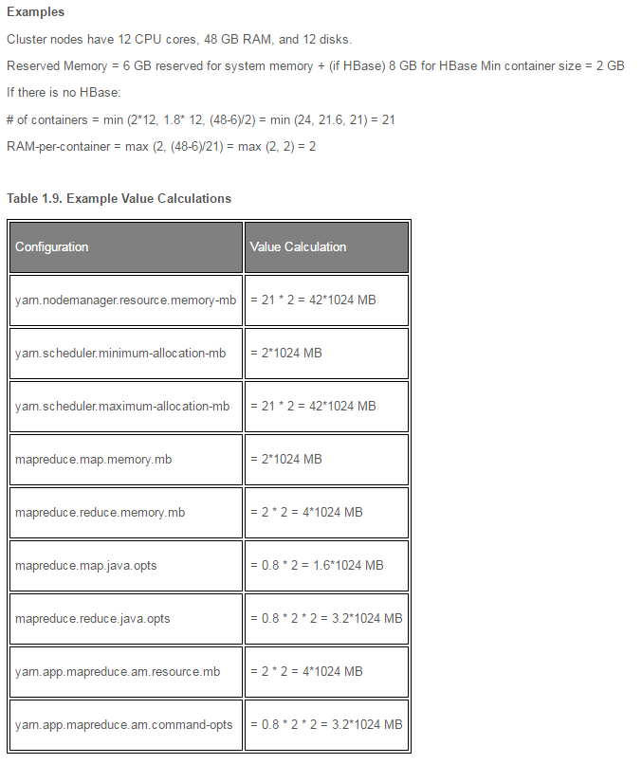
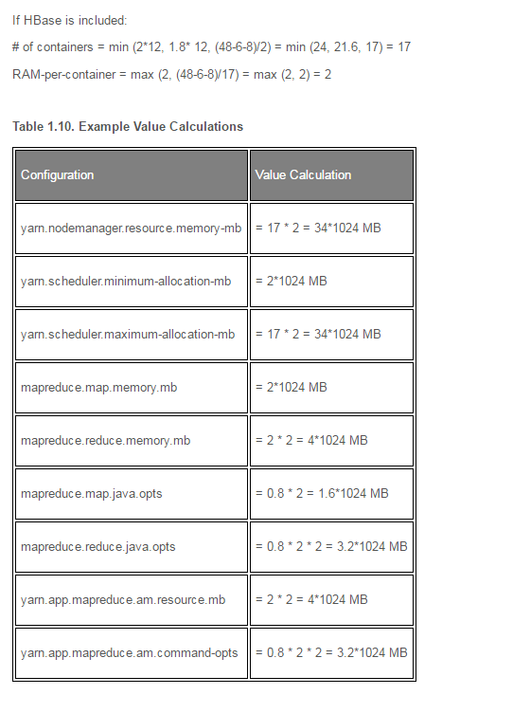
YARN - Tuning – Memory Configurations

Slide 38
Alternatives - Mesos vs YARN
“While Mesos and YARN both have schedulers at two levels, there are two very significant differences. First, Mesos is an offer-based resource manager, whereas YARN has a request-based approach. YARN allows the AM to ask for resources based on various criteria including locations, allows the requester to modify future requests based on what was given and on current usage. Our approach was necessary to support the location based allocation. Second, instead of a per-job intraframework scheduler, Mesos leverages a pool of central schedulers (e.g., classic Hadoop or MPI). YARN enables late binding of containers to tasks, where each individual job can perform local optimizations, and seems more amenable to rolling upgrades (since each job can run on a different version of the framework). On the other side, per-job ApplicationMaster might result in greater overhead than the Mesos approach.”

Slide 39
References - Papers
HDFS - http://static.googleusercontent.com/media/research.google.com/en//archive/gfs-sosp2003.pdf
YARN - http://web.eecs.umich.edu/~mosharaf/Readings/YARN.pdf
MapReduce - http://static.googleusercontent.com/media/research.google.com/en//archive/mapreduce-osdi04.pdf
Hive - http://infolab.stanford.edu/~ragho/hive-icde2010.pdf
Hive - http://web.cse.ohio-state.edu/hpcs/WWW/HTML/publications/papers/TR-14-2.pdf
Tez - http://dl.acm.org/citation.cfm?id=2742790
Zookeeper - http://static.cs.brown.edu/courses/cs227/archives/2012/papers/replication/hunt.pdf
Zookeeper - https://www.datadoghq.com/wp-content/uploads/2016/04/zab.totally-ordered-broadcast-protocol.2008.pdf
Kafka - http://research.microsoft.com/en-us/um/people/srikanth/netdb11/netdb11papers/netdb11-final12.pdf

Slide 40
References – Documentation Links/Articles
User Defined – functions, table-generating functions, aggregation functions - https://cwiki.apache.org/confluence/display/Hive/LanguageManual+UDF
Windowing functions - https://cwiki.apache.org/confluence/display/Hive/LanguageManual+WindowingAndAnalytics
ORC - https://cwiki.apache.org/confluence/display/Hive/LanguageManual+ORC
Kafka – Zookeeper usage - https://cwiki.apache.org/confluence/display/KAFKA/Kafka+data+structures+in+Zookeeper

Slide 41
References - Slides
Tez - http://www.slideshare.net/Hadoop_Summit/w-1205phall1saha

