Slide 1

Advanced Excel Data Analyzer
Roll No. | PRN | Name of Student | Contact No. | Email ID
50 | 12414948 | ISHWARI SALUNKE | 9421008189 | Ishwari.salunke24@vit.edu
52 | 12410371 | VAIDIK SAMARTH | 8830920593 | vaidik.samarth24@vit.edu
60 | 12414029 | HUNAIN SHAIKH | 91566997911 | hunain.shaikh24@vit.edu
69 | 12411515 | YASH SHINDE | 9881091459 | yash.shinde24@vit.edu
72 | 12415124 | TEJAS TERDALE | 8668977202 | tejas.terdale24@vit.edu
Class: CSAI Division: E Batch: 3
Project Guide: SHARADA DESAI

Slide 2

Abstract
The Advanced Excel Data Analyzer is a GUI-based application developed using Python, Tkinter, Pandas, Matplotlib, and Seaborn to facilitate efficient data analysis and visualization of Excel/CSV files. The application allows users to upload datasets, select a category column, choose a graph type, and optionally clean the data by removing missing values.
The tool provides three visualization options—Bar Chart, Line Chart, and Pie Chart—to help users gain insights into categorical data distributions. The analyzed data is summarized and exported as a CSV file, making it useful for business intelligence, research, and data-driven decision-making.

Slide 3
Flow Of Program
Start the Application - The program initializes a Tkinter GUI window with a user-friendly interface.
Upload an Excel/CSV File
The user selects a dataset using the file dialog.
The selected file is loaded into a Pandas DataFrame.
Select Category Column & Graph Type
The application retrieves column names from the dataset.
The user selects a categorical column and a graph type (Bar, Line, Pie).
Data Cleaning (Optional) - If enabled, the program removes missing values from the selected column.
Data Analysis & Visualization
The selected column's value counts are computed.
Based on the chosen graph type, the data is visualized using Matplotlib/Seaborn.
Save Summary Report - The summarized category count is saved as a CSV file in the working directory.
Display Completion Message - A message box notifies the user that the analysis is complete.
End of Process - The user can upload a new file or exit the application.

Slide 4
List Of The Topics/Concept Which Are Covered From The Syllabus
File Handling & Data Processing
Reading Excel/CSV files using Pandas
Extracting & processing data from a dataset
Handling missing values (Data Cleaning)
Data Visualization
Matplotlib (Line Chart, Pie Chart)
Seaborn (Bar Chart, Color Palettes)

Slide 5
List Of The Topics/ Concept Which Are Out Of Syllabus
Data Analysis Techniques
Value counts for categorical columns
Summary generation and exporting as a CSV file
Graphical User Interface (GUI) Programming
Tkinter (Widgets, Frames, Buttons, Labels, Messagebox, File Dialog)
Event Handling

Slide 6
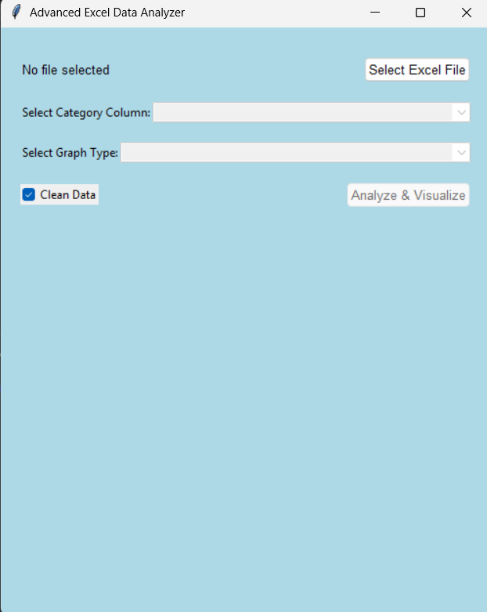
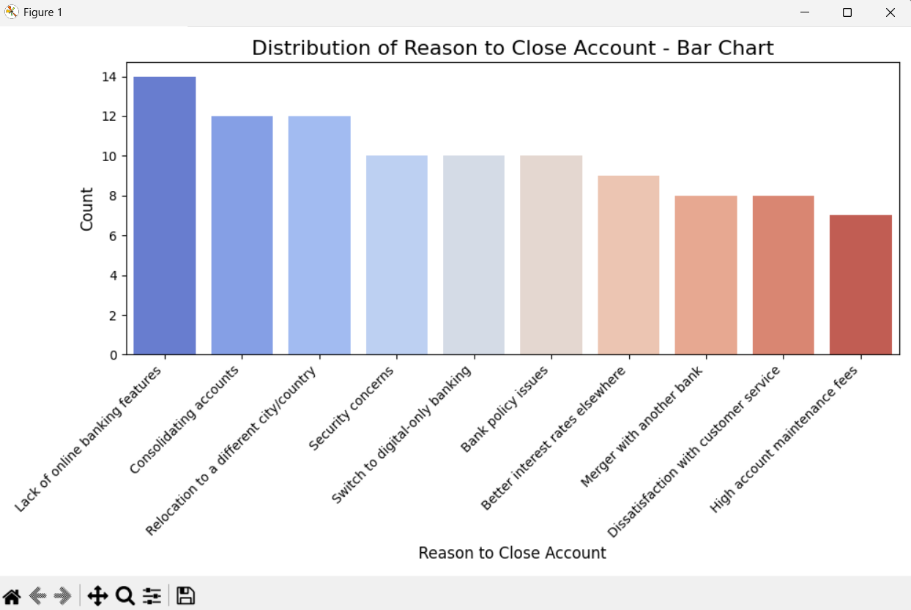
Final Output of Project

Slide 7
Conclusion
The Excel Data Analyzer provides an efficient way to process and visualize categorical data from Excel and CSV files. By integrating Tkinter for GUI, Pandas for data handling, and Matplotlib/Seaborn for visualization, the application ensures a seamless user experience for data cleaning, analysis, and graphical representation.
This project effectively applies key programming concepts such as GUI development, file handling, data preprocessing, and data visualization, reinforcing their practical significance. It serves as a foundation for more advanced data analytics applications, demonstrating the power of Python in real-world data analysis tasks.

Slide 8
Thank You

