Slide 1
Pneumonia vs Normal on Pediatric Chest X-rays
Reproducing Kermany et al. (Cell, 2018) + one change
Milestones 2–5

Slide 2
Why this problem?
• Pneumonia: 740 180 deaths in children under 5 in 2019 (14% of under-5 deaths) — WHO
• Chest X-rays are the main test, but subtle and hard to read
• Radiologists are scarce where the burden is highest
• Deep learning + transfer learning (ImageNet → X-rays) can help as a support tool

Slide 3
Base paper & method
Kermany et al., Cell 172(5), 2018 · ~5.2k train / 624 test images (Normal vs Pneumonia)
Chest X-ray
299×299
InceptionV3
(ImageNet)
FROZEN
2048
features
Linear
layer
Normal /
Pneumonia
• Only the new linear layer is trained
• Adam, lr 0.001 · batch 256 · 4000 steps

Slide 4
Paper vs our reproduction
Metric | Paper | Ours (frozen)
Accuracy | 92.8% | 80.1%
Sensitivity | 93.2% | 98.4%
Specificity | 90.1% | 49.7%
AUC | 96.8% | 92.9%
Test set: 624 images (234 Normal / 390 Pneumonia). Ours: mean of 5 seeds. Paper values: confirm against Fig. 6.

Slide 5
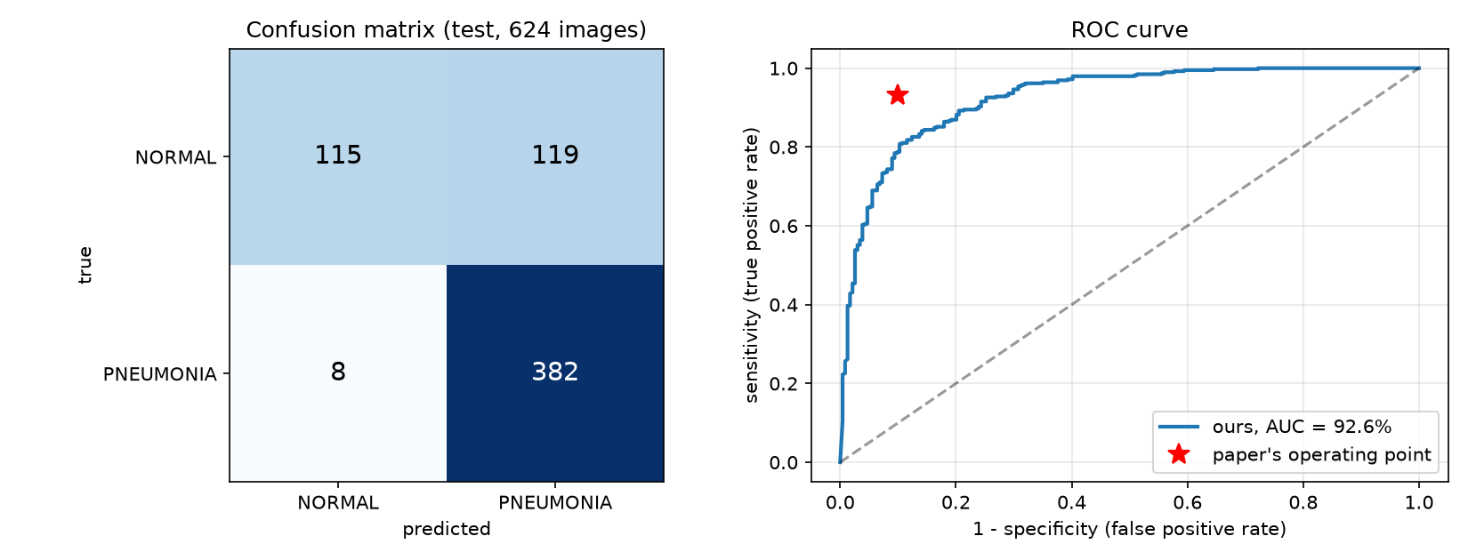
Where the baseline fails
• 119 of 127 errors: NORMAL called PNEUMONIA
• Val acc 98.7% vs test acc 80% → train/test shift
• 3:1 class imbalance pushes toward 'pneumonia'
• AUC within ~4 pts of paper; gap is mostly specificity

Slide 6
Hypothesis: the one change
Chest X-ray
299×299
InceptionV3
+ Mixed_7b/7c
TRAINED
2048
features
Linear
layer
Normal /
Pneumonia
• Unfreeze only the last 2 Inception blocks (Mixed_7b, Mixed_7c)
• Train them with the head at a small learning rate (1e-4)
• Everything else identical to the baseline

Slide 7
Prediction & reasoning
Prediction
Reasoning
• AUC up ~1–2 points
• Specificity improves most (fewer Normal → Pneumonia errors)
• Wrong if: no AUC gain, or gain without better specificity
• ImageNet = colour photos; X-rays = grayscale
• Top layers learn X-ray patterns (opacities)
• Early layers stay frozen → less overfitting on ~5k images
• Risk: overfitting / train–test shift

Slide 8
Plan: Milestone 4 ablation
0 blocks
(baseline)
1 block
2 blocks
(ours)
Whole
network
• Report accuracy, sensitivity, specificity, AUC + confusion matrix
• Same data, seed and settings for every run
• Limitations: small single-hospital dataset; no clinical claims

Slide 9
Milestone 4: ablation results
Unfrozen | Seeds | Acc | Sens | Spec | AUC | Train acc
0 blocks (baseline) | 5 | 80.2 | 98.6 | 49.7 | 92.9 | 99.7
1 block | 1 | 82.2 | 99.7 | 53.0 | 92.3 | 100.0
2 blocks (ours) | 2 | 80.8 | 99.5 | 49.8 | 92.6 | 100.0
Whole network* | 1 | 78.4 | 100.0 | 42.3 | 93.9 | 99.9
• Same data, split, batch 256, 4000 steps; only the unfrozen part changes (blocks lr 1e-4, head lr 1e-3)
• *Whole network: smaller budget (batch 32, 1000 steps, 1 seed) — rough guide only
• Test set: 624 images; mean over seeds; threshold 0.5

Slide 10
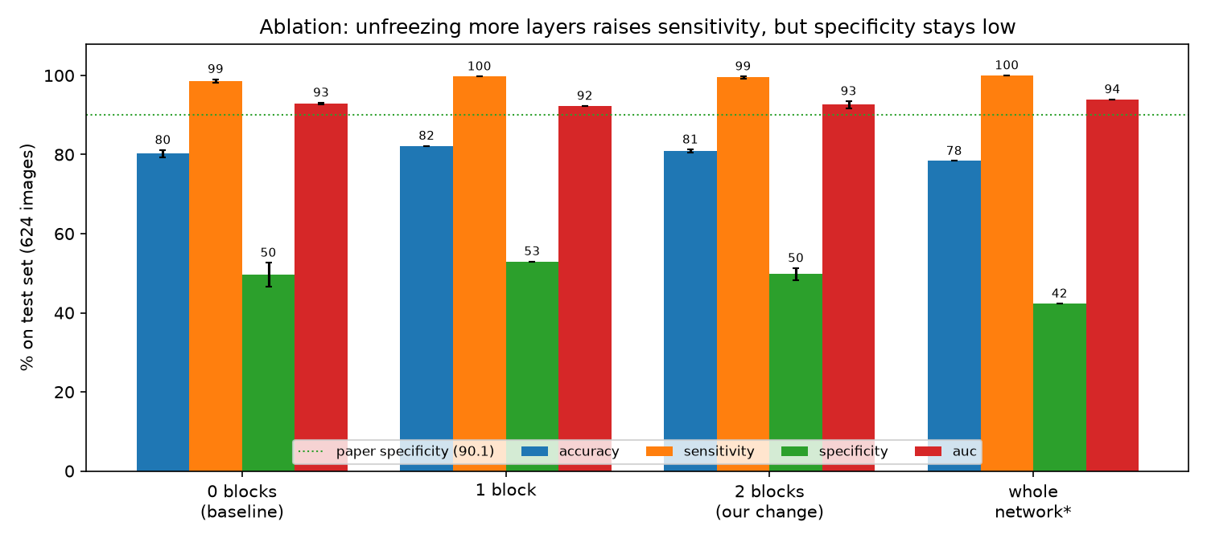
Ablation at a glance

Slide 11
Was our prediction right?
NO
AUC up ~1–2 points
-0.3 pts
NO
Specificity improves the most
+0.1 pts
YES
Sensitivity within ~1 point
+0.9 pts
Hypothesis not supported: 2 blocks vs frozen baseline, accuracy +0.6 pts. Prediction was written before the experiment.

Slide 12
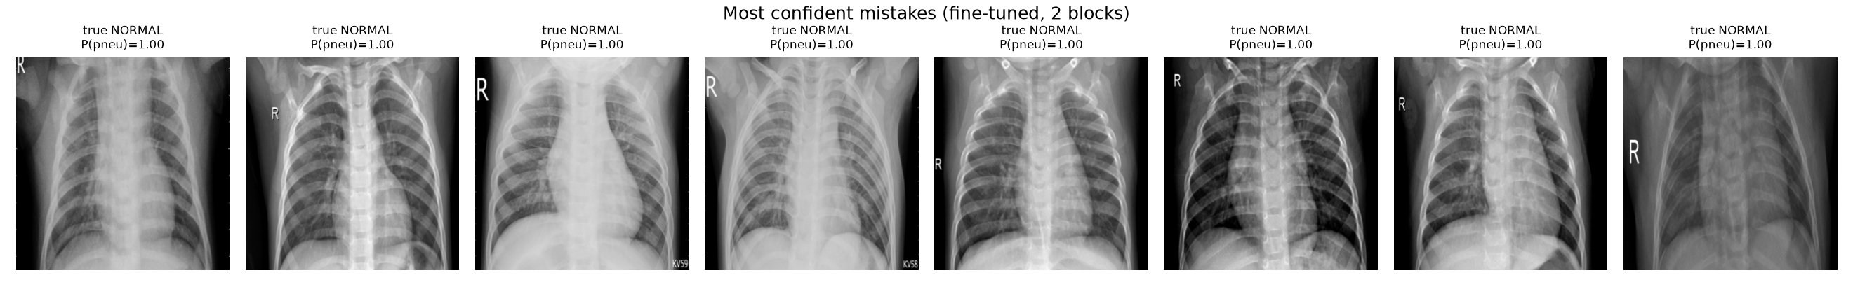
Failure analysis
• Normal → Pneumonia errors: 114 (frozen) vs 114 (2 blocks); missed pneumonia: 8 vs 3
• Train acc 100.0% / val 98.9% vs test 80.8% → train/test shift dominates
• 3:1 class imbalance + threshold 0.5 bias the model toward 'pneumonia'

Slide 13
Limitations & next steps
Limitations
Next steps
• One hospital, one fixed 624-image test set
• Few seeds for fine-tuned runs
• Whole-network row uses a smaller budget
• Research exercise only — no clinical claims
• Class-weighted loss for the 3:1 imbalance
• Choose threshold on validation, not 0.5
• Data augmentation against train/test shift
• External test set (another hospital)

Slide 14
Conclusion
• Reproduced Kermany et al.: AUC 92.9% vs 96.8% (paper); low specificity (49.7%) is the main gap
• One change (fine-tune top 2 blocks): AUC 92.6%, specificity 49.8%, accuracy 80.8%
• Hypothesis not supported against criteria fixed in advance
• Code, results and paper: github.com/Vaiditya2207/pneumonia-cxr-reproduction

