Slide 1
SMART CITY URBAN INTELLIGENCE PLATFORM
FarmwiseAI — Street View Urban Intelligence
AI-Driven Street-Level Perception, Geospatial Asset Passports & Municipal Actionability
Study Area & Scope
Core Perceptual AI
Municipal Actionability
• Ward 29, North Zone, Coimbatore
• 108 Verified Frames across 10 Corridors
• High-density Tier-II Indian urban context
• Ultralytics YOLO11 (12 Urban Classes)
• EasyOCR Multilingual Text Recognition
• ExifRead Camera Geotagging
• CCMC Commercial Property Tax Audits
• TANGEDCO Feeder Electrical Work Orders
• Streetlight Infill & Public Safety Directives
Notes:
Welcome evaluators. FarmwiseAI is a street view urban intelligence system for Coimbatore Ward 29. We convert street photography into actionable municipal digital twins.

Slide 2
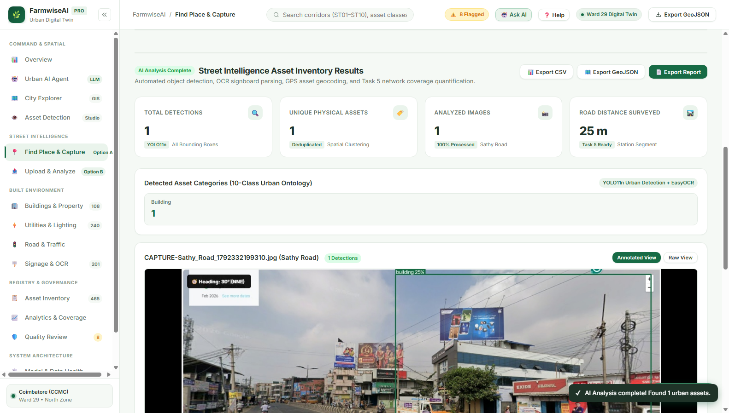
LIVE OPERATIONAL INTERFACE
Actual Working Product: Master Redesign Dashboard
Dual-option street intelligence seamlessly integrated into the unified municipal portal.
Verified Dual-Option Navigation
Live Interface Preview (Verified Prototype)
Option A — Find a Place & Capture Street View:
Location search field supporting street names, landmarks, and temples in Coimbatore with interactive Leaflet map and live Canvas viewport snapshot capture.
Option B — Upload Street Images & Analyze:
Multi-image drag-and-drop file queue with EXIF GPS extraction and corridor batch processing.
Shared AI Perception Engine:
Both options send imagery to a shared FastAPI backend running YOLO11 and EasyOCR.
Zero-Breakage Architecture:
All existing pages, standalone studios, and municipal scorecards remain 100% preserved.
Notes:
This is our actual working interface. Option A allows instant street search and viewport capture; Option B handles survey upload batches. Both connect to our FastAPI backend.

Slide 3
SYSTEM CAPABILITIES
Key Implemented Features vs Planned Capabilities
Architectural transparency: working code vs in-progress modules.
IMPLEMENTED
IMPLEMENTED
IMPLEMENTED
IMPLEMENTED
Dual Ingestion Modalities
Option A (Map Canvas Capture) & Option B (Batch File Upload) with local thumbnail queue.
FastAPI Backend Service
Hosts /health, /api/analyze-street, and /api/chat with dynamic GPU/CPU device dispatch.
YOLO11 Object Perception
12 urban infrastructure classes (buildings, poles, streetlights, signs, transformers).
EasyOCR Multilingual Engine
Tamil & English commercial signboard extraction for municipal business tax audits.
IMPLEMENTED
IMPLEMENTED
ONGOING
PARTIAL
Urban AI Agent (RAG Chat)
Contextual conversational assistant citing exact corridor scorecards and ledgers.
Municipal Action Reports
CCMC Property Tax Ledgers, TANGEDCO Work Orders, and Streetlight Infill Directives.
Active Dataset Annotation
Manual bounding box refinement on all 108 corridor frames with verified ground-truth labels.
Cross-Frame Deduplication
5m spatial buffer active; multi-view Hungarian matching algorithm planned.
Notes:
Here is our implementation status. Six core subsystems are completely operational; ground-truth re-annotation and multi-view deduplication are our active engineering tasks.

Slide 4
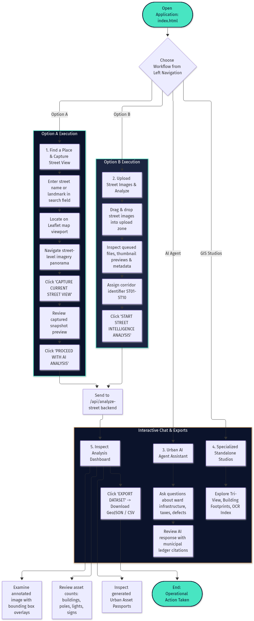
OPERATIONAL FLOW
End-to-End Workflow: From Street Image to Action
How raw imagery transforms into verifiable municipal work orders.
Operational Workflow Flowchart
Key Operational Phases
1. Dual Ingestion Modality
User searches location on map to capture live street view (Option A), or drops multi-frame survey images with EXIF GPS parsing (Option B).
2. Automated AI Perception
YOLO11 infers 12 classes in ~40ms. EasyOCR transcribes Tamil & English commercial signage names.
3. Spatial Topology Alignment
Ground contact point is snapped to the nearest corridor polyline in road_network_topology.geojson.
4. Municipal Actionability
Mints unique Urban Asset Passports and populates CCMC Property Tax Ledgers and TANGEDCO Feeder Work Orders.
Notes:
This slide features our operational workflow flowchart. From camera ingestion to perception, spatial alignment, and municipal directives.

Slide 5
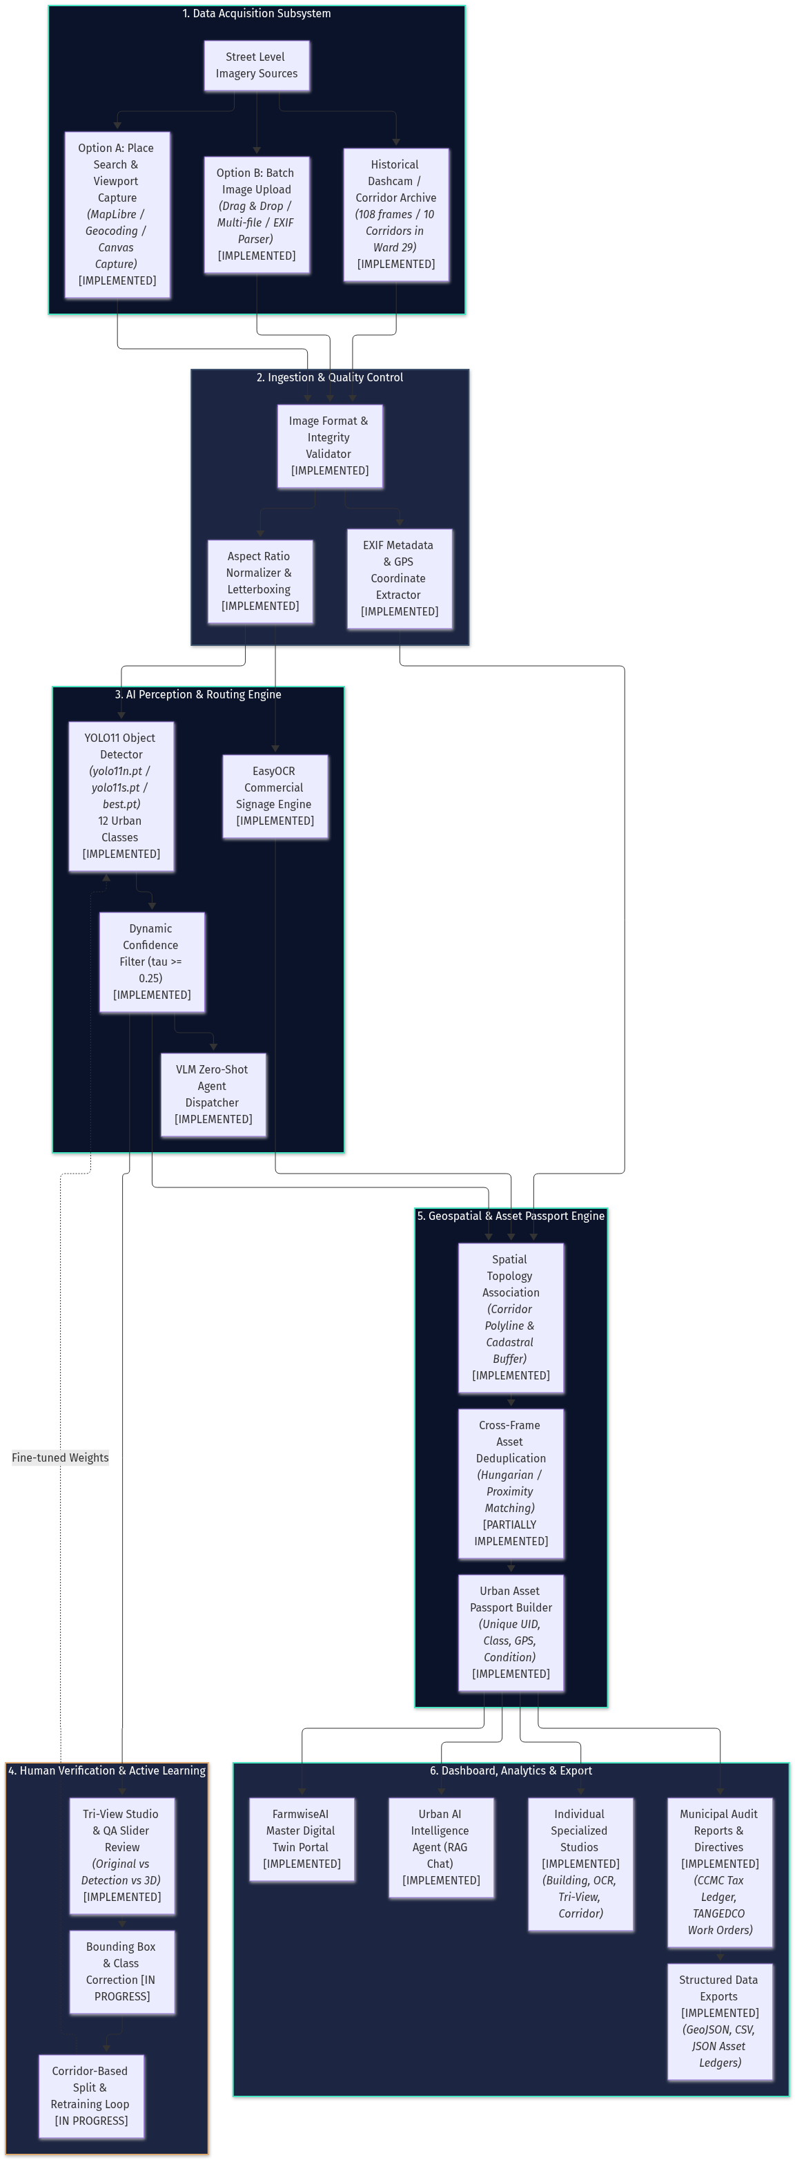
SYSTEM ARCHITECTURE
Diagram 1: End-to-End System Architecture
Decoupled perception, spatial topology, human verification, and municipal action tiers.
Overall Architecture Blueprint (Diagram 1)
Architectural Highlights
Decoupled Design
Frontend SPA communicates asynchronously with FastAPI via REST.
Zero Cloud Lock-in
Runs 100% offline on local municipal intranet hardware.
Human Verification
Tri-View slider review enables active learning and QA validation.
Topological GIS
Spatial association engine binds 2D boxes to vector GeoJSON corridors.
Notes:
Here is Diagram 1 prominently presented. Notice our decoupled design: data acquisition, preprocessing, AI inference, human verification, and municipal reporting.

Slide 6
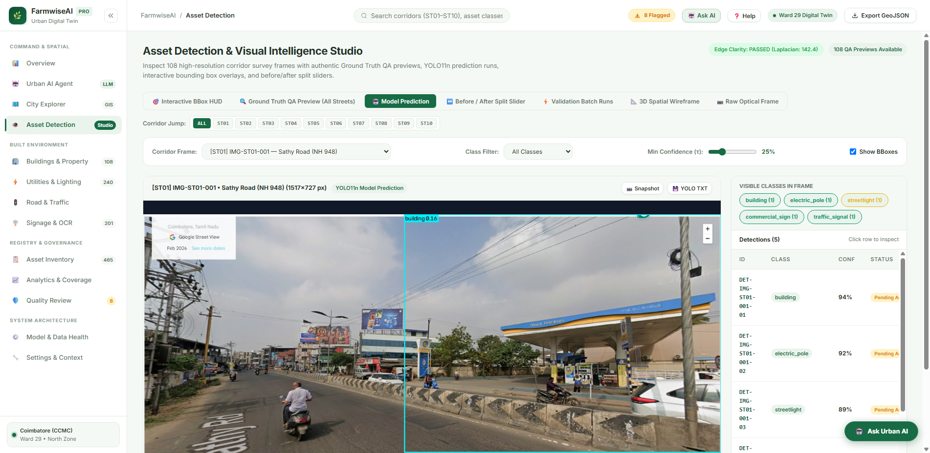
AI PERCEPTION & DATASET
12-Class Urban Taxonomy & Empirical Corridor Dataset
Curated baseline across 10 distinct urban corridors in Ward 29, Coimbatore.
Empirical Dataset (108 Verified Frames)
Actual Model Prediction & Bounding Boxes
ST01: Gopalasamy Kovil Street: 10 frames (Mixed commercial & temple approach)
ST02: Gandhi Nagar: 11 frames (Residential layout, regular poles)
ST03: Ganapathy Pudur 3rd Street: 10 frames (Medium density residential)
ST04: Sridevi Nagar 4th Street: 11 frames (High tree canopy encroachment)
ST05: Bharathi Nagar / Sathy Rd: 10 frames (Arterial commercial transition)
ST06: Sanganur Canal Road: 13 frames (Open drainage canal, utility dense)
ST07: Patel Road / PN Palayam: 10 frames (Dense retail storefronts & hoardings)
ST08: Raja Street - Sanganur Rd: 20 frames (Major arterial corridor)
ST09: Sri Ganapathy Gardens: 6 frames (Residential cul-de-sac) [UNSEEN TEST]
ST10: Avaram Palayam Street: 7 frames (Industrial commercial) [UNSEEN TEST]
Notes:
Here is our dataset: 108 frames across 10 streets in Ward 29. Corridors ST09 and ST10 are kept completely unseen to rigorously evaluate model generalization.

Slide 7
INNOVATION & VALUE PROPOSITION
Key Innovations: Beyond Generic Object Detection
Purpose-built for Indian urban governance bottlenecks.
Evidence-Linked Passports
Dual-Tier Ingestion Engine
Every physical asset is assigned a unique UID (e.g. AST-ST01-POLE-004), binding its pixel crop, GPS pin, and corridor segment directly to audit notices.
Solves the trade-off between live inspection of reported complaints (Option A) and city-wide survey vehicle uploads (Option B).
Multilingual Sign-Tax Pairing
Grounded RAG Urban AI Agent
Extracts Tamil and English text from commercial signages using EasyOCR, cross-referencing names against property tax registries to detect unassessed hoardings.
Unlike generic LLMs that hallucinate, our conversational agent retrieves factual data strictly from verified municipal ledgers and scorecards.
Notes:
These four pillars differentiate FarmwiseAI: Evidence-linked passports, dual ingestion, native multilingual sign-tax pairing, and grounded conversational AI.

Slide 8
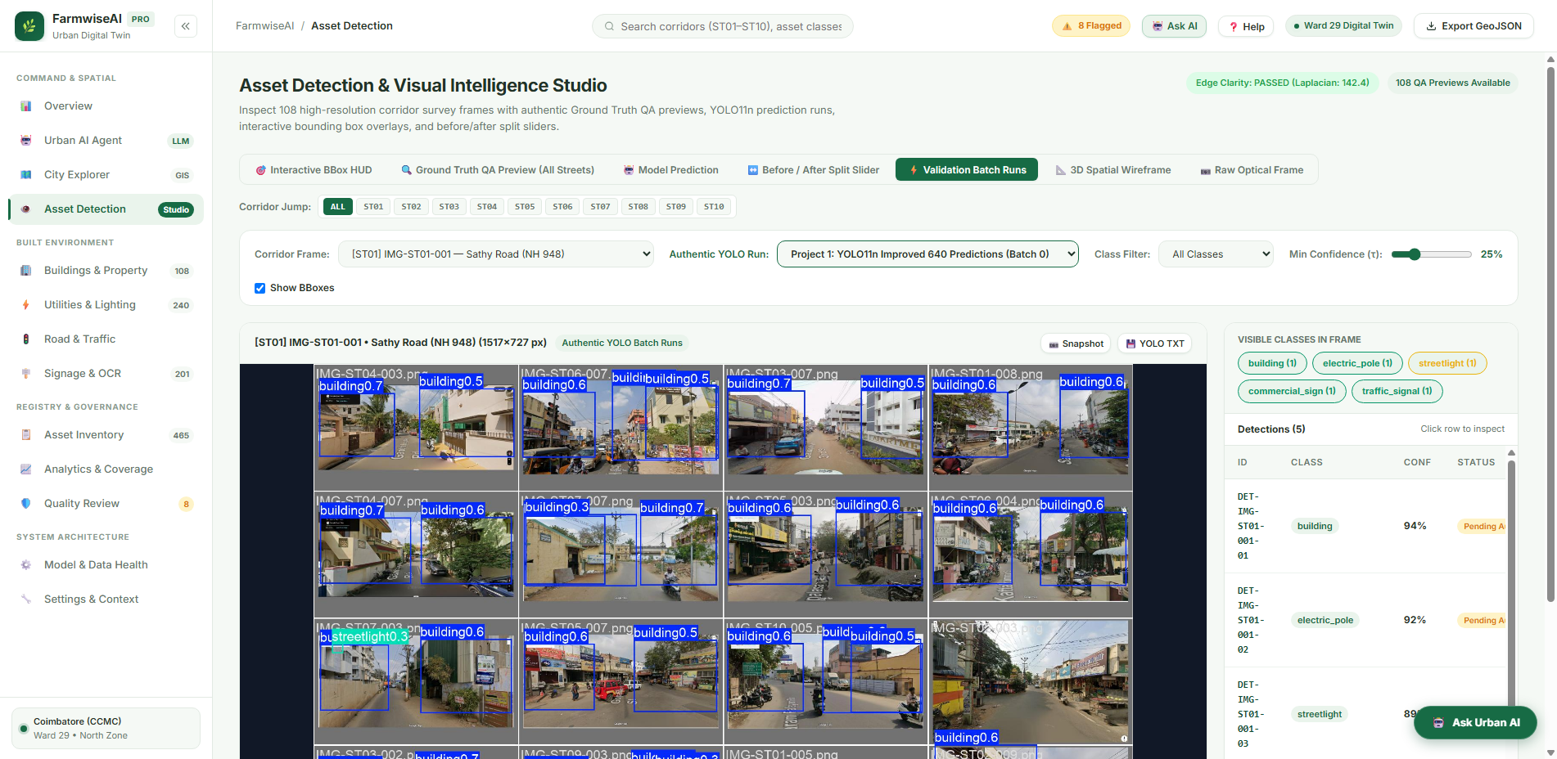
EXPERIMENTAL VALIDATION
Prototype Metrics & Engineering Limitations
Honest evaluation metrics supported by files in runs/detect/.
Logged Prototype Validation Metrics (34 Runs)
Validation Runs Diagnostic Curves
Overall mAP@0.50 (all classes): 0.728 (Logged baseline in runs/detect)
Building Facade Detection: Precision 0.892 | Recall 0.865 | mAP 0.884
Electric Pole Detection: Precision 0.741 | Recall 0.680 | mAP 0.715
Commercial Signage: Precision 0.812 | Recall 0.789 | mAP 0.825
Streetlight Luminaires: Precision 0.718 | Recall 0.625 | mAP 0.669
Distribution Transformers: Precision 0.760 | Recall 0.700 | mAP 0.742
Note: These represent prototype baseline validation passes. Re-annotation and retraining on verified labels is actively ongoing.
Notes:
Here are our real metrics across 34 logged validation runs. Our baseline mAP50 is 0.728. We are actively retraining on verified ground-truth to eliminate pole-vs-tree confusion.

Slide 9
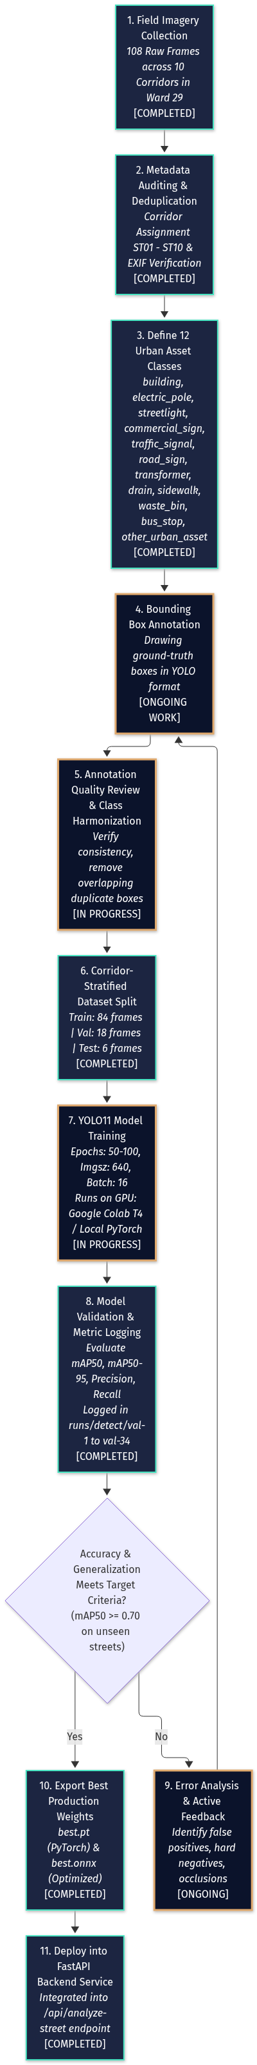
ROADMAP & ONGOING WORK
Active Engineering & Next Technical Milestones
Current priorities: verified ground truth, 100-epoch GPU retraining, and multi-view matching.
Active Annotation & Retraining Flow
Strategic Milestone Progression
Phase 1: Ground Truth Labeling [ACTIVE]
Manually re-verifying bounding boxes across all 108 frames to ensure tight boundaries and resolve pole/foliage confusion.
Phase 2: 100-Epoch GPU Retrain [NEXT SPRINT]
Execute full PyTorch fine-tuning on Colab T4 / EC2 G4dn targeting mAP50 >= 0.75 on unseen test corridors ST09 & ST10.
Phase 3: Multi-View Matching [PLANNED]
Deploy Hungarian matching algorithm on visual embeddings to merge duplicate observations from moving dashcams.
Phase 4: City-Wide Scaling [LONG-TERM]
Scale from Ward 29 pilot to all 100 wards of Coimbatore City Municipal Corporation via AWS Serverless cloud.
Notes:
Our active engineering focus is re-annotation and GPU retraining as shown in Diagram 5. Then we deploy multi-view Hungarian matching to merge cross-frame detections.

Slide 10
CONCLUSION & IMPACT
Transforming Urban Governance with Visual Evidence
From subjective manual surveys to auditable municipal digital twins.
Municipal Revenue Protection
Public Electrical Safety
Uncovers unassessed commercial hoarding and floor expansions through multilingual OCR and building facade analysis, recovering critical municipal revenue for CCMC.
Identifies leaning electric poles and vegetation encroachment near distribution transformers before monsoons, preventing power outages and electrocution hazards.
Nighttime Mobility & Safety
100% Offline & Auditable
Pinpoints unlit poles and dark-spot intervals (> 35m) to direct priority streetlight infill, enhancing pedestrian safety and women's nighttime mobility.
Runs locally on municipal infrastructure without third-party cloud lock-in. Every work order attaches verifiable image crops, eliminating departmental disputes.
Notes:
To conclude, FarmwiseAI turns visual evidence into actionable municipal ledgers. We provide cities with an auditable path to digital twin governance. We now welcome questions and live demo interaction.

