Slide 1

DevOps
By Vaijinath Harbak

Slide 2

DevOps
Overview

Slide 3

Why DevOps?

Slide 4
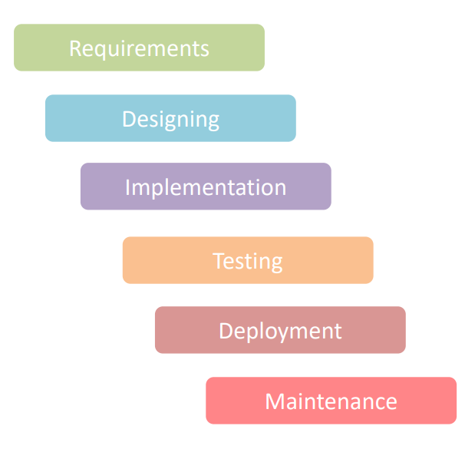
Waterfall Model
In the early year of software development when it was just coming up, waterfall model was used.
Waterfall model is a very standard model used in many different fields, not just software development.
It was very useful when the requirements were concrete and the development cycles were long.

Slide 5
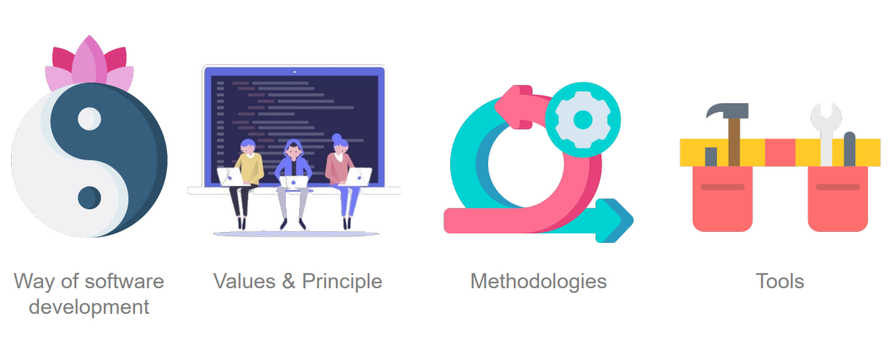
What is DevOps?

Slide 6
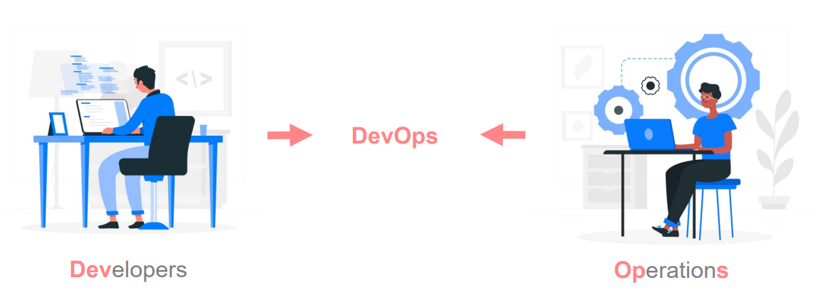
What is DevOps?
The name DevOps comes from Developer and Operations. DevOps bridges the communication gap between the software developers and the It operation teams.

Slide 7

What is DevOps?
“DevOps is a set of practices that combines software development (Dev) and IT operations (Ops). It aims to shorten the systems development life cycle and provide continuous delivery with high software quality. DevOps is complementary with Agile software development; several DevOps aspects came from Agile methodology.”

Slide 8
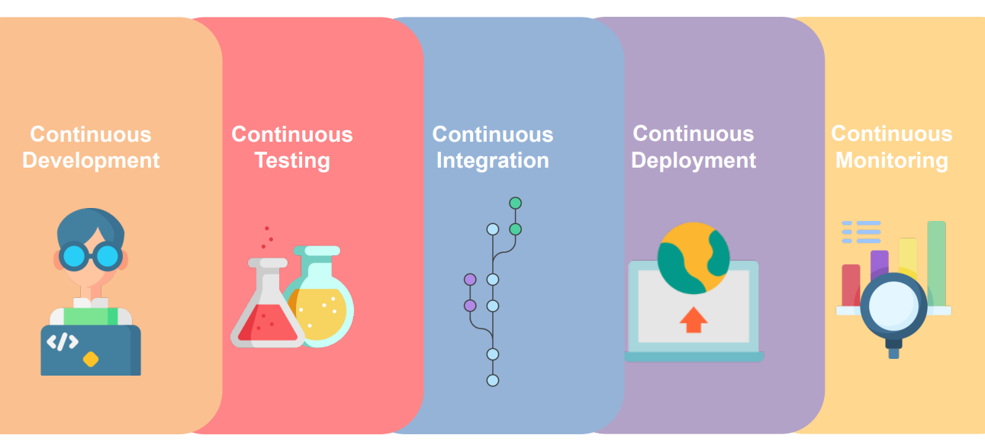
DevOps Phases

Slide 9

Who is a DevOps Engineer?

Slide 10
DevOps Engineer
Basically a DevOps engineer is responsible for designing, maintaining the software development pipeline. He also makes sure that a software is deployed properly without any issues. A DevOps engineer knows how to automate processes and writing automation scripts. He also knows how to keep the whole infrastructure secure and robust.
A DevOps engineer has excellent communication skills that help him to convey ideas and exchange information between different teams.
On daily level, a DevOps engineer is responsible for makes sure scaling needs of cloud are fulfilled, optimization, managing permissions, documentations

Slide 11
DevOps Engineer
A DevOps engineer has a wealth of knowledge such as:
• Knowledge of Linux, Windows Operating Systems
• Database Tech
• Server Tech
• Orchestration
• Cloud tech
• Source Control
• Continuous integration & Deployment
• Automation
• Scripting
• Excellent Communication

Slide 12
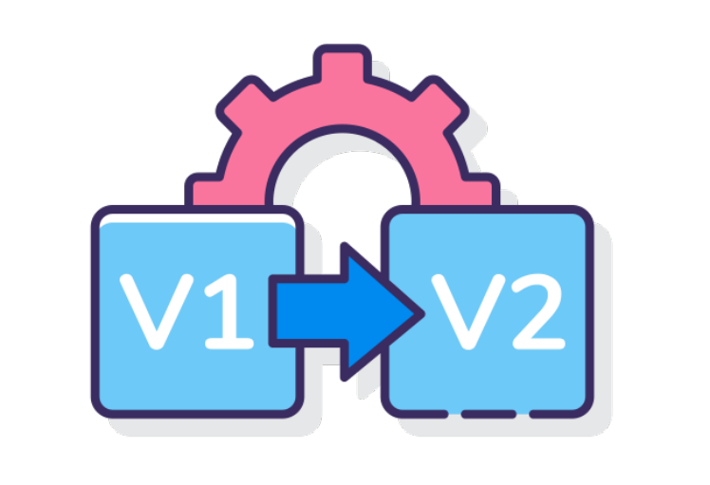
What is Version Control?

Slide 13
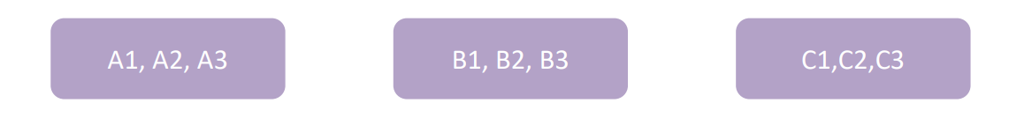
What is Version Control?
These days when software is developed, It is not developed with the mind-set that there will only be one piece of code that will be deployed and that’s it. These days smaller snippets of code are deployed in regular successions with regular feedbacks. This leads to many different versions of the code.
And that creates a need to organize the code and all of its different version of it. This is where Version Control comes in. It is a practice of managing and storing different version of a source code.
This is especially the case with Larger companies that have multiple projects and multiple teams working within it.

Slide 14
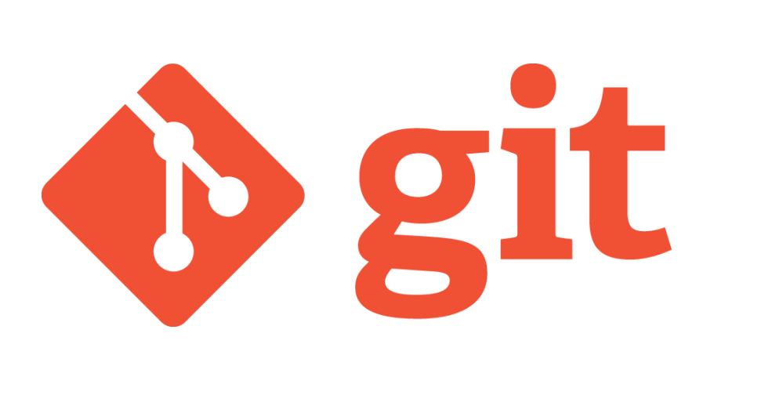
What is Git?

Slide 15
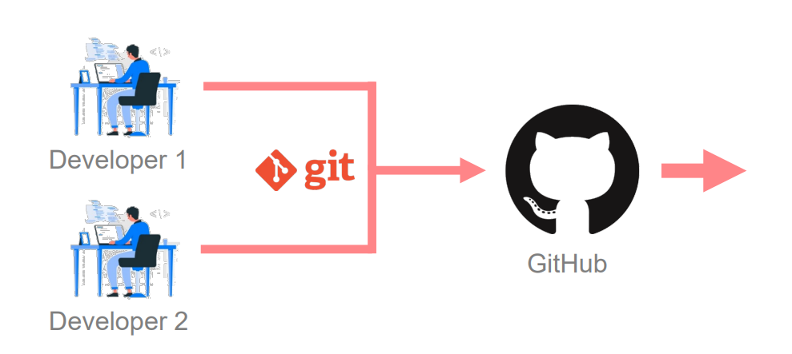
What is Git?
Git is an open source version control system that allows the user to keep track of all the changes that have been made to the source code of the software.

Slide 16
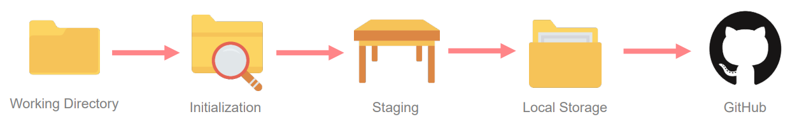
What is Git?
The lifecycle of the code within Git.

Slide 17
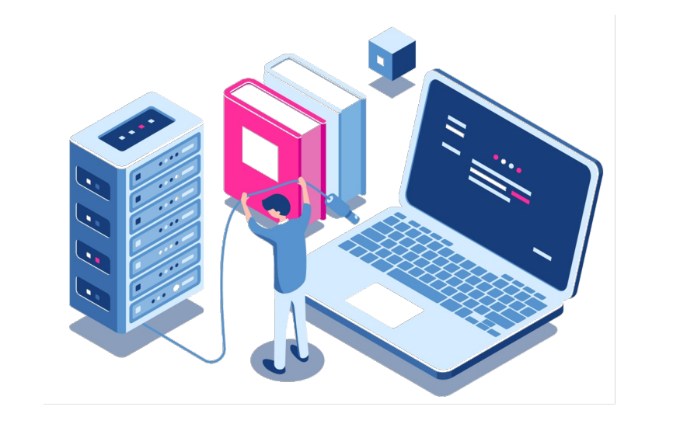
Installing & Configuring Git

Slide 18
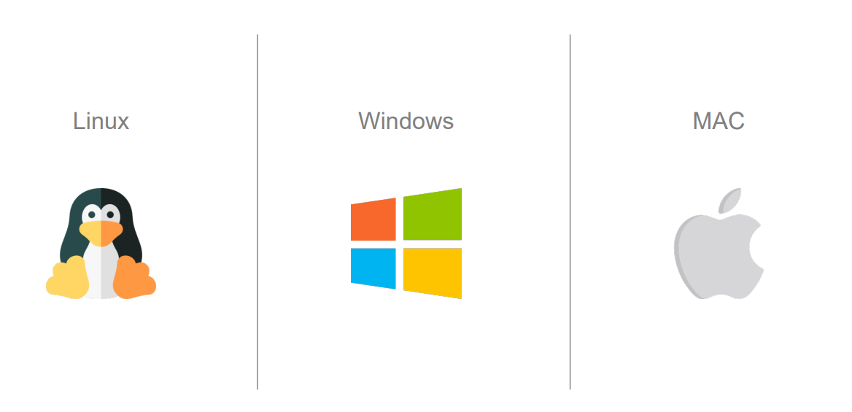
Git Installation & Setup
https://git-scm.com/downloads

Slide 19
Common Git Commands
Git Init
This is used for initializing your local folder(working directory) as local Git Repository.
Git status
This is used for checking the status of your local Git Repository. Like, what are the updated or newly added file to your local git repository.
Git add <filename>
This is used for adding all the updated or newly added file to the staging area so that you can commit those files to your local Git Repository.
Git commit -m "<comment>“
This is used for saving or commit the staged changes to your local Git Repository.
git remote add origin <remote repo path>
This is used for mapping your remote git repository with your local Git Repository. So that when you push the committed changes, those will get pushed to your remote repository
git push –u origin main
This is used to push you committed changes to you remote repository.

Slide 20
Git Branching
Main branch
Production env
Develop branch (child of Main
Feature branch 1
Feature branch 2
Feature branch 3
Feature branch 4
Feature branch 5

Slide 21
Advanced Git Commands
git clone
cloning/getting your existing remote repository to you local
git pull
get/download the latest changes from the remote branch
git fetch
fetch down all the branches from remote repository
git branch
list all the branches from your local repository. A '*' will appear next to the current active branch
git branch <branch name>
Creates new branch
git checkout <branch name>
switch to the given branch
git reset <file name>
unstage but keeps the changes in the working derectory for the given file
git restore --stage <filename>
unstage and undo changes from the working directory
git reset head~1
undoing your last one commit

Slide 22
Advanced Git Commands
Chery-Pick
Used for merging a particular commit from one branch to another branch.
First you need to checkout to the target branch
Use command-
git cherry-pick <commitid>
Commit the changes and push it to remote target branch

Slide 23
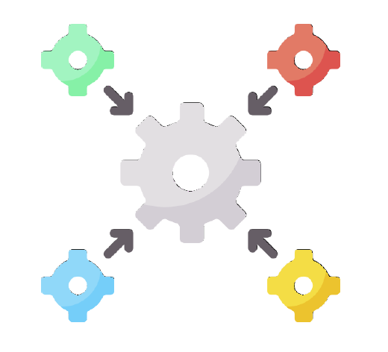
Continuous Integration -Jenkins

Slide 24
Agenda
Why Continuous integration?
What is Jenkins?
What are Jenkins Features?
Jenkins architecture
Jenkins installation & setup
Setting up a CI/CD pipeline

Slide 25
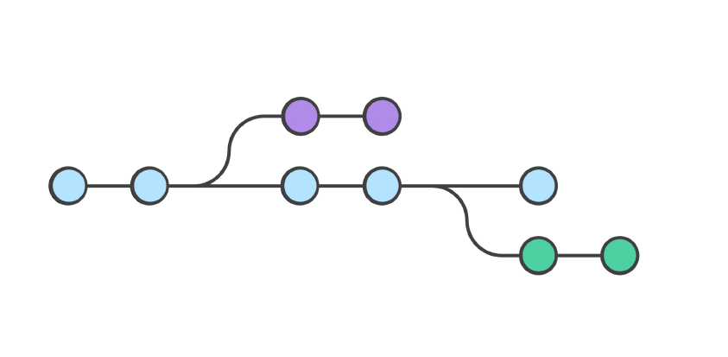
Why Continuous Integration?

Slide 26
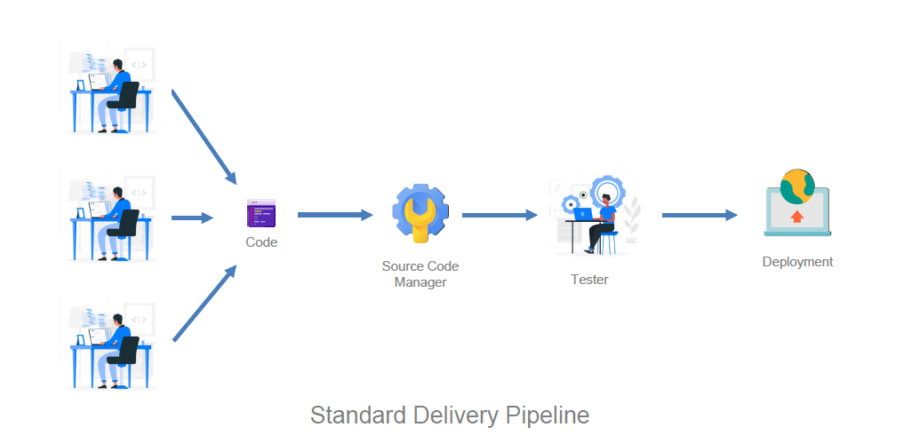
Why Continuous Integration?

Slide 27

What is Jenkins?

Slide 28
What is Jenkins?
Jenkins is an Open Source continuous integration tool written in java that allows us to automate the software development process, making sure that there is minimum involvement from us. It also integrates all the different parts of the development.

Slide 29
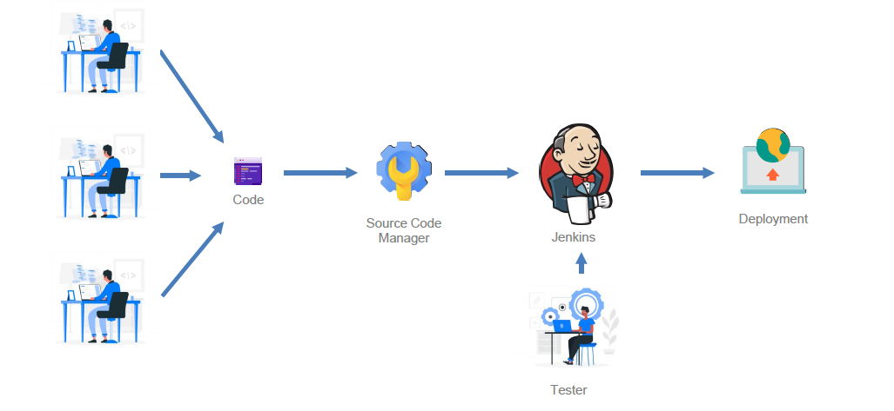
What is Jenkins?

Slide 30
Benefits of Jenkins?
Jenkins is a community tool – Its open source and has a very very large community that contributes to it regularly.
It’s free, so you don’t have to accrue anymore subscription costs.
It is highly modifiable and adaptable and has a support for a very large number of plugins.
It can run on any major platform without any compatibility issues.
Azure DevOps
TFS (Team Foundation Server)

Slide 31
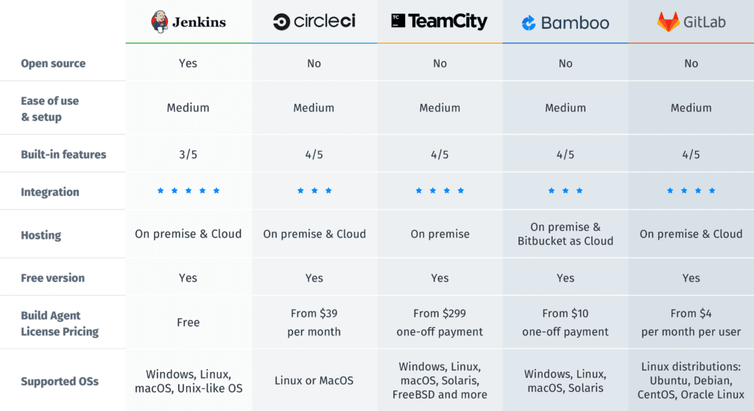
Parallel Tools with Jenkins

Slide 32
Jenkins Features
Easy Installation
Easy Configuration
Available Plugins
Extensible
Easy Distribution
Free Open Source

Slide 33
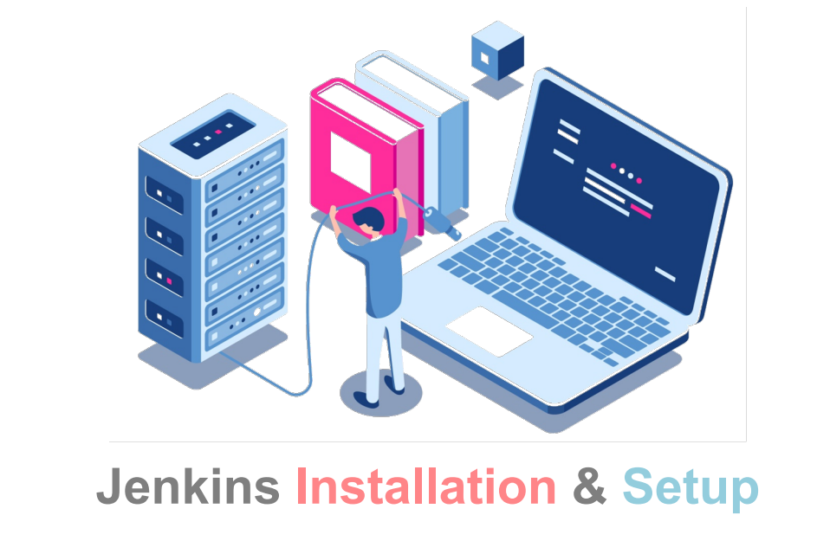

Slide 34
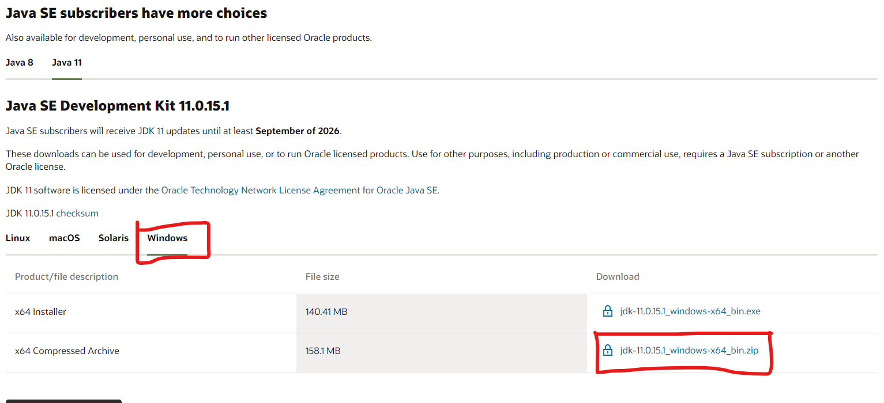
Jenkins Installation & Setup
Jenkins s developed in Java so it requires Java 8 or Java 11 are required for running modern versions of Jenkins. First we need to install Java 11 or Java 8 on our machine if not installed already.
To install Java follow below steps
Step1: Download Java 11
Download Java 11 from below link
https://www.oracle.com/java/technologies/downloads/#java11

Slide 35
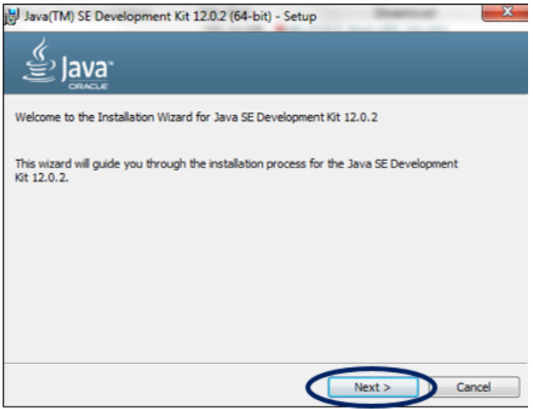
Java Installation
Step 2: Install Java
Once you download the Java 11, double click on the setup file (downloaded .exe/.msi file) and click on Next

Slide 36
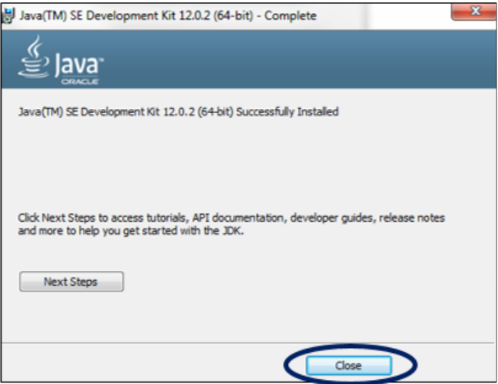
Java Installation
Once you download the Java 11, double click on the setup file (downloaded .exe/.msi file) and click on Next

Slide 37
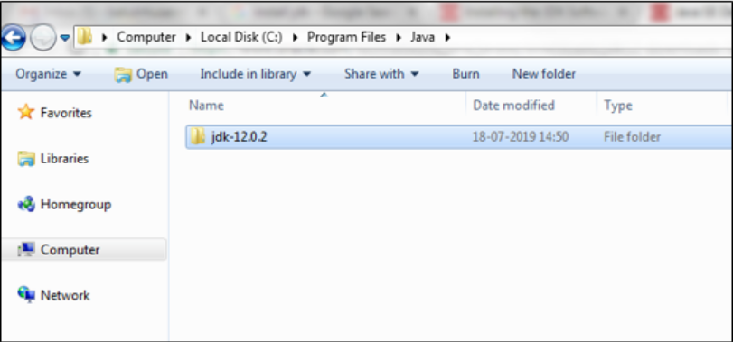
Java Installation
Step 3: Check the Directory
JDK gets installed in the C directory of our system by default having the path “C:\Program Files\Java\jdk-12.0”. If we make any change to this path at all, we need to make a note of it as it will be required in the upcoming steps.

Slide 38
Java Installation
Step 4: Update the Environment Variables
Right-click the Computer icon on your desktop and select Properties.
Click Advanced system settings.
Click Environment variables.
Under System variables, locate Path.
Select the Path variable and click on Edit.
Add the path of your JDK installation directory. For example, C:\Program Files \Java\jdk1.8.0_281.
Click OK.

Slide 39
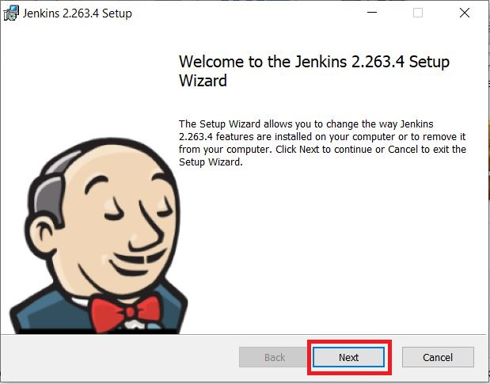
Jenkins Installation & Setup
Step 1: Setup wizard
On opening the Windows Installer, an Installation Setup Wizard appears, Click Next on the Setup Wizard to start your installation

Slide 40
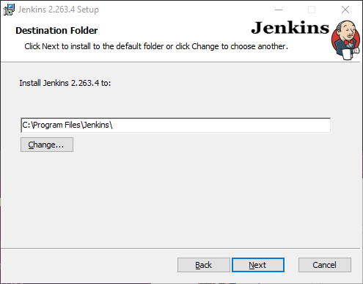
Step 2: Select destination folder
Select the destination folder to store your Jenkins Installation and click Next to continue.

Slide 41
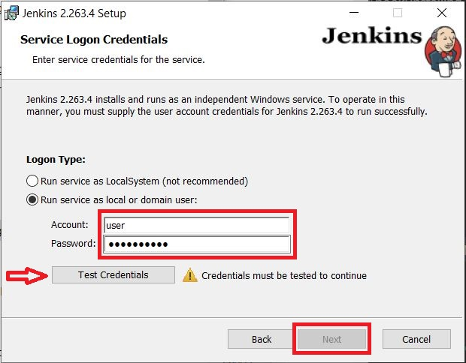
Step 3: Service logon credentials
When Installing Jenkins, it is recommended to install and run Jenkins as an independent windows service using a local or domain user as it is much safer than running Jenkins using LocalSystem(Windows equivalent of root) which will grant Jenkins full access to your machine and services.

Slide 42
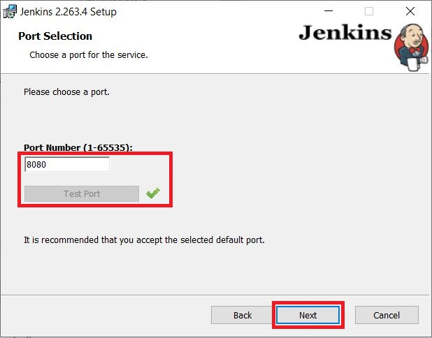
Step 4: Port selection
Specify the port on which Jenkins will be running, Test Port button to validate whether the specified port if free on your machine or not. Consequently, if the port is free, it will show a green tick mark as shown below, then click on Next.

Slide 43
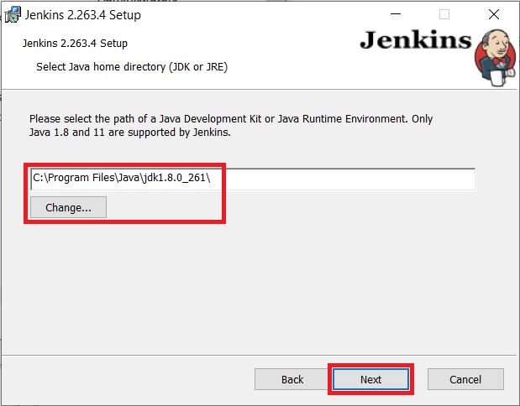
Step 5: Select Java home directory

Slide 44
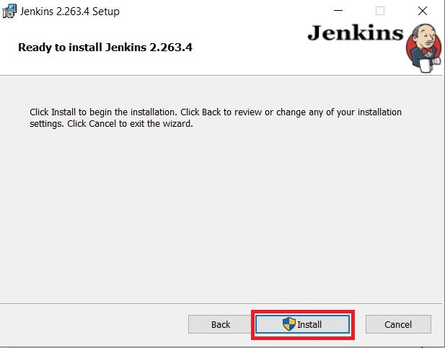
Step 6: Install Jenkins

Slide 45
Post-installation setup wizard
Unlocking Jenkins
When you first access a new Jenkins instance, you are asked to unlock it using an automatically-generated password
Step 1
Browse to http://localhost:8080 (or whichever port you configured for Jenkins when installing it) and wait until the Unlock Jenkins page appears.

Slide 46
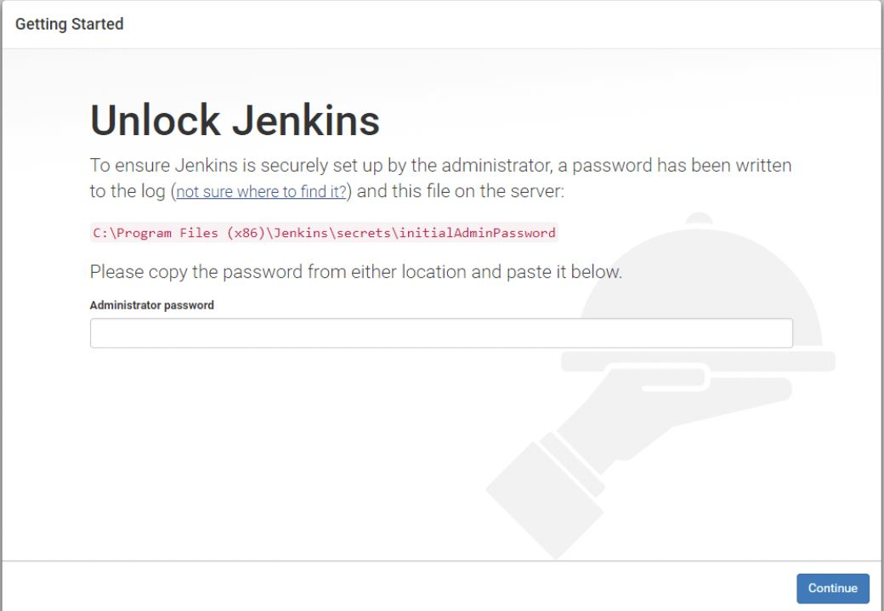

Slide 47
Post-installation setup wizard
Step 2: Find Initial Password
The initial Administrator password should be found under the Jenkins installation path (set at Step 2 in Jenkins Installation).
For default installation location to C:\Program Files\Jenkins, a file called initialAdminPassword can be found under C:\Program Files\Jenkins\secrets.
However, If a custom path for Jenkins installation was selected, then you should check that location for initialAdminPassword file.

Slide 48
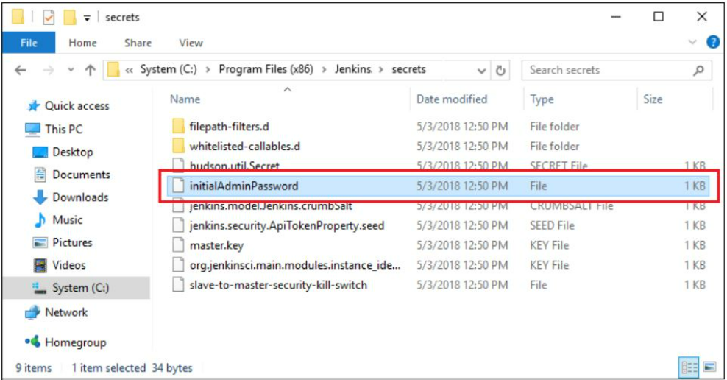

Slide 49
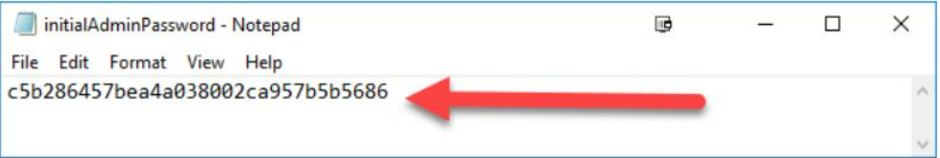
Post-installation setup wizard
Step 3: Enter Initial Password
Open the highlighted file and copy the content of the initialAdminPassword file.
On the Unlock Jenkins page, paste this password into the Administrator password field and click Continue.
After unlocking Jenkins, the Customize Jenkins page appears. Here you can install any number of useful plugins as part of your initial setup.
Click one of the two options shown:
Install suggested plugins - to install the recommended set of plugins, which are based on most common use cases.
Select plugins to install - to choose which set of plugins to initially install. When you first access the plugin selection page, the suggested plugins are selected by default.

Slide 50
General Terms
Agent
An agent is typically a machine, or container, which connects to a Jenkins controller and executes tasks when directed by the controller.
Artifact
An immutable file generated during a Build or Pipeline run which is archived onto the Jenkins Controller for later retrieval by users.
Build
Result of a single execution of a job
Controller
The central, coordinating process which stores configuration, loads plugins, and renders the various user interfaces for Jenkins.
Core
The primary Jenkins application (jenkins.war) which provides the basic web UI, configuration, and foundation upon which Plugins can be built.

Slide 51
General Terms
Executor
A slot for execution of work defined by a Pipeline or job on a Node. A Node may have zero or more Executors configured which corresponds to how many concurrent Jobs or Pipelines are able to execute on that Node.
Node
A machine which is part of the Jenkins environment and capable of executing Pipelines or jobs. Both the Master and Agents are considered to be Nodes.
Pipeline
A user-defined model of a continuous delivery pipeline, for more read the Pipeline chapter in this handbook.
Release
An event, indicating availability of Jenkins distribution products or one of Jenkins plugins. Jenkins products belong either to LTS or weekly Release lines.
Stage
stage is part of Pipeline, and used for defining a conceptually distinct subset of the entire Pipeline, for example: "Build", "Test", and "Deploy", which is used by many plugins to visualize or present Jenkins Pipeline status/progress.
Step
A single task; fundamentally steps tell Jenkins what to do inside of a Pipeline or job.

Slide 52
Thank You

