Slide 1

DevOps
By Vaijinath Harbak

Slide 2

DevOps
Overview

Slide 3

Why DevOps?

Slide 4
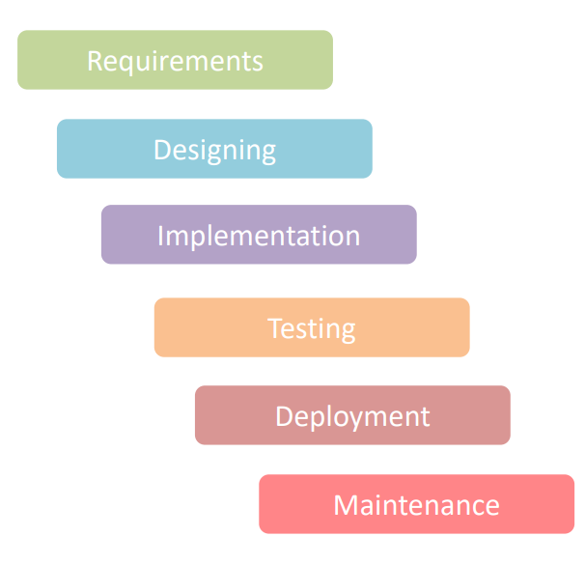
Waterfall Model
In the early year of software development when it was just coming up, waterfall model was used.
Waterfall model is a very standard model used in many different fields, not just software development.
It was very useful when the requirements were concrete and the development cycles were long.

Slide 5
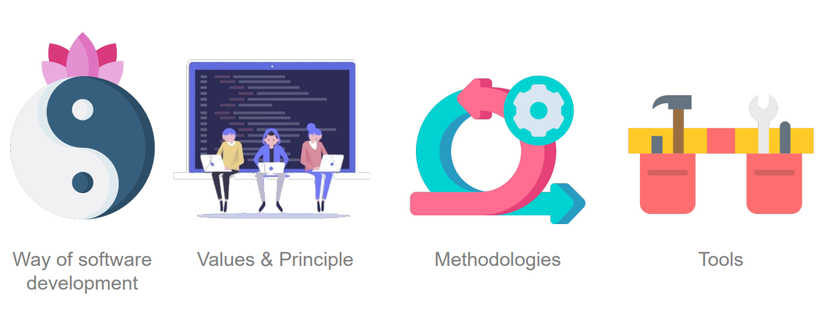
What is DevOps?

Slide 6
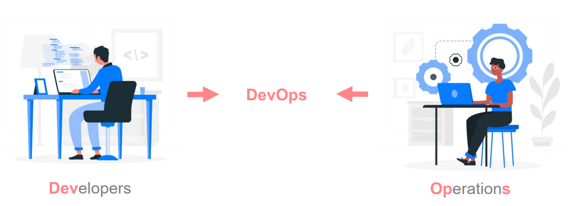
What is DevOps?
The name DevOps comes from Developer and Operations. DevOps bridges the communication gap between the software developers and the It operation teams.

Slide 7

What is DevOps?
“DevOps is a set of practices that combines software development (Dev) and IT operations (Ops). It aims to shorten the systems development life cycle and provide continuous delivery with high software quality. DevOps is complementary with Agile software development; several DevOps aspects came from Agile methodology.”

Slide 8
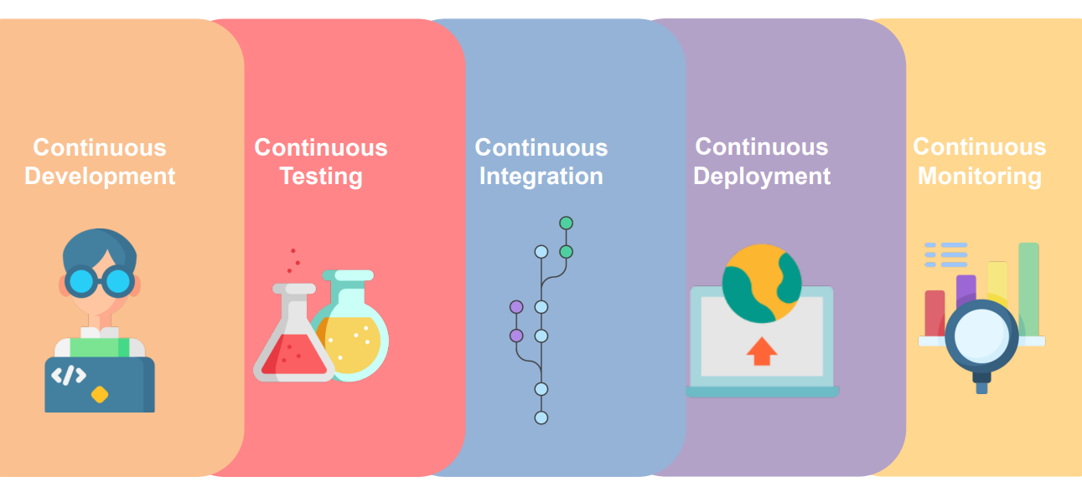
DevOps Phases

Slide 9

Who is a DevOps Engineer?

Slide 10
DevOps Engineer
Basically a DevOps engineer is responsible for designing, maintaining the software development pipeline. He also makes sure that a software is deployed properly without any issues. A DevOps engineer knows how to automate processes and writing automation scripts. He also knows how to keep the whole infrastructure secure and robust.
A DevOps engineer has excellent communication skills that help him to convey ideas and exchange information between different teams.
On daily level, a DevOps engineer is responsible for makes sure scaling needs of cloud are fulfilled, optimization, managing permissions, documentations

Slide 11
DevOps Engineer
A DevOps engineer has a wealth of knowledge such as:
• Knowledge of Linux, Windows Operating Systems
• Database Tech
• Server Tech
• Orchestration
• Cloud tech
• Source Control
• Continuous integration & Deployment
• Automation
• Scripting
• Excellent Communication

Slide 12
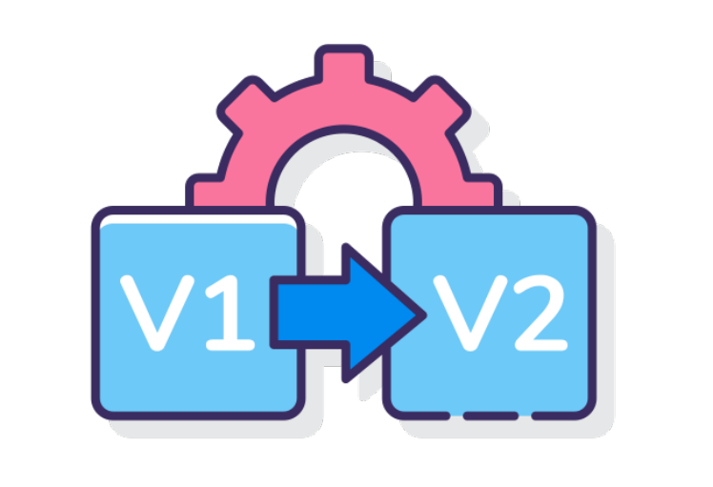
What is Version Control?

Slide 13
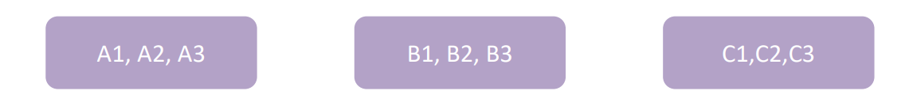
What is Version Control?
These days when software is developed, It is not developed with the mind-set that there will only be one piece of code that will be deployed and that’s it. These days smaller snippets of code are deployed in regular successions with regular feedbacks. This leads to many different versions of the code.
And that creates a need to organize the code and all of its different version of it. This is where Version Control comes in. It is a practice of managing and storing different version of a source code.
This is especially the case with Larger companies that have multiple projects and multiple teams working within it.

Slide 14
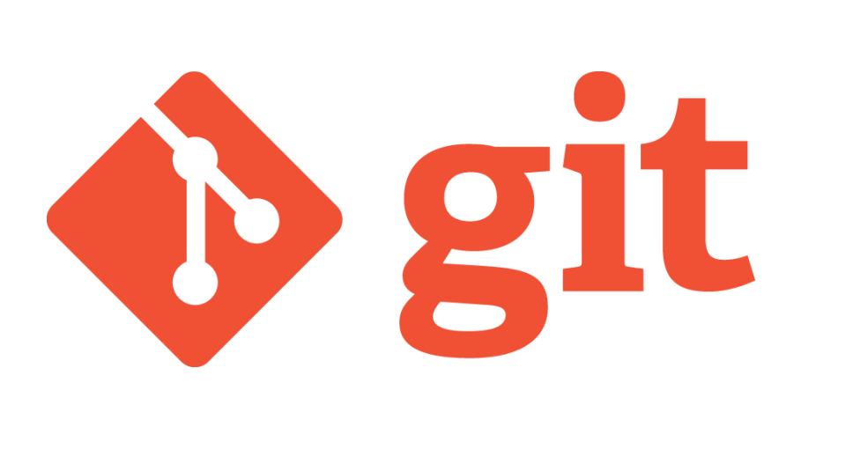
What is Git?

Slide 15
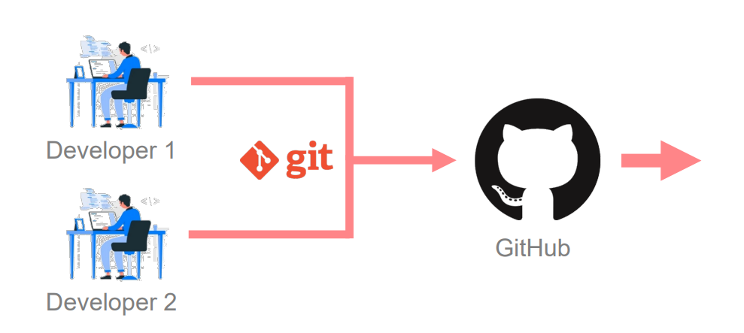
What is Git?
Git is an open source version control system that allows the user to keep track of all the changes that have been made to the source code of the software.

Slide 16
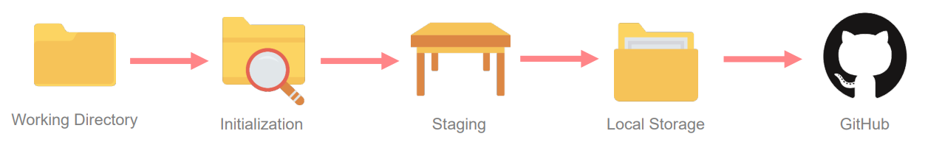
What is Git?
The lifecycle of the code within Git.

Slide 17
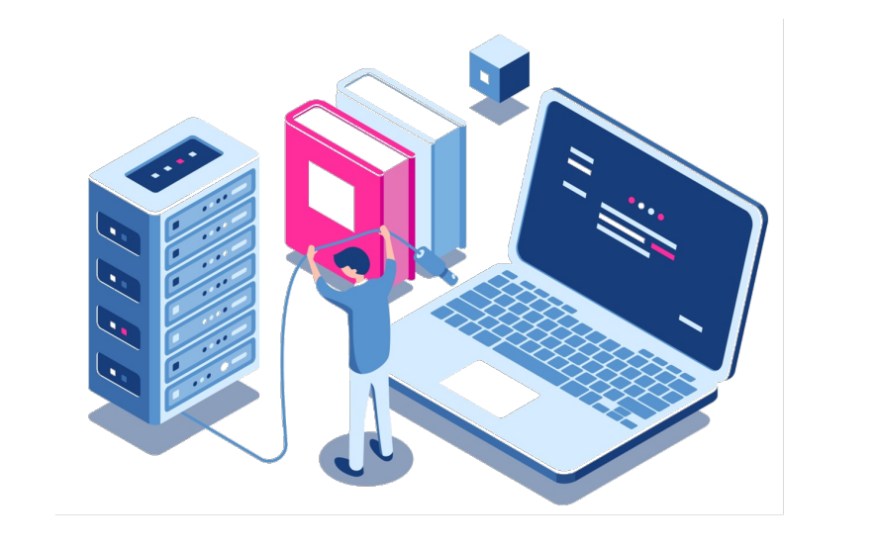
Installing & Configuring Git

Slide 18
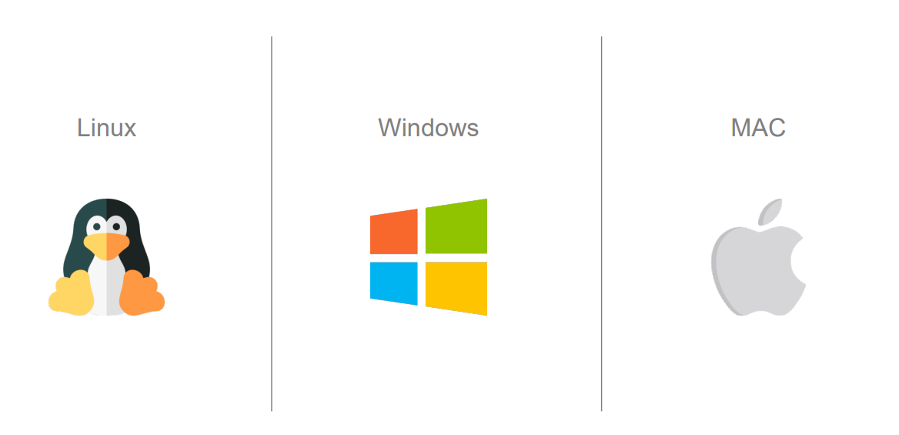
Git Installation & Setup
https://git-scm.com/downloads

Slide 19
Common Git Commands
Git Init
This is used for initializing your local folder(working directory) as local Git Repository.
Git status
This is used for checking the status of your local Git Repository. Like, what are the updated or newly added file to your local git repository.
Git add <filename>
This is used for adding all the updated or newly added file to the staging area so that you can commit those files to your local Git Repository.
Git commit -m "<comment>“
This is used for saving or commit the staged changes to your local Git Repository.
git remote add origin <remote repo path>
This is used for mapping your remote git repository with your local Git Repository. So that when you push the committed changes, those will get pushed to your remote repository
git push –u origin main
This is used to push you committed changes to you remote repository.

Slide 20
Git Branching
Main branch
Production env
Develop branch (child of Main
Feature branch 1
Feature branch 2
Feature branch 3
Feature branch 4
Feature branch 5

Slide 21
Advanced Git Commands
git clone
cloning/getting your existing remote repository to you local
git pull
get/download the latest changes from the remote branch
git fetch
fetch down all the branches from remote repository
git branch
list all the branches from your local repository. A '*' will appear next to the current active branch
git branch <branch name>
Creates new branch
git checkout <branch name>
switch to the given branch
git reset <file name>
unstage but keeps the changes in the working derectory for the given file
git restore --stage <filename>
unstage and undo changes from the working directory
git reset head~1
undoing your last one commit

Slide 22
Advanced Git Commands
Chery-Pick
Used for merging a particular commit from one branch to another branch.
First you need to checkout to the target branch
Use command-
git cherry-pick <commitid>
Commit the changes and push it to remote target branch

Slide 23
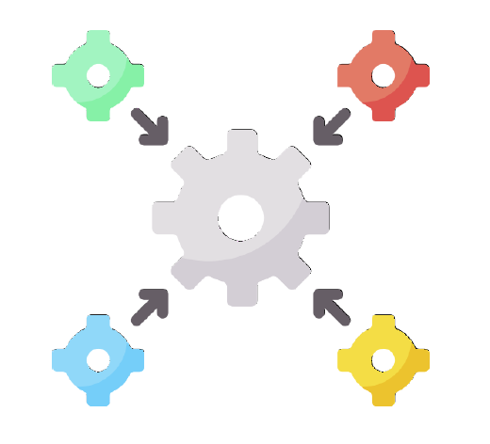
Continuous Integration -Jenkins

Slide 24
Agenda
Why Continuous integration?
What is Jenkins?
What are Jenkins Features?
Jenkins architecture
Jenkins installation & setup
Setting up a CI/CD pipeline

Slide 25
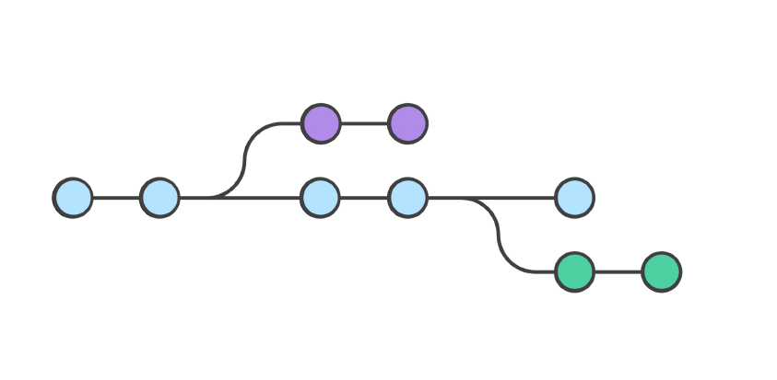
Why Continuous Integration?

Slide 26
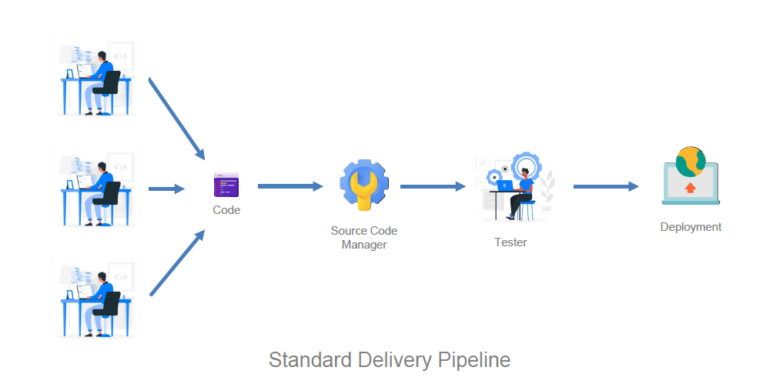
Why Continuous Integration?

Slide 27

What is Jenkins?

Slide 28
What is Jenkins?
Jenkins is an Open Source continuous integration tool written in java that allows us to automate the software development process, making sure that there is minimum involvement from us. It also integrates all the different parts of the development.

Slide 29
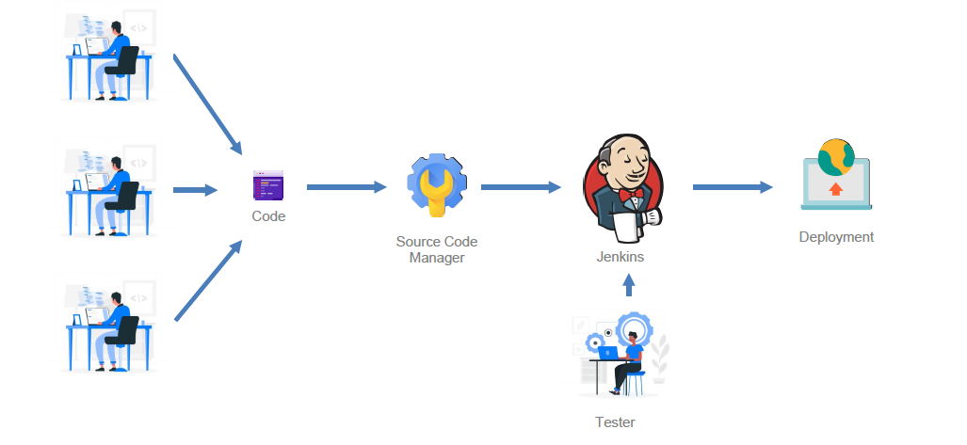
What is Jenkins?

Slide 30
Benefits of Jenkins?
Jenkins is a community tool – Its open source and has a very very large community that contributes to it regularly.
It’s free, so you don’t have to accrue anymore subscription costs.
It is highly modifiable and adaptable and has a support for a very large number of plugins.
It can run on any major platform without any compatibility issues.

Slide 31
Thank You

