Slide 1
Shell Bootcamp 2024 3 Reflections for Week #2
Vainavi Samant
Date : 30-Aug-2024

Slide 2

About Me
“Luck is just probability taken personally”

Slide 3

My learnings from this week!

Slide 4

Learning 1 | My takeaways
Soft Skills Day 1:
Types of performers(CART analogy)
Neuroplasticity
POWER technique
Email etiquettes

Slide 5
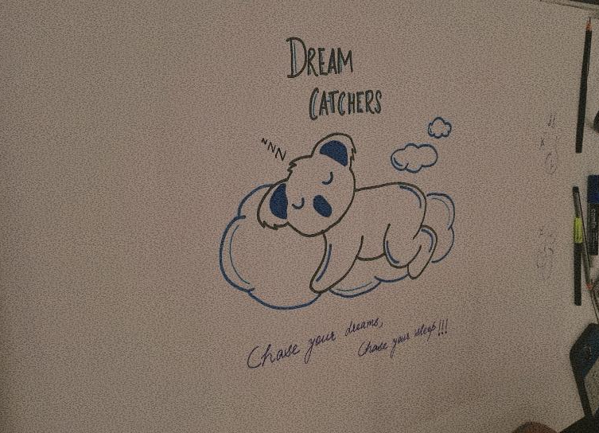
Learning 2 | My takeaways
Soft Skills Day 2 and 3:
Attitude and Mindset
Stakeholder
Interest Power Grid
Self Orientation
Tucker Model
Presentation skills

Slide 6
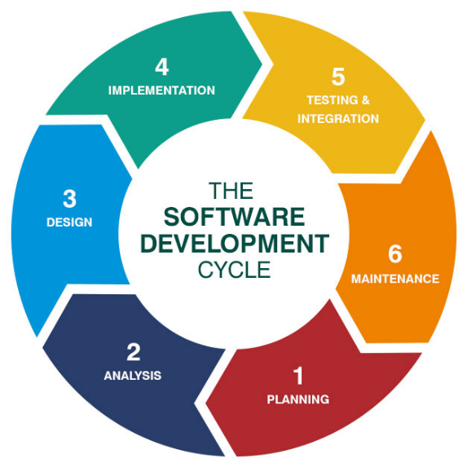
Learning 3 | My takeaways
Technical Bootcamp (Day 3)
Introduction to Business Analysis
SDLC (Software Development Life Cycle)
Requirement Analysis
Requirement Elicitation
Requirement modelling
Requirement Management Techniques (Work Breakdown, Gantt Chart, Critical Path Method, Waterfall method, Kanban, Scrum)

Slide 7

Relevance of learnings for my organization

Slide 8

Learning 1 | Relevance for Shell
The soft skills bootcamp day 1 covered essential topic like CART analogy which enhances teamwork and adaptability. The activities also helped foster effective communication methods.
Necessary email etiquettes were covered which will help one to be respectful while talking to anyone and allow workers be more productive. It taught us effective methods of communication.

Slide 9
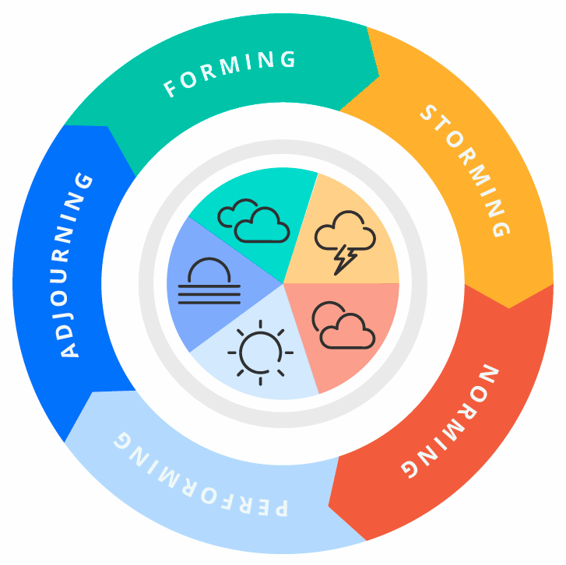
Learning 2 | Relevance for Shell
Shell implements effective communication and networking methods by methods like GTKYs. The bootcamp emphasized having a good attitude and positive work environment. Shell follows an open culture, and every worker is friendly with the other which shows a positive mindset.
Stakeholder management helped understand the internal and external stakeholders in Shell.

Slide 10
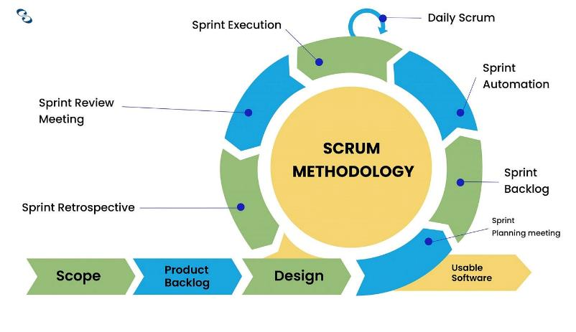
Learning 3 | Relevance for Shell
Business Analysis helps make informed decision making, greater revenue can be generated because of it. Iterative set of activities that help ensure that elicitation, documentation, refinement, and changes of requirements is adequately dealt with during a lifecycle.
Reduces cost, improves quality, decreases time taken, decreases risks, increased flexibility, continuous improvement are some benefits from AGILE. Shell follows a scrum based AGILE method which has a high efficiency of work done.

Slide 11

Challenges in implementing learning

Slide 12

Challenge faced while implementing Learning 1
Everyone was new and shy so no one was ready to share. But because of the activities, people started gelling with each other. Some parts were a bit long but were conveyed in a fun and understanding manner.

Slide 13

Challenge faced while implementing Learning 2
Stakeholder Management was a difficult topic to understand. But with the help of multiple activities about it, it was easy to understand the practical use of the same.
Teamwork activities were challenging in the beginning but helped nurture a bond.

Slide 14

Challenge faced while implementing Learning 3
Though I have done BA and Agile in college, it was a nice recap in the bootcamp. The concepts sounded heavy at first but were conveyed in a very easy manner. It does take some time to get through it in detail but it is necessary.

Slide 15

Action Plan

Slide 16
My Action Plan for this Week
Actions
Timeline
Status
Going through the concepts taught in Business analysis
Understand Agile process and scrum workflow
Practice DBMS
Saturday- Go through the Soft skills concepts
Sunday- Brush-up the concepts taught in Business Analysis
Status of the same by the end of the week

Slide 17

Learning is also Fun!

Slide 18
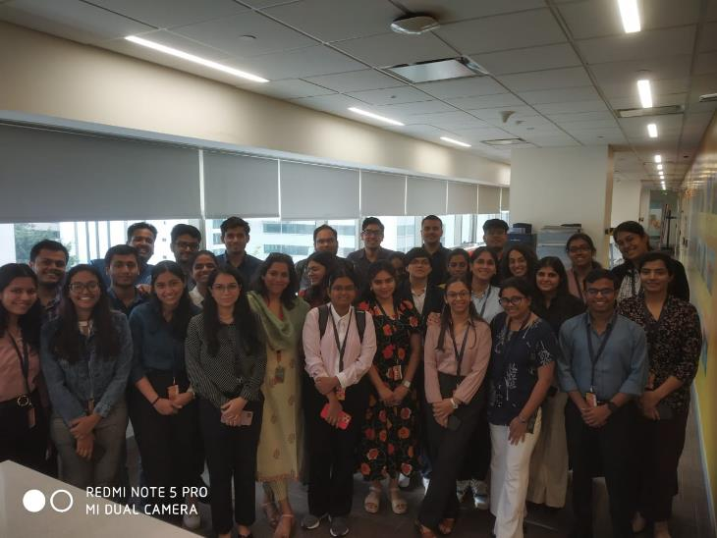
Learning is also Fun!
Nitya was very fun and was very encouraging for everyone to share their opinions. The activities were fun and very interactive. Exciting, engaging, fun, with a lot of learning which made the sessions fun. The best advice she gave which stuck a chord with a lot of us was not to take oneself too seriously.

Slide 19

Summary
Learned soft skills, BA & agile
Will revise DBMS learned from college
Software setup is needed.

Slide 20
Thank You

