Slide 1
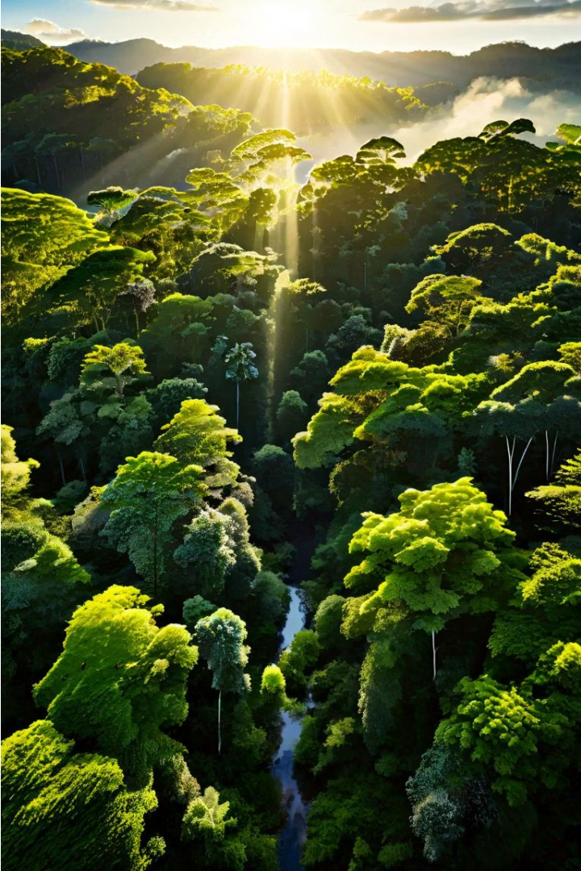

Examples of Biomimicry
By observing the natural world, we can draw inspiration from the ingenious solutions that have evolved over billions of years.
Va

Slide 2
Velcro and the Bur
The Inspiration
The Design
The Impact
Swiss inventor George de Mestral was inspired by the tiny hooks on the burs that clung to his clothing after a walk in the woods.
De Mestral's biomimetic invention, Velcro, replicates the hook-and-loop system found in the bur's structure, creating a strong, adjustable fastener.
Velcro has become a ubiquitous fastener, used in everything from clothing to spacecraft, demonstrating the power of taking cues from nature.

Slide 3
Sharkskin and Swimsuit Design
1
Drag Reduction
2
Biomimetic Fabric
3
Self-Cleaning Properties
The unique structure of sharkskin, with its tiny, v-shaped scales, helps reduce drag and increase swimming efficiency.
Swimsuit designers have created fabrics that mimic the sharkskin's texture, improving the speed and performance of competitive swimmers.
Sharkskin's rough texture also helps to repel dirt and debris, inspiring the development of self-cleaning surfaces.

Slide 4



Termite Mounds and Passive Cooling
Termite Mound Structure
Termite mounds have a complex network of tunnels and chambers that allow for efficient air circulation and temperature regulation.
Passive Cooling Principles
Architects have studied the termite mound's passive cooling system and applied similar principles to the design of energy-efficient buildings.
Sustainable Cooling Solutions
Biomimetic cooling systems inspired by termite mounds can reduce the need for energy-intensive air conditioning, promoting sustainable design.

Slide 5


Kingfisher Beak and Bullet Train Design
Beak Shape
Train Design
The smooth, streamlined beak of the kingfisher allows it to dive into water with minimal splash and resistance.
Japanese engineers studied the kingfisher's beak and applied the same principles to the design of the Shinkansen bullet train, reducing noise and energy consumption.

Slide 6
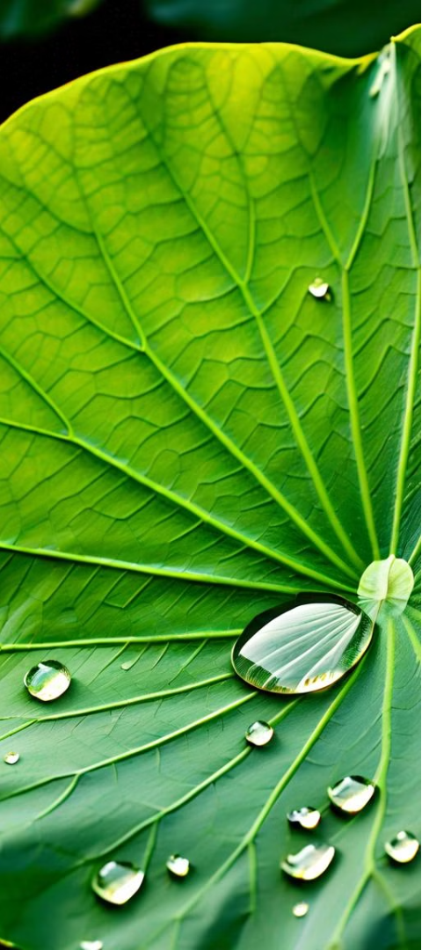
Lotus Leaf and Self-Cleaning Surfaces
Superhydrophobic Surface
Biomimetic Applications
The lotus leaf's surface is covered in microscopic bumps and a waxy coating, making it highly water-repellent and self-cleaning.
Engineers have created synthetic surfaces that mimic the lotus leaf's properties, leading to the development of self-cleaning paints, fabrics, and building materials.
Sustainable Solutions
Biomimetic self-cleaning surfaces reduce the need for harsh chemicals and water-intensive cleaning, promoting eco-friendly and low-maintenance solutions.

Slide 7
Spider Silk and Lightweight Fibers
Strength
Spider silk is five times stronger than steel, yet lighter and more flexible.
Elasticity
The unique molecular structure of spider silk allows it to stretch up to five times its original length without breaking.
Biomimetic Applications
Researchers are working to replicate the properties of spider silk to create lightweight, high-strength materials for use in everything from bulletproof vests to advanced textiles.

Slide 8
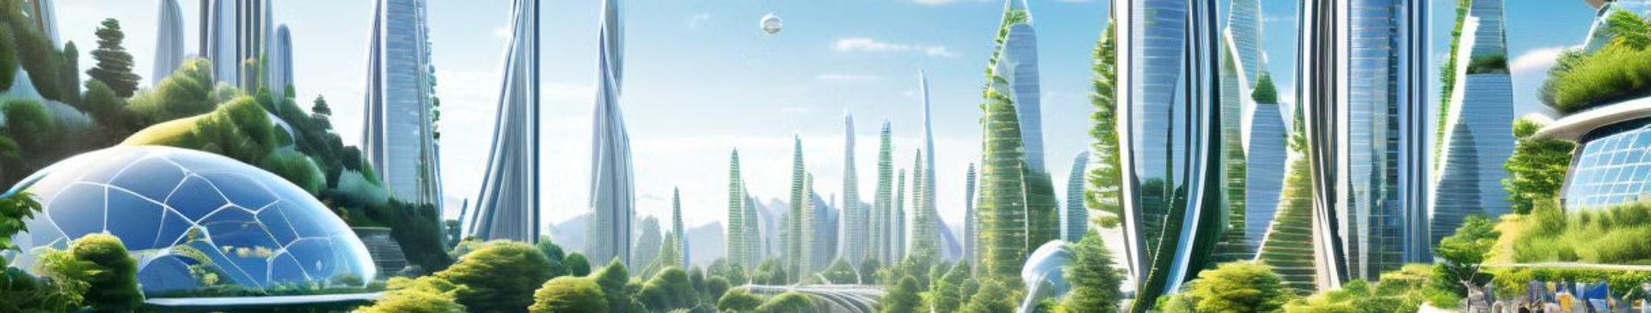
Conclusion and Future Applications
Biomimicry has already yielded numerous innovations, and the future holds even greater potential as we continue to draw inspiration from the natural world. As we face complex challenges, the solutions may be found in the remarkable designs and processes that have evolved over billions of years.

