Slide 1
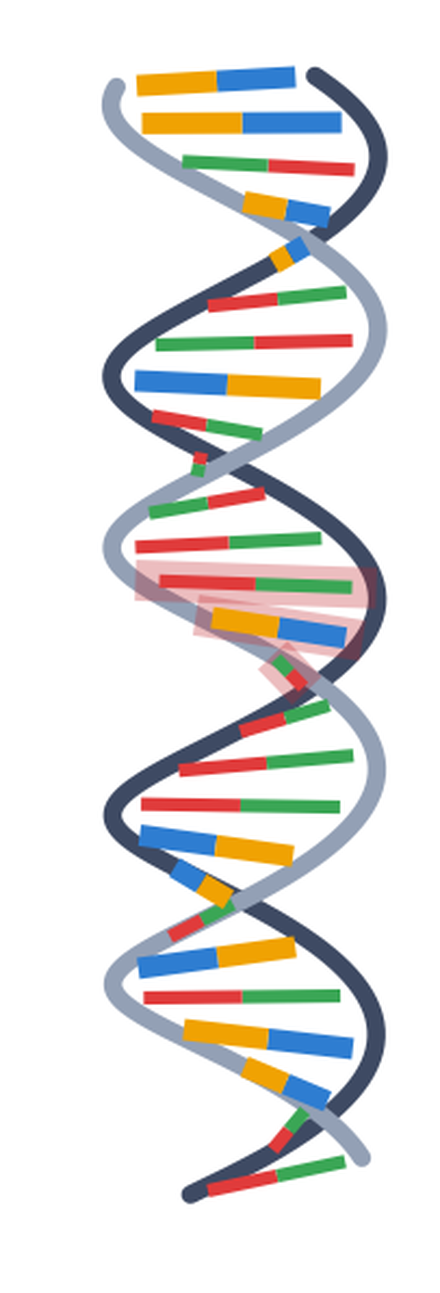
MINI-PROJECT · COMPARATIVE GENOMICS
From Trees to Traits
Finding the DNA behind a body feature, by comparing many animals
Bats and dolphins both hunt using echoes. They are not close relatives, so they learned this on their own. We looked for the DNA changes they made twice, separately.
GROUP MEMBERS
Vaishnavi Magadum
Adarsh Madivala
Bhavya Pandya
Avatar Pacharane
Sakshi Paradkar
Gene: prestin (SLC26A5) · 10 animals · all data downloaded from public databases
Notes:
Title slide. Two topics: PhyloG2P (finding which DNA change causes a body feature) and pan-genome graphs (a better way to store many genomes together). Both done on real downloaded data.

Slide 2
Topic 1: What is PhyloG2P?
A method to find which change in the DNA causes a feature in the body — by comparing many different animals.
Phylo
G
2
P
Why the tree matters
the family tree
of animals
Genotype
= the DNA
to
Phenotype
= the body feature
Two animals can share the same DNA letter for two very different reasons.
So the name simply means: use the family tree to connect DNA to a body feature.
Close relatives
How it works — three steps
They just inherited it from the same parent. This proves nothing.
1
Choose a feature
Pick something some animals have and others do not. Here: hunting by echo.
2
Compare the same gene
Distant relatives
Line up that gene from every animal and read it letter by letter.
They must have changed it separately, on their own. This is real evidence.
3
Find the odd spot
Look for one spot where every animal WITH the feature has the same letter, and no animal without it does.
Changing the same letter twice, separately, is called convergent evolution.
Notes:
Slide 2: PhyloG2P explained in plain words. The key point is the tree: shared letters only count as evidence when the species are distant relatives.

Slide 3
Topic 2: What is a pan-genome graph?
A way to store many genomes together, instead of treating one animal's DNA as the only correct version.
!
The problem
✓
The fix
Normally we pick one genome and call it the reference. Everyone else is compared to it. Anything missing from that one genome becomes invisible. This is called reference bias.
A graph keeps every version at the same time. Where all genomes agree, they share one box. Where they differ, the path splits into a bubble and then joins back.
The idea in one picture
TCA
G
CA
TG
the longer version simply cannot be shown
One linear reference
CA
Pan-genome graph
TCA
G
TG
both versions are kept — the extra letters are visible
CATTGA
Why it is useful: big insertions and deletions become easy to see · no single genome is treated as the “correct” one · important in medicine, where a patient's DNA often does not match the standard reference.
Notes:
Slide 3: pan-genome graphs. Shared parts share a box; differences open a bubble. The bubble in the diagram holds an insertion - four extra letters.

Slide 4
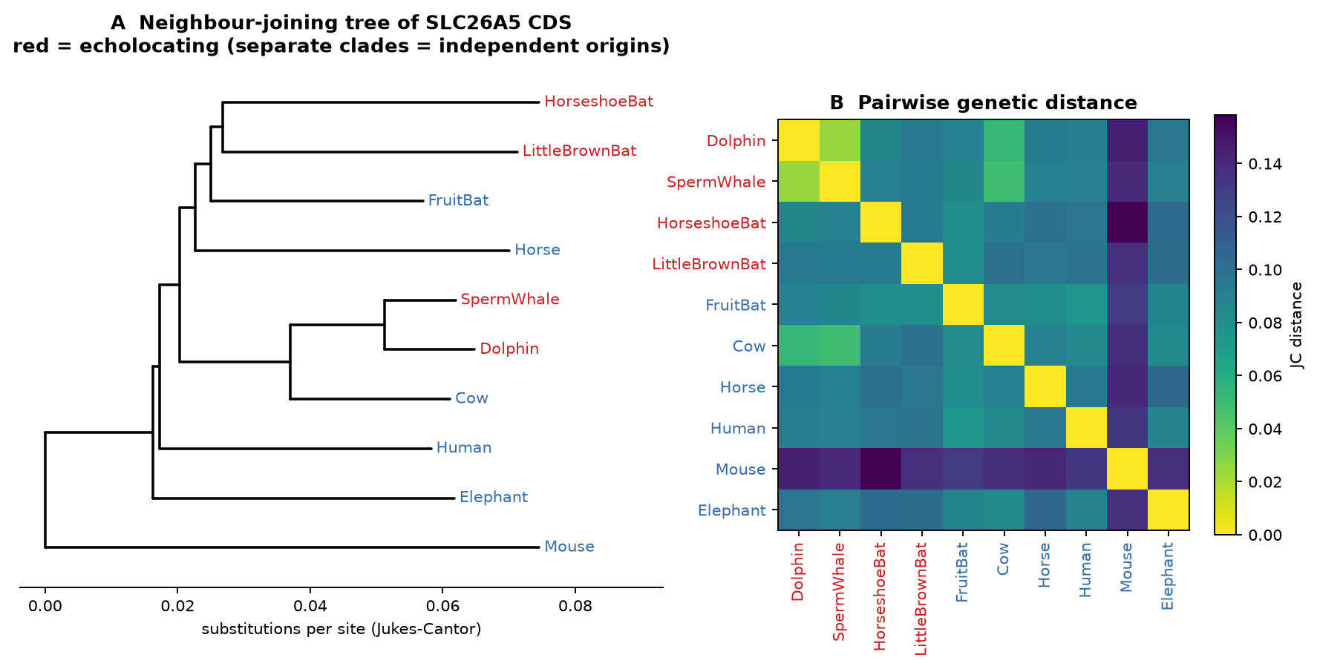
What our project is, and why we did it
We took both ideas above and tested them on one real gene, using real DNA from 10 animals.
Our aim
Find the DNA changes linked to hunting by echo — and check whether the method really works.
Why this gene?
Prestin is the protein that makes hearing sharp. It sits in the inner ear. Animals that hunt by echo need very good high-pitch hearing.
Why this feature?
Bats and dolphins both hunt by echo, but they are not close relatives. Their shared ancestor could not do it. So they developed it twice, separately.
What the family tree shows
The red animals (the ones that hunt by echo) sit in two separate branches, far apart. The fruit bat, which does not hunt by echo, sits right next to the bats that do. This is exactly the pattern we need.
Why these controls?
We added a fruit bat (a bat that does NOT hunt by echo) and a cow (the dolphin's closest relative that does not). If our result is real, these two must not show the change.
Notes:
Slide 4: the aim, the gene, the feature, and the two control animals. The tree proves echolocation appeared twice here.

Slide 5
How we did it
All DNA is downloaded from public databases while the program runs. Nothing is made up or copied by hand.
NCBI
UniProt
The DNA of the prestin gene for all 10 animals
Which part of the protein sits inside the cell, and which part crosses the membrane
What the program does, step by step
1
2
3
4
5
Line up the genes
Draw the family tree
Score every position
Test the result
Build the graph
Put the same gene from all 10 animals side by side, letter under letter.
Work out which animals are close relatives and which are not.
At each spot, check if the echo-hunters share a letter the others do not have.
Give the label to 4 random animals, 10,000 times. Only 126 of those runs matched our result.
Join the parts that are the same, and open a bubble where they differ.
10
744
10,000
0.0127
animals compared
protein letters
statistical tests
p-value: 1 in 79 by chance
Notes:
Slide 5: data sources and the five steps, in plain words.

Slide 6
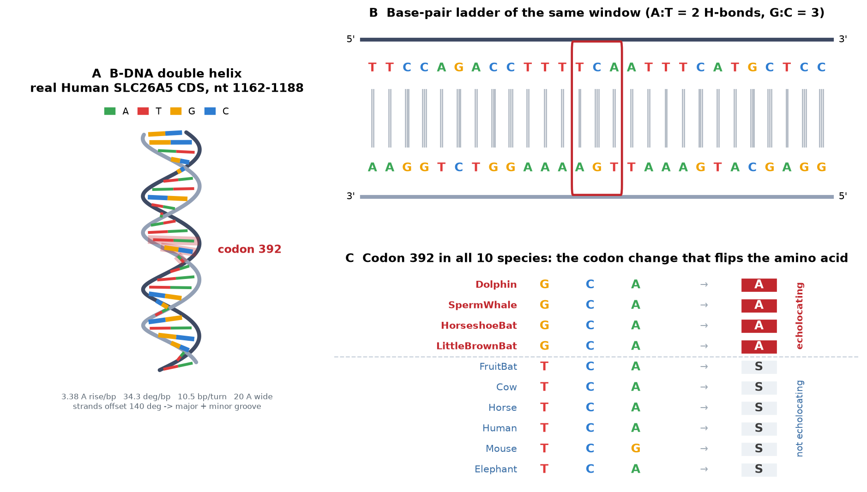
Seeing the DNA itself
We drew the real DNA of the prestin gene, using the true shape and measurements of a DNA molecule.
A · The double helix
Drawn with the real measurements of DNA. The two strands are not exactly opposite each other, which is what makes the wide and narrow grooves.
B · The letters
A always pairs with T, and G always pairs with C. G–C pairs are held by three bonds, A–T by only two.
C · The answer
All four echo-hunters read GCA here. All six other animals read TCA or TCG. One letter is different.
Notes:
Slide 6: the DNA drawing. Panel C is the key result - a single letter change that bats and whales both made, on their own.

Slide 7
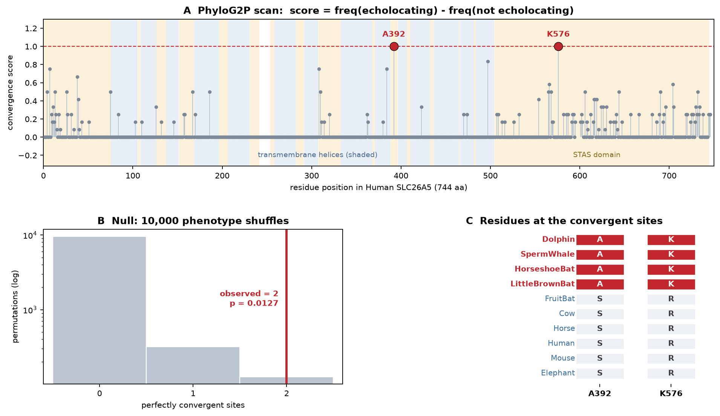
Result 1: two special spots in the gene
We scored all 744 positions, then tested whether the result could have happened by chance.
2
spots where all echo-hunters
match and no one else does
0.0127
probability of this by chance
(about 1 in 79)
0.06
spots expected by chance alone
Where they are
Spot 392 on the outside edge of the protein
Spot 576 on the part inside the cell
Look at box C: every echo-hunter is red, every other animal is grey. There is no exception.
Notes:
Slide 7: main result. p = 0.0127 means about a 1 in 79 chance of seeing this by chance, so it is unlikely to be an accident.

Slide 8
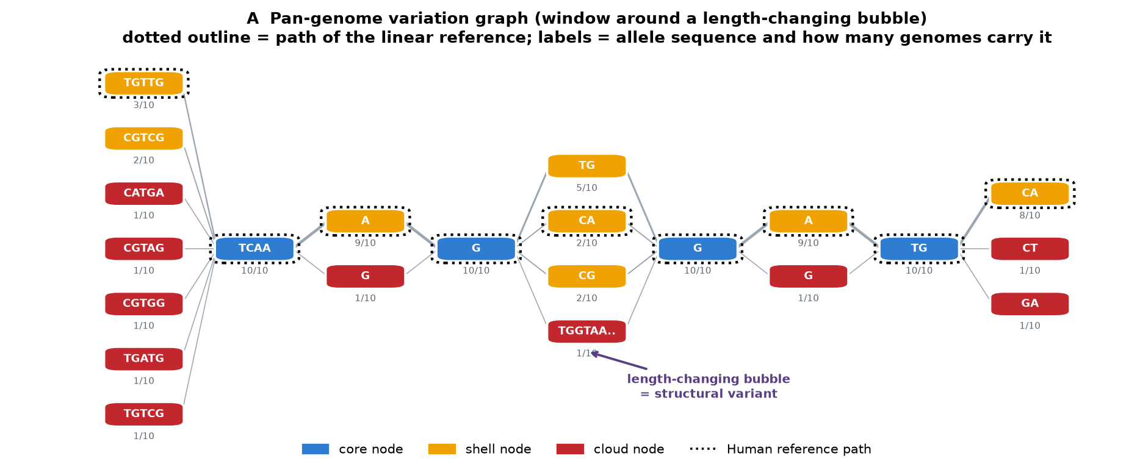
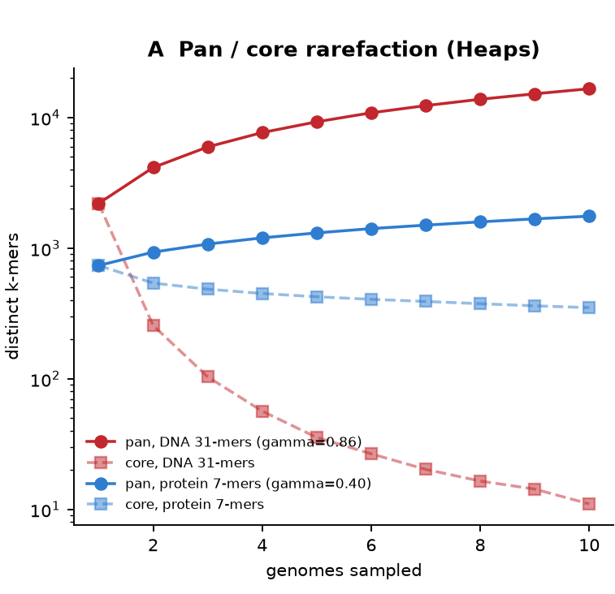
Result 2: the pan-genome graph
Parts that are the same in all 10 animals share one box. Parts that differ open a bubble.
1,615
boxes in the graph
458
bubbles (differences)
3
bubbles with extra letters
36%
Does adding more animals keep adding new DNA?
Yes at the DNA level, much less at the protein level.
of the DNA in our graph is not present in the human version. A method that uses only the human genome would miss all of it.
0.86
DNA — almost all new each time
0.40
protein — a shared core stays
The animals split apart over 100 million years ago, so the exact DNA letters differ a lot — but the protein has stayed similar.
Notes:
Slide 8: the graph. 36% of the sequence is off the human path - that is reference bias measured directly.

Slide 9
Conclusion
What we found, and what it means.
GENE
WHAT IT DOES
SPOTS
BY CHANCE?
RESULT
What we learned
SLC26A5
helps the ear hear
2
0.0127
found
The family tree is what makes the evidence strong. Without it, a shared letter means nothing. And keeping every genome in a graph shows differences that one reference genome would hide.
TMC1
opens the ear's channel
2
0.0037
found
OTOF
sends the ear's signal
3
0.0352
found
GAPDH
nothing to do with ears
0
1.0000
nothing
MB
used for diving, not hearing
0
1.0000
nothing
We ran the same program on five different genes, using the same animals.
Honest limits
Three ear genes gave the same answer
All three are used for hearing, but in different ways. Each one showed the same kind of change in the echo-hunters.
We used one gene and 10 animals, not whole genomes.
Our test is simple compared to professional tools.
This finds good suspects — it does not prove cause.
The two check genes stayed empty
A gene with no link to hearing found nothing. This tells us our method is not just finding random noise.
A graph shows more than one genome can
36% of the DNA in our graph is missing from the human version. Using one genome alone hides real differences.
Vaishnavi Magadum · Adarsh Madivala · Bhavya Pandya · Avatar Pacharane · Sakshi Paradkar
Notes:
Slide 9: conclusion. Three ear genes agree, two control genes stay empty, and the graph shows 36% more sequence than a single reference.

