Slide 1
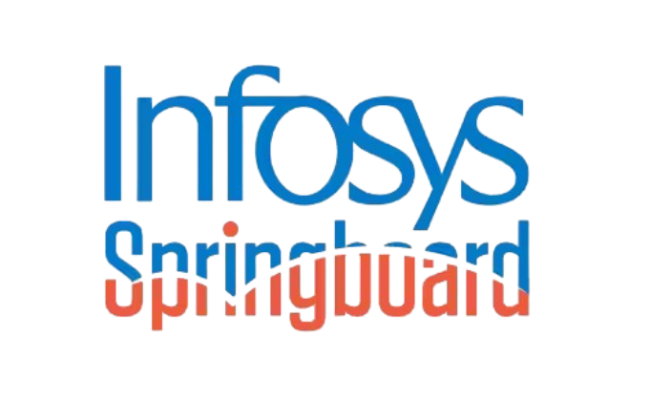
Food Trends Understanding Customer Preferences in FB
Power BI Sentiment Analysis Project
Batch 4 – Team B
Vaishnavi Jerkoni
Omsri Behera
Krishna Samarth
Kunal Chawla
Pallabi Singh

Slide 2
Project Objectives
Analyze customer feedback from structured and unstructured data
Understand customer sentiment, preferences, and recurring complaints
Apply sentiment analysis and customer segmentation techniques
Identify trending keywords and product-level insights
Build interactive Power BI dashboards to support

Slide 3
Project Agenda
Step 1
Step 2
Step 3
Step 4
Step 5
Step 6
Data Collection
Sentiment Score Analysis
System Architecture
Data Transformation & Modeling
Dashboards
Results & Outcomes

Slide 4
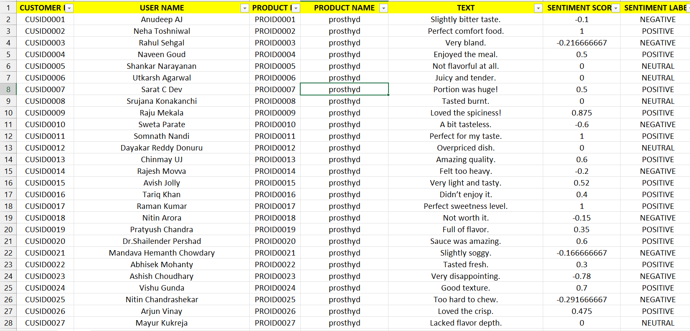
Unstructured Dataset
A collection of information that lacks a predefined data model, format, or schema, making it difficult for traditional databases to process, but rich in qualitative insights, existing as free-form text, images, audio, video, emails, and social media posts, requiring advanced tools like AI and NLP for analysis. Sources used:Apify scrapper,facebook review urls.

Slide 5
Structured Data
A structured dataset is data organized into a fixed, predefined format, typically in tables with rows and columns (like spreadsheets or relational databases), making it easily searchable, understandable, and processable by machines for analysis. It uses a schema (data model) to define distinct fields, such as names, dates, or numbers, allowing for efficient storage and retrieval of quantitative or qualitative information.
Distribution Channels:
Whatsapp
Instagram Stories
Direct Form Links

Slide 6
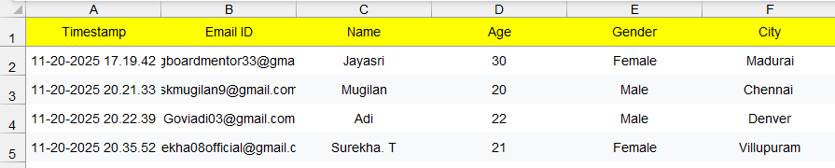
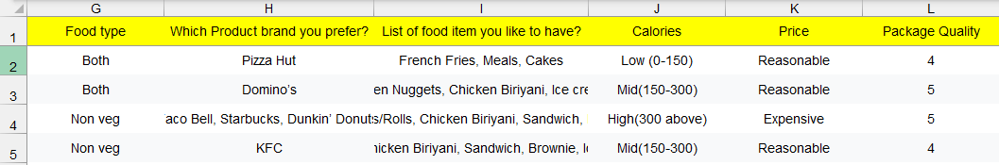
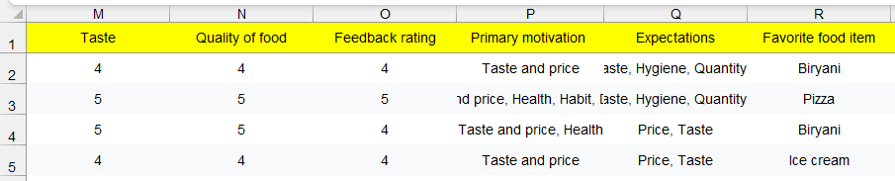
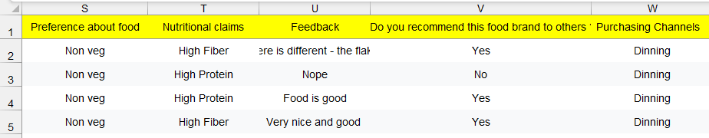

Slide 7
Sentiment Analysis(calculation of sentiment score)
Language Used: Python
Libraries: LTK, TextBlob, VADER, NLP, LLM
PROCESS
Step 1
Text Cleaning
Text cleaning in Python involves a series of steps to remove noise and standardize raw text data for analysis, commonly using libraries like Python's built-in re (regular expressions), NLTK, and spaCy.
Step 2
Tokenization
The process of breaking down text into smaller units called tokens, such as words or sentences. This is a foundational step in Natural Language Processing (NLP) to prepare text for analysis or machine learning models.
Step 3
Sentiment scoring
(Positive :1/Neutral:0/Negative:-1)
Sentiment scoring in Python is commonly performed using libraries like NLTK's VADER
The output is stored after the process for Power BI visualization

Slide 8
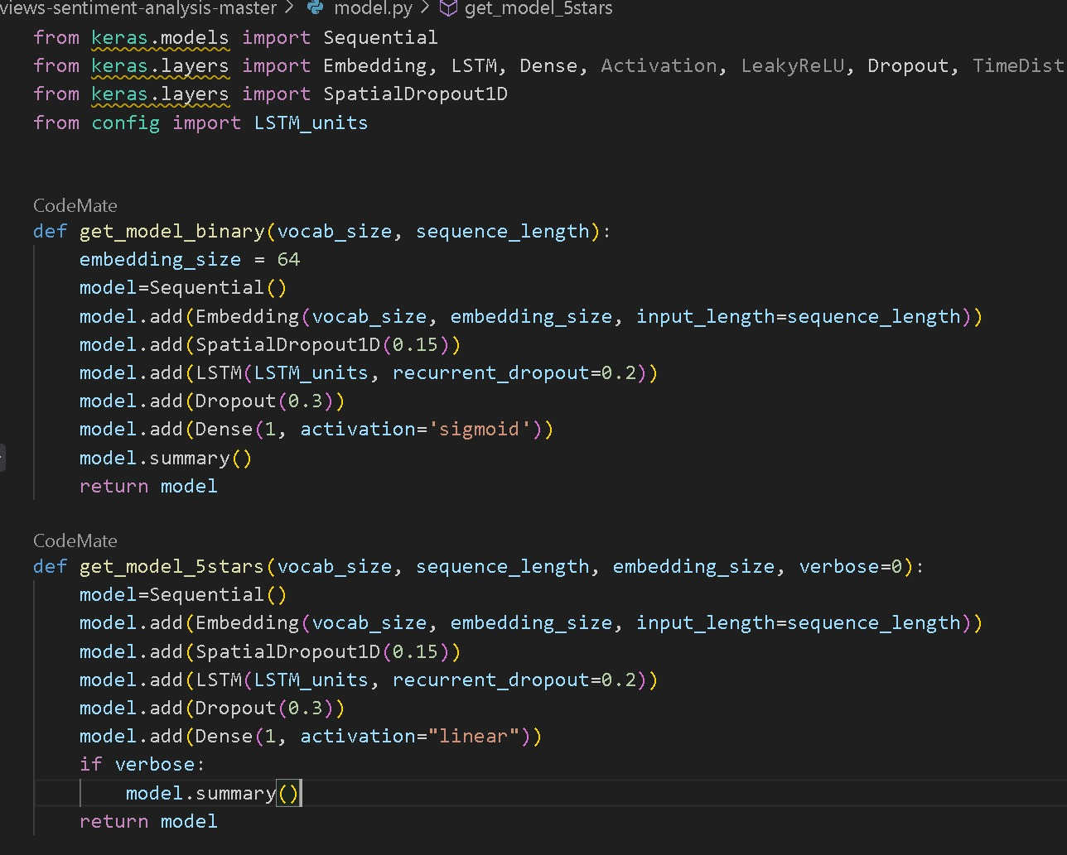
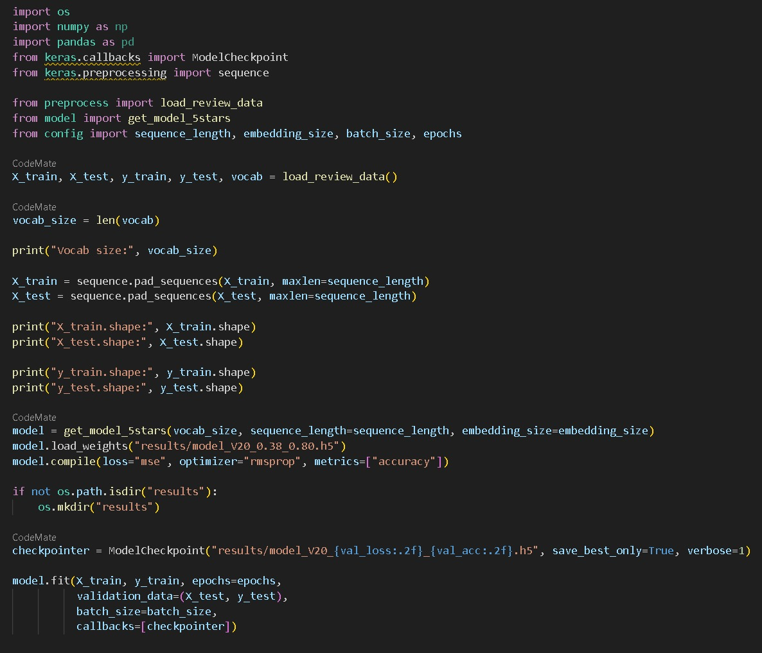

Slide 9
DATA INGESTION
PREPROCESSING & CLEANING
SENTIMENT ANALYSIS (Python)
DASHBOARD DEPLOYMENT
INSIGHTS & DECISION MAKING
POWER BI VISUALIZATION
DATA MODELING (Star Schema)
Architecture

Slide 10
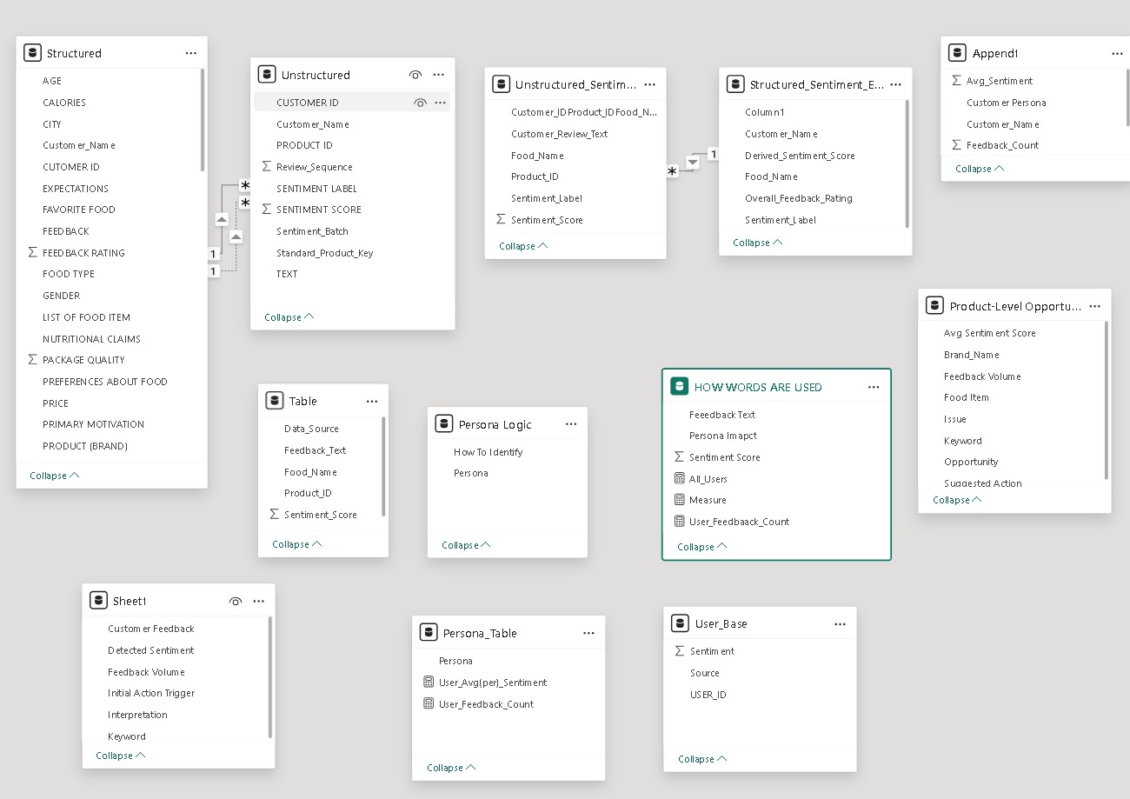

Slide 11
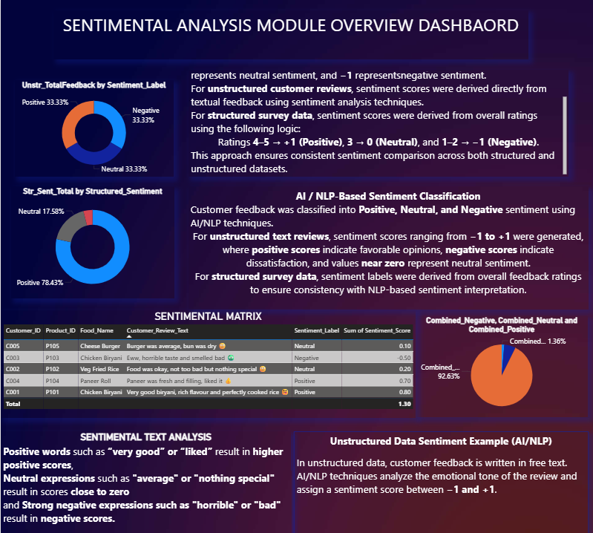

Slide 12
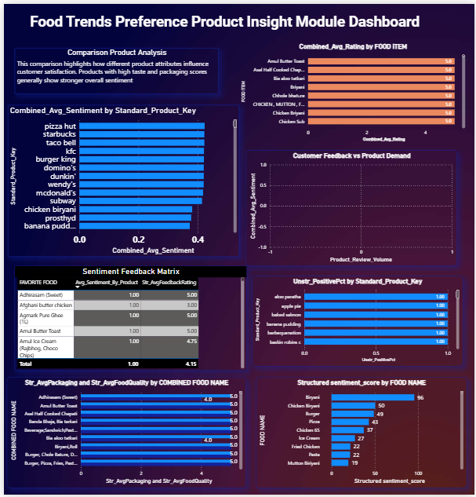
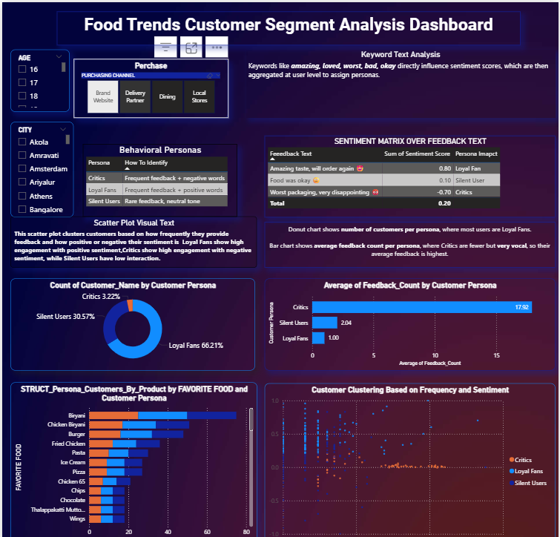

Slide 13
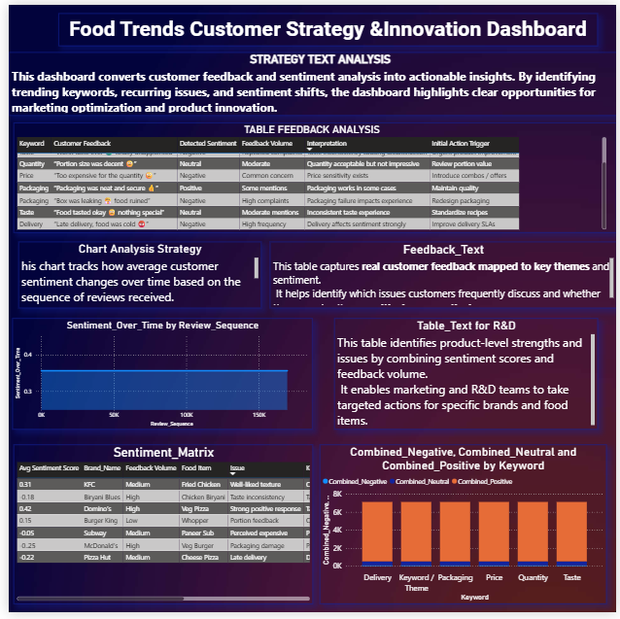

Slide 14
Results & Outcomes
Product-wise sentiment scores and rankings
Top positive and negative keywords customers type like critic,loyal fans and silent users
Clear understanding of customer preferences and pain points
Identification of high-performing and low-performing products
Actionable insights for product improvement and marketing strategy
Data driven customer segementation for targeted decisions
Interactive Power BI dashboards supporting strategic decison making

Slide 15
Thank you

