Slide 1


Credit Card Fraud Detection REVIEW – 1
Team Members
Roll No Name
2320030223 B. Varshitha
2320090045 D. Sarika
2320090076 V. Vaishnavi
Department of Computer Science and Engineering
KONERU LAKSHMAIAH EDUCATION FOUNDATION

Slide 2
Outline
Abstract
Introduction
Objectives
Literature Survey
Proposed Method
Implementation
Architecture
Module Design

Slide 3
Abstract
The rapid growth of digital payments has increased the risk of credit card fraud, making fraud detection an important challenge for financial institutions. Traditional systems use batch processing, which detects fraud only after transactions are stored, causing delays and potential financial losses. This project proposes a real-time credit card fraud detection system using big data and machine learning technologies. The system uses Apache Kafka for real-time transaction streaming, Apache Spark for large-scale data processing, and machine learning models to predict fraudulent transactions based on features like amount, location, time, and merchant details. A dashboard provides real-time visualization of transaction activities, including fraud rate and transaction statistics. The model is trained using the Kaggle Credit Card Fraud Detection Dataset. The system improves fraud detection by processing transactions instantly, reducing delays, and enabling quick response to suspicious activities. This scalable architecture can be further enhanced using cloud deployment and advanced deep learning models for higher accuracy.

Slide 4
Introduction
Financial institutions process millions of credit card transactions
With the rise of online payments, fraudulent activities are increasing rapidly.
Traditional fraud detection systems rely on batch processing and cannot detect fraud instantly.
This project proposes a real-time fraud detection system using streaming data processing and machine learning.
Applications
Banking Security
Payment gateway monitoring
Financial risk management
Fraud prevention systems

Slide 5
Objectives
The main objectives of this project are:
Detect fraudulent credit card transactions in real time.
Stream transaction data using Apache Kafka.
Process large scale data using Apache Spark Structured Streaming.
Apply machine learning models for fraud prediction.
Visualize fraud analytics using an interactive dashboard.

Slide 6
Literature Survey
Paper Title | Reference Link | Drawback | Future Work
Credit Card Fraud Detection Using Machine Learning | https://ieeexplore.ieee.org/document/8716026 | Limited performance when handling extremely imbalanced datasets. | Use advanced sampling techniques and ensemble learning models to improve accuracy.
Real-Time Credit Card Fraud Detection Using Streaming Data | https://link.springer.com/article/10.1007/s00521-020-04844-7 | High computational cost for real-time processing of massive transaction streams. | Optimization using distributed streaming frameworks like Apache Spark.
Credit Card Fraud Detection with Deep Learning | https://arxiv.org/abs/1908.04263 | Deep learning models require large labeled datasets and high computational resources. | Improve model efficiency using hybrid ML and deep learning approaches.
Fraud Detection in Financial Transactions Using Big Data Analytics | https://www.sciencedirect.com/science/article/pii/S187705091731982X | Difficult integration of big data technologies with traditional banking systems. | Develop scalable cloud-based architectures for seamless integration.
Anomaly Detection for Fraud Transactions Using Machine Learning | https://ieeexplore.ieee.org/document/8489313 | High false positive rate affecting legitimate transactions. | Improve anomaly detection algorithms and feature engineering methods.

Slide 7
Paper Title | Reference Link | Drawback | Future Work
Credit Card Fraud Detection Using Neural Networks | https://ieeexplore.ieee.org/document/8454906 | Neural networks require large training datasets and longer training time. | Use optimized deep learning models and distributed training techniques.
Online Payment Fraud Detection Using Data Mining | https://link.springer.com/article/10.1007/s11042-019-08417-3 | Data mining techniques struggle with evolving fraud patterns. | Integrate adaptive machine learning algorithms that update continuously.
Machine Learning Approaches for Financial Fraud Detection | https://arxiv.org/abs/2003.06558 | High computational complexity for large transaction datasets. | Use distributed big data frameworks like Spark for scalable analysis.
Fraud Detection in Electronic Payment Systems | https://ieeexplore.ieee.org/document/8074713 | Difficulty detecting new or unknown fraud patterns. | Implement hybrid models combining anomaly detection and supervised learning.
Big Data Techniques for Financial Fraud Detection | https://www.sciencedirect.com/science/article/pii/S0957417419301622 | Large storage and processing requirements for big data systems. | Cloud-based big data architectures and optimized storage solutions.

Slide 8
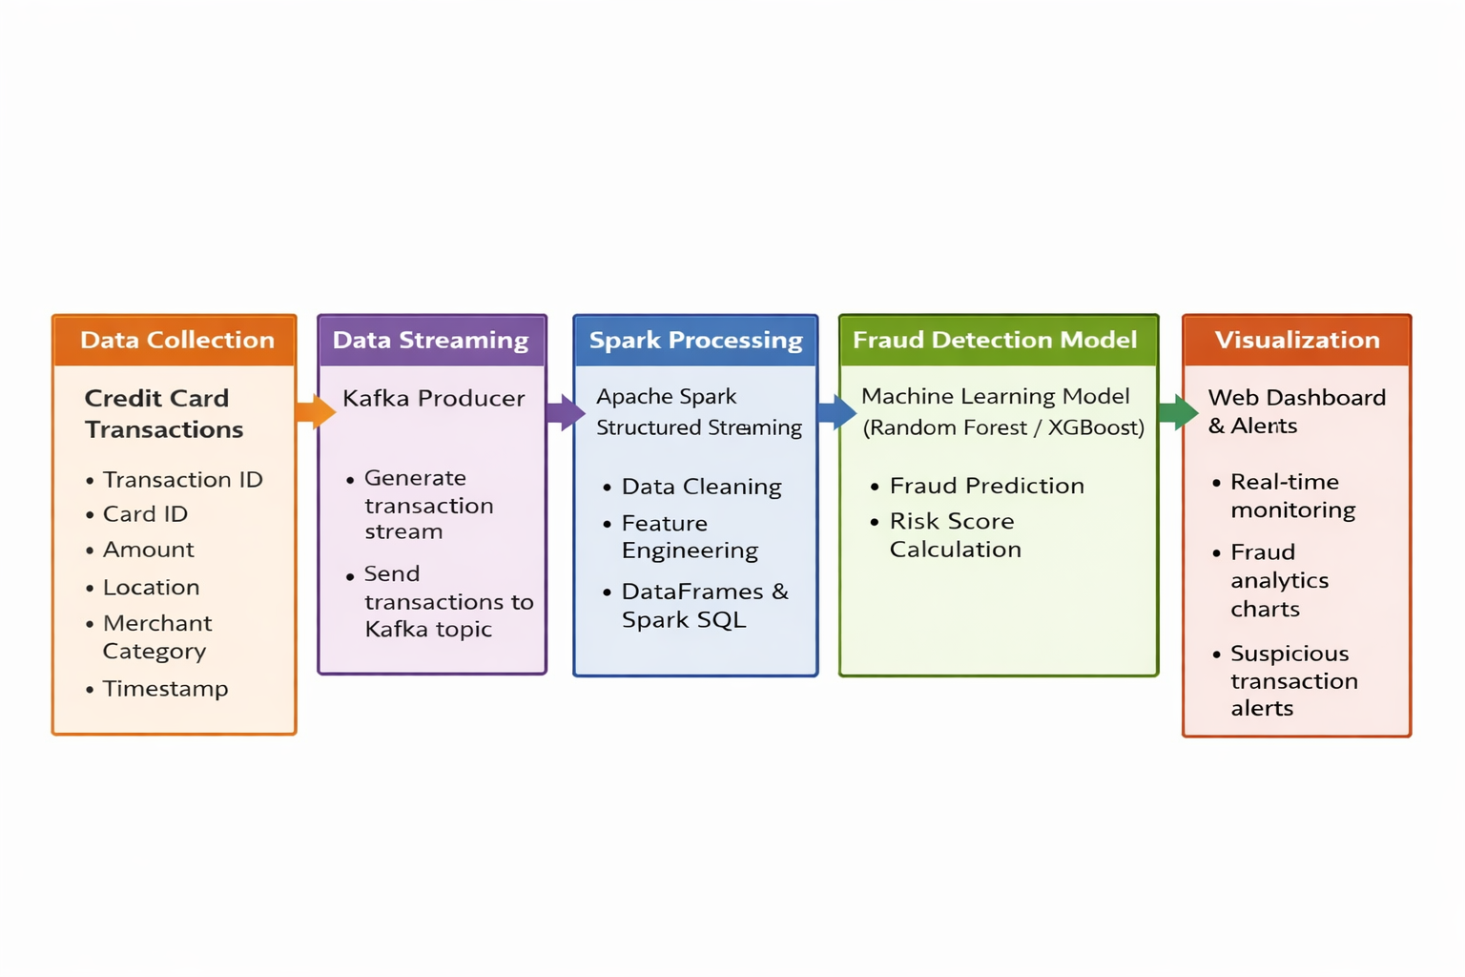
Proposed Method

Slide 9
Implementation
Tools and Technologies Used
Apache Spark
Python (PySpark)
Scikit-learn
XGBoost
PostgreSQL
React Dashboard
Tailwind CSS
Recharts/Chart.js
Dataset
Transaction ID • Card ID • Transaction Amount • Merchant Category • Transaction Location • Transaction Time
Log Fields
Transaction ID
Card ID
Transaction Amount
Merchant Category
Transaction Location
Transaction Timestamp
Transaction Type (Online / POS / Transfer)
Fraud Prediction
Risk Score
Example dataset:Transaction_ID: TXN1087
Card_ID: 4921-****-****-2866
Amount: $245.90
Location: Mumbai, IN

Slide 10
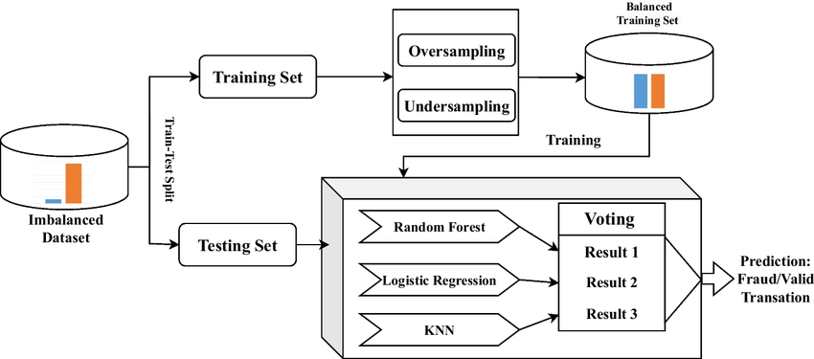
Architecture

Slide 11
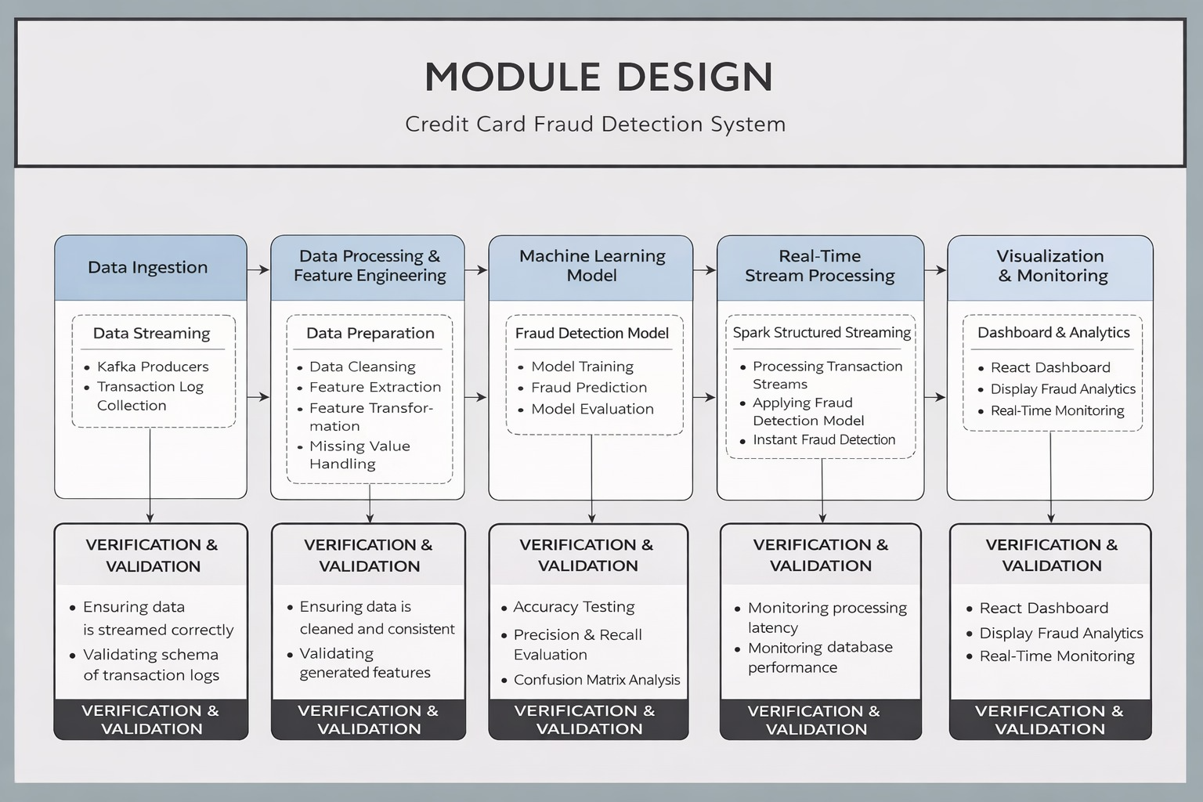

Slide 12
THANK YOU

