Slide 1


Credit Card Fraud Detection REVIEW – 1
Team Members
Roll No Name
2320030223 B. Varshitha
2320090045 D. Sarika
2320090076 V. Vaishnavi
Department of Computer Science and Engineering
KONERU LAKSHMAIAH EDUCATION FOUNDATION

Slide 2
Outline
Introduction
Objectives
Literature Survey
Proposed Method
Implementation
Conclusion

Slide 3
Introduction
Financial institutions process millions of credit card transactions
With the rise of online payments, fraudulent activities are increasing rapidly.
Traditional fraud detection systems rely on batch processing and cannot detect fraud instantly.
This project proposes a real-time fraud detection system using streaming data processing and machine learning.
Applications
Banking Security
Payment gateway monitoring
Financial risk management
Fraud prevention systems

Slide 4
Objectives
The main objectives of this project are:
Detect fraudulent credit card transactions in real time.
Stream transaction data using Apache Kafka.
Process large scale data using Apache Spark Structured Streaming.
Apply machine learning models for fraud prediction.
Visualize fraud analytics using an interactive dashboard.

Slide 5
Literature Survey
Paper Title | Reference Link | Drawback | Future Work
Credit Card Fraud Detection Using Machine Learning | https://ieeexplore.ieee.org/document/8716026 | Limited performance when handling extremely imbalanced datasets. | Use advanced sampling techniques and ensemble learning models to improve accuracy.
Real-Time Credit Card Fraud Detection Using Streaming Data | https://link.springer.com/article/10.1007/s00521-020-04844-7 | High computational cost for real-time processing of massive transaction streams. | Optimization using distributed streaming frameworks like Apache Spark.
Credit Card Fraud Detection with Deep Learning | https://arxiv.org/abs/1908.04263 | Deep learning models require large labeled datasets and high computational resources. | Improve model efficiency using hybrid ML and deep learning approaches.
Fraud Detection in Financial Transactions Using Big Data Analytics | https://www.sciencedirect.com/science/article/pii/S187705091731982X | Difficult integration of big data technologies with traditional banking systems. | Develop scalable cloud-based architectures for seamless integration.
Anomaly Detection for Fraud Transactions Using Machine Learning | https://ieeexplore.ieee.org/document/8489313 | High false positive rate affecting legitimate transactions. | Improve anomaly detection algorithms and feature engineering methods.

Slide 6
Paper Title | Reference Link | Drawback | Future Work
Credit Card Fraud Detection Using Neural Networks | https://ieeexplore.ieee.org/document/8454906 | Neural networks require large training datasets and longer training time. | Use optimized deep learning models and distributed training techniques.
Online Payment Fraud Detection Using Data Mining | https://link.springer.com/article/10.1007/s11042-019-08417-3 | Data mining techniques struggle with evolving fraud patterns. | Integrate adaptive machine learning algorithms that update continuously.
Machine Learning Approaches for Financial Fraud Detection | https://arxiv.org/abs/2003.06558 | High computational complexity for large transaction datasets. | Use distributed big data frameworks like Spark for scalable analysis.
Fraud Detection in Electronic Payment Systems | https://ieeexplore.ieee.org/document/8074713 | Difficulty detecting new or unknown fraud patterns. | Implement hybrid models combining anomaly detection and supervised learning.
Big Data Techniques for Financial Fraud Detection | https://www.sciencedirect.com/science/article/pii/S0957417419301622 | Large storage and processing requirements for big data systems. | Cloud-based big data architectures and optimized storage solutions.

Slide 7
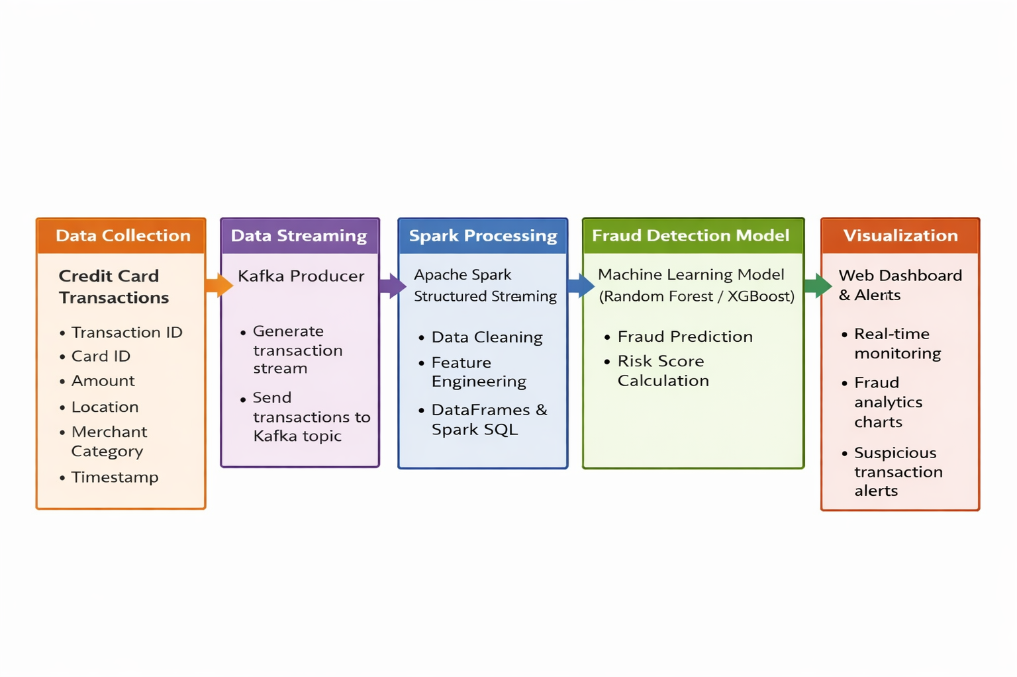
Proposed Method

Slide 8
Implementation
Tools and Technologies Used
Apache Spark
Python (PySpark)
Scikit-learn
XGBoost
PostgreSQL
React Dashboard
Tailwind CSS
Recharts/Chart.js
Dataset
Transaction ID • Card ID • Transaction Amount • Merchant Category • Transaction Location • Transaction Time
Log Fields
Transaction ID
Card ID
Transaction Amount
Merchant Category
Transaction Location
Transaction Timestamp
Transaction Type (Online / POS / Transfer)
Fraud Prediction
Risk Score
Example dataset:Transaction_ID: TXN1087
Card_ID: 4921-****-****-2866
Amount: $245.90
Location: Mumbai, IN

Slide 9
Fraud Detection Dashboard
The dashboard provides real-time monitoring of transactions.
Features:
Total Transactions
Fraud Transactions
Fraud Rate
Transaction Amount Distribution
Fraud Probability Distribution
Real-Time Transaction Table

Slide 10
Conclusion
This project demonstrates a real-time credit card fraud detection system using Apache Kafka, Apache Spark, and machine learning. The system processes large volumes of transaction data efficiently and identifies suspicious activities in real time. The dashboard provides insights into transaction patterns and fraud alerts for quick monitoring.
Future Work • Integration with real banking transaction systems • Deployment using cloud technologies • Use of advanced deep learning models for better fraud detection

Slide 11
References
Research Papers
IEEE – Credit Card Fraud Detection Using Machine Learning
Random Forest for Fraud Detection – arXiv
Apache Spark Documentation – https://spark.apache.org
Apache Kafka Documentation – https://kafka.apache.org
Kaggle Credit Card Fraud Dataset – https://kaggle.com

Slide 12
THANK YOU

