Slide 1
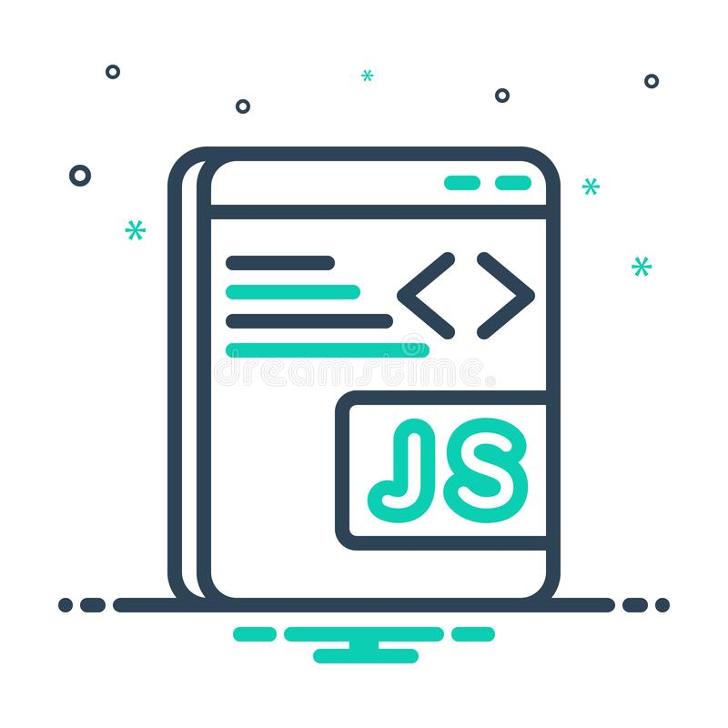
JavaScript
JavaScript is a programming language designed for Web pages

Slide 2
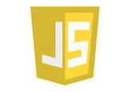
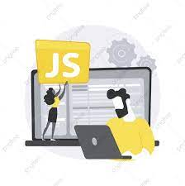
What is JavaScript?
a lightweight programming language ("scripting language")
used to make web pages interactive
insert dynamic text into HTML (ex: user name)
react to events (ex: page load user click)
get information about a user's computer (ex: browser type)
perform calculations on user's computer (ex: form validation
A web standard (but not supported identically by all browsers)
NOT related to Java other than by name and some syntactic similarities

Slide 3
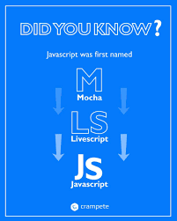
History
Frist Web scripting language
Developed by Netscape and Sun
Initiated by Netscape and called Livescript
In parallel with this, Sun was developing java

Slide 4
Why Use JavaScript?
JavaScript enhances Web Pages with dynamic and interactive features
JavaScript runs in client software.
JavaScript 1.3 works with version 4.0 browsers.

Slide 5
What can a JavaScript Do?
JavaScript gives HTML designers a programming tool.
Validate Data.
It can be used to detect the visitor’s browser.
JavaScript can react to events.
Creates Cookies.
Read/Write/Modify HTML elements.

Slide 6
Writing a JavaScript Program
The Web browser runs a JavaScript program when the Web page is first loaded, or in response to an event.
JavaScript programs can either be placed directly into the HTML file or they can be saved in external files.
Placing a program in an external file allows you to hide the program code from the user
Source code placed directly in the HTML file can be viewed by anyone.
A JavaScript program can be placed anywhere within the HTML file. In head tag or Body tag

Slide 7
Linking to a JavaScript File:
script tag should be placed in HTML page's head
script code is stored in a separate .js file
JS code can be placed directly in the HTML file's body or head (like CSS)
But this is bad style (should separate content, presentation, and behavior)
<script src="filename" type="text/javascript"></script> HTML

Slide 8
