Slide 1

Toxicity Detection in Business: Leveraging NLP for Safer Online Spaces

Slide 2
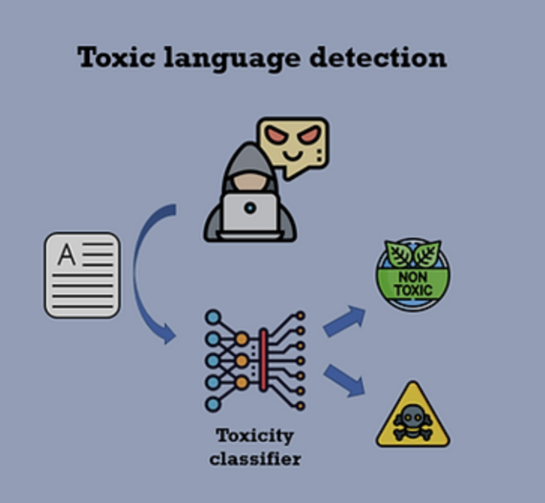
Table of contents
01
02
03
04
Project
Overview
Dataset & Methodology
Business Impact, Challenges &
Future Scope
Modeling

Slide 3
Project Overview

Slide 4
Overview - The Bias in Online Moderation
Current Issue
AI moderation systems exhibit bias.
Identity terms (e.g., "gay," "Muslim," "Black") are unfairly flagged as toxic.
Example: “I am a gay woman" incorrectly flagged as toxic.
Root Cause
Training data over represents abuse targeting marginalized groups.
Models learn to wrongly link identity terms with toxicity.
Project Goals
Build models that accurately detect genuine toxicity.
Prevent bias against identity terms in moderation.
Notes:
Introduction (20 seconds)
"Today I'm discussing a critical issue affecting online spaces: bias in AI moderation systems. These systems, designed to detect toxic content, often unfairly flag identity terms like 'gay,' 'Muslim,' or 'Black' as inappropriate. For instance, even a simple statement like 'I am a gay woman' can be incorrectly flagged as toxic."
Root Cause (20 seconds)
"This happens because training data overrepresents abuse targeting marginalized groups. As a result, AI models mistakenly learn to associate these identity terms with toxicity, rather than recognizing the context in which they appear."
Project Goals (15 seconds)
"Our project aims to build more accurate moderation systems that can detect genuine toxicity while preventing bias against identity terms, creating fairer online spaces for everyone."

Slide 5
Business Use Cases for Toxicity Detection
Gaming & Online Communities:
Detect and mitigate toxic behavior in multiplayer games and forums.
Social Media
Platforms:
Automatically filter or flag toxic comments to reduce hate speech and online harassment.
E-commerce &
Marketplaces
Protect sellers and buyers by filtering out abusive & manipulative messages.
Notes:
Business Applications (30 seconds)
"This technology has wide-ranging applications across industries:
In gaming and online communities, it can detect toxic behavior without silencing marginalized voices
On social media platforms, it enables fair filtering of genuinely harmful content
For e-commerce marketplaces, it protects all users from abuse and manipulation
In workplace communication, it reduces toxicity while mitigating legal risks"

Slide 6
Dataset & Methodology

Slide 7
Data Overview
~2 million public online comments
24 identity groups (gender, sexual orientation, religion, etc.)
Target: Toxicity label for each comment, fractional value between 0 to 1
To obtain the toxicity labels, each comment was shown to up to 10 annotators
Evaluation: Focused on identity groups with 500+ examples in the test set
Notes:
Toxicity Distribution: "Most comments have low toxicity scores, indicating class imbalance."
Top Words: "High frequency of common stopwords may dilute signal for tree-based models."
Word Cloud: "Frequent toxic terms give insight into targeted identities and sentiments."

Slide 8
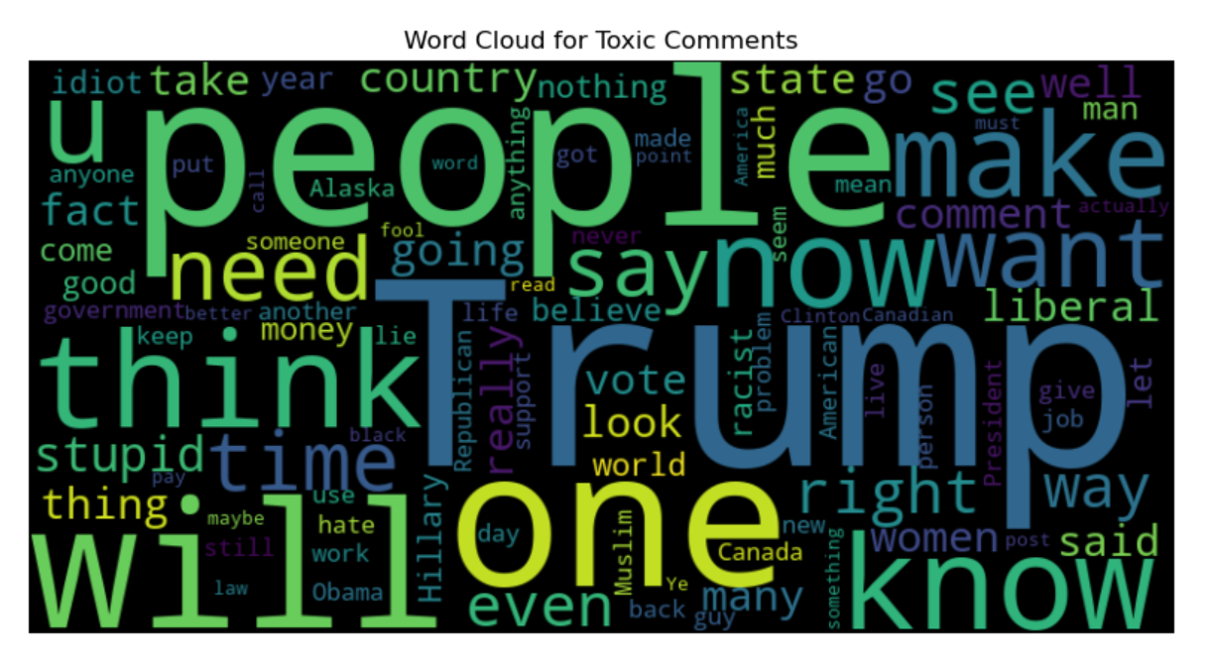
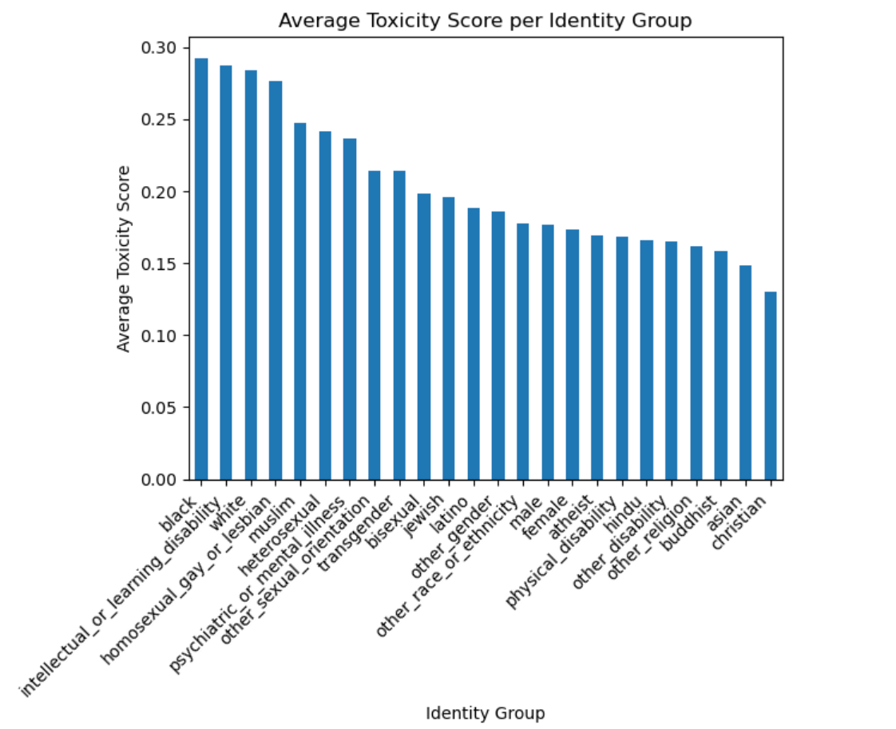
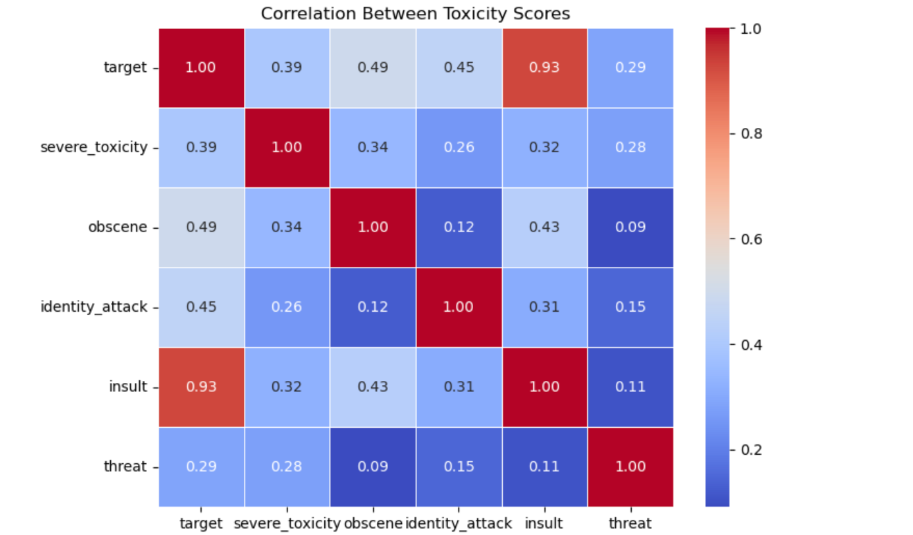
Data Overview
Notes:
Toxicity Distribution: "Most comments have low toxicity scores, indicating class imbalance."
Top Words: "High frequency of common stopwords may dilute signal for tree-based models."
Word Cloud: "Frequent toxic terms give insight into targeted identities and sentiments."

Slide 9
Models Utilized
XGBoost: Handles engineered text features (like comment length, punctuation use) to capture structural patterns of toxicity.
BERT: Understands the context of words in comments, helping detect subtle toxic language.
RoBERTa: Builds on BERT with better training for nuanced language, improving bias handling.
LSTM: Captures word sequences to identify toxicity patterns over the flow of text.

Slide 10
Preprocessing Steps
Missing Value Handling:
Drop missing comments, fill identity columns with zeros.
Text Normalization:
Lowercasing, URL and @mention removal, unusual symbol cleanup, punctuation preserved.
Stopword Removal:
Removed common English stopwords to reduce noise.
Model-Specific Processing:
XGBoost/LSTM: Word2Vec embeddings, feature extraction.
BERT/RoBERTa: WordPiece tokenization, tensor conversion.
Notes:
Stopwords retained to preserve contextual meaning (unlike traditional models)

Slide 11
Evaluation Metrics
Overall AUC
Final Score
Custom Bias subgroup AUCs
Measures the model’s general ability to classify toxic vs. non-toxic comments.
Subgroup AUC
Background Positive Subgroup Negative AUC (BPSN AUC)
Background Negative Subgroup Positive AUC (BNSP AUC)
Combine Overall AUC with a generalized mean of Bias AUCs

Slide 12
Models

Slide 13
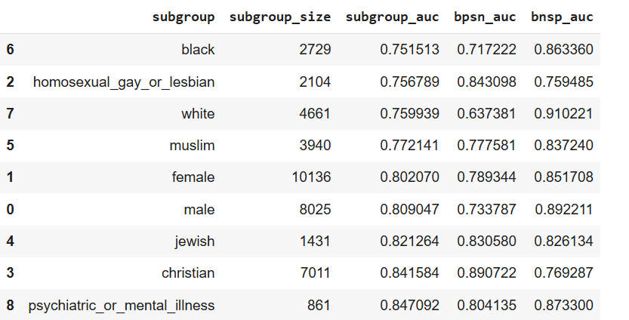
XGBoost
Why XGBoost?
Great for structured data
Handles imbalanced data well
Fast and efficient
Model Performance
Overall AUC: 0.85
Final score: 0.81
Challenges
Not designed for sequential data
Failure to detect sarcasm or implicit toxicity
Feature extraction dependency
Inference
XGBoost shows strong predictive performance
BPSN_AUC of “white” is 0.637: model struggles to differentiate neutral identity mentions from actual toxic comments.

Slide 14
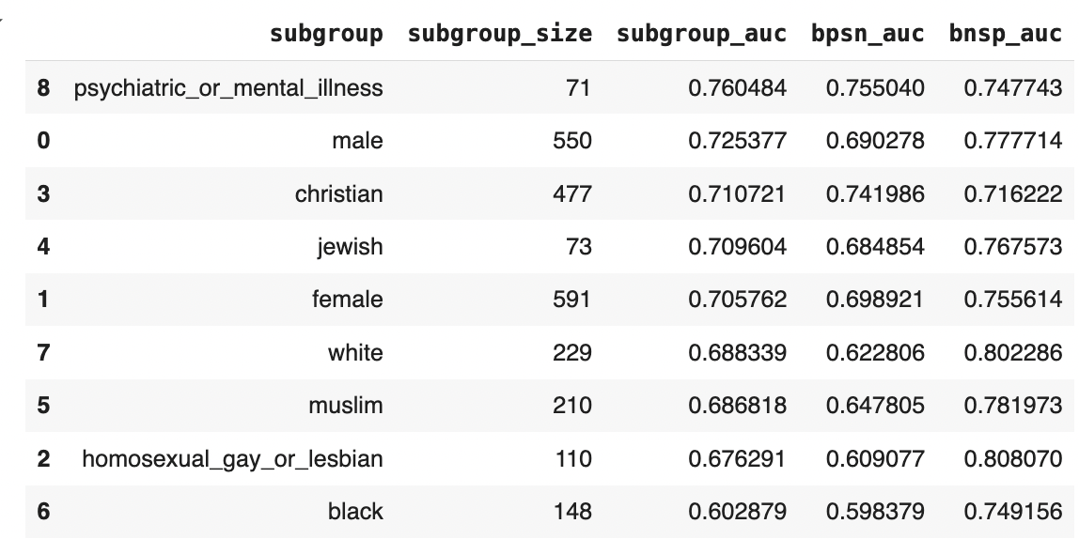
BERT
Why BERT?
Model Performance
Overall AUC: 0.82
Final Score: 0.71
Pretrained on Large Datasets
Bidirectional Contextual Understanding
Robustness to Textual Variations
Scalability and Flexibility
Challenges
Sensitivity to Class Imbalance
High Computational Cost
Model Interpretability
Inference
BERT results in moderate performance with room for further optimization.
Subgroup disparities indicate potential bias amplification in pre-trained language models.
Class imbalance may have hindered BERT's performance, favoring XGBoost

Slide 15
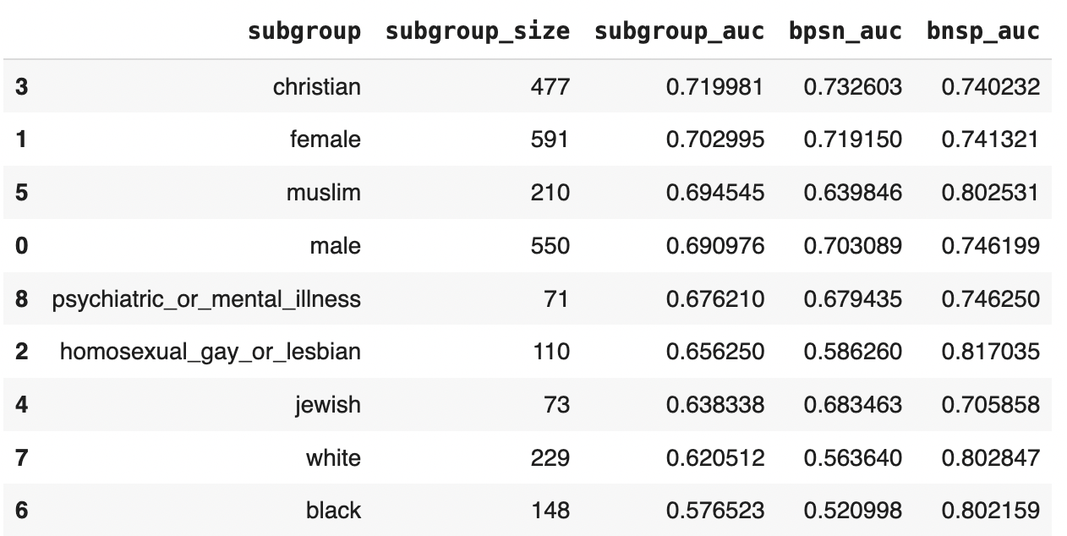
RoBERTa
Why RoBERTa?
Model Performance
Overall AUC: 0.75
Final Score: 0.69
Increased Robustness Over BERT
Larger Training Corpus
Optimized Training Strategy
Challenges
Sensitivity to Class Imbalance
Overfitting and bias amplification
Higher resource requirements
Inference
RoBERTa is outperformed by BERT, showing weaker discriminative ability.
Subgroup disparities and class imbalance issues are more pronounced with RoBERTa
RoBERTa's higher complexity may have led to overfitting

Slide 16
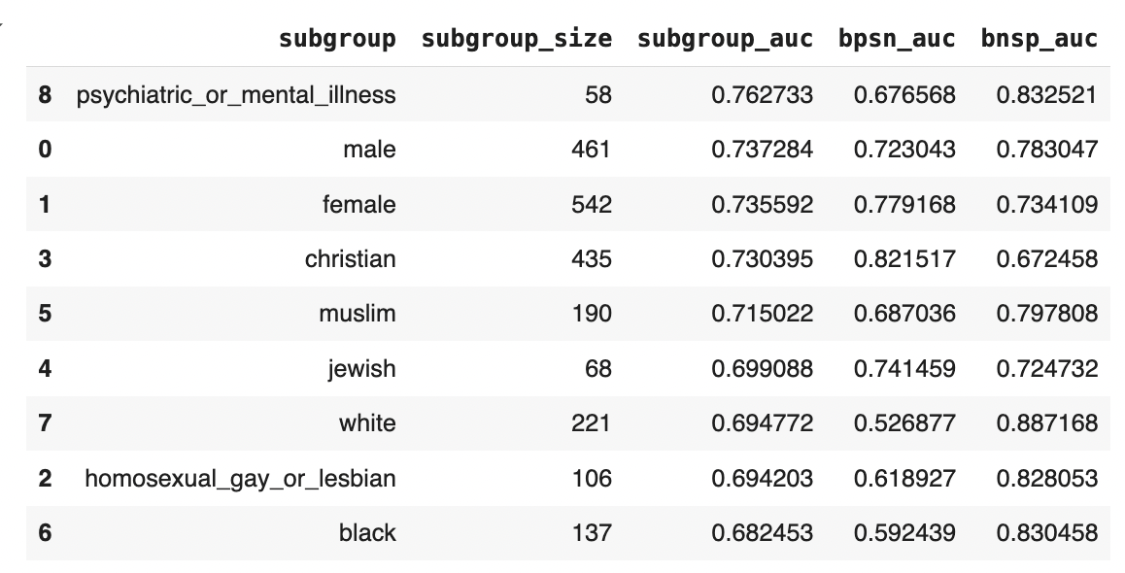
LSTM
Why LSTM?
Model Performance
Overall AUC: 0.7
Final Score: 0.67
Improves over traditional RNNs
Capturing Sequential, Long term Dependencies
Contextual Understanding
Handles Variable-Length Input
Challenges
Overfitting Risk
Limited Vocabulary Handling
High Computational Cost
Context shifts
Inference
LSTM shows moderate predictive performance
Bias AUC is lower than ideal, suggesting fairness issues for certain sub-groups
Due to class imbalance, tree-based models would outperform LSTM
Notes:
Preprocessing:
Tokenized text using 10000-word vocabulary size.
Padded sequences to a fixed length of 100 to standardize input.
🔹 Model Architecture:
Embedding Layer (10000 vocab size, 128-dim vectors) to convert words into dense representations.
LSTM Layer (128 units, 20% dropout & recurrent dropout) to learn sequential dependencies.
Dense Output Layer (Sigmoid activation) for binary classification.
🔹 Training Approach:
Used class weights to handle class imbalance and prevent bias.
Optimized using Adam optimizer & Binary Cross-Entropy loss for stable learning.
Trained for 15 epochs with a batch size of 16 for efficiency.

Slide 17
Business Impact, Challenges &
Future Scope

Slide 18
Business Impact
Our toxicity classification model can:
Enable Fair Moderation Decisions, reducing disproportionate flagging of marginalized communities across platforms
Can identify patterns of toxicity across different groups, helping policy teams refine moderation guidelines across industries
Enable proactive intervention toward rising toxicity among certain groups
Reduced toxicity can improve social media and gaming experience resulting in higher engagement and increased brand trust
HR & Workplace Communication can filter harmful content in workplace interactions and forums, reducing toxicity and legal risks
Notes:
Our model helps tackle this issue in five key ways.
First, it enables fair moderation, reducing bias and preventing marginalized communities from being unfairly flagged. Second, it helps policy teams identify patterns of toxicity, refining guidelines across industries. Third, it allows for proactive intervention, flagging rising toxicity before it escalates into serious issues.
Beyond moderation, our model has a direct business impact. By reducing toxicity, platforms see higher user engagement, stronger brand trust, and increased revenue. And finally, it extends to the workplace—filtering harmful content in internal communications, reducing legal risks, and fostering a safer work environment.
In short, our model isn’t just about filtering content—it’s about making online spaces safer, more engaging, and ultimately more profitable

Slide 19
Challenges and Future Scope
Challenges
⚠ Class Imbalance :
Most comments are non-toxic, making it harder for models to learn subtle toxic patterns.
⚠ Hardware Limits:
Training big models like BERT takes a lot of time and computing power.
⚠ Bias in Identity Terms:
Models may still associate certain identity words with toxicity due to patterns in the data.
Future Scope
Ensemble modeling to balance strengths
Experiment with simple debiasing tricks like swapping identity terms.
Explore adding more diverse data to reduce hidden biases
Create custom loss functions with fairness metrics in the pre-training process (FairBERT, ToxicBERT, etc.)
Notes:
Despite our progress, several significant challenges remain:
First, we face class imbalance issues, as most online comments are non-toxic, making it difficult for models to detect subtle toxic patterns.
Second, hardware limitations constrain our ability to train large models like BERT, which require substantial computing resources and time.
Third, bias in identity terms persists, as models continue to associate certain identity words with toxicity based on patterns in training data.
Looking ahead, our future work will focus on:
Implementing ensemble modeling techniques to combine multiple approaches and balance their respective strengths
Experimenting with debiasing methods such as swapping identity terms during training
Incorporating more diverse data sources to minimize hidden biases
Developing custom loss functions that incorporate fairness metrics directly into the pre-training process, following examples like FairBERT and ToxicBERT
These advancements will move us closer to truly equitable online moderation systems that protect all users while ensuring marginalized voices aren't silenced."

