Slide 1


Major Project Presentation Phase-I
INTELLIGENT SWARM BASED BOTS FOR CONTINUOUS AREA PATROLLING AND DETECTION
Team Members:
Ashwin Suresh- 4SF23EC022
Neha Raj - 4SF23EC066
Preetham Krishna - 4SF23EC077
Vaishak D Karkera - 4SF23EC117
Under the Guidance of:
Ms. Mehnaz Fathima C
Assistant Prof.
ECE, SCEM
Department of Electronics and Communication Engineering
1

Slide 2
Contents
Contents
  Introduction
  Problem Description
  Objectives
  Hardware Requirements Specification
  Methodology
  Results and Discussion
  Conclusion
  Literature Survey
  References
2

Slide 3
Introduction
  The INTELLIGENT SWARM BASED BOTS FOR CONTINUOUS AREA PATROLLING AND DETECTION is a cost-effective demonstration prototype designed to monitor sensitive areas using real-time sensors and a live dashboard.
  The system provides a live 360° situational awareness interface similar to a defense-grade control panel.
Radar-based scanning using Radar sensor
Object detection system with Ultrasonic/ToF sensor + servo motor
GPS-based location tracking of detected events
Local data processing using ESP32 (edge computing)
Bot to bot access of information in low network areas
ESP-NOW communication between nodes for fast data transfer
WebSocket-based dashboard for real-time monitoring
Multi-frame verification to reduce false alarms using ESP-CAM
Continuous real-time surveillance and system operation
3

Slide 4
Problem Description
  Traditional border surveillance faces several challenges:
  Existing border surveillance systems are not efficient for large and complex areas. They depend heavily on manual monitoring and have limitations like blind spots and delayed response. This is needed for a smart, low-cost system that can monitor continuously and provide real-time alerts.
Border areas are large and difficult to monitor continuously
Manual patrolling is time-consuming and unsafe
Existing systems have limited coverage and blind spots
Delay in detection can lead to security risks
High data load increases human error
Advanced systems are expensive for large-scale deployment
Need for a low-cost, real-time automated surveillance system
7

Slide 5
Implement basic Object detection using Ultrasonic / ToF (VL53L0X) sensors with servo motor
Develop radar-style scanning using Radar sensor (HLK- LD24106)
Integrate GPS for location tracking
Establish ESP-NOW communication between nodes
Develop WebSocket-based dashboard for real-time monitoring
Perform local data processing on ESP32
Reduce false alarms using multi-frame verification from ESP-CAM
Threat classification as animal/human using YOLOv8
Objectives

Slide 6
Hardware Requirements Specification
Hardware Requirements:
Sl. No | Component Name | Quantity | Key Features
1 | ESP32 Microcontroller | 1 | Main control unit, built-in Wi-Fi, supports real-time processing
2 | ESP32-CAM Module | 1 | Image capture, supports basic AI detection, low power
3 | Ultrasonic Sensor | 1 | Distance measurement, real-time object detection
4 | Servo Motor | 1 | Rotates sensor, enables radar-style scanning
5 | GPS Module | 1 | Provides location coordinates, supports tracking
6 | Temperature & Humidity Sensor | 1 | Monitors environmental conditions
7 | ESP8266 Module | 1 | Wireless communication, receives data
8 | Power Supply Unit | 1 | Provides stable power for system operation

Slide 7
Methodology
Sensor Integration
System starts with initialization of ESP32 and all sensors
Ultrasonic sensor with servo performs radar-style scanning
Object detection triggers ESP32-CAM to capture images
GPS module provides location of detected events
Data is processed locally on ESP32
ESP-NOW used for communication between nodes
Data is sent to WebSocket dashboard
Dashboard Development
Real-time radar animation
Map visualization (Leaflet)
Logs console
Connection panel
Testing and Analysis
Real-time scanning
Object detection validation
GPS accuracy check
10

Slide 8
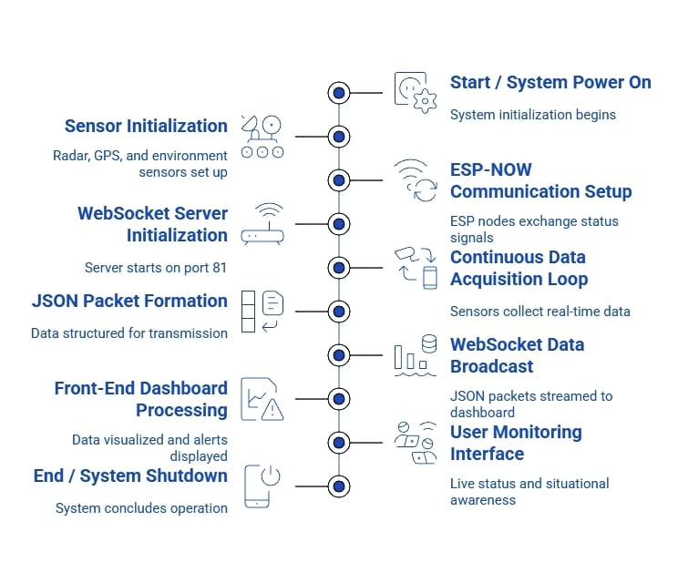
Methodology
11

Slide 9
Results and Discussion
The system was able to detect objects and monitor the area continuously without issues.
Sensor readings and camera capture worked properly during testing.
Communication between nodes was fast and data was displayed clearly on the dashboard.
Multi-frame checking helped reduce false alarms and improved overall reliability.
Overall, the system showed stable performance during testing and was able to handle real-time monitoring effectively. All components worked together smoothly, and the integration of sensors, communication, and dashboard provided clear and timely information. The proposed system is reliable for basic surveillance and can be improved further in the next phase.
12

Slide 10
Conclusion
Our Project demonstrates a practical and low-cost model for intelligent border surveillance
Key achievements:
Functional multi-sensor surveillance platform
WebSocket-based real-time monitoring
Radar and Object detection
Environmental monitoring
GPS tracking
Wireless communication using ESP-NOW
The Phase 1 of this project was successfully completed, where a basic real-time surveillance system was developed and tested. The system was able to detect objects, capture images, and send data properly using the embedded components. All the sensors, communication modules, and dashboard worked together smoothly, making it easy to monitor the system performance. Processing the data locally helped in faster response, and checking multiple frames reduced false alarms. Overall, the system is simple, cost-effective, and provides a good base for improving and expanding the project in the next phase.
14

Slide 11
Literature Survey
Literature Survey
Paper Title | Methodology Adopted | Remarks/Conclusions
Malathy et al [1] | It aims to study the use of WSN in border monitoring, with particular emphasis on methods for clustering to potentially save energy at the sensor nodes. Viewed how Elliptic Curve Cryptography (ECC) allows for secure communication, letting only the legitimate user access information on border surveillance. | This paper demonstrates that clustering combined with ACO significantly enhances energy efficiency and, hence prolongs the sensor network lifetime in border surveillance scenarios. Overall, this approach improves the network lifetime, packet delivery, and throughput; thus, it acts as a very strong reference model for building secure and efficient border monitoring systems..
Essendorfer et al [2] | Studied how data from different sensors (radar, sonar, IR, video) can be converted into a common format for smooth sharing and integration. Understood how automated data fusion combines multi-sensor inputs to reduce operator workload and improve real-time monitoring. | The integrated multi-sensor approach provides a clearer and more accurate operational picture for border security. Standardized data sharing helps authorities respond faster and improves overall surveillance effectiveness.
4

Slide 12
Literature Survey
Literature Survey
Paper Title | Methodology Adopted | Remarks/Conclusions
John A. Sautera et al[3] | Studied how digital-pheromone–based swarming algorithms were used to coordinate UAVs, UGVs, PTZ cameras, and ground sensors for autonomous border/perimeter surveillance. Reviewed how the system was tested in real environments (e.g., NASA Wallops Island & perimeter-protection field tests) to evaluate detection, tracking, and multi-sensor coordination in realistic intrusion scenarios. | The swarming algorithms proved to be highly adaptive and reliable, successfully detecting, tracking, and neutralizing intruders even during hardware failures or communication issues. The tests showed that a single operator can manage multiple autonomous sensors, creating an effective, scalable surveillance system suitable for border security applications.
Fatima et al[4] | Studied how an IoT + Machine Learning–based intruder alert system uses a Pi Camera, Raspberry Pi, ML models (Faster R-CNN), and cloud storage to detect uniformed/un-uniformed individuals and send alerts in real time Reviewed the two-stage detection pipeline, where the system first checks uniform vs. civilian using object detection, | The system provides automated, and low-cost approach to border surveillance, reducing heavy manpower requirements and improving safety in extreme terrains The approach achieves high accuracy in intruder detection and secure data handling, using ML models and AES encryption, though improvements like better masked-face detection
5

Slide 13
Literature Survey
Paper Title | Methodology Adopted | Remarks/Conclusions
Arjun et al [5] | Studied different wireless sensor network techniques used for intrusion detection in large surveillance areas. Reviewed methods for sensor deployment, communication, and data collection for efficient monitoring. | Wireless sensor networks provide good coverage for large areas with low power consumption. However, issues like network reliability and coordination between sensors still remain challenges..
Nahata et al [6] | Implemented a YOLO-based object detection model for real-time surveillance applications. Tested the system using image datasets to evaluate detection speed and accuracy. | YOLO provides fast and accurate detection suitable for real-time systems. Performance depends on lighting conditions and quality of input images.

Slide 14
Literature Survey
Paper Title | Methodology Adopted | Remarks/Conclusions
Noor et al [7] | Developed a digital border surveillance system using YOLOv7 for object detection. Integrated camera-based monitoring with real-time detection and alert generation. | The system showed good accuracy in detecting humans and objects in real time. Requires proper hardware support for stable performance in continuous monitoring.
Kumar et al [8] | Applied deep learning models for detecting objects in surveillance systems. Focused on improving detection in different environmental conditions such as low light. | Deep learning improves detection accuracy compared to traditional methods. Computational requirements can be high for embedded systems.
6

Slide 15
Literature Survey
Paper Title | Methodology Adopted | Remarks/Conclusions
Reddy et al [9] | Designed a robotic surveillance system with real-time monitoring and detection features. Integrated sensors and camera modules for autonomous operation. | The system demonstrated effective monitoring with reduced human effort. Mobility improves coverage but increases system complexity.
Taneja et al [10] | Developed a real-time surveillance system using YOLO-based object detection. Tested detection of multiple objects such as humans, vehicles, and threats. | The system achieved reliable detection performance in real-time scenarios. Accuracy may vary depending on environmental noise and object movement.
6

Slide 16
References
[1] Malathy et al., “Energy-efficient wireless sensor network for border surveillance,” 2024.
[2] Essendorfer et al., “Integrated architecture for border surveillance systems,” 2024.
[3] Sauter et al., “Swarm-based control for surveillance applications,” IEEE Trans. Robotics, 2024.
[4] Fatima et al., “IoT-based smart border security system using machine learning,” IEEE Internet of Things Journal, 2024.
[5] Arjun et al., “Wireless sensor networks for intrusion detection: A survey,” IEEE Communications Surveys & Tutorials, 2024.
[6] Nahata et al., “YOLO-based real-time object detection system,” Proc. ICCV, 2024.
[7] Noor et al., “Digital border surveillance system using YOLOv7,” IEEE Conference on Security and Privacy, 2024.
[8] Kumar et al., “Deep learning for object detection in surveillance systems,” IEEE Trans. Geoscience and Remote Sensing, 2024.
[9] Reddy et al., “Automated surveillance robot with real-time monitoring,” Proc. IEEE ICRA, 2024.
[10] Taneja et al., “Real-time surveillance system using YOLO-based detection,” Proc. ICIP, 2024.
15

Slide 17
Thank You
16

