Slide 1
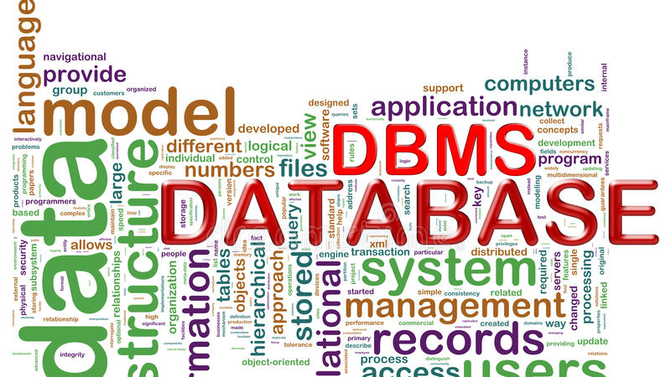
Data Base Management System Project
1
Mini chat application – Team 16

Slide 2
Team Members :
2
BL.EN.U4CSE20196 – V S S R L Asritha
BL.EN.U4CSE20192 – Vaishakh Nambiar
BL.EN.U4CSE20123 – P Rithika Reddy
BL.EN.U4CSE20200 – Vignesh G S

Slide 3
Objectives :
3
The main purpose of the software is to provide users with an instant messaging tool that has the ability to handle millions of users simultaneously when needed and can be easily done.
And this project is to develop a chat application using the client server architecture. This architecture depends on socket programming provided by java.

Slide 4
Introduction :
4
Our project is an example of chat application which is basically based on public chatting ( message is broadcast to connect all users )
It is made of two applications :
1.client application
2. Server application
To start chatting client should get connected to server

Slide 5
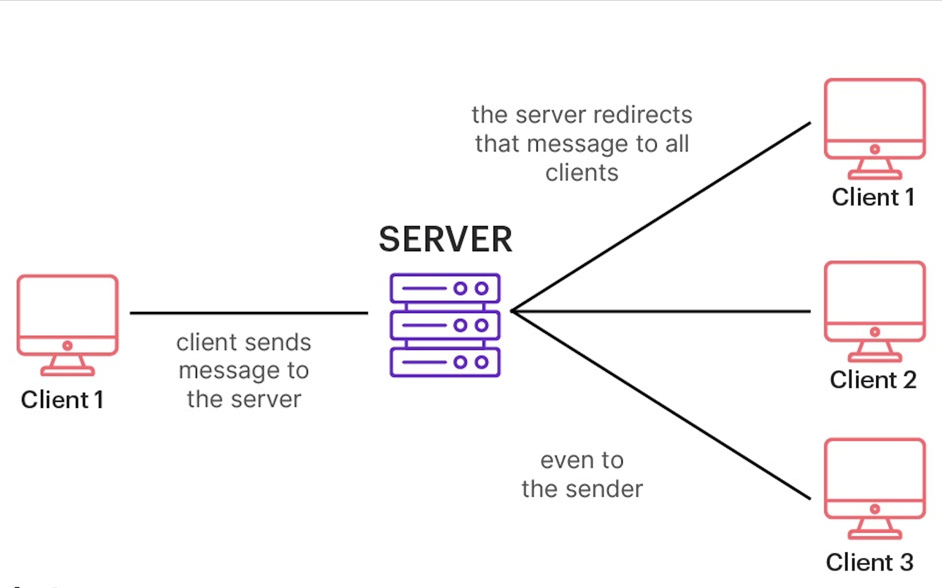
Infrastructure :
5

Slide 6
Modules :
6
Server Module : A server is a specially equipped computer connected to the internet that allows users with chat clients to converse with one other via typed messages in real time
Client Module : A client is a software program that allows users to connect to chat servers and communicate with other users via a chat room

Slide 7
Frontend Development :
7
The frontend of a chat application is the part the user interacts with directly. It is usually referred to as the application's "client side. The frontend consists of everything that the user sees when interacting with the app.
The key focus points of frontend development are responsiveness and performance.
Languages that we used in this chat application :
HTML , CSS , JAVASCRIPT , BOOTSTRAP

Slide 8
Backend Development :
8
The backend is also known as the server-side of a website or application. It organizes and stores data, as well as ensuring that everything on the client side of the website functions properly.
While the backend doesn't interact with users directly, it plays an indispensable role behind the scenes by adding key functionality to a site. Without a clean and proper backend, the frontend won’t work properly.
Languages that we used in this chat application :
NODEJS, EXPRESS.JS , MySQL (DBMS) , SOCKET.IO , POSTMAN(API-TESTING) .

Slide 9
Websocket Server :
9
A WebSocket server and client library are useful components for a chat app.
Typical communication between a client and server is done using HTTP and requires that the client makes a request for data from the server.
A WebSocket is a persistent connection between client and server that provides a bidirectional communication pathway.

Slide 10
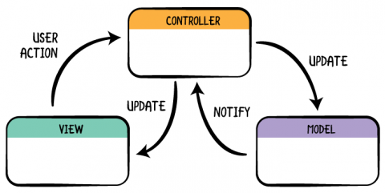
Implementation Methodology :
10
Model , View , Controller , as it is popularly called is a software design pattern for developing web applications
MVC pattern is made up of following three parts :
Model , View , Controller

Slide 11
Features and Functionalities :
11
User Registration and Authentication
Individual and group messaging
Push notifications
Sharing of media files
User settings & profile customization

Slide 12
Login page :
12
Database
Member Connect
Member
Login page
Username
Web server
Database
Password
< Connections >
Admin connect
Admin

Slide 13
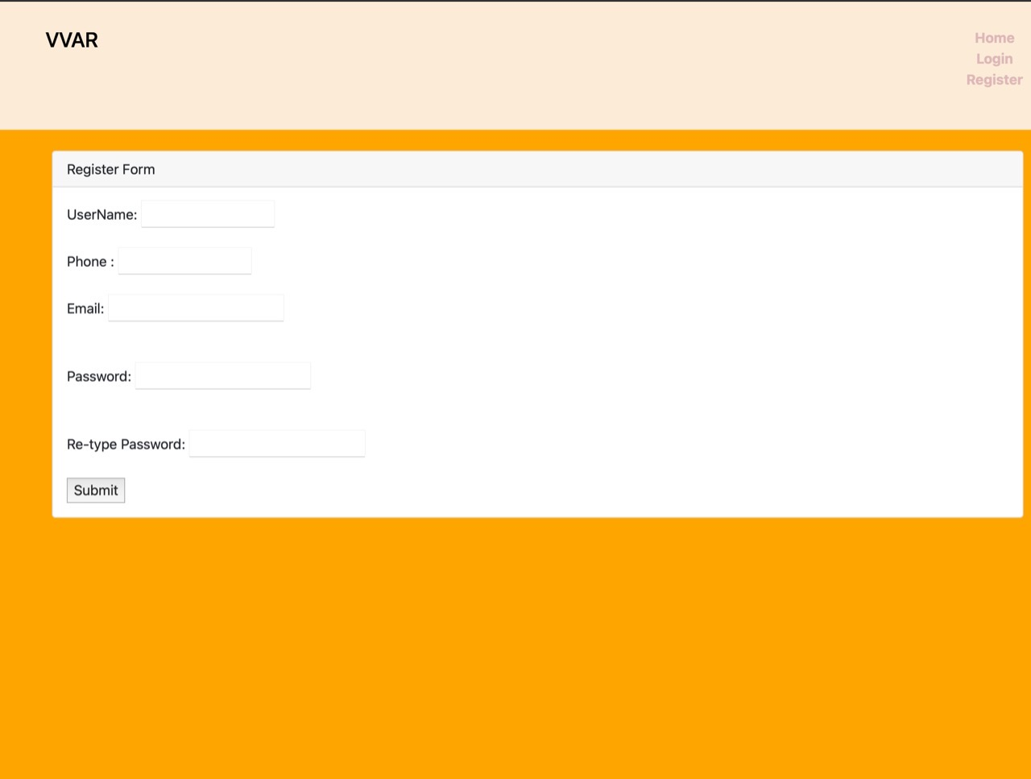
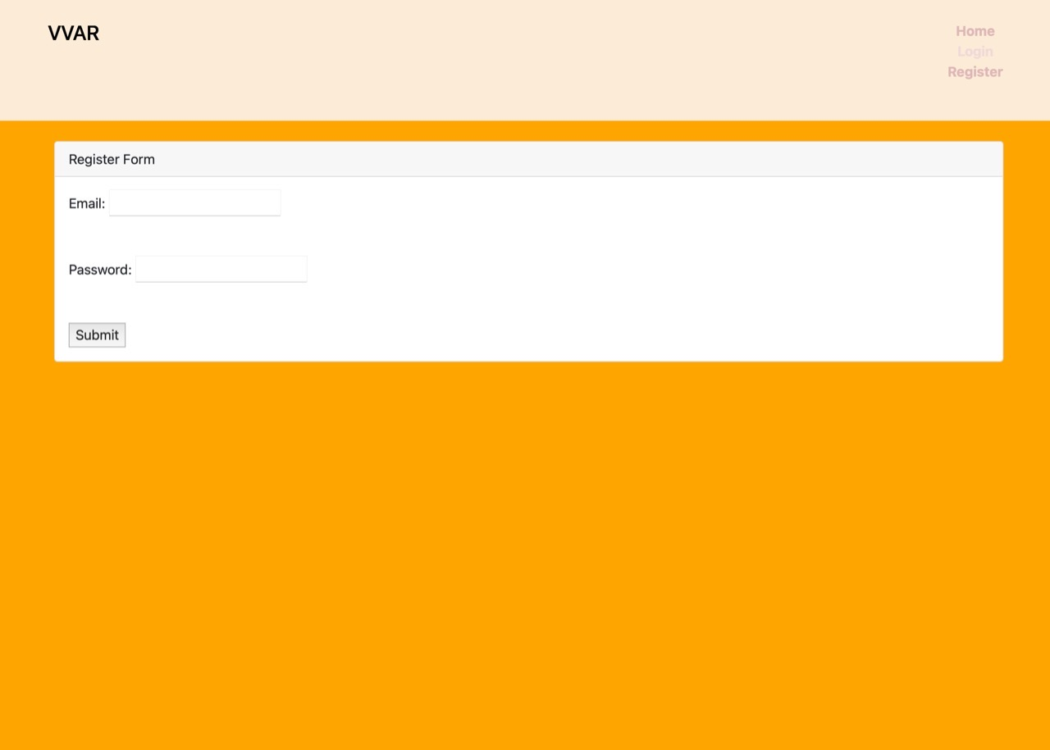
UI design :
13
Login and Register page

Slide 14
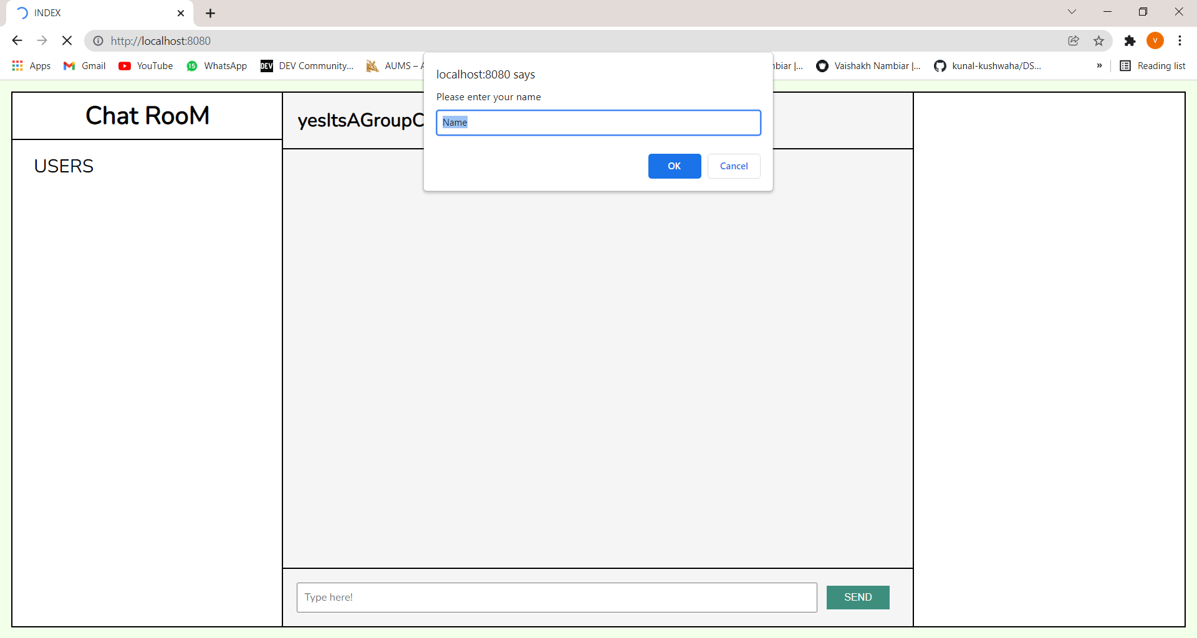
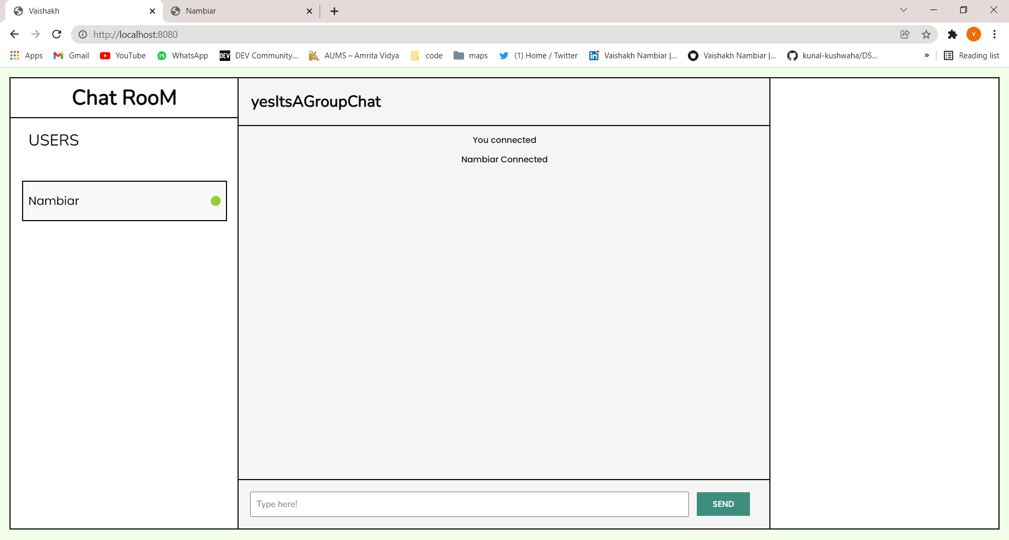
14
User’s Home page

Slide 15
Tables :
15
Tables are database objects that contain all the data in a database. In tables, data is logically organized in a row-and-column format similar to a spreadsheet.
A well-designed database has a specific table for each type of data to be managed, and then displays the appropriate content from those tables in clusters relating to a single process that the user needs to manage.
That clustering of associated records of information, would never be possible without tables.

Slide 16
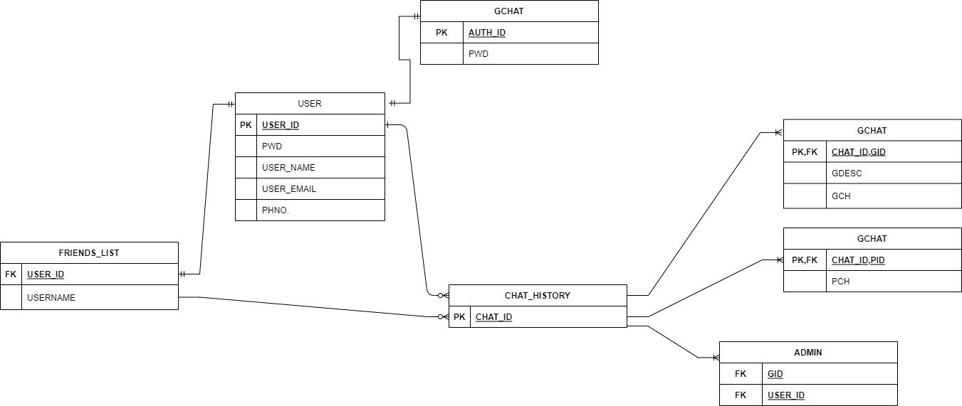
SQL tables :
16

Slide 17
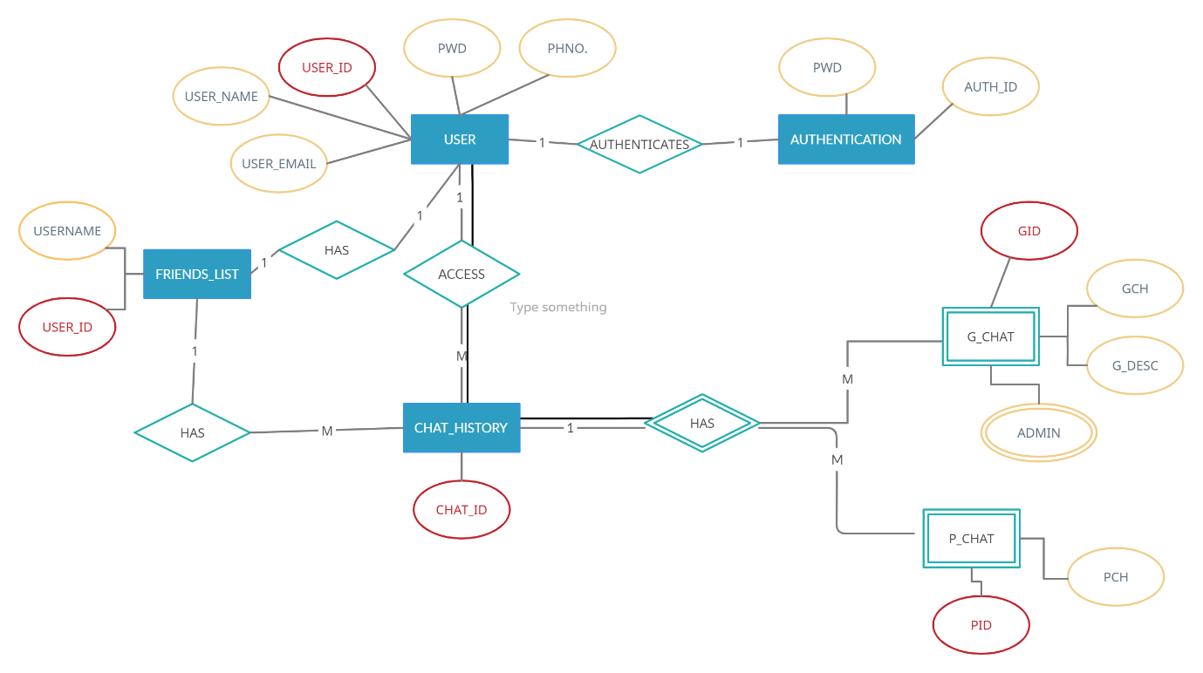
ER diagram :
17
It shows all the instrument of Database Tables and the relations between tables.

Slide 18
Conclusion and Scope :
18
There is always a room for improvements in any software package however good and efficient it may be done. But the most important thing should be flexible to accept further modification right now we are just dealing with text communication. In future this software may be extended to include features such as :
File transfer : This will enable the user to send files of different formats to others via the chat application.
Voice chat : This will enhance the application to a higher level where communication will be possible via voice calling as in telephone.

Slide 19
Demo of our project Mini chat Application

Slide 20
Thank you !! Team-16

