Slide 1
Organization name: ISRO Problem Statement : Depth Estimation of Valles Marineris
using ISRO’s Mars Color Camera (MCC) images.
Problem Code: NM392 Team Name : SATTVA Team Leader Name : Vaishak Nair College Code : 1-4259322058

Slide 2
The idea is to create a Depth Estimation System that uses multiple techniques to estimate the depth of Valles Marineris based on an input set of MCC images. The system will then compare the resulting depth maps of all techniques to provide a thorough depth estimate.

Slide 3
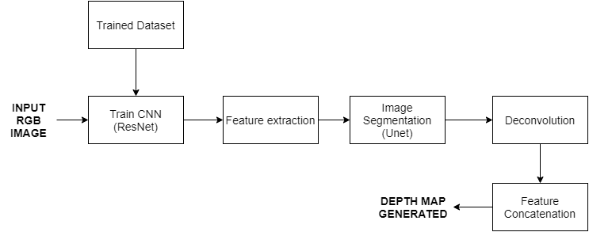
OUR APPROACH

Slide 4
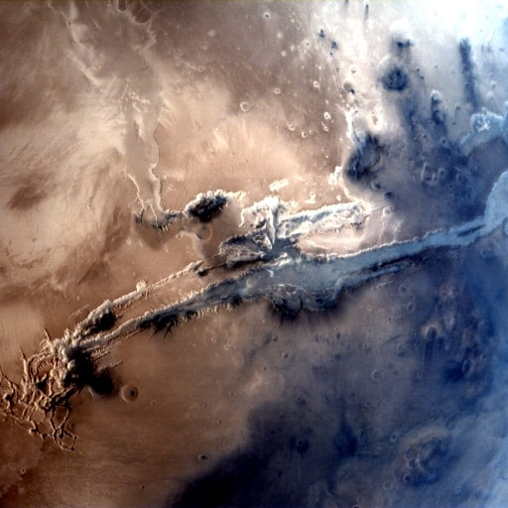
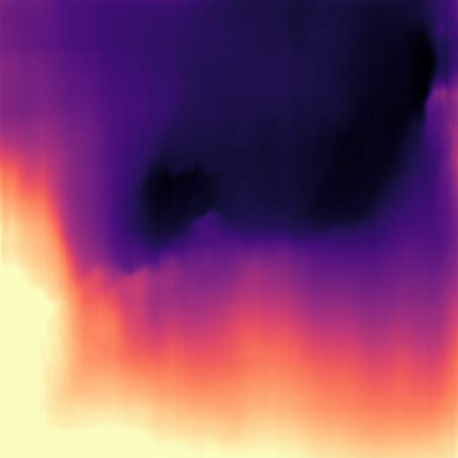
DAY 1 OUTPUT (CNN and Pose estimation)
Output: Generated Depth Map
Input: RGB image

Slide 5
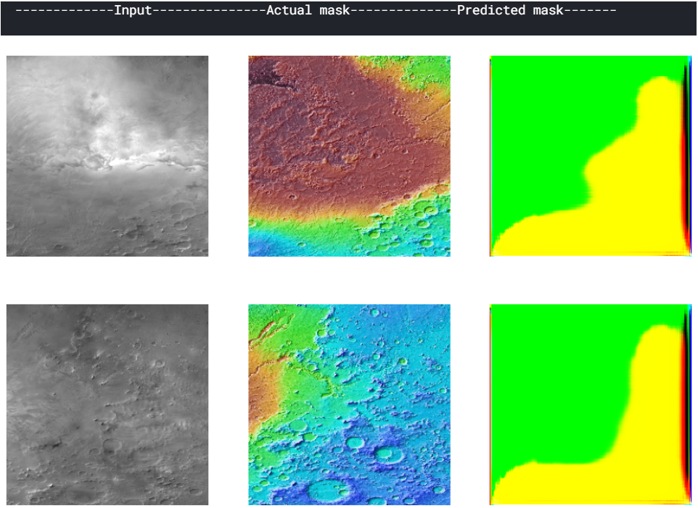
DAY 2 OUTPUT (CNN and ResNet with Unet)
TRAINING DATA: 4 Images EPOCH: 1

Slide 6
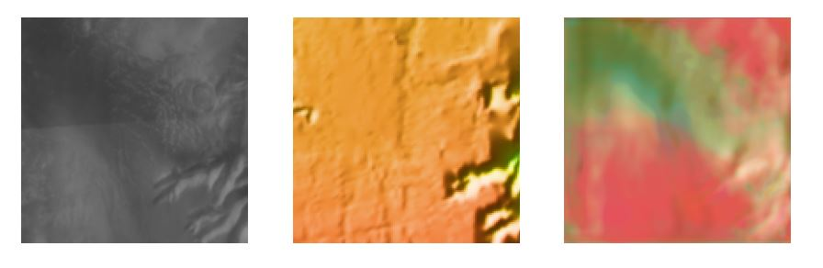
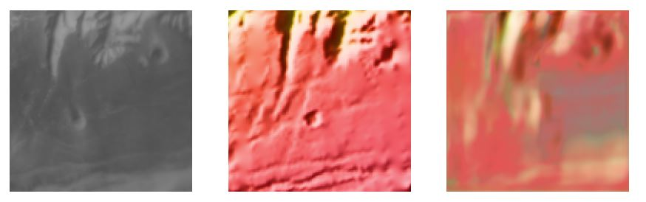
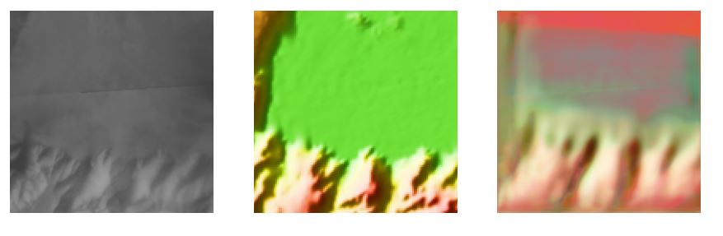
DAY 3 OUTPUT
TRAINING DATA: 900 Images
EPOCH: 30

Slide 7
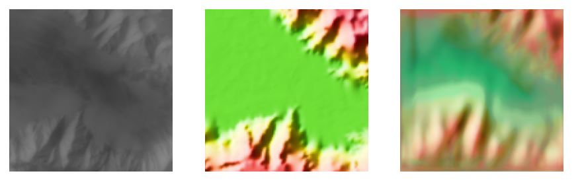

Slide 8
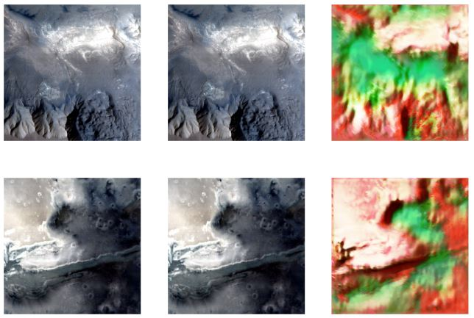
Depth estimation of provided images

Slide 9
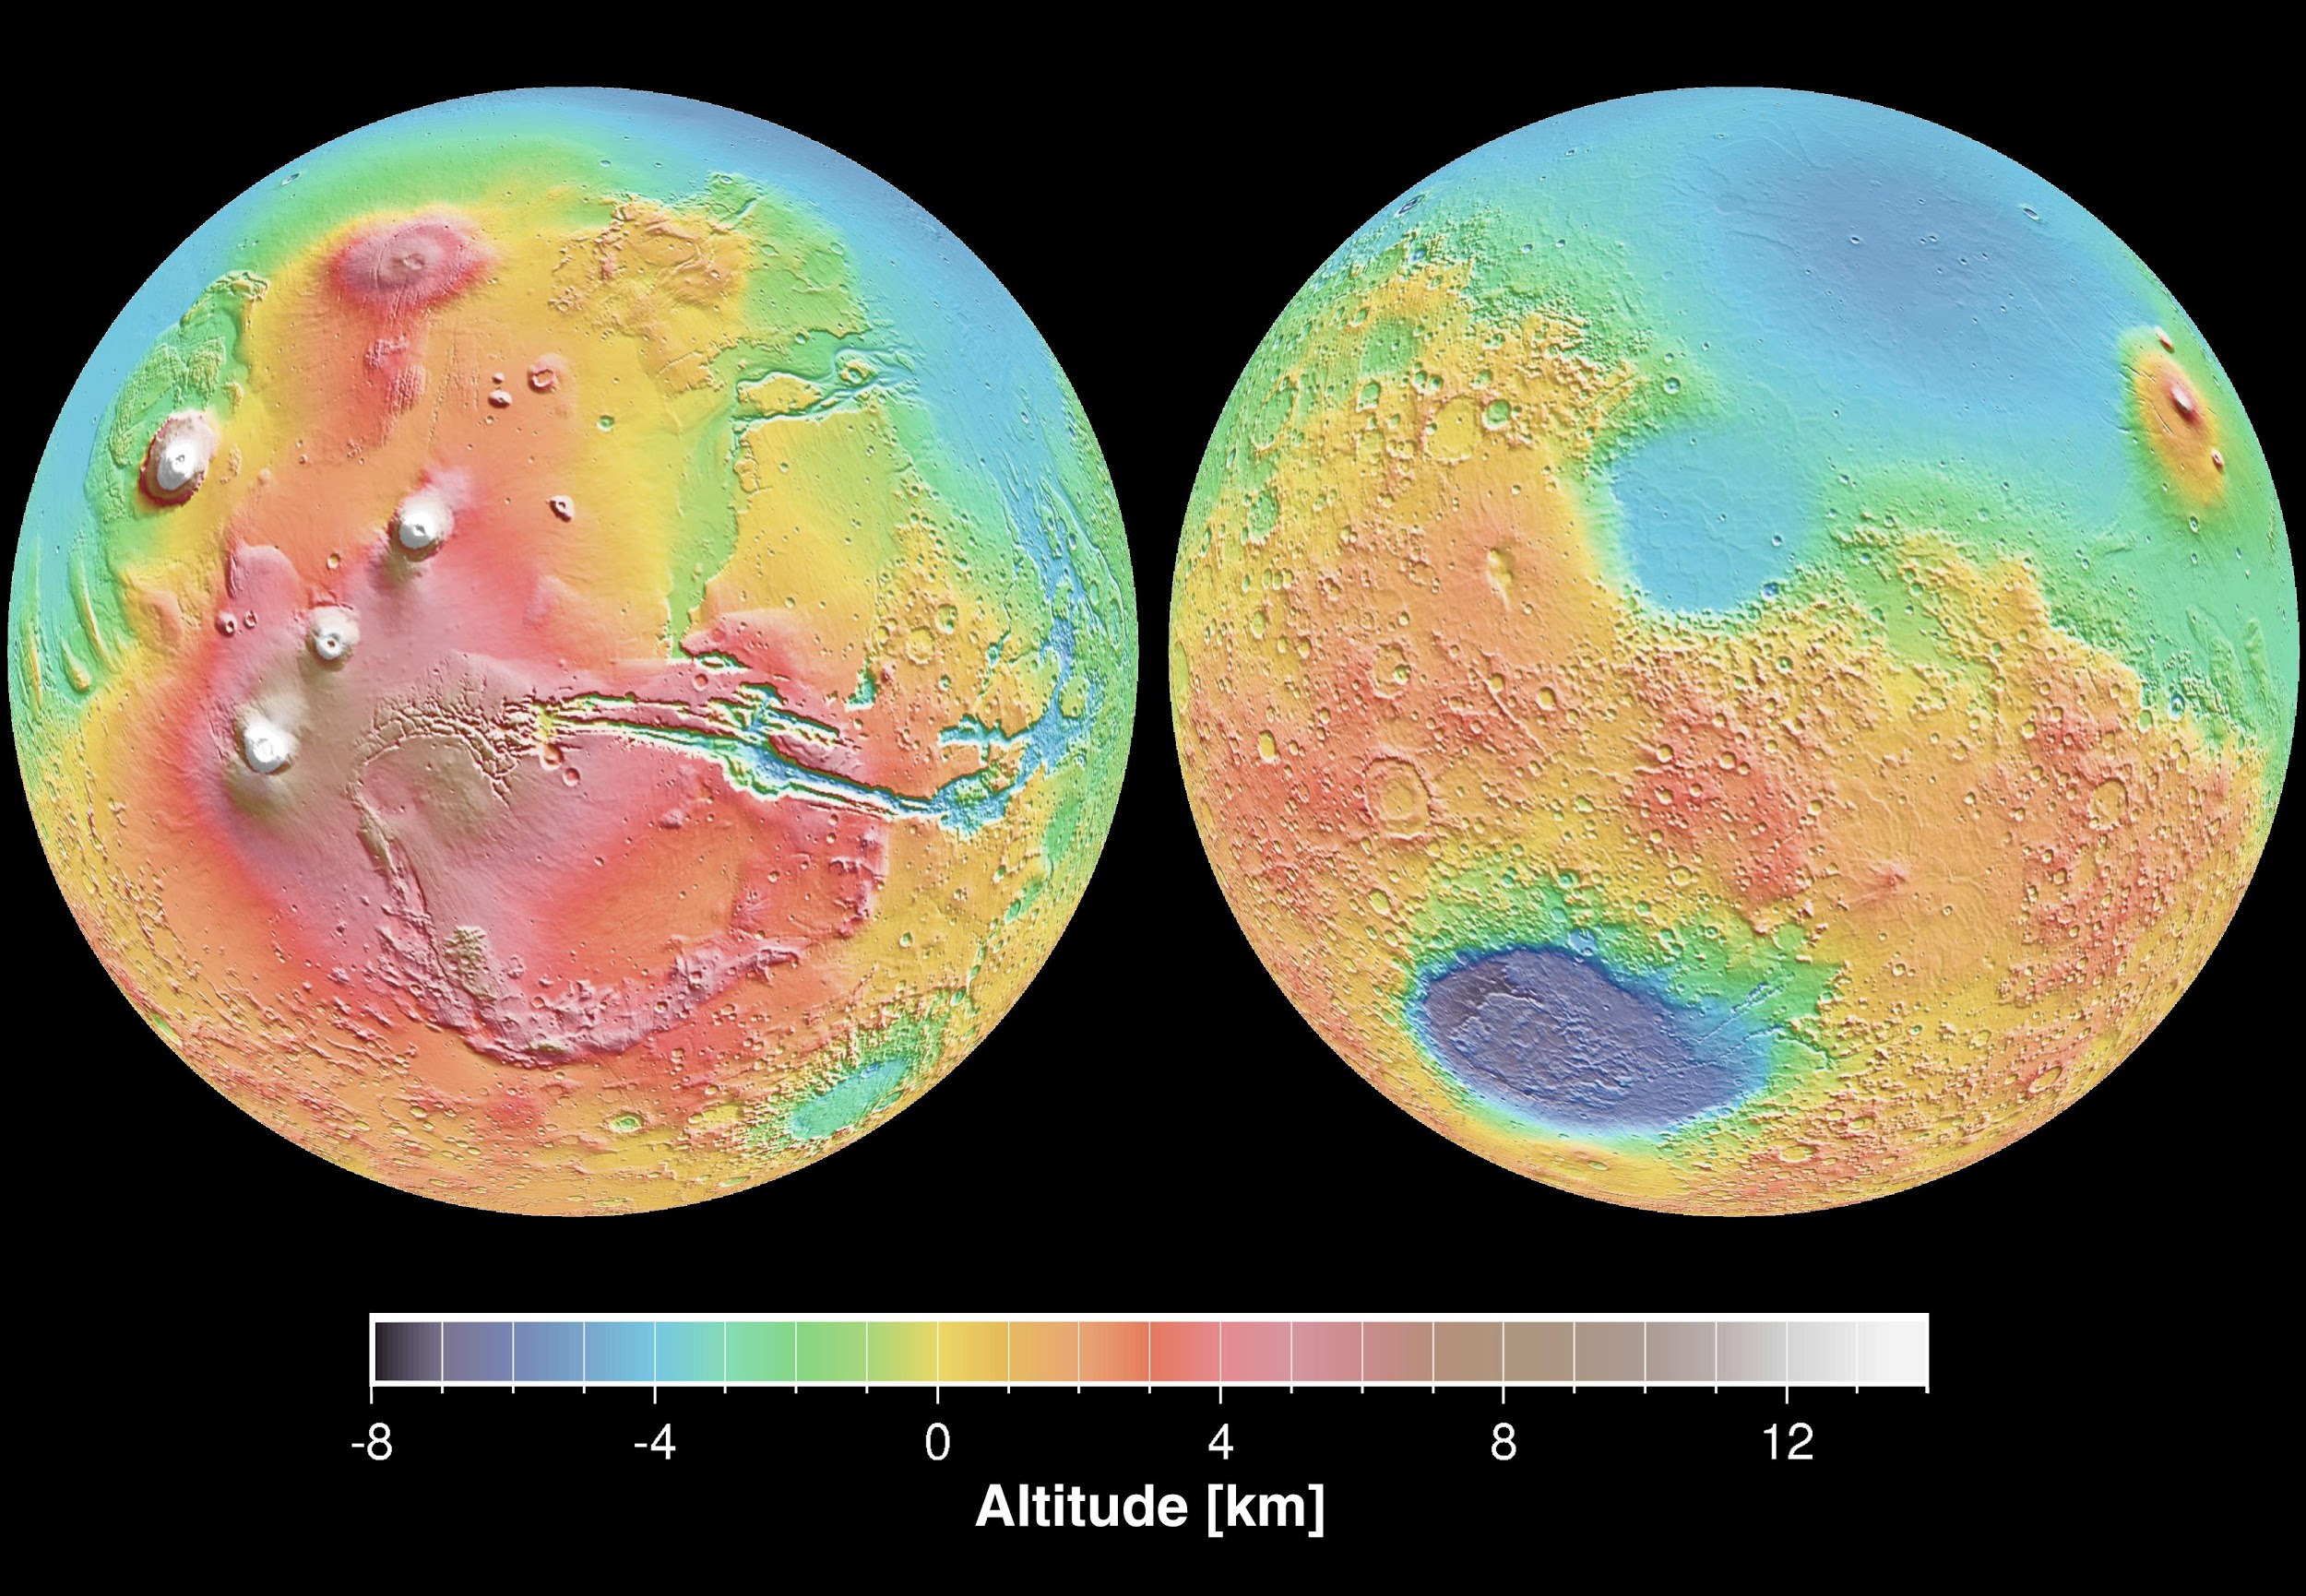
NASA’S BASIC DEPTH MEASURING SCHEME

Slide 10
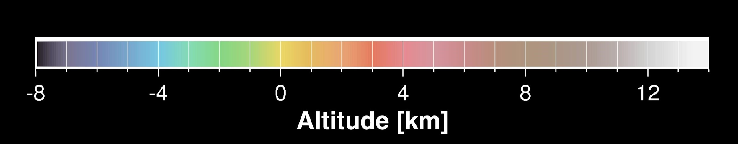
According to the depth map generated, Depth≈5km

Slide 11
MODULES USED
NumPy(): NumPy is a python library used for working with arrays. NumPy aims to provide an array object that is up to 50x faster that traditional Python lists.
OpenCV: OpenCV is a cross-platform library using which we can develop real-time computer vision applications. It mainly focuses on image processing, video capture and analysis including features like face detection and object detection.
tensorflow(): TensorFlow is a Python-friendly open source library for numerical computation that makes machine learning faster and easier.
keras(): Keras is a powerful and easy-to-use free open source Python library for developing and evaluating deep learning models. It wraps the efficient numerical computation libraries Theano and TensorFlow and allows you to define and train neural network models in just a few lines of code.
glob(): A glob is a string of literal and/or wildcard characters used to match filepaths. Globbing is the act of locating files on a filesystem using one or more globs.
tqdm(): smart progress meter

Slide 12
DATASET
To generate depth map for the given input RGB image, the system should be trained using relevant dataset.
Trained System ∝ Better depth map generation.
DATASET SPECIFICATIONS
SIZE: ≈ 16 KB (RGB), 27-35 KB (DEPTH MAP)
DIMENSIONS(pixels x pixels): 256 x 256
Image format: PNG
1700 RGB Images and 1700 Depth Images used for training the model

Slide 13
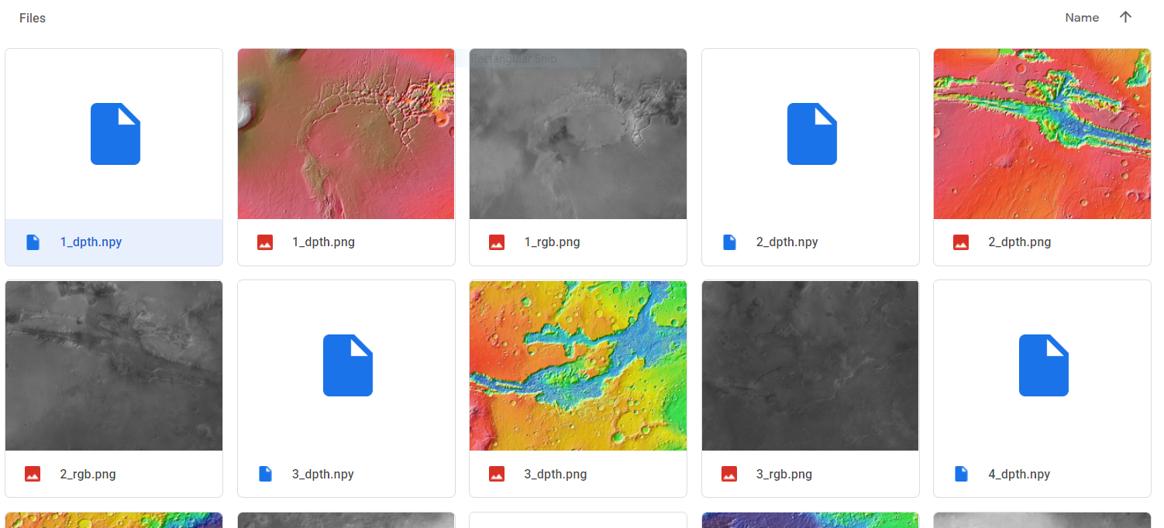
DATASET

Slide 14
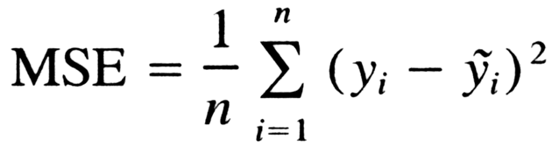
LOSS FUNCTION :
ACTIVATION FUNCTION : ReLu

Slide 15
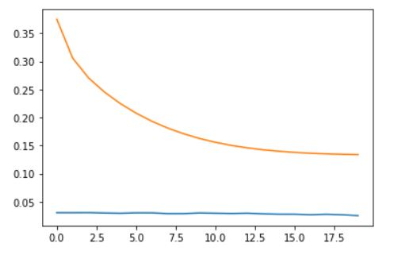
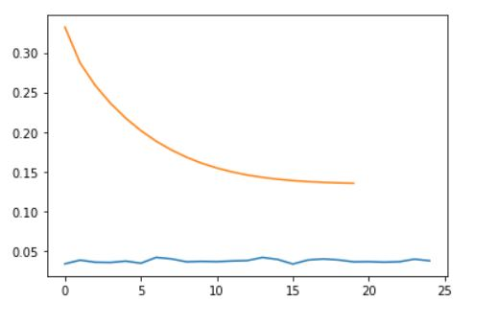
LOSS VALUE CHANGE(X-axis: Epochs, Y-axis: Loss Value)
Training Data, Loss (MSE)
Validation Data, Loss (MSE)
After 40 epochs:- Loss: 0.0258, Val_loss: 0.0382

