Slide 1

ML-Based Network Intrusion Detection System CYB23IN201 Internship –II First Review Date: 05/06/2026
Student Name: Vaishali. B
Unique Id: E0224009
Guide Name: Dr. Surya. S

Slide 2
INTRODUCTION
Need for the Technology:
Manual log analysis is time-consuming and requires expert knowledge.
ML models can detect patterns in large traffic data that humans cannot spot easily.
LLMs can explain alerts in plain English, making it usable by non-experts too.
Applications:
Network security monitoring in organizations and data centers.
SOC (Security Operations Center) alert management.
Cloud infrastructure threat detection.
Motivation behind the study:
Cyber attacks on networks are increasing every year and cause major damage to organizations.
Existing rule-based systems cannot detect new or unknown attack patterns.
There is a growing need for smarter, automated detection systems that can adapt.
Challenges to be addressed:
Handling class imbalance in network traffic datasets.
Making ML models explainable and not just a black box.
Integrating multiple modules (ML + SHAP + LLM) into one working system.

Slide 3
REVIEW OF LITERATURE (Minimum 15 Works)
Author and Year (chronological order) | Methodology/ Materials and Methods | Datasets | Results/Outcome | Advantage / Key findings from the work | Disadvantage/ GAP Identified from the work
Vapnik (1995) | Support Vector Machine classification | Multiple | Strong performance on binary classification | Good for high-dimensional data | Slower on large datasets, hard to tune
Breiman (2001) | Random Forest algorithm | Multiple | High accuracy, handles noise well | Works well with tabular data | Black-box model, needs SHAP for explanation
Yin et al. (2017) | Deep belief network for intrusion detection | KDD Cup 99 | Good detection rate | Can handle high-dimensional data | Older dataset, no explainability
Lundberg & Lee (2017) | SHAP values for model interpretation | Multiple | Unified explainability framework | Works with any ML model | Computationally expensive for large datasets
Sharafaldin et al. (2018) | Collected and labelled network traffic for multiple attack types | CICIDS 2017 | Created a benchmark dataset with 15 attack types | First realistic modern IDS dataset | Does not include detection model
Mirsky et al. (2018) | Kitsune — network anomaly detection using autoencoders | Real traffic | Detects anomalies without labelled data | Unsupervised, plug-and-play | Lower accuracy than supervised methods
Khraisat et al. (2019) | Survey of IDS techniques including signature, anomaly, hybrid | Multiple | Compared strengths of each approach | Comprehensive overview | No implementation or comparison on single dataset

Slide 4
Author and Year (chronological order) | Methodology/ Materials and Methods | Datasets | Results/Outcome | Advantage / Key findings from the work | Disadvantage/ GAP Identified from the work
Ferrag et al. (2020) | Deep learning models for intrusion detection | NSL-KDD, CICIDS | High accuracy with CNN and LSTM | Good accuracy results | High computational cost, lacks explainability
Chen & Guestrin (2016) | Gradient boosted trees (XGBoost) | Multiple | Faster and more accurate than traditional boosting | Efficient for tabular data | Not specifically applied to cybersecurity
Devlin et al. (2019) | BERT — bidirectional transformer for NLP tasks | Multiple | State-of-the-art NLP performance | Strong language understanding | Large model size, slow inference
Liu et al. (2019) | RoBERTa — improved BERT training | Multiple | Better than BERT on most NLP benchmarks | More robust training | Needs more compute than BERT
Faker & Dogdu (2019) | Random Forest and other classifiers on NSL-KDD | NSL-KDD | RF achieved 99% accuracy | Simple and effective | Dataset is outdated compared to CICIDS 2017
Ring et al. (2019) | Survey of network-based IDS datasets | Multiple | Evaluated 35 datasets for IDS research | Good reference for dataset selection | No new model proposed

Slide 5
Author and Year (chronological order) | Methodology/ Materials and Methods | Datasets | Results/Outcome | Advantage / Key findings from the work | Disadvantage/ GAP Identified from the work
Abdulhammed et al. (2019) | Feature selection using machine learning on CICIDS | CICIDS 2017 | Improved accuracy with selected features | Reduced training time | Limited attack categories tested
Zhao et al. (2023) | Survey of large language models and their capabilities | Multiple | Comprehensive overview of LLM capabilities | Covers latest LLM developments | Not applied to cybersecurity specifically

Slide 6
REVIEW OF EXISTING SYSTEM
Author /Developer Year (chronological order) | Methodology/ Materials and Methods | Datasets | Results/Outcome | Advantage / Key findings from the work | Disadvantage/ GAP Identified from the work
Snort (Cisco) 1998–present | Signature-based rule matching on network traffic | Real network traffic | Detects known attacks accurately in real time | Free, open source, widely used in industry | Cannot detect unknown or new attack types — no ML
Suricata 2010–present | Signature + protocol analysis, multi-threaded processing | Real network traffic | Faster detection than Snort with multi-threading | Better performance than Snort, still free | Still rule-based, no machine learning, misses novel attacks
Darktrace 2013–present | Unsupervised ML for anomaly detection on live traffic | Live enterprise network data | Self-learning system that detects threats without manual rules | No need for manual rule configuration | Expensive, closed source, no explainability — black box model

Slide 7
PROBLEM STATEMENT
Network attacks are becoming more frequent, but existing tools like Snort and Suricata can only detect known attacks using fixed rules, and AI-based systems like Darktrace lack explainability.
So this project builds an ML-based intrusion detection system that not only detects multiple attack types accurately but also explains its decisions using SHAP and summarises alerts in plain English using an LLM.

Slide 8
OBJECTIVES
Objective 1:
To build a multi-class network intrusion detection system using the CICIDS 2017 dataset that classifies traffic into normal and attack categories with a minimum accuracy of 92%.
Objective 2:
To compare three ML classifiers — Random Forest, XGBoost, and SVM — and identify the best model based on accuracy, F1-score, and ROC-AUC.
Objective 3:
To apply SHAP to explain which network traffic features influence each classification decision, making the model transparent and interpretable.
Objective 4:
To integrate an LLM that reads detection alerts and generates simple, readable summaries with suggested response actions.
Objective 5:
To deploy the complete system as an interactive Streamlit dashboard for real-time network threat monitoring.

Slide 9
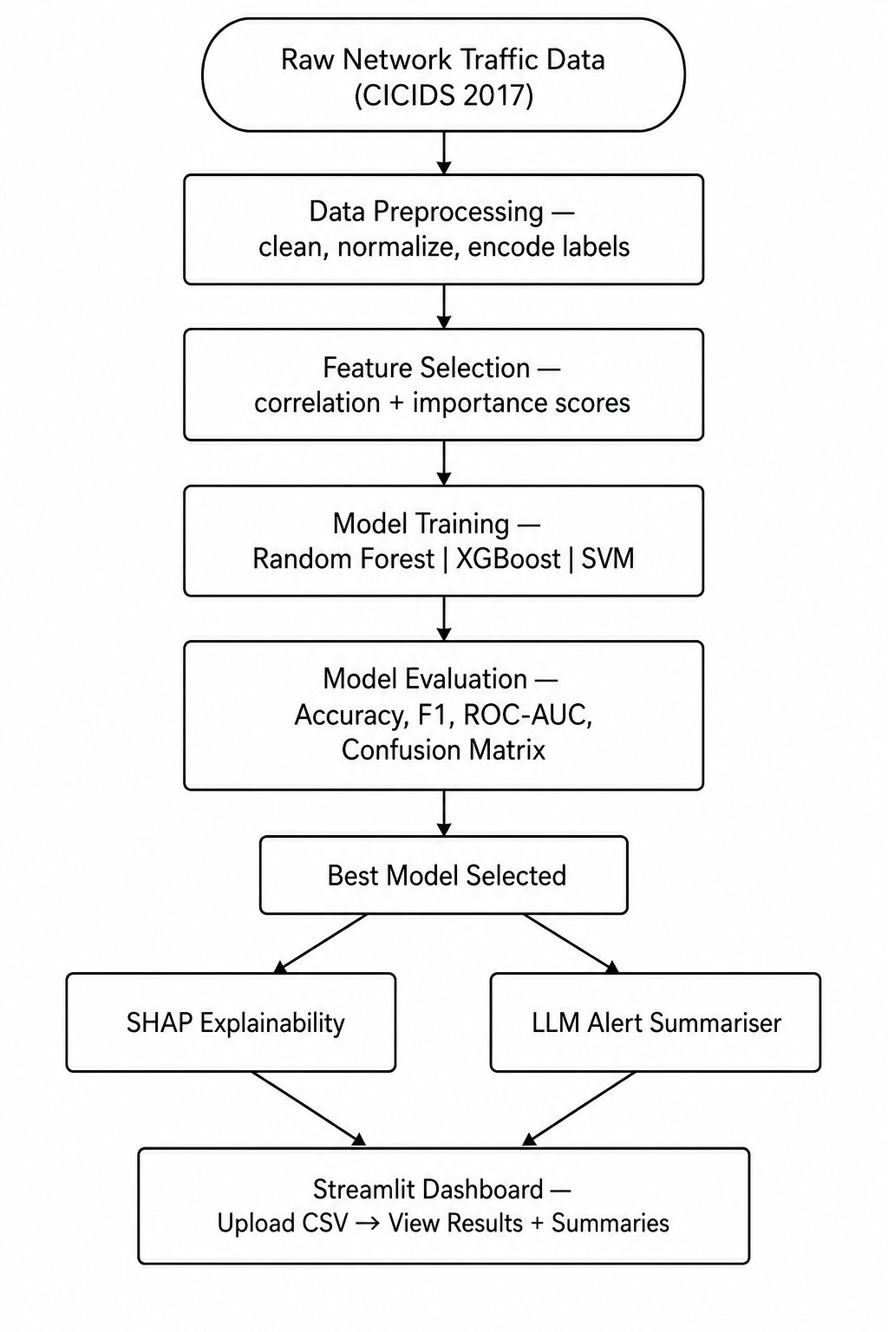
WORKFLOW DIAGRAM

Slide 10
MODULES
# | Modules | Methodology/ Algorithm | Technologies (H/W and S/W) | Implementation
1 | Data Preprocessing | Missing value removal, MinMaxScaler, Label Encoding | Python, Pandas, NumPy | Planned
2 | Feature Selection | Correlation matrix, Feature importance ranking | Scikit-learn, Seaborn, Matplotlib | Planned
3 | Multi-Classifier Training | Random Forest, XGBoost, SVM | Scikit-learn, XGBoost | Planned
4 | Explainability Module | SHAP values, force plots, bar charts | SHAP library | Planned
5 | LLM Log Summariser | Prompt engineering, HuggingFace Transformers | HuggingFace API, Python | To Be Determined
6 | Streamlit Dashboard | File upload, chart display, summary output | Streamlit, Matplotlib | To Be Determined

Slide 11
EXPECTED OUTCOME
A trained and tested intrusion detection model with 92%+ classification accuracy on CICIDS 2017.
A comparison table showing accuracy, F1-score, precision, recall, and ROC-AUC for all three classifiers.
SHAP feature importance charts showing which traffic features most influence attack classification.
An LLM pipeline that reads alert logs and outputs readable threat summaries with response suggestions.
A working Streamlit web application where a user can upload traffic data and get detection results + summaries in real time.
A fully documented GitHub repository with all code, notebooks, and trained models.

Slide 12
CONCLUSION
Cyber attacks are increasing and traditional IDS are not enough.
This project builds an ML-based IDS using Random Forest, XGBoost, and SVM to detect and classify network attacks.
SHAP makes the model explainable — not just a black box.
LLM converts alerts into simple, readable summaries.
Everything is deployed as a Streamlit dashboard.
Goal: make intrusion detection smarter, explainable, and practical.

Slide 13
REFERENCES
[1] I. Sharafaldin, A. H. Lashkari, and A. A. Ghorbani, "Toward generating a new intrusion detection dataset and intrusion traffic characterization," in Proc. ICISSP, 2018, pp. 108–116.
[2] A. Khraisat, I. Gondal, P. Vamplew, and J. Kamruzzaman, "Survey of intrusion detection systems: Techniques, datasets and challenges," Cybersecurity, vol. 2, no. 1, pp. 1–22, 2019.
[3] M. A. Ferrag, L. Maglaras, A. Moschoyiannis, and H. Janicke, "Deep learning for cyber security intrusion detection," J. Inf. Secur. Appl., vol. 50, p. 102419, 2020.
[4] T. Chen and C. Guestrin, "XGBoost: A scalable tree boosting system," in Proc. KDD, 2016, pp. 785–794.
[5] S. M. Lundberg and S. I. Lee, "A unified approach to interpreting model predictions," in NeurIPS, vol. 30, 2017, pp. 4765–4774.
[6] Y. Mirsky, T. Doitshman, Y. Elovici, and A. Shabtai, "Kitsune: An ensemble of autoencoders for online network intrusion detection," in Proc. NDSS, 2018.
[7] O. Faker and E. Dogdu, "Intrusion detection using big data and deep learning techniques," in Proc. ACM SE, 2019.
[8] M. Ring et al., "A survey of network-based intrusion detection data sets," Comput. Secur., vol. 86, pp. 147–167, 2019.
[9] R. Abdulhammed et al., "Features dimensionality reduction for ML-based network intrusion detection," Electronics, vol. 8, no. 3, p. 322, 2019.

Slide 14
[10] W. X. Zhao et al., "A survey of large language models," arXiv:2303.18223, 2023.
[11] J. Devlin, M. Chang, K. Lee, and K. Toutanova, "BERT: Pre-training of deep bidirectional transformers," in Proc. NAACL-HLT, 2019, pp. 4171–4186.
[12] Y. Liu et al., "RoBERTa: A robustly optimized BERT pretraining approach," arXiv:1907.11692, 2019.
[13] C. Yin, Y. Zhu, J. Fei, and X. He, "A deep learning approach for intrusion detection," IEEE Access, vol. 5, pp. 21954–21961, 2017.
[14] L. Breiman, "Random forests," Mach. Learn., vol. 45, no. 1, pp. 5–32, 2001.
[15] V. N. Vapnik, The Nature of Statistical Learning Theory. New York: Springer, 1995.

Slide 15
WEB REFERENCES
[1] Kaggle – CICIDS 2017 Dataset. Available: https://www.kaggle.com/datasets/cicdataset/cicids2017
[2] SHAP Documentation. Available: https://shap.readthedocs.io/en/latest/
[3] HuggingFace Transformers. Available: https://huggingface.co/docs/transformers
[4] Streamlit Documentation. Available: https://docs.streamlit.io
[5] Snort IDS Official Site. Available: https://www.snort.org
[6] Suricata IDS. Available: https://suricata.io
[7] Scikit-learn Documentation. Available: https://scikit-learn.org/stable/

Slide 16
Thank you

