Slide 1




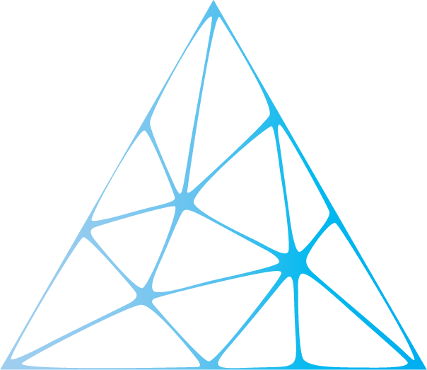

Federated Machine Learning
www.continental-corporation.com
Systems & Technology

Slide 2
Overview
Introduction
Why?
How?
Where?
Technicalities
Heads-up on what we are going to talk about
So what exactly do we mean by Federated Learning?
Okay, but why do we adopt this technology?
Now that we know what it is and why we use it, lets get to know how it is being implemented
Tools and frameworks we will need
We understand what, why and how we use federated learning for, but where do we use it?
What?
FL in Automotive Industry
When?
Bottlenecks
Summary
References
When do we use it?
How do we make it a part of our automotive family?
Now lets flippedy flip to the other side, shall we?
Long story short
What I plan to focus on next
Well, now that we are into federated learning, should I call them my sources or my clients?
Future Progress Plan

Slide 3
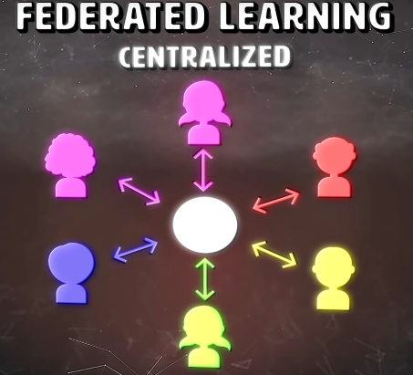
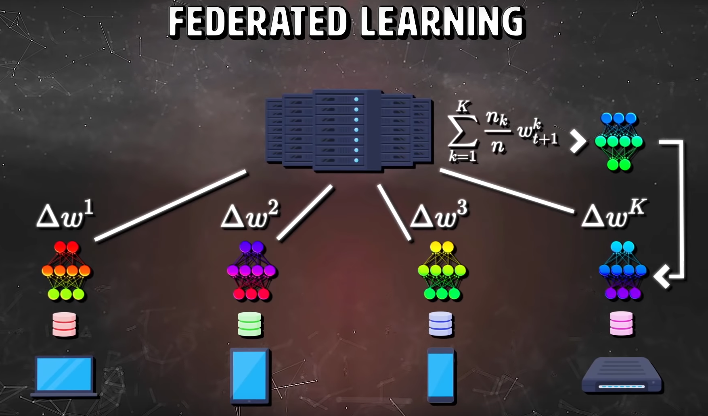
Federated Machine Learning
Introduction
Before training a machine learning model, a data scientist must first collect user data.
User's generate these data, generally by using devices like mobile phones or laptops, by recording the events in the real world.
The way this data is usually aggregated is by following a simple server-client model.
Data is sent from multiple user devices to a central server that contains the model and the model then trains on this data. We can consider this the centralized learning, as the learning or training process occurs on the central server.
Federated learning, however, flips this pipeline. Instead of bringing training data to the model via a central server, it brings the model to the training data on whichever machine it is located.
This allows the people who create the data to maintain ownership, without sending it off to a machine, that they don’t control.

Slide 4
So, What do understand by the term ‘Federated’ ?
set up as a single centralized unit within which each state or division keeps some internal autonomy.

Slide 5
Federated Machine Learning
What is federated Learning?
Federated Learning is a machine learning setting where the goal is to train a high quality centralized model while training data remains distributed over a large number of clients each with unreliable and relatively slow network connections.
Instead of gathering data in the cloud from users to train data sets, federated learning trains AI models on mobile devices in large batches, then transfers those learnings back to a global model without the need for data to leave the device.
We consider learning algorithms for this setting where on each round, each client independently computes an update to the current model based on its local data, and communicates this update to a central server, where the client-side updates are aggregated to compute a new global model.
Step 1
Step2
Step3

Slide 6
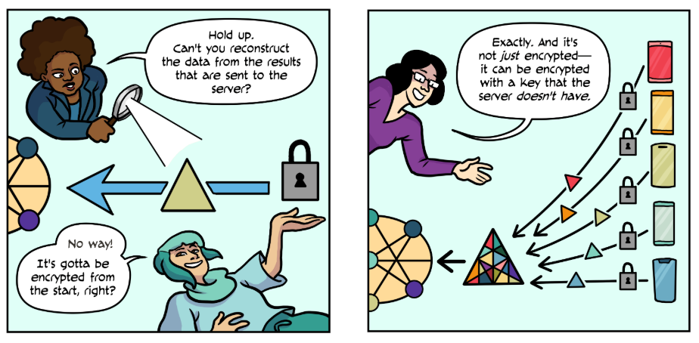
Federated Machine Learning
The typical clients in this setting are mobile phones, and communication efficiency is of the utmost importance.
Federated Learning enables mobile phones to collaboratively learn a shared prediction model while keeping all the training data on device, decoupling the ability to do machine learning from the need to store the data in the cloud.
The devices are used as nodes performing computation on their local data in order to update a global model.

Slide 7
Federated Machine Learning
And what do we encrypt?
We want to encrypt the gradients (or model updates) before performing the aggregation so that no one will be able to see the gradients.
  Google developed a Secure Aggregation protocol in which the main idea is server generates a public and private key pair and share public keys to each client
  Secret sharing is a method where the secret is divided and the shares are distributed among multiple participants, each having no value as such but when combined, gives a meaningful result (i.e., the secret can be determined)
  Homomorphic encryption generates an encrypted result which, when decrypted, matches the result of the operations as if they had been performed on the plaintext.

Slide 8
Federated Machine Learning
Here's how Google described it when it first announced the technology two years ago:
It works like this:
  your device downloads the current model, improves it by learning from data on your phone, and then summarizes the changes as a small focused update. Only this update to the model is sent to the cloud, using encrypted communication, where it is immediately averaged with other user updates to improve the shared model. All the training data remains on your device, and no individual updates are stored in the cloud.

Slide 9
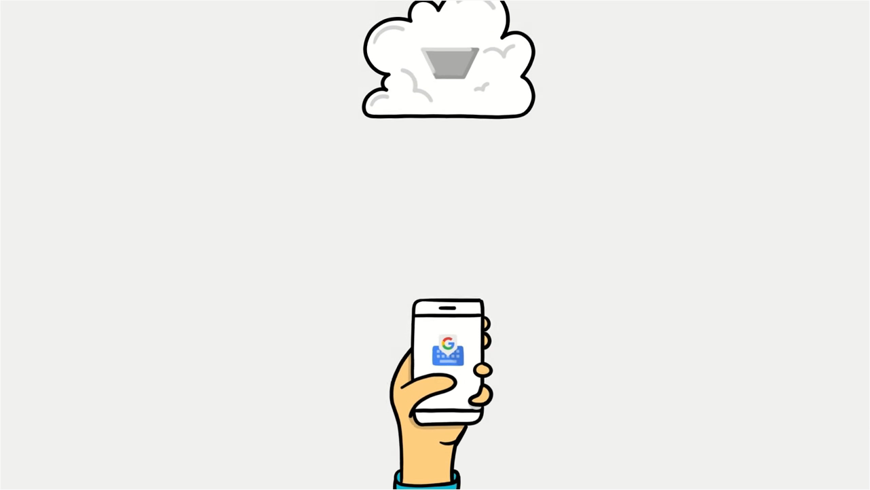
This work is still in an early stage, and we do not have all problems solved, nor are we able to give a comprehensive discussion of all required components. Rather, we attempt to sketch the major components of the system, describe the challenges, and identify the open issues, in the hope that this will be useful to spark further systems research.

Slide 10
Federated Machine Learning
What is the problem with traditional AI?
The AI market is dominated by tech giants such as Google, Amazon and Microsoft, offering cloud-based AI solutions and APIs.
In the traditional AI methods sensitive user data are sent to the servers where models are trained.
It includes network latencies and costs due to continuously sharing data with the server.

Slide 11
Federated Machine Learning
Traditional AI
Giant AI companies such as Google, Facebook, and Amazon have been collecting a gigantic amount of data and store these data in their datacenters.
This centralized training approach, however, is privacy-intrusive, especially for mobile phone users.
This is because mobile phones may contain the owners’ privacy-sensitive data.
To train or obtain a better machine learning model under such a centralized training approach, mobile phone users have to trade their privacy by sending their personal data stored inside phones to the clouds owned by the AI companies.

Slide 12
Federated Machine Learning
Centralized AI - Constraints
Centralized AI is by far the most common architecture. However, by separating AI algorithms from users’ devices, we are constantly moving colossal volumes of data.
These repetitive transfers create serious constraints:
  Diminished privacy: the obligation to transfer our data and to have it stored on remote servers creates opportunities for hackers to intercept data and use it inappropriately
  Incompatibility with many sectors: for confidentiality reasons several industries are not able to share their data and store it in the cloud (health sector, insurance, bank, military etc.). These sectors cannot benefit from Centralized Artificial Intelligence.
  Latency problems that slow inference ; centralized AI is inappropriate for many use-cases where AI needs to interact in real time with the real world.
  High transfer costs due to the exploding amount of data that needs to be handled.

Slide 13
Federated Machine Learning
So, why Federated Learning?
Compared to the centralized training approach, federated learning is a decentralized training approach which enables mobile phones located at different geographical locations to collaboratively learn a machine learning model while keeping all the personal data that may contain private information on device.
In such a case, mobile phone users can benefit from obtaining a well-trained machine learning model without sending their privacy-sensitive personal data to the cloud.
Saves battery and bandwidth, since you would have to download the model on Wi-Fi
Federated Learning models are hyper personalized for an user, involve minimum latencies, and are privacy preserved by design.

Slide 14
Federated Machine Learning
Now that we understood what federated learning is, lets see how it is set up
Iterative learning
To ensure good task performance of a final, central machine learning model, federated learning relies on an iterative process broken up into an set of client-server interactions known as a federated learning round.
Each round of this process consists in
  transmitting the current global model state to participating nodes,
  training local models on these local nodes to produce a set of potential model updates at each node,
  and then aggregating and processing these local updates into a single global update and applying it to the global model.

Slide 15
In the methodology below, we use a central server for this aggregation, while local nodes perform local training depending on the central server's orders. However, other strategies lead to the same results without central servers, in a peer-to-peer approach, using gossip methodologies
Initiation : A statistical model (e.g., linear regression,..) is chosen to be trained on local nodes and initialized. Nodes are activated and wait for the central server to give calculation tasks.
Iterative training : For multiple iterations of so-called federated learning rounds, the following steps are performed:
  Selection : A fraction of local nodes are selected to start training on local data. They all acquire the same current statistical model from the central server. Other nodes wait for the next federated round.
  Configuration : The central server orders selected nodes to undergo training of the model on their local data.
  Reporting : Each node returns the locally learned incremental model updates to the central server.
  The central server aggregates all results and stores the new model. It also handles failures (e.g., connection lost with a node while training). The system returns to the selection phase.
Termination : When a pre-specified termination criterion (e.g. maximal number of rounds or local accuracies higher than some target) has been met, the central server orders the end of the iterative training process. The central server contains a robust model which was trained on multiple heterogeneous data sources.

Slide 16
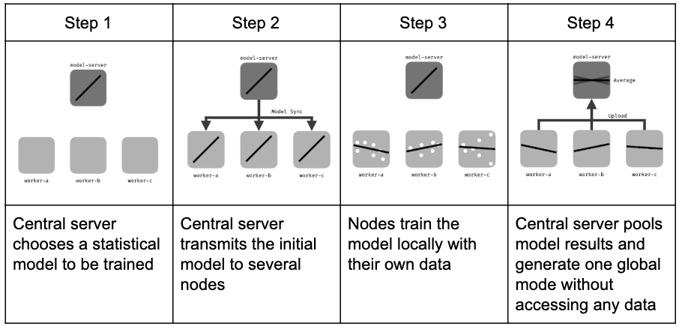
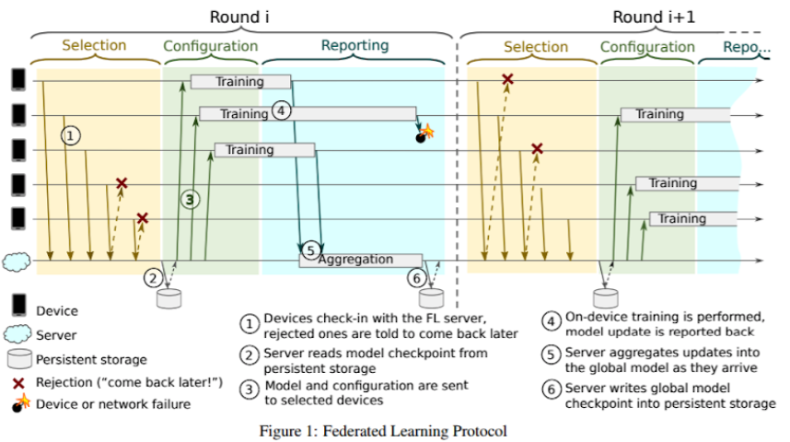

Slide 17
Federated Machine Learning
Other strategy in Federated Learning?
Orchestrator-less distributed networks
The way the statistical local outputs are pooled and the way the nodes communicate with each other can change from the centralized model explained in the previous section.
This leads to a variety of federated learning approaches: for instance no central orchestrating server, or stochastic communication.
In particular, orchestrator-less distributed networks are one important variation.
In this case, there is no central server dispatching queries to local nodes and aggregating local models.
Each local node sends its outputs to a several randomly-selected others, which aggregate their results locally.
This restrains the number of transactions, thereby sometimes reducing training time and computing cost.

Slide 18
Federated Machine Learning
Technologies and Frameworks for Federated Learning Implementation
Some of the popular and recent Federated Learning frameworks include TensorFlow Federated, an open source framework by Google for experimenting with machine learning and other computations on decentralized data.
PySyft is an open source library (a set of tool) that is built on top of PyTorch for encrypted, privacy preserving deep learning.

Slide 19
NumPy | PyTorch | TensorFlow
You can build a machine learning algorithm even with NumPy, but creating a deep neural network is getting exponentially harder. NumPy is designed for (fast) computations, and not machine learning. It is usually used for machine learning together with a machine learning package. | It is a library that can be used to build Machine learning algorithms when you program in Python language. PyTorch is similar to NumPy in the way that it manages computations, but has a strong GPU support. Similarly to NumPy, it also has a C (the programming language) backend, so they are both much faster than native Python libraries. NumPy could be GPU accelerated (with some extra code), but it doesn't have this strong GPU support that PyTorch or TensorFlow do. Finally, PyTorch was specifically tailored for GPU functionality in Python. | TensorFlow, on the other hand, was written mainly in C++ and CUDA (language for programming GPUs), and was not specifically created for Python. It provides functionalities in C, C++, Java, Go (Google's language). So, with TF, you are not restricted by Python. Even if the syntax differs a bit across languages, the concepts are the same. TENSOR - N dimensional matrix, a format we feed data to neural networks in. That’s why tensor flow is called so as tensors flow through the computation graph.
PySyft represents pointers to tensors that live on remote machine easily. Once we have these pointers, we will store them in a list, and start training our model. It will iterate through each worker's respective dataset and train the model on them.

Slide 20
Federated Machine Learning
Comparison
Now, PyTorch has deep neural networks functionalities and that is why it is often compared with TensorFlow, sklearn, etc. Knowing NumPy, it is easier to switch to PyTorch than TensorFlow, that is why it is gaining popularity so fast.
PyTorch, on the other hand, is more recent, so it does not have the full range of capabilities of other packages. This might change and they are on their way to catch up.
As TensorFlow was used by Google for so long, it is very easy to deploy algorithms using it.
Point being, the TensorFlow community is stronger, because TF is older.

Slide 21
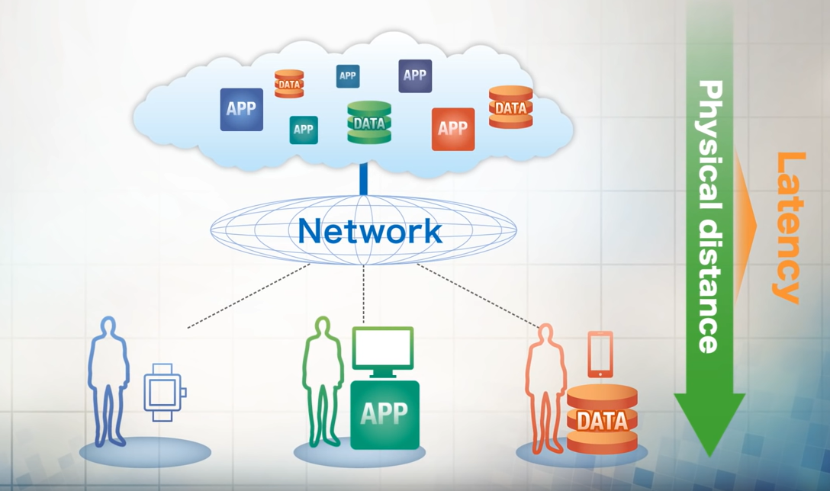
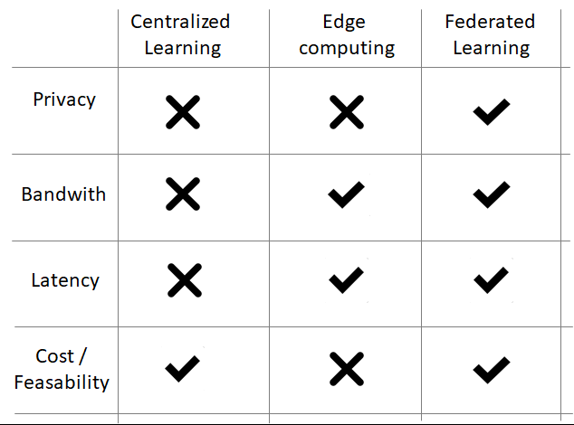
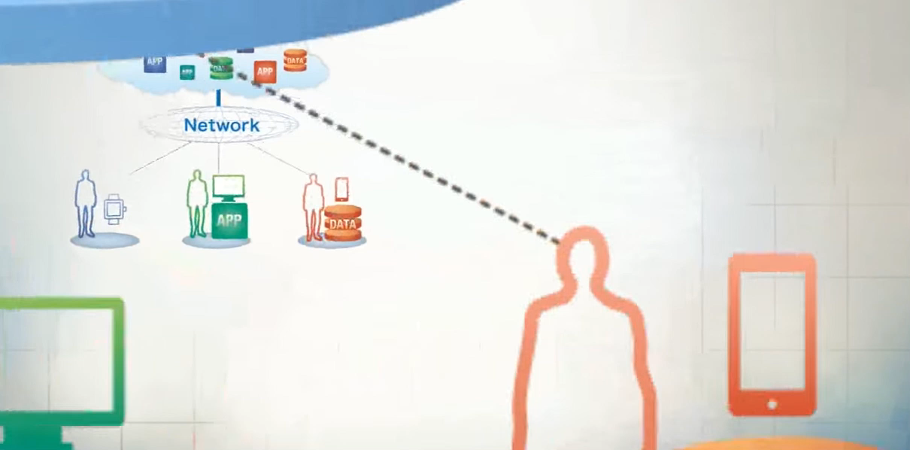
Federated Machine Learning
Comparison

Slide 22
Federated Machine Learning
Where do we use this approach?
Federated learning is revolutionizing how machine learning models are trained. Google has just released their first production-level federated learning platform, which will spawn many federated learning-based applications such as on-device item ranking, content suggestion, etc.
Federated Learning is obviously finding and will find home in many applications. Its most popular form is perhaps about smartphone keyboards learning words sequences from many users, aggregating findings and reusing them globally. A very helpful feature we know nowadays as assistants suggesting next words for our texts (Gboard), e-mails etc.
As privacy becomes a selling point, federated learning is poised to grow in popularity among both tech giants and industries. By using aggregated updates to train algorithms instead of raw data, Federated Learning empowers sectors where data cannot be transferred to third parties for confidentiality reasons (health sector, banks, insurance companies etc.) with data network effects.
Federated learning offers powerful new tools to treatment centers to make new discoveries without comprising the confidentiality of their patients.
Its applications are spread over a number of industries including defense, telecommunications, IoT, or pharmaceutics.
Federated learning doesn’t stop there, it can be used for numerous tasks where there are different versions of a model required, based on locale, context, sub-domains within a domain, and so on. In this sense, this is an exciting development and is probably set for more widespread adoption.

Slide 23
Federated Machine Learning
Where do we use this approach?
One of the popular open-source community whose goal is to make the world more privacy-preserving by lowering the barrier-to-entry to private AI technologies :
          OpenMined - http://openmined.org
With OpenMined, an AI model can be governed by multiple owners and trained securely on an unseen, distributed dataset.

Slide 24
Federated Machine Learning
When do we use this approach?
Privacy in data science
  Federated Learning
  Secure Multi Party Computation
  Differential Privacy
European Union generated GDPR - General Data Protection Regulation
107 countries has now put in place legislation to secure the protection of personal data.
HIPAA – Health Insurance Portability and Accountability Act in the healthcare sector.
Secure Multi Party Computation aims on creating methods for parties to jointly compute a function over their inputs while keeping those inputs private.
Differential privacy is a system for publicly sharing information about a dataset by describing the patterns of groups within the dataset while withholding information about individuals in the dataset.
We can use a combination of Federated Learning, Secure Multi Party Computation and Differential Privacy to create intelligent app.
Thus, using these three techniques, we can create a training pipeline that keeps both user data private and keeps a model's valuable intelligence private.

Slide 25
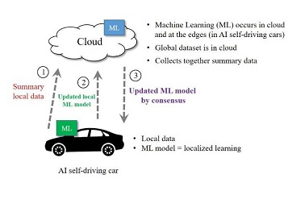
Federated Machine Learning
What does Federated Learning have to do with Automotive industry?
Federated Machine Learning in AI Self Driving Cars
The conventional approach right now to Machine Learning for most AI self-driving cars is that the Machine Learning happens in the cloud.
The AI self-driving car, we’ll consider it an edge device, provides data that is uploaded to the cloud.
The Machine Learning takes place in the cloud and then the resultant updated ML model is pushed down into the AI self-driving car. This happens via the OTA (Over The Air) capabilities of the AI self-driving car.
For this conventional approach, there really isn’t much of a federation taking place per se. It is simply that each of the AI self-driving cars that are included in this collective are dutifully uploading their collected data, and the real action of using that data for ML purposes occurs in the cloud. Presumably, all of the AI self-driving cars then get the resultant updated ML model and are obligated to use it, once it has been pushed down into the AI self-driving car locally.

Slide 26
Federated Machine Learning
Federated Machine Learning in AI Self Driving Cars
As shown, the Machine Learning in the AI self-driving car is also doing actual Machine Learning, and it then provides an updated ML up to the cloud. The cloud then has to figure out what to do with this updated ML, along with having the summarized data from the AI self-driving car too.
The cloud-based Machine Learning can potentially use the now-provided updated ML model from the AI self-driving car, further expand or refine it, and then ultimately push it back down to the AI self-driving car, which would replace the prior ML model with the new one.
Alternatively, the push could be just the changes of a new version of the updated ML model that has been modified via efforts in the cloud.
It will be unlikely that there is only one AI self-driving car in the collective or federation. Instead, it is assumed that there will be lots of AI self-driving cars in a particular federation.

Slide 27
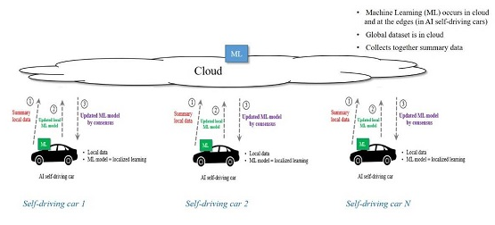
Federated Machine Learning
Federated Machine Learning in AI Self Driving Cars
Here, you can see that there are some multiple number of AI self-driving cars, each of which has its own respective ML model, each of which is collecting its own local data, and each of which is providing up to the cloud it’s local summarized data and its latest updated ML model.
The cloud now has the “collective wisdom” from the set of AI self-driving cars.
You might call this the wisdom of the crowd approach, or more formerly it is referred to as a Federated Machine Learning Architecture.

Slide 28
Federated Machine Learning
Federated Machine Learning in AI Self Driving Cars - But the question is..
Will all of the AI self-driving cars in the federation be ending up with the same ML model, upon each of the refresh cycles?
In other words, we could force all of the AI self-driving cars to have the same ML model, which would provide consistency across the AI self-driving cars and greatly simplify matters.
On the other hand, this might also then negate some localized ML model aspects that would otherwise be helpful or maybe even crucial to a particular AI self-driving car or subset of the AI self-driving cars.
This dovetails into a related question, namely how will the localized ML models be comingled into a single comprehensive ML model?
Some say that there should be a consensus approach. If enough of the localized ML models seem to have reached a new state that offers value, it gets included. Meanwhile, if the localized ML model is the only one or less than a consensus worth of having something new, it does not get included.
We next need to consider the security aspects. Suppose somehow a localized ML model gets infiltrated with something bad, such as an indication that once the AI self-driving car goes over 50 miles per hour and sees a green street sign it should then direct the self-driving car to crash into the nearest wall. Let’s pretend this gets pushed up to the cloud.
Let’s further assume that the cloud realizes this is something new, but doesn’t have any particular means to determine the reasonableness of it, and opts to then include it into the federated ML model. The federated model gets pushed out to the AI self-driving cars. Voila, this is like allowing a malware virus to readily be shared, doing so via the handy mechanism put in place for more valid purposes.

Slide 29
Federated Machine Learning
Federated Machine Learning in AI Self Driving Cars – Another question is..
Another aspect involves conflicts among the ML models that are provided to the cloud.
Let’s say that one ML model indicates to never go faster than the speed limit, while another ML model has indicated that sometimes going faster than the speed limit is warranted such as an emergency to rush the occupants to a hospital.
How again will the cloud be ascertaining what stays and what goes, and if model updates are in contradiction how to resolve the contradiction.

Slide 30
Federated Machine Learning
Federated Machine Learning in AI Self Driving Cars – And more questions are..
How much ML should be taking place in the AI self-driving car itself?
Should it be getting data from the cloud that was collected from other AI self-driving cars, so it can do further ML?
How much processing do we want to take place in an AI self-driving car and how much will that raise the cost and complexity of the AI self-driving car?
These and many other questions are now being explored, and the future of AI self-driving cars as being part of a Federated Machine Learning approach is a necessity and still open matter of intense and vital focus.
Google is doing some fascinating work on Federated Machine Learning as it relates to mobile devices such as smart phones. They have considered too aspects of optimization algorithms, and how it can be utilized in this Federated ML structure.

Slide 31
Federated Machine Learning
Every coin has another side, doesn't it? Let’s see the bottlenecks of FL now.
Inference Attacks
  the repeated model weight updates can be exploited to reveal properties not global to the data but specific to individual contributors
Model Poisoning
  Some researchers have investigated the possibility of misbehaving clients introducing backdoor functionality or mounting Sybil attacks to poison the global model.
Communication bandwidth
  the bottleneck is shifted from computation to communication. As a consequence, limited communication bandwidth could incur long communication latency, and thus could significantly slow down the convergence time of the federated learning process
Feasibility
  highly constrained by the capabilities of the edge devices to perform local training and inferencing. While this may not remain a major barrier to entry as most smartphones and IoT devices newly launched are equipped with GPUs or sufficient computing hardware to run powerful AI models. Today it’s still impossible to train a network without compromising device performance and user experience or compressing a model and resorting to a lower accuracy.

Slide 32
Federated Machine Learning
Bottlenecks
High model convergence time
  There could be reliability issues where not all devices participate in the Federated Learning process due to connectivity issues, different app usage patterns and model training times, irregular or missed updates, etc.
  Reliability of end devices
  in real-world deployments, due to various practical reasons, not all end devices may fully participate in the complete iterative process from beginning to end. For end devices which drop out in the middle of the federated learning process, their data cannot be fully utilized during the learning process. As such, the learning quality of federated learning could be considerably jeopardized
Federated learning will enable malicious third parties to test against on-device anti-phishing security models, so it’s not a great fit in security yet, but they’re working towards that goal
Federated Learning should be considered only when the size of the data and cost of aggregating from distributed sources is very high.

Slide 33
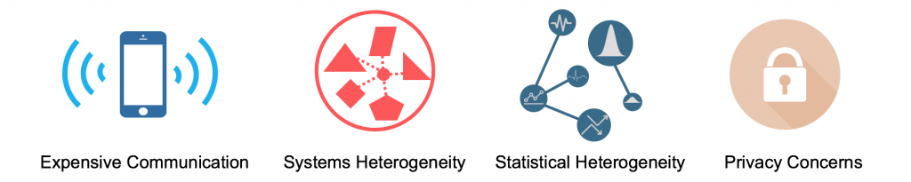
Federated Machine Learning
Bottlenecks
Federated Learning is a distributed learning paradigm with two key challenges that differentiate it from others:
    significant variability in terms of the systems characteristics on each device in the network (systems heterogeneity), and
    non-identically distributed data across the network (statistical heterogeneity).

Slide 34
Federated Machine Learning
Not giving up on it..
Nevertheless, federated learning raises several types of issues and has been the topic of multiple research efforts studying the learning and generalization properties in that scenario systems, networking and communication bottleneck problems due to frequent exchanges between the central server and the clients, with unreliable or relatively slow network connections and many others.
Federated Learning is still in its early stages and faces numerous challenges with its design and deployment.

Slide 35
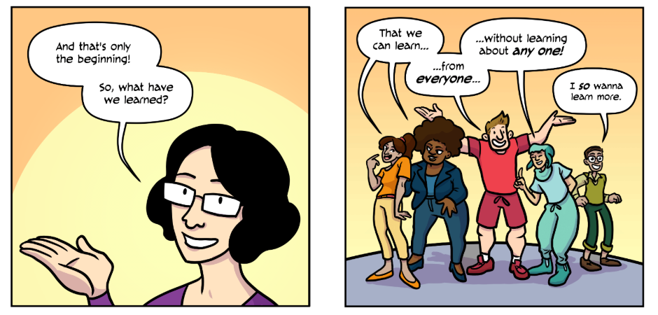
Federated Machine Learning
Summary
To simplify, Federal learning consists of the following steps :
  A subset of existing clients is selected, each of which downloads the current model.
  Each client in the subset computes an updated model based on their local data.
  The model updates are sent from the selected clients to the sever.
  The server aggregates these models (typically by averaging) to construct an improved global model.
Federated learning enables multiple actors to build a common, robust machine learning model without sharing data, thus addressing critical issues such as data privacy, data security, data access rights and access to heterogeneous data.
Federated Learning models are hyper personalized for an user, involve minimum latencies and are privacy preserved by design.
Because of this limited agreement for the users, they can decide to not participate or to join in the network, and this gives more control to the data owners. This is a real big PR win because you don't have to appear as the one that's taking all the data from everybody.

Slide 36
Federated Machine Learning
What Next?
Currently, most of the existing studies focus on optimizing federated learning algorithms to improve model training performance.
Stochastic gradient descent (SGD)
The standard optimization algorithm used in this scenario is Federated Averaging (FedAvg).
Agnostic federated learning (AFL)
A framework, FedProx, tackles heterogeneity in federated networks. FedProx can be viewed as a generalization and re-parametrization of FedAvg, the current state-of-the-art method for federated learning.

Slide 37
Federated Machine Learning
References
Source:
https://federated.withgoogle.com/
https://en.wikipedia.org/wiki/Federated_learning
https://ai.googleblog.com/2017/04/federated-learning-collaborative.html
https://blog.fastforward3737labs.com/2018/11/14/federated-learning.html
https://venturebeat.com/2019/06/03/how-federated-learning-could-shape-the-future-of-ai-in-a-privacy-obsessed-world/
https://arxiv.org/pdf/1902.01046.pdf
https://hackernoon.com/a-beginners-guide-to-federated-learning-b29e29ba65cf
https://www.youtube.com/watch?v=39hNjnhY7cY&feature=youtu.be&a=
https://www.infoq.com/presentations/federated-learning-distributed-ml/
https://medium.com/datadriveninvestor/an-overview-of-federated-learning-8a1a62b0600d
https://towardsdatascience.com/introduction-to-federated-learning-and-privacy-preservation-75644686b559
In Automotive:
https://www.aitrends.com/ai-insider/federated-machine-learning-for-ai-self-driving-cars/
PyTorch:
https://www.analyticsvidhya.com/blog/2019/09/introduction-to-pytorch-from-scratch/
https://www.quora.com/How-is-PyTorch-different-from-TensorFlow-What-are-the-advantages-of-using-one-vs-the-other-When-should-I-use-one-or-the-other
Neural Network using Python and R:
https://www.analyticsvidhya.com/blog/2017/05/neural-network-from-scratch-in-python-and-
r/?utm_source=blog&utm_medium=introduction-to-pytorch-from-scratch
Optimizing Federated Learning:
https://arxiv.org/pdf/1910.06378.pdf
https://arxiv.org/pdf/1905.07479.pdf
https://arxiv.org/pdf/1812.06127.pdf
https://openreview.net/pdf?id=SkgwE5Ss3N
http://proceedings.mlr.press/v97/mohri19a/mohri19a.pdf
https://www.researchgate.net/publication/321963259_Differentially_Private_Federated_Learning_A_Client_Level_Perspective
Example:
https://medium.com/@marcrojek/devices-learning-from-each-other-see-it-live-this-september-at-ai-summit-in-san-francisco-9ac6462d7f8e
Overview

Slide 38
Thank you ☺

