Slide 1
DATA ANALYTICS INTERNSHIP PROJECT
Revenue (FY22–FY25)
Executive Business Intelligence Dashboard
$1.65M
Profit
Turning sales data into decisions: what happened, why it happened, and what management should do next.
$194.4K
Profit margin
11.8%
Prepared by: Vaishali A | Tool: Power BI | September 2026
Notes:
Introduce yourself and the project. This dashboard was built for senior management: it tells them what happened to the business, why, and what to do. The three numbers on the right are the headline: about $1.65M of revenue over four years, $194K profit, and an 11.8% margin. The rest of the talk explains why that margin is under pressure.

Slide 2








AGENDA
What this presentation covers
01
02
03
04
Business problem
Data & tools
KPI framework
Dashboard design
Why management needs this dashboard
Dataset, preparation and data model
Six KPIs across revenue, risk and compliance
Layout, filters and the final dashboard
05
06
07
08
What happened
Why it happened
What to do
Conclusion
Revenue vs. profit trend
Discounting, product mix and delivery
Recommendations with business impact
Key takeaways and learnings
Executive Business Intelligence Dashboard
2
Notes:
Walk through the flow: we start with the business problem, explain the data and KPIs, show the dashboard, then follow the storytelling sequence of what happened, why it happened, and what action to take.

Slide 3

1 BUSINESS PROBLEM
Revenue is booming, but profit is not keeping up
FY2022 → FY2025
What happened?
+93%
+68%
Sales rose every year, but margin fell from 13.0% to 11.3% and loss-making orders grew from 13% to 17%.
Revenue growth
Profit growth
Why did it happen?
Deeper discounts, a weak Furniture margin in the Central and South regions, and slow delivery in those same regions.
Profit margin
13.0% → 11.3%
What action should be taken?
Every extra dollar of sales now earns less profit. Management needs to know where and why.
Cap discounts, reprice Furniture where it is unprofitable, and fix fulfilment in Central and South.
Executive Business Intelligence Dashboard
3
Notes:
State the business problem in one sentence: revenue almost doubled but profit grew much more slowly, so margin is shrinking. The dashboard is designed to answer three management questions: what happened, why it happened, and what action to take.

Slide 4




2 DATA & TOOLS
The dataset and the tools behind the dashboard
Dataset overview
Power BI
Data model, DAX measures, dashboard
Retail order data (Superstore-style schema), synthetic sample, Jan 2022 – Dec 2025
Excel / Power Query
6,050
48
4
3
Cleaning and validation
order lines
months
regions
categories
Python (optional)
Fields used
Data checks and sample data
OrderID
OrderDate
Region
Category
Segment
Quantity
Sales
Discount
Profit
ShipDays
Returned
GitHub
Repository with files and screenshots
Executive Business Intelligence Dashboard
4
Notes:
Explain that the dataset follows the popular Superstore schema with order-level sales, discount, profit, shipping days and returns. Mention that you used Power BI for modelling and the dashboard, Excel or Power Query for cleaning, and GitHub for the submission. Replace the source line with your actual dataset name and link if you use a different one.

Slide 5


2 DATA & TOOLS
From raw file to a reliable data model
1. Import
2. Clean
3. Model
4. Measure
5. Visualize
Load CSV into Power BI
Fix types, remove duplicates, check nulls
Fact table + Date, Region, Category
Write DAX for every KPI
Build pages, slicers, tooltips
Star schema
Key DAX measures
Dim: Date
Dim: Region
Total Sales = SUM ( Sales[Sales] )
Total Profit = SUM ( Sales[Profit] )
Profit Margin % = DIVIDE ( [Total Profit], [Total Sales] )
Sales YoY % = DIVIDE ( [Total Sales] - [Sales PY], [Sales PY] )
Loss Order % = DIVIDE ( COUNTROWS ( FILTER ( Sales, Sales[Profit] < 0 ) ), COUNTROWS ( Sales ) )
On-Time % = DIVIDE ( COUNTROWS ( FILTER ( Sales, Sales[ShipDays] <= 5 ) ), COUNTROWS ( Sales ) )
Fact: Sales
Dim: Category
Dim: Segment
Executive Business Intelligence Dashboard
5
Notes:
Describe the pipeline: import, clean, model, write measures, visualize. A star schema keeps the model simple and fast: one Sales fact table linked to Date, Region, Category and Segment dimensions. The DAX measures on the right power every KPI card, so definitions stay consistent across the whole dashboard.

Slide 6






3 KPI FRAMEWORK
Six KPIs that give management a complete view
REVENUE
PROFIT
GROWTH
Total Sales
Profit Margin %
Sales YoY %
$526.5K
11.3%
+11.8%
FY25 net sales after discount
Profit $59.6K | Target 13%
FY25 vs FY24
RISK
EFFICIENCY
COMPLIANCE
Loss-making orders
Avg. shipping days
On-time delivery %
17.4%
4.5 days
75.1%
Share of orders with profit < 0 | Target < 12%
Order date to ship date | Target ≤ 4
Shipped within 5 days | SLA ≥ 85%
Red = below target, amber = watch, green = on track. Targets are illustrative management assumptions.
Executive Business Intelligence Dashboard
6
Notes:
Explain that the KPIs were chosen to cover the categories in the guidelines: revenue, profit, growth, risk, efficiency and compliance. Each KPI has a definition and a target so management can see instantly whether the business is on track. The colours already tell the story: growth is green, but profit margin, risk and compliance are all red.

Slide 7
4 DASHBOARD DESIGN
A professional layout that guides the eye
SIDE
Filters &
Slicers
KPI
KPI
KPI
KPI
KPI
KPI
1
KPI cards
Six headline numbers with colour-coded status and change vs. last year.
MIDDLE
Trend over time
MIDDLE
Comparison
2
Trends & comparisons
Revenue vs. margin over time, and margin by discount band to explain the cause.
3
Detailed analysis
Region × category heat-map table for drilling into problem areas.
BOTTOM
Detailed analysis / table
4
Filters & slicers
Year, region, category and segment so managers can self-serve.
Executive Business Intelligence Dashboard
7
Notes:
This is the recommended structure from the dashboard guidelines. KPI cards on top give the answer in five seconds, trends and comparisons in the middle explain the change, a detailed table at the bottom supports drill-down, and slicers on the side let managers filter by year, region, category and segment.

Slide 8
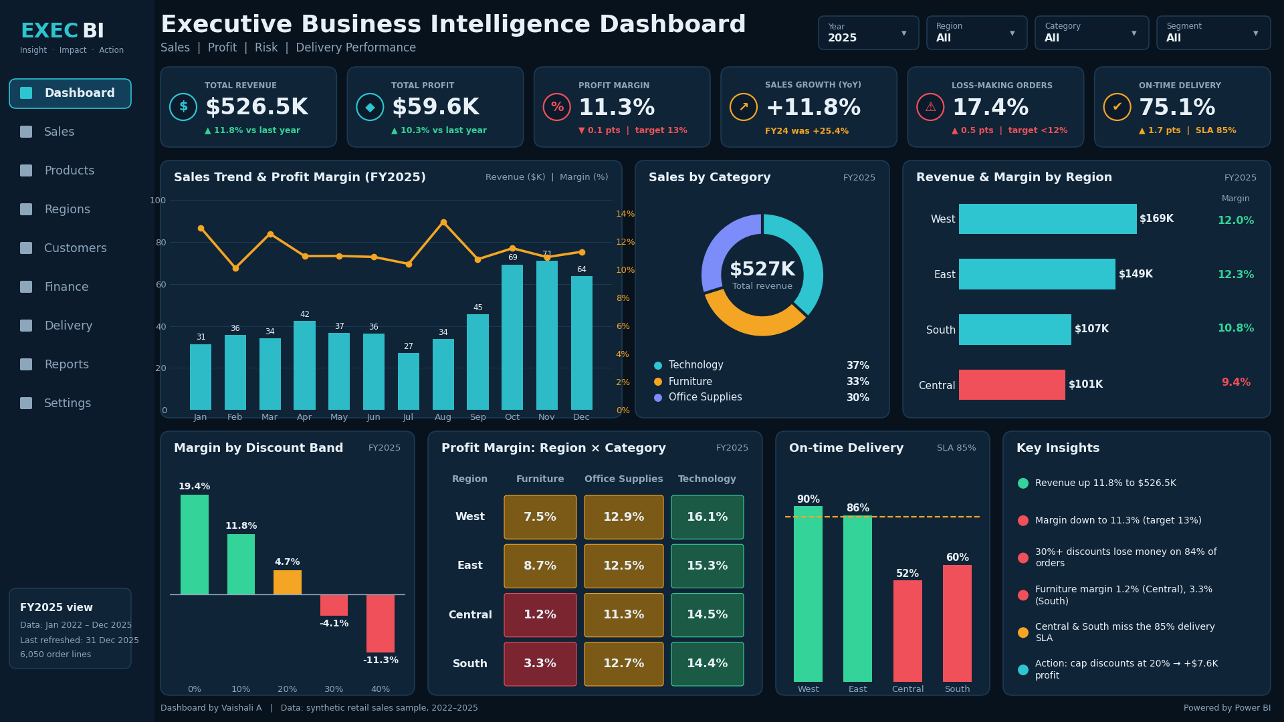
4 DASHBOARD DESIGN
Executive overview dashboard (FY2025 view)
Executive Business Intelligence Dashboard
8
Notes:
This is the dashboard view. Walk through it top to bottom: KPI cards first, then the sales trend and margin, the category and region comparisons, then the discount band, region by category heat-map and delivery panels, and finally the key insights on the right. If you rebuild the dashboard in Power BI or Tableau, replace this picture with your own screenshot. In the walkthrough video, click the slicers live: set Year to 2025, then Region to Central, and show how the Furniture margin turns red.

Slide 9
5 WHAT HAPPENED?
Revenue nearly doubled, but margin slipped every year
Annual revenue ($K) and profit margin (%)
+93%
Revenue FY22 → FY25 ($272.6K → $526.5K)
+68%
Profit grew far slower ($35.5K → $59.6K)
-1.7 pts
Margin fell from 13.0% to 11.3%, below the 13% target
Executive Business Intelligence Dashboard
9
Notes:
This is the 'what happened' slide. Bars show revenue by year: it grows every year, up 93% in total. The amber line is profit margin, which falls from 13.0% to 11.3%. So growth is real, but it is becoming less profitable.

Slide 10
6 WHY DID IT HAPPEN?
Heavy discounting turns sales into losses
Profit margin (%) by discount band
Share of orders with 30%+ discount in Furniture (Central + South)
Orders with 30%+ discount are 15% of all orders, but 84% of them lose money. Margin shrinks to 4% at a 20% discount and turns negative beyond it.
Executive Business Intelligence Dashboard
10
Notes:
This is the first reason. In the left chart, margin falls steadily as discount increases and turns negative at 30% and above. On the right, the share of very heavy discounts in Furniture in the Central and South regions grew from 9.5% to 35.9% in four years. Discounting is buying revenue at the cost of profit.

Slide 11


6 WHY DID IT HAPPEN?
Furniture in Central and South is the weak spot
Profit margin (%) by region and category, FY22–FY25
Furniture margin is 6.6% vs. 15.9% for Technology, despite similar sales.
Region | Furniture | Office Supplies | Technology | All
West | 7.1% | 13.2% | 16.0% | 12.1%
East | 8.2% | 12.8% | 16.1% | 12.4%
Central | 4.9% | 12.4% | 15.6% | 11.1%
South | 5.1% | 12.8% | 15.9% | 11.2%
All regions | 6.6% | 12.8% | 15.9% | 11.8%
In Central and South, Furniture margin fell from 8.9% (FY22) to 2.2% (FY25).
Office Supplies and Technology are stable, so the problem is specific, not company-wide.
Red < 8% | Amber 8–13% | Green > 13%
Executive Business Intelligence Dashboard
11
Notes:
This heat-map table is the detailed analysis section of the dashboard. Red cells show the problem: Furniture in Central and South. Technology and Office Supplies earn healthy margins in every region. This tells management the fix should be targeted rather than a company-wide cost cut.

Slide 12
6 WHY DID IT HAPPEN?
Risk and delivery problems sit in the same regions
On-time delivery % by region (FY25), SLA 85%
Loss-making orders (% of all orders)
Central and South ship in 5.5 and 5.2 days on average vs. 3.7 in the West. Slow delivery, deep discounts and thin margins cluster in the same regions.
Executive Business Intelligence Dashboard
12
Notes:
Two more KPI signals. On the left, only West and East meet the 85% on-time SLA; Central and South are well below. On the right, the share of loss-making orders rose from 13.4% to 17.4%. The same regions appear in every problem, which strengthens the case for a targeted regional action plan.

Slide 13
STORYTELLING
The story in one page: what, why and what next
WHAT HAPPENED
WHY IT HAPPENED
WHAT TO DO
Revenue +93% since FY22
Profit only +68%
Margin down from 13.0% to 11.3%
Loss-making orders up to 17%
30%+ discounts lose money on 84% of orders
Furniture in Central and South: margin 2.2% in FY25
Delivery SLA missed in Central and South
Cap discounts at 20%
Reprice and renegotiate Furniture costs
Fix regional fulfilment
Track with dashboard alerts
-1.7 pts
84%
+$7.6K
profit margin since FY22
of 30%+ discount orders lose money
annual profit from a 20% discount cap
Executive Business Intelligence Dashboard
13
Notes:
Recap the whole story in 30 seconds. What happened: growth without matching profit. Why: discounting, one weak product-region combination, and slow delivery. What to do: the three actions on the next slide.

Slide 14
7 RECOMMENDATIONS
Four actions to protect profit
ACTION
OWNER
EXPECTED IMPACT
TIMELINE
Cap discounts at 20%
Sales + Finance
Margin 11.3% → 12.7%
0–30 days
1
Require director approval above 20%. Discounts of 30%+ lose money on 84% of orders.
Reprice Furniture in Central and South
Category team
Furniture margin 2.2% → 8%+
1–3 months
2
Review list prices, bundle low-margin items and renegotiate supplier cost.
Fix fulfilment in Central and South
Operations
On-time 52% / 60% → 80%+
3–6 months
3
Add a regional stock point and set carrier SLAs to hit 5-day shipping.
Set up dashboard alerts
BI team
Early warning on every KPI
Ongoing
4
Flag margin below 10%, discount above 20% and loss-making orders above 12%.
Executive Business Intelligence Dashboard
14
Notes:
Each recommendation has an owner, a measurable impact and a timeline, so management can act on it. The first action is the quickest win: capping discounts at 20% is a policy change that can be applied within a month.

Slide 15
7 RECOMMENDATIONS
Business impact: a 20% discount cap lifts profit
FY25 profit ($K): actual vs. scenario
+$7.6K
Extra annual profit (+12.7%)
11.3% → 12.7%
Profit margin, back toward the 13% target
$526.5K → $528.4K
Revenue stays flat, so growth is protected
Assumptions
FY25 orders above 20% discount are re-priced at 20%. 15% of those orders are lost to lower discounts. Margin effect: 0.75 pts per 1 pt of discount, from the data.
Executive Business Intelligence Dashboard
15
Notes:
This is the business-impact slide. It is a simple what-if scenario on FY25 data, not a forecast. Even if we lose 15% of the orders that were discounted above 20%, profit rises from $59.6K to about $67.1K, and margin recovers to roughly 12.7%. Explain that you can build this as a what-if parameter in Power BI so managers can test different caps.

Slide 16


8 CONCLUSION
Key takeaways and what I learned
Key takeaways
Skills gained
Growth is strong, but margin has fallen 1.7 points since FY22.
Data modelling and DAX
KPI design and thresholds
Dashboard layout and storytelling
Turning insights into recommendations
Discounts above 20% are the main driver of lost profit.
Furniture in Central and South and slow delivery are the hotspots.
Next steps
Add a sales forecast page
Add drill-through to order level
Add a discount what-if parameter
Capping discounts could add about $7.6K profit a year.
Executive Business Intelligence Dashboard
16
Notes:
Close the walkthrough with the four takeaways, then briefly mention what you learned and what you would build next if you had more time.

Slide 17


APPENDIX
Project deliverables and submission checklist
GitHub repository
Walkthrough video
LinkedIn project post
README with problem, KPIs and insights
Dataset (CSV) and data dictionary
Power BI (.pbix) or Tableau file
Dashboard screenshots
This presentation (PPT / PDF)
Business problem (20 sec)
Dashboard overview and layout (30 sec)
KPIs and key insights (60 sec)
Recommendations and impact (30 sec)
Post the video on LinkedIn
One-line business problem
2–3 headline insights with numbers
Dashboard screenshot or video
Tools used and GitHub link
Submit through the official form
Executive Business Intelligence Dashboard
17
Notes:
This slide is for your own submission planning and can be removed before presenting to management. Complete at least three projects to be eligible for the certificate, and submit each one only through the official form.

Slide 18
Thank you
Questions and discussion
Executive Business Intelligence Dashboard | Data Analytics Internship Project
Notes:
Thank the audience and invite questions.

