Slide 1
DATABASE MANAGEMENT SYSTEM PROJECT REVIEW
Department of Artificial Intelligence and Data Science
Academic Year: 2024 – 2025 (Even Semester)
Register Number : 2303811724322118
Name : VAISHALI A
Year : II
Semester : IV
Section : B
Date : 04-06-2025
CGB1221 – DATABASE MANAGEMENT SYSTEMS

Slide 2
Title of the Project
ONLINE EXAMINATION
SYSTEM
CGB1221 – DATABASE MANAGEMENT SYSTEMS

Slide 3
Problem Identified
1. Scalability Issues
As the number of users grows, the system must handle high traffic loads,, and large-scale data storage without performance degradation.
2. Cheating Prevention
Online tests are vulnerable to malpractices such as multiple logins, screen sharing, external help, and AI-based cheating tools
3. Data Privacy & Security
Sensitive data, including student details, exam results, and authentication credentials, must be protected against cyber threats, and unauthorized access.
CGB1221 – DATABASE MANAGEMENT SYSTEMS

Slide 4
Objective
The objective of the Online Examination System is to design and implement a secure, scalable, and user-friendly platform that facilitates the end-to-end process of conducting examinations digitally.
The system aims to automate exam creation, management, execution, evaluation, and reporting, thereby eliminating the inefficiencies and limitations of traditional paper-based exams.
CGB1221 – DATABASE MANAGEMENT SYSTEMS

Slide 5
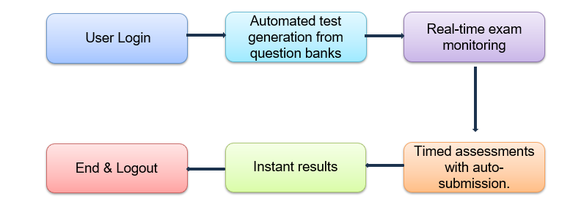
Proposed Architecture
CGB1221 – DATABASE MANAGEMENT SYSTEMS

Slide 6
Module List
Authentication Module
Test Creation & Management
Test Execution & Monitoring
Evaluation & Reporting
Feedback module
CGB1221 – DATABASE MANAGEMENT SYSTEMS

Slide 7
Module Implemented
Authentication Module:
This module handles user registration, login, logout, and role-based access control to ensure secure authentication for students, teachers, and admins. It manages password hashing, session management, and access restrictions to protect exam data and system integrity.
Key Methods:
login(username, password) — Authenticates user credentials and initiates a session.
logout(user_id) — Ends the user session securely.
CGB1221 – DATABASE MANAGEMENT SYSTEMS

Slide 8
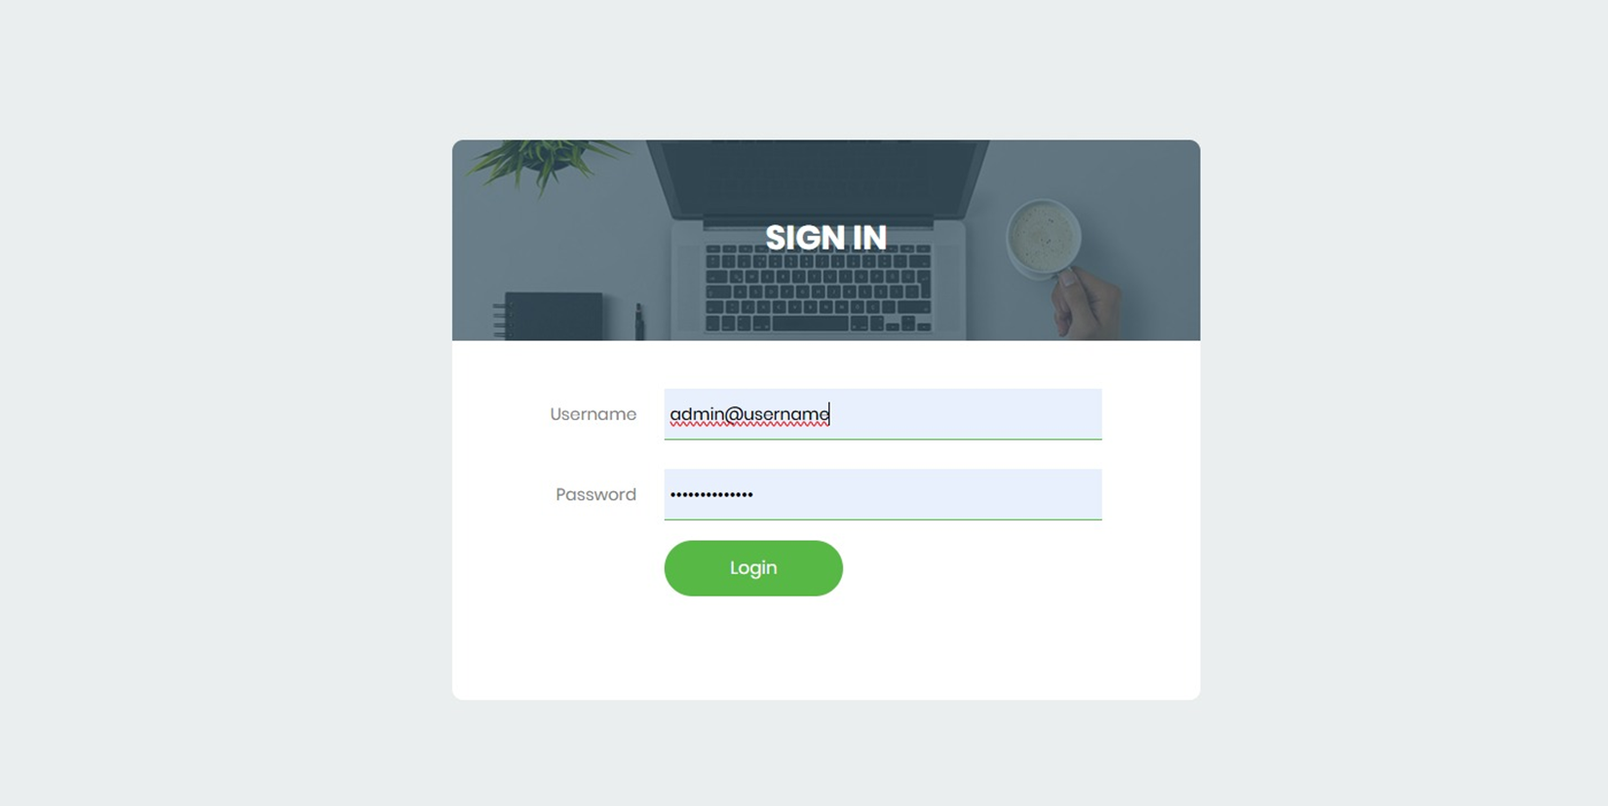
Module Implemented
CGB1221 – DATABASE MANAGEMENT SYSTEMS

Slide 9
Module Implemented
Dashboard
Displays the main navigation panel after login, giving access to all online exams system.
MANAGE COURSE
MANAGE EXAM
MANAGE EXAMINEE
RANKING
REPORTS
FEEDBACK
CGB1221 – DATABASE MANAGEMENT SYSTEMS

Slide 10
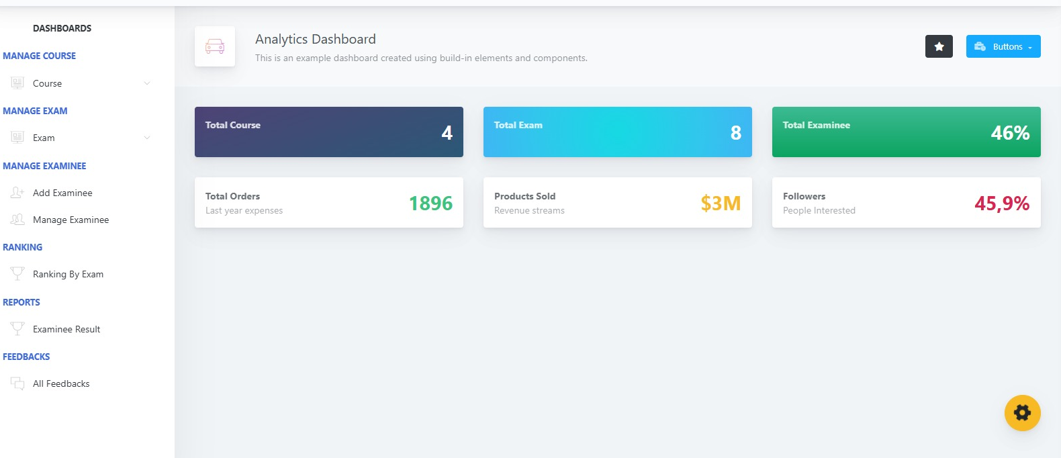
Module Implemented
CGB1221 – DATABASE MANAGEMENT SYSTEMS

Slide 11
Module Implemented
Test Creation & Management:
Allows teachers or admins to create, update, organize, and delete tests. Tests include metadata like title, description, duration, and question sets. Supports categorization and status control (draft, published).
Key Methods:
create_test(test_data) — Inserts a new test into the database.
update_test(test_id, updated_data) — Modifies existing test details.
add_question(test_id, question_data) — Adds questions to a test.
CGB1221 – DATABASE MANAGEMENT SYSTEMS

Slide 12
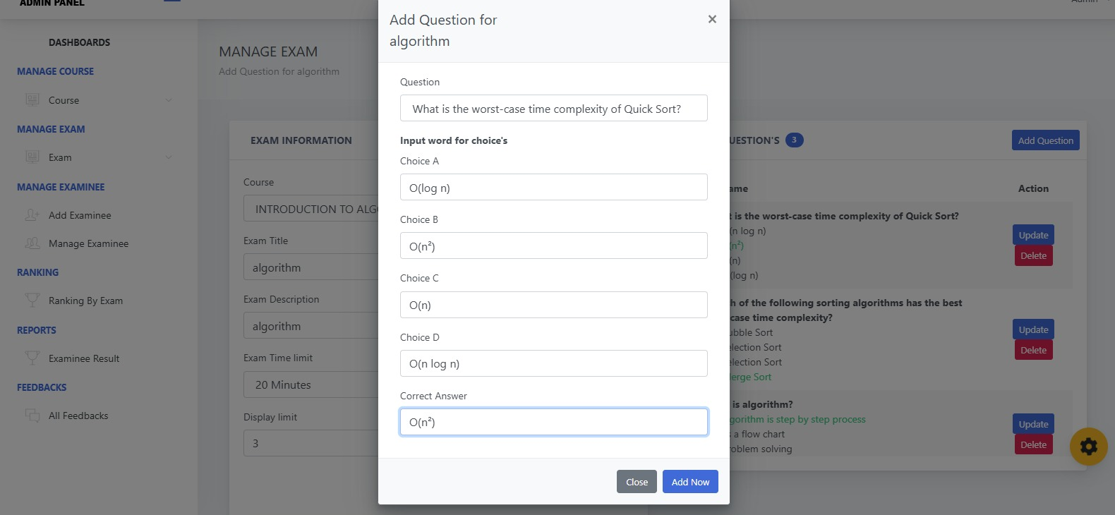
Module Implemented

Slide 13
Module Implemented
Test Execution & Monitoring:
Handles the student-facing test interface including timing, navigation between questions, answer submission, and real-time monitoring to prevent cheating (e.g., tab-switch detection).
Key Methods:
start_test(user_id, test_id) — Initializes a test session for the user.
submit_answer(session_id, question_id, answer) — Records the student's answer.
get_next_question(session_id) — Retrieves the next question for the student.
.
CGB1221 – DATABASE MANAGEMENT SYSTEMS

Slide 14
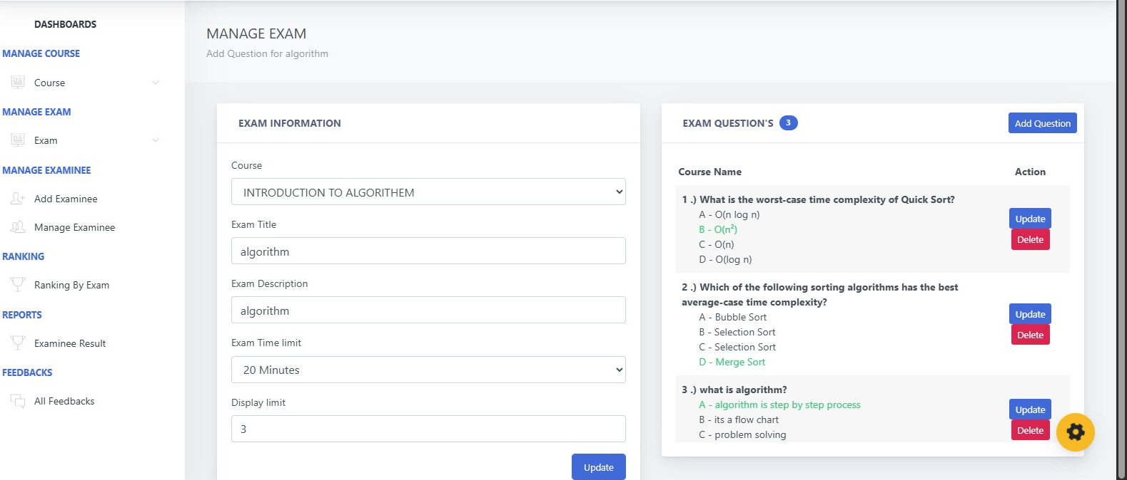
Module Implemented
CGB1221 – DATABASE MANAGEMENT SYSTEMS

Slide 15
Module Implemented
Evaluation & Reporting:
Automates scoring for objective questions, collects subjective answers for manual review, and generates comprehensive reports for students and instructors.
Key Methods:
auto_score(session_id) — Automatically scores multiple-choice questions.
generate_report(user_id, test_id) — Produces performance reports and analytics.
CGB1221 – DATABASE MANAGEMENT SYSTEMS

Slide 16
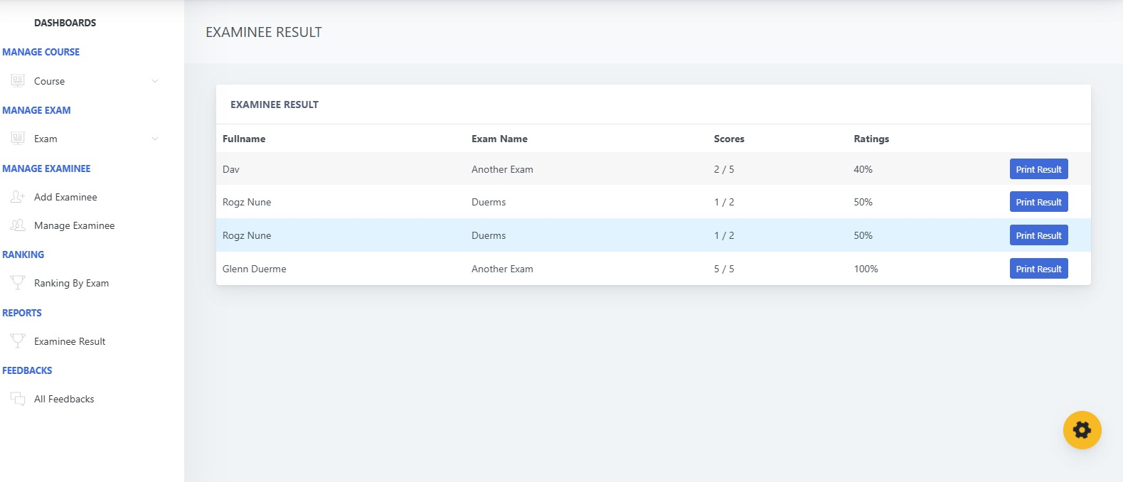
Module Implemented
CGB1221 – DATABASE MANAGEMENT SYSTEMS

Slide 17
Module Implemented
Feedback Module
Collects student feedback on tests and the system itself to improve the quality of exams and user experience.
Key Methods:
submit_feedback(user_id, test_id, feedback_text, rating) — Records feedback from users.
view_feedback(test_id) — Allows instructors to view feedback for specific tests.
CGB1221 – DATABASE MANAGEMENT SYSTEMS

Slide 18
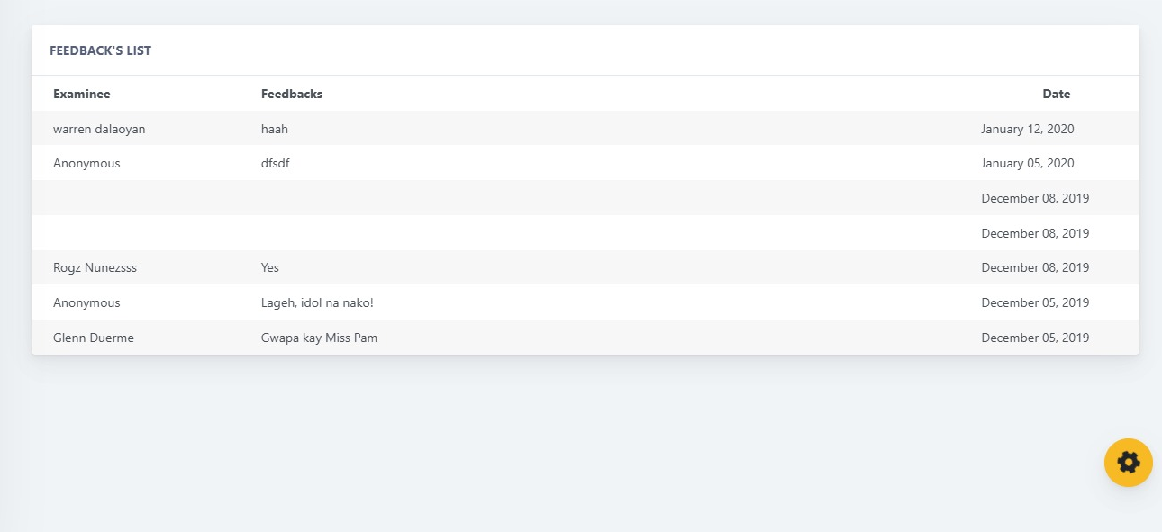
Module Implemented
CGB1221 – DATABASE MANAGEMENT SYSTEMS

Slide 19
Conclusion
Conclusion:
The Online Examination System provides a robust, user-friendly, and secure platform for managing the end-to-end process of conducting digital exams.
It is a modular architecture covering authentication, test creation, execution, evaluation, and feedback collection, the system effectively reduces manual overhead and improves exam accuracy and efficiency.
Future Scope:
AI-Based Proctoring
Advanced Analytics Dashboard
Mobile Application Support
CGB1221 – DATABASE MANAGEMENT SYSTEMS

Slide 20
Thank You
CGB1221 – DATABASE MANAGEMENT SYSTEMS

