Slide 1



Predicting Property Prices Using SQL Analysis

Slide 2




ABOUT US
To analyze property prices and predict future trends using SQL.
Data-Driven Insights for Real Estate Market

Slide 3
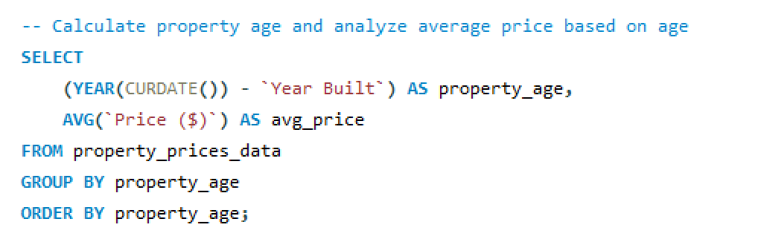
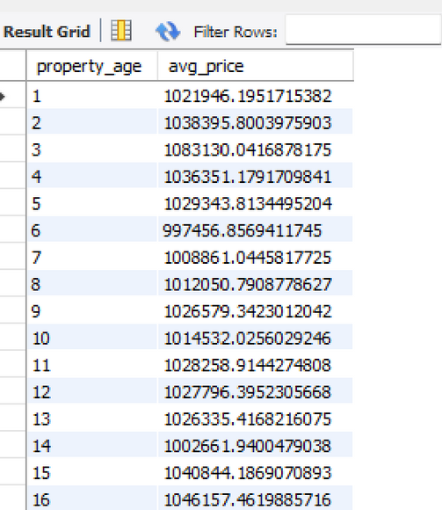

Identify patterns over time, such as price changes based on property age or construction year.
Output:

Slide 4
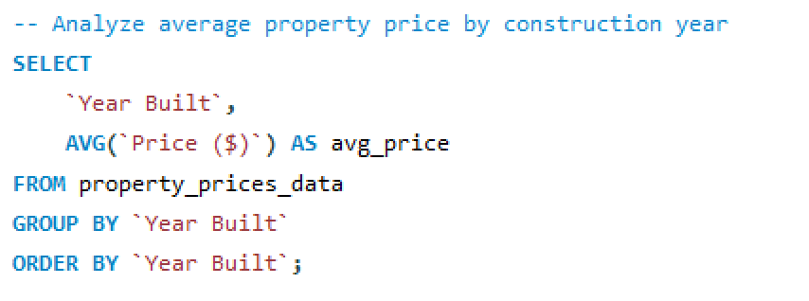
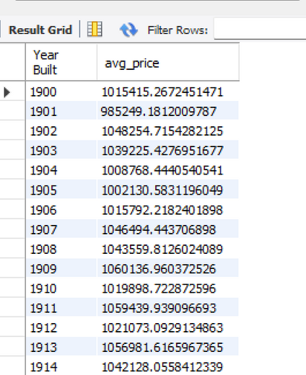
Analyze Price Changes Over Different Construction Years
Output:

Slide 5
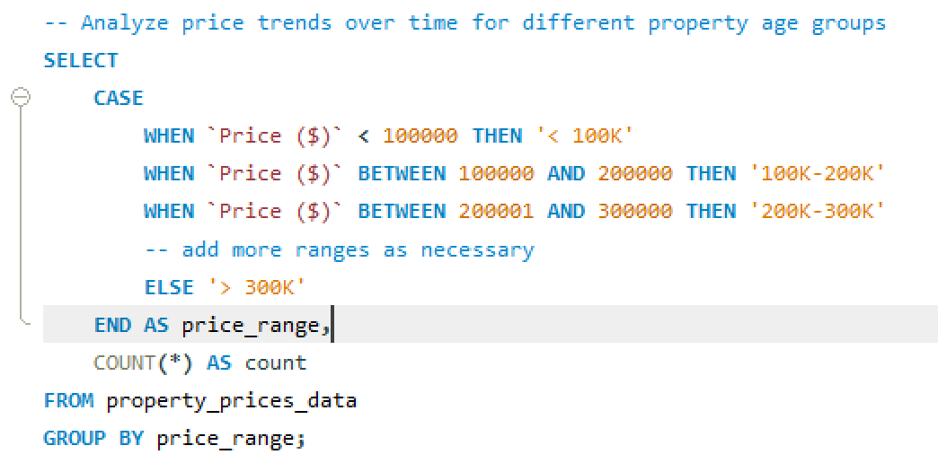
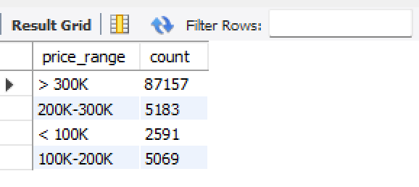
Analyze Price Trends Over Time by Property Age Groups
Output:

Slide 6
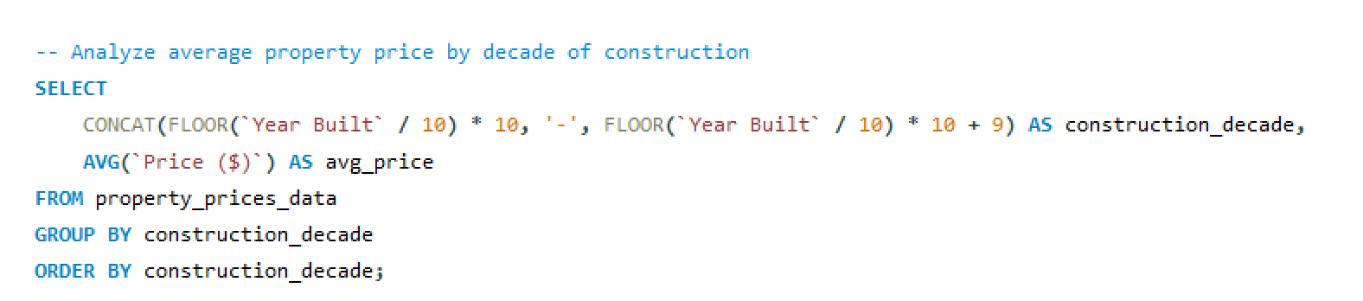
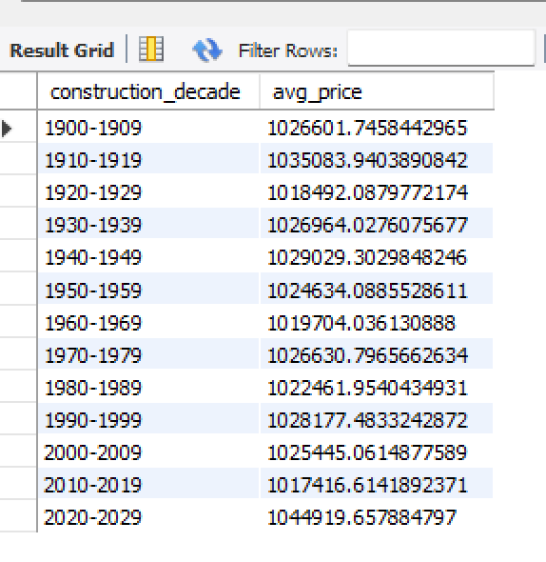
Analyze Price Changes by Decade of Construction
Output:

Slide 7
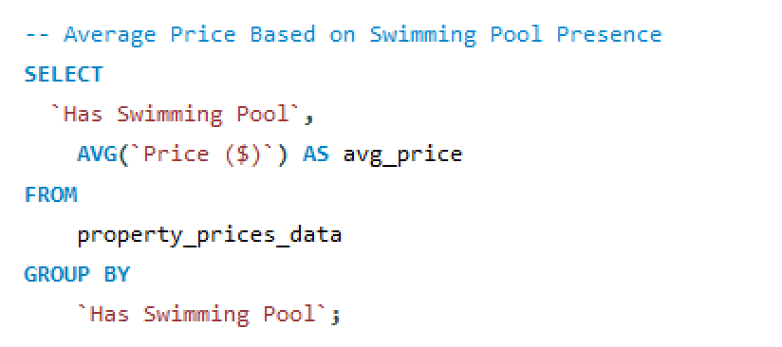
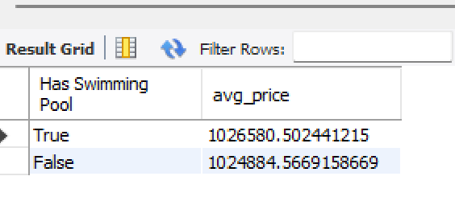
Evaluate the impact of different features on property prices, such as the presence of amenities like swimming pools or gardens. Determine which features are associated with higher or lower prices.
Average Price Based on Swimming Pool Presence
Output:

Slide 8
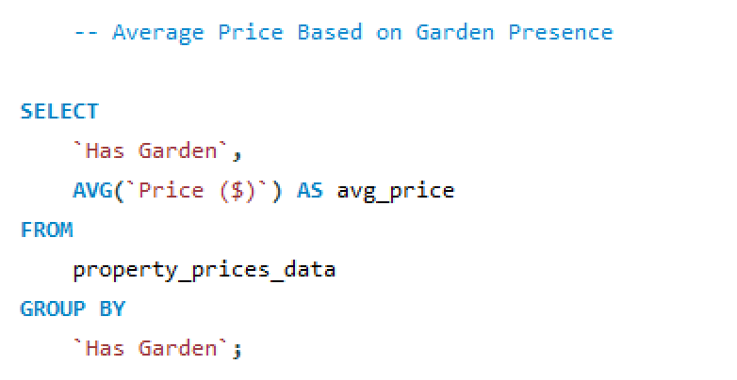
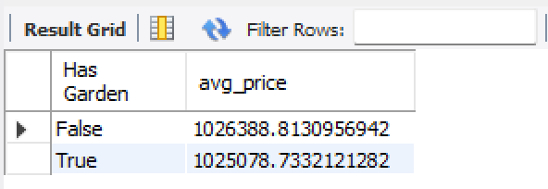
Average Price Based on Garden Presence
Output:

Slide 9
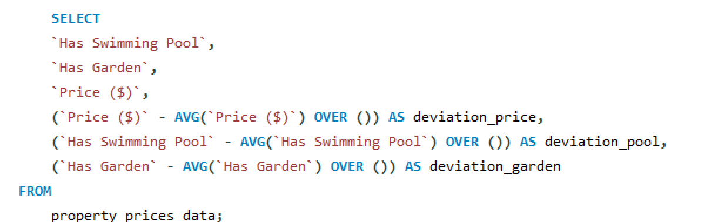
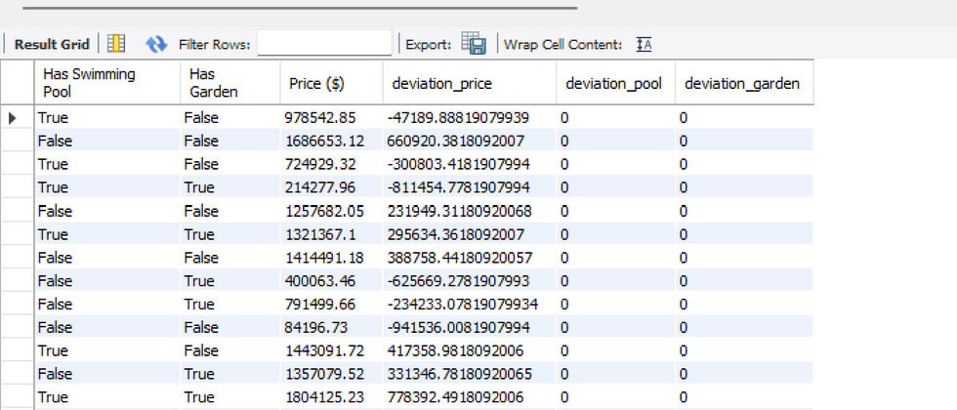
Simple Linear Regression Example
Output:

Slide 10
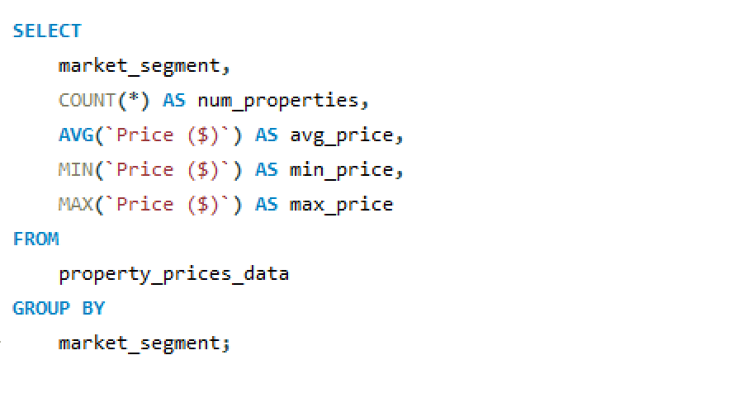
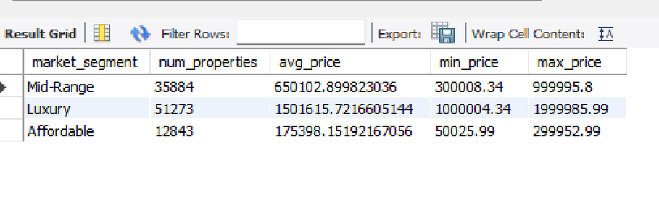
Analyze property prices based on market segments (e.g., Luxury, Affordable). Understand how different market segments influence property values
Output:

Slide 11
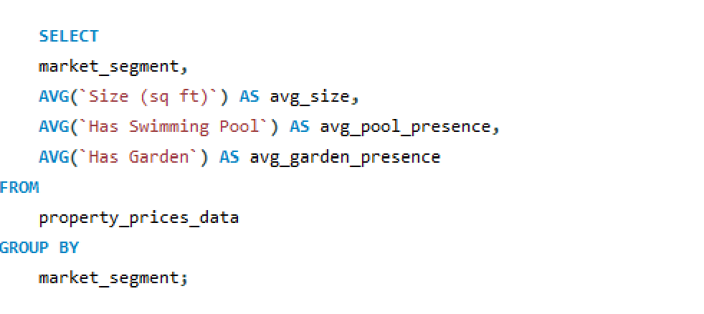
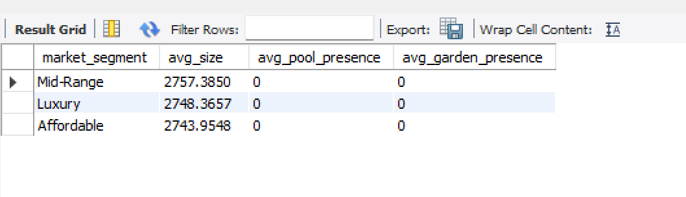
Compare Property Features Across Segments
Output:

Slide 12
Compare Property Features Across Segments
Output:

Slide 13


THANK'S FOR WATCHING
Vaishali Naikade

