Slide 1
Employee Salary Prediction USING machine learning algorithm
CAPSTONE PROJECT
Presented By:
Vaishnavi Manoj Raut-CSE-Aicte Id: STU67166c9447b731729522836

Slide 2
OUTLINE
Problem Statement
System Approach
Algorithm & Deployment
Result
Conclusion
References

Slide 3
Problem Statement
Organization often struggle to determine fair and competitive salaries for employees due to variation in education, experience, job role, and other personal or professional factors. There is need to understand how different employee attributes influence their salary to ensure equity and support effective compensation planning.

Slide 4
System Approach
The System Approach outlines the overall strategy and methodologyfor developing and implementing the Employee Salary Prediction model.
System requirements
Hardware: Processor: i3, Ram: minimum 4GB, Storage: 2GB free space
Software: Operating System: Windows/MacOS, Jupyter Notebook/ VS Code, Python(Version 3.7 or above)

Slide 5
System Approach
Library required to build the model
Pandas
Numpy
Matplotlib
Scikit-learn
Seaborn
Joblib
Streamlit

Slide 6
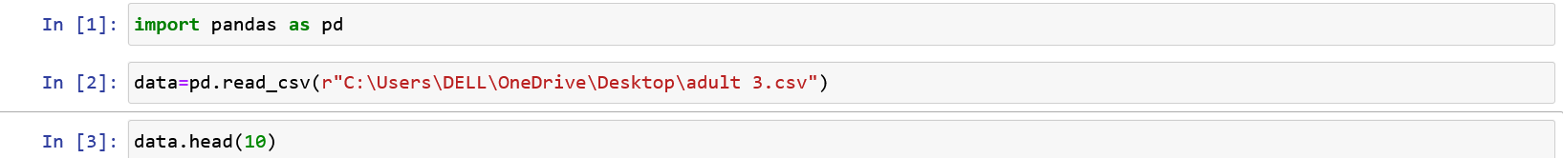
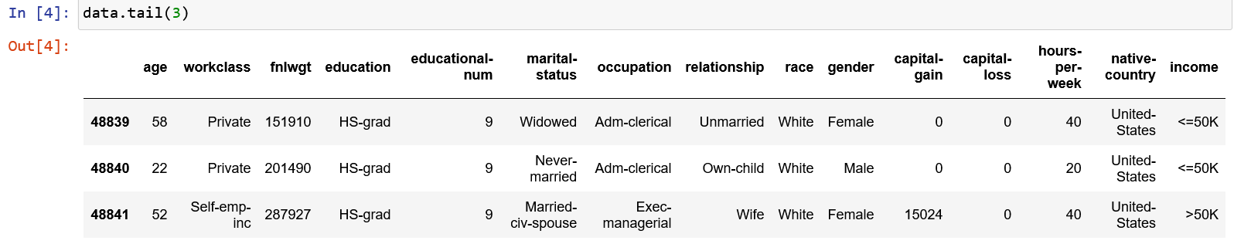
Algorithm & Deployment
Data Collection

Slide 7
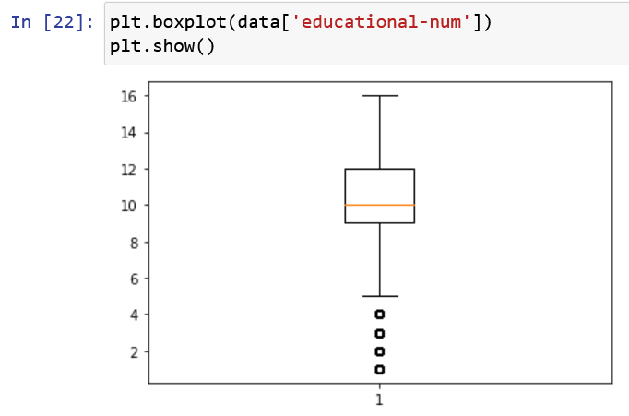
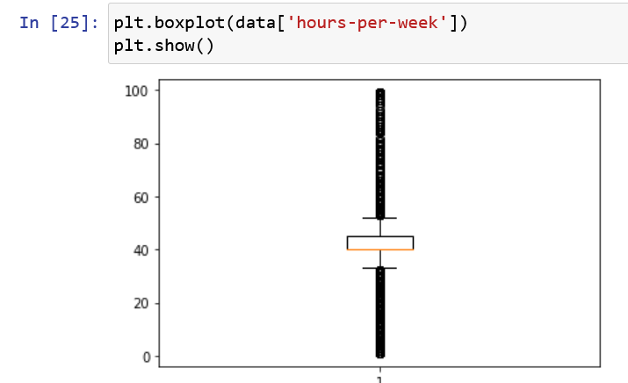
Algorithm & Deployment
Data Collection

Slide 8
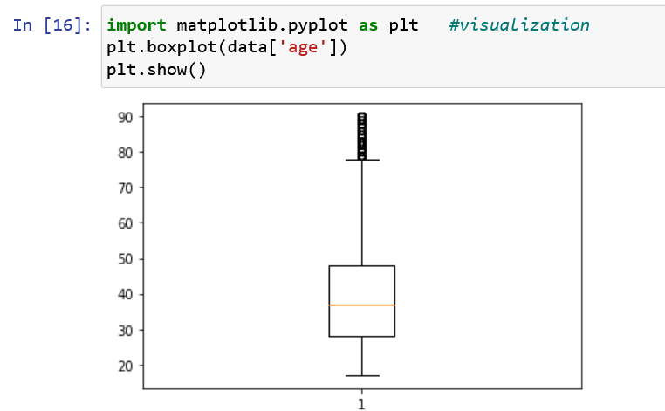
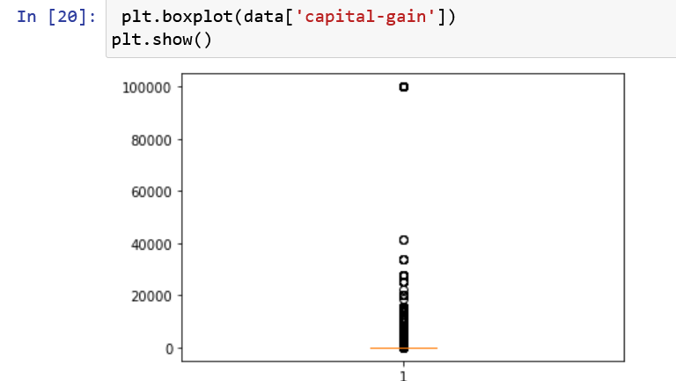
Algorithm & Deployment
Data Visualization

Slide 9
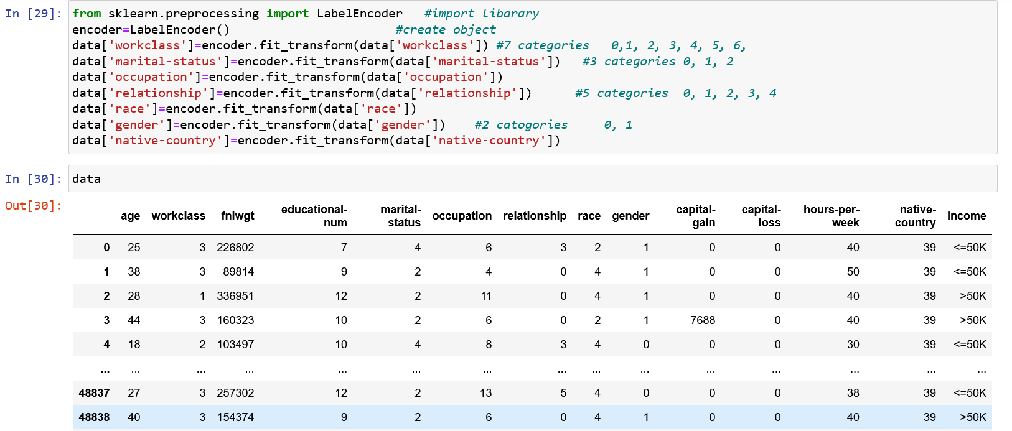
Algorithm & Deployment
Data Preprocessing
Processing data handle like missing value, data cleaning, etc.

Slide 10
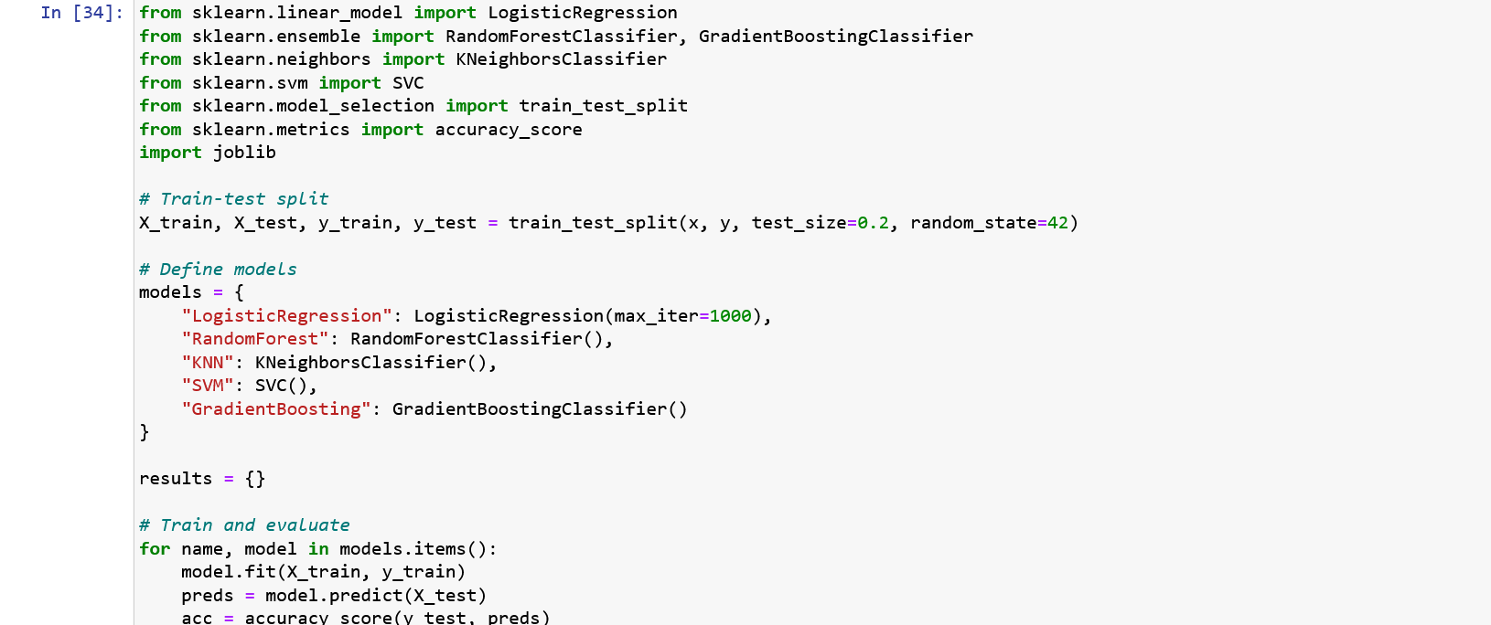
Algorithm & Deployment
Model Building

Slide 11
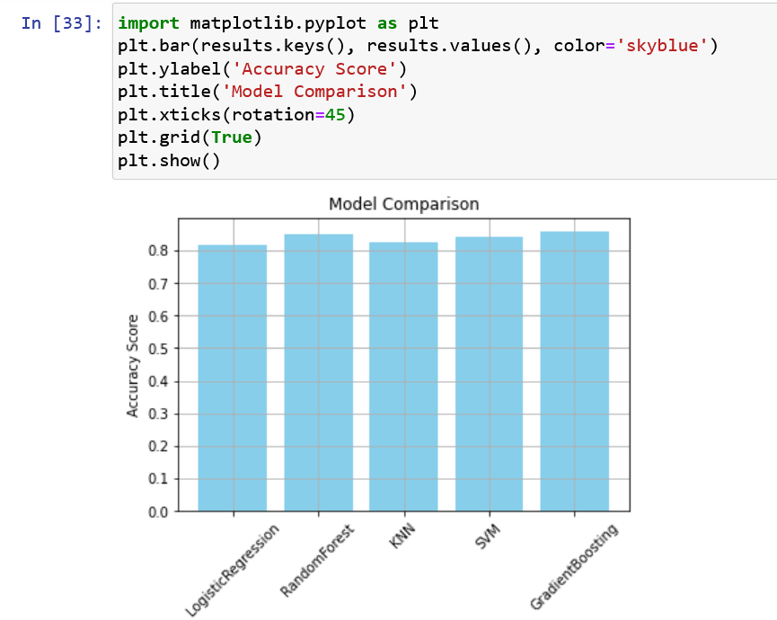
Result
Model Comparison result:

Slide 12
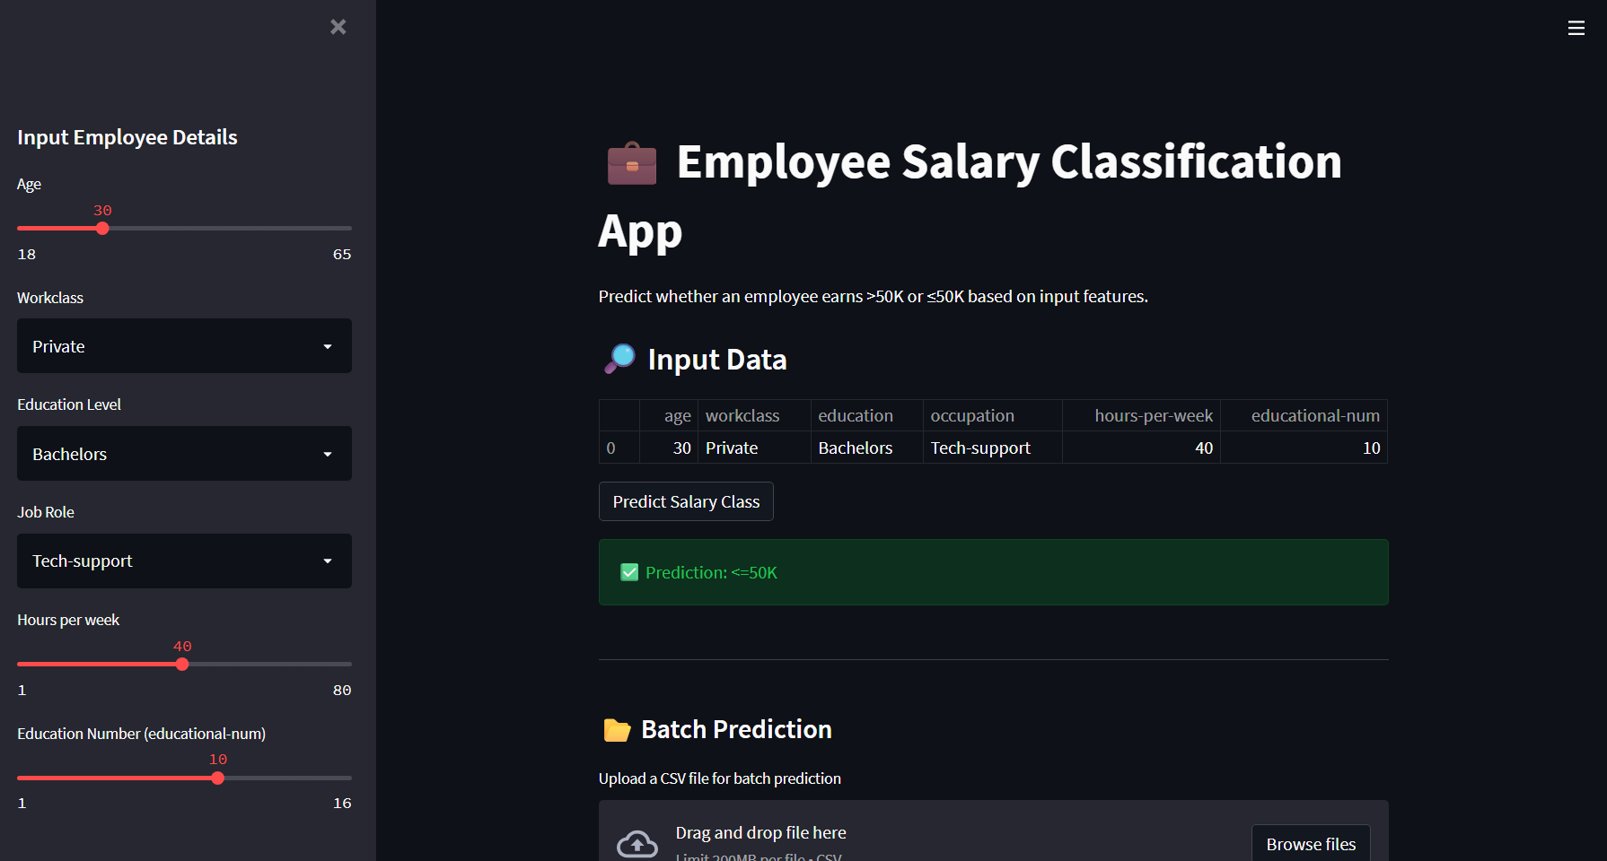
Result
Streamlit App Preview:

Slide 13
Conclusion
This project underscores the potential of machine learning in accurately predicting employee salaries by leveraging critical features such as job title, education level, department, and company-specific attributes.
To achieve high predictive accuracy, a Gradient Boosting Regressor was utilized—well-known for its strength in capturing complex, non-linear patterns through sequential learning and error minimization.
The model was trained on a meticulously cleaned and preprocessed dataset, ensuring data integrity and relevance. Its performance across essential evaluation metrics confirmed both robustness and reliability, making it a practical solution for real-world salary prediction tasks in HR analytics and workforce planning.

Slide 14
References
Pandas Documentation: Data analysis and manipulation tool
NumPy Documentation: The fundamental package for scientific computing
Matplotlib Documentation: Visualization with Python
Scikit-learn: Machine Learning in Python
Streamlit: The fastest way to build and share data apps

Slide 15
project
Discuss GitHub Repo: https://github.com/Vaishav15/Employee-Salary-Prediction.git

Slide 16
THANK YOU

