Slide 1
Linear Regression

Slide 2
Definition
In linear regression, the relationships are modeled using linear predictor functions whose unknown model parameters are estimated from the data.
Linear regression requires the dependent variable to be continuous i.e. numeric values (no categories or groups).

Slide 3
Equation
A linear regression line has an equation of the form Y = a + bX, where X is the explanatory variable and Y is the dependent variable. The slope of the line is b, and a is the intercept (the value of y when x = 0).

Slide 4
Examples
Crop yields on rainfall : Yield is Dependent variable (Nothing but Output which we forecast), Rainfall is explanatory variable.
Products on sales: Sales are explanatories
Marks on activities : Marks is dependent and activities explanatory

Slide 5
Pros
Linear regression is an extremely simple method. It is very easy and intuitive to use and understand.
A person with only the knowledge of high school mathematics can understand and use it.
It works in most of the cases.
Even when it doesn’t fit the data exactly, we can use it to find the nature of the relationship between the two variables.
the best fit line is the line with minimum error from all the points ,it has high efficiency.

Slide 6
Cons
It assumes there is a straight-line relationship between them which is incorrect sometimes.
Linear regression is very sensitive to the anomalies in the data (or outliers).
If we have a number of parameters than the number of samples available then the model starts to model the noise rather than the relationship between the variables.

Slide 7
Naive Bayes

Slide 8
Definition
It is a classification algorithm.
Naive Bayes theorem works on conditional probability
The fundamental Naive Bayes assumption is that each feature makes an independent equal contribution to the outcome.
Despite its simplicity, Naive Bayes can often outperform more sophisticated classification methods.
Naive Bayes classifier gives great results when we use it for textual data analysis. Such as Natural Language Processing.

Slide 9
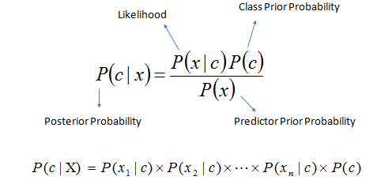
Equation
Bayes theorem provides a way of calculating the posterior probability, P(c|x), from P(c), P(x), and P(x|c). Naive Bayes classifier assume that the effect of the value of a predictor (x) on a given class (c) is independent of the values of other predictors. This assumption is called class conditional independence.

Slide 10
Examples
To mark an email as spam, or not spam ?
Classify a news article about technology, politics, or sports ?
Check a piece of text expressing positive emotions, or negative emotions?
Also used for face recognition software.

Slide 11
Pros
Very simple, easy to implement and fast.
Need less training data.
Highly scalable. It scales linearly with the number of predictors and data points.
Can be used for both binary and multi-class classification problems.
Not sensitive to irrelevant features.
Handles continuous and discrete data.

Slide 12
Cons
It makes a very strong assumption on the shape of your data distribution, i.e. any two features are independent given the output class. Due to this, the result can be (potentially) very bad - hence, a “naive” classifier.
Another problem happens due to data scarcity. For any possible value of a feature, you need to estimate a likelihood value by a frequentist approach. This can result in probabilities going towards 0 or 1, which in turn leads to numerical instabilities and worse results.
A third problem arises for continuous features. It is common to use a binning procedure to make them discrete, but if you are not careful you can throw away a lot of information.

Slide 13
Logistic Regression

Slide 14
Introduction
Logistic regression measures the relationship between the categorical dependent variable and one or more independent variables by estimating probabilities using a logistic function.
It's a classification technique used to predict the likelihood occurrence of an event, resulting in yes or no.
Decision Boundary
To predict which class a data belongs, a threshold can be set. Based upon this threshold, the obtained estimated probability is classified into classes.
Say, if predicted_value ≥ 0.5, then classify email as spam else as not spam.

Slide 15
Types of Logistic Regression:
1. Binary Logistic Regression:
The categorical response has only two 2 possible outcomes. Example: Spam or Not
2. Multinomial Logistic Regression:
Three or more categories without ordering. Example: Predicting which food is preferred more (Veg, Non-Veg, Vegan)
3. Ordinal Logistic Regression:
Three or more categories with ordering. Example: Movie rating from 1 to 5

Slide 16
Pros and Cons
Pros
Probabilistic approach, gives information about statistical significance of features
Simple and linear, reliable, no parameters to tune.
Cons
The Logistic Regression Assumptions.
Cannot handle non-linearity in the data

Slide 17
K – Means Clustering

Slide 18
Introduction
It is a supervised learning method.
The K-means clustering algorithm is used to find groups which have not been explicitly labeled in the data.
The results of the K-means clustering algorithm are:
The centroids of the K clusters, which can be used to label new data
Labels for the training data (each data point is assigned to a single cluster)

Slide 19
Examples of use cases are:
Behavioral segmentation:
Segment by purchase history
Segment by activities on application, website, or platform
Define personas based on interests
Create profiles based on activity monitoring.
Inventory categorization:
Group inventory by sales activity
Group inventory by manufacturing metrics

Slide 20
Pros and Cons
Pros
Simple to understand, easily adaptable.
Works well on small or large datasets.
Fast, efficient and performant.
Cons
Need to choose the number of clusters

Slide 21
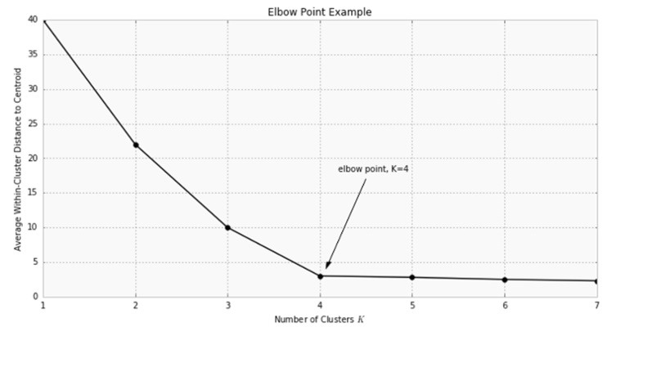

Slide 22
S.V.M
Support Vector Machine

Slide 23
Working
SVM is one of the powerful technique for Classification, Regression & Outlier detection
SVM uses a technique called the kernel trick to transform your data and then based on these transformations it finds an optimal boundary between the possible outputs.
It comes under Supervised Learning Algorithm.
For a data having p-dimensions the hyperplane(boundary) is built by using (p-1) dimensions.

Slide 24
Working Continued…
The primary focus while drawing the hyperplane is on maximizing the distance from hyperplane to the nearest data point of either class.
The Points which are influencing the hyperplane are called Support Vectors

Slide 25
Pros
Classification and Regression problems
Works very well for large no. of features and also when features > no. of samples
Non-Linear data can also be classified using customized hyperplanes built by using kernel trick.

Slide 26
Cons
No choice of kernel leading to more errors
Sample size and accuracy are inversely proportional
More time and memory are needed to implement with complex calculations involved

Slide 27
Real Time Usage
Facial Expression Classification
Speech Recognition
Handwritten Digit Recognition & Text Classification

Slide 28
Decision Tree

Slide 29
Decision Tree
The decision tree algorithm tries to solve the problem, by using tree representation. Each internal node of the tree corresponds to an attribute, and each leaf node corresponds to a class label.

Slide 30
Decision Tree Algorithm Pseudocode
Place the best attribute of the dataset at the root of the tree.
Split the training set into subsets. Subsets should be made in such a way that each subset contains data with the same value for an attribute.
Repeat step 1 and step 2 on each subset until you find leaf nodes in all the branches of the tree.

Slide 31
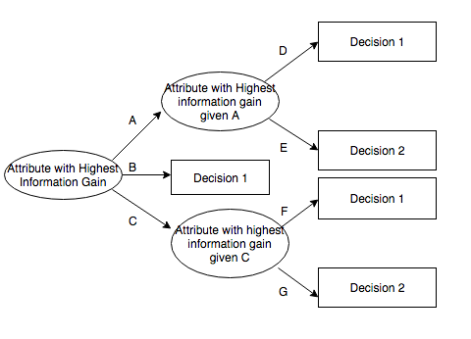
ID3 Algorithm

Slide 32
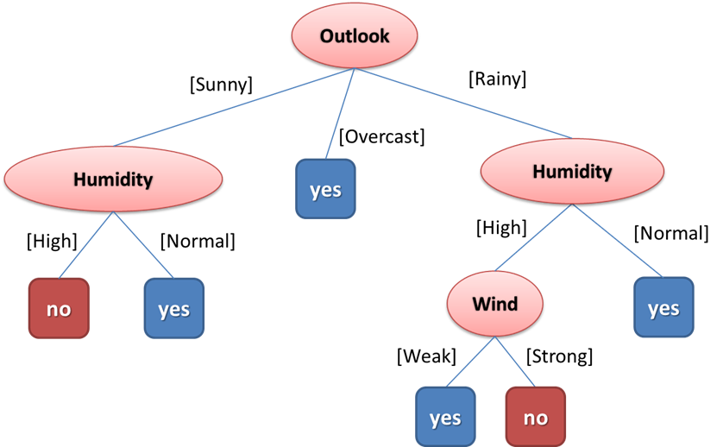
DECISION TREE REPRESENTATION
Example: PLAY TENNIS
(Outlook =Sunny ,Humidity =High)=>(Play Tennis = No)

Slide 33
ATTRIBUTE SELECTION
The popular attribute selection measures:
1.Information gain
2.Gini index
To measure the randomness or uncertainty of a random variable X is defined by Entropy.
Gini Index is a metric to measure how often a randomly chosen element would be incorrectly identified.

Slide 34
Advantages and Disadvantages
Advantages:
Decision Trees are easy to explain
It follows the same approach as humans generally follow while making decisions.
Even a naive person can understand logic.
Disadvantages:
Overfitting
Low prediction accuracy for a dataset
Handling with missing attributes
Calculations can become complex when there are many class labels.

Slide 35
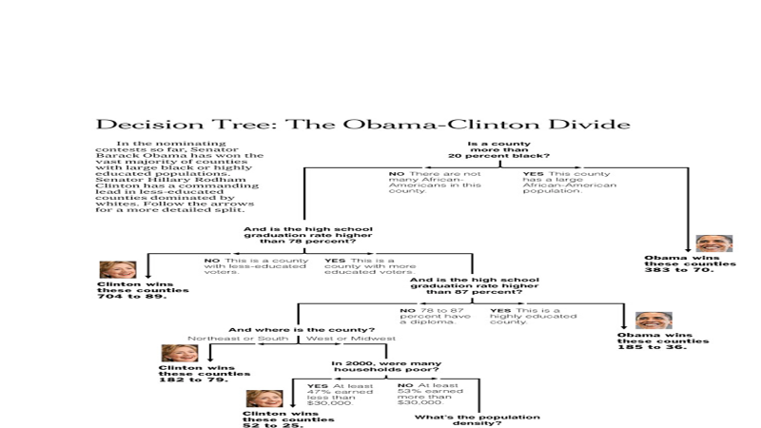

Slide 36
Classifier | Handling Large Data | Handling More Features | Processing Time | Complexity
Linear | Yes | No | Fast | No
Logistic | Yes | Yes | Fast | No
Naïve Bayes | No | Yes | Fast | No
K-Means | Yes | Yes | Fast | No
SVM | No | Yes | Slow | Yes
Decision Tree | Yes | No | Fast | No

Slide 37
Thank You!

