Slide 1
Classifiers

Slide 2
Classifier | Handling Large Data | Handling More Features | Training Time | Complexity
Linear | Yes | No | Fast | No
Logistic | Yes | Yes | Fast | No
Naïve Bayes | No | Yes | Fast | No
K-Means | Yes | Yes | Fast | No
SVM | No | Yes | Slow | Yes
Decision Tree | Yes | No | Fast | No

Slide 3
Classifier | Algorithm Type | Implementation | Application
Linear | Supervised | Classifier & Regression | Financial Forecasting , Software cost prediction
Logistic | Supervised | Classifier & Regression | Geographic Image Processing
Naïve Bayes | Supervised | Classifier | Email Spam Classification
K-Means | Unsupervised | Clustering | Recommendation Systems , Digital Marketing
SVM | Supervised | Classifier & Regression | Face Detection Speech Recognition
Decision Tree | Supervised | Classifier & Regression | Customer Relationship Management, Fraudulent Statement Detection,Data Modelling

Slide 4
Start
Classification
Predict category
Yes
Yes
No
Regression
Labeled
Data
Predict
quantity
Yes
No
No
Clustering
Dimensionality Reduction

Slide 5
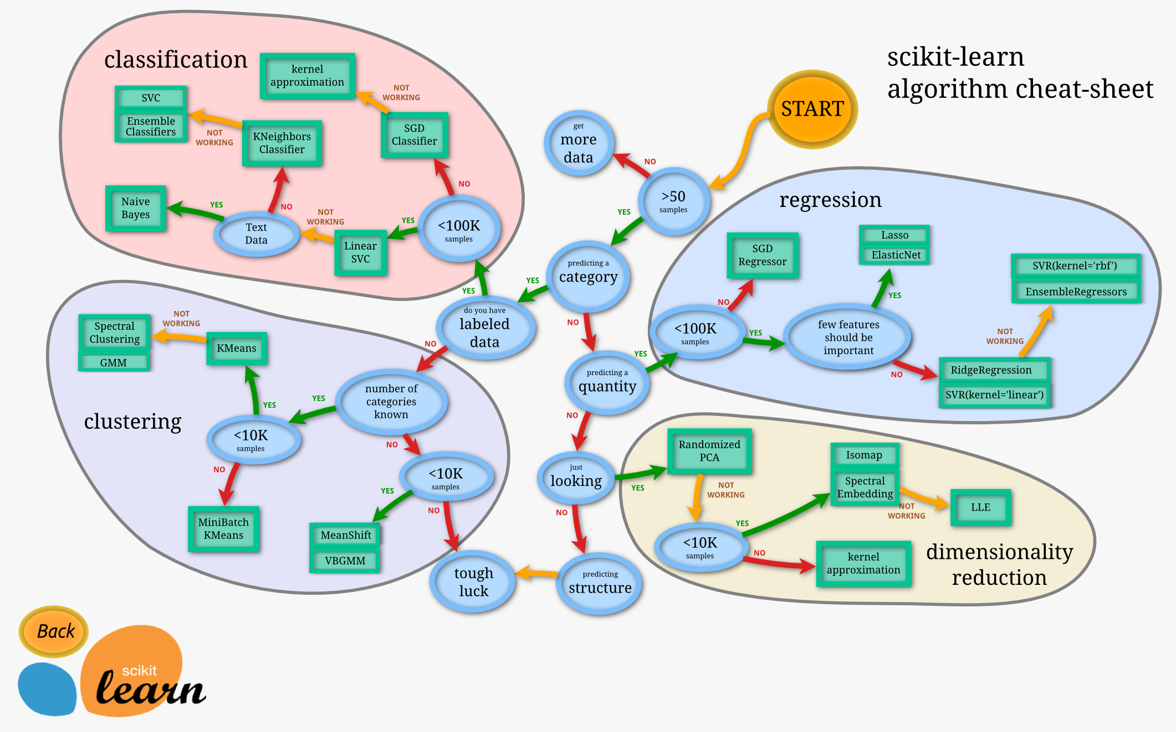

Slide 8
Thank You!

