Slide 1
“Torture the data, and it will confess to anything.” ~ Ronald Cease ~
Notes:
Here, we will discuss some of the trends we observed and potential causes for the same.

Slide 2



BARCELONA ACCIDENTs ANALYSIS
Group: H17A – 04 Manav Abichandani | Qingyang Zhang | Vaishnav Gadia

Slide 3
Trends & Causes
Written: Manav A. Presenter: Manav A.
Notes:
Here, we will discuss some of the trends we observed and potential causes for the same.

Slide 4

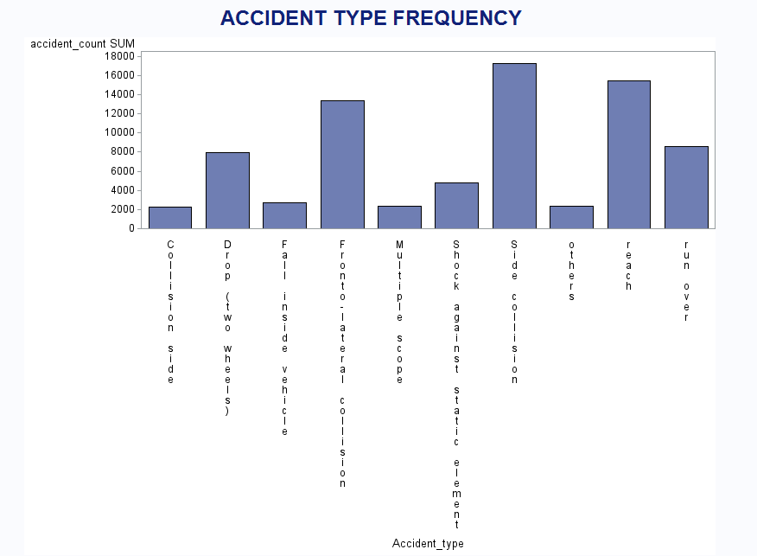
Accidents by Type
Written: Manav A. Presenter: Manav A.
Notes:
SAS Output 1: We analysed accidents by Type and found that side collisions are the most common type of accidents which occur in Barcelona, Spain. Potential causes for these could be: i. High Traffic volume; as Barcelona is a densely populated city with a lot of vehicle traffic. ii. Narrow street width iii. Side street parking accepted as a common practice

Slide 5
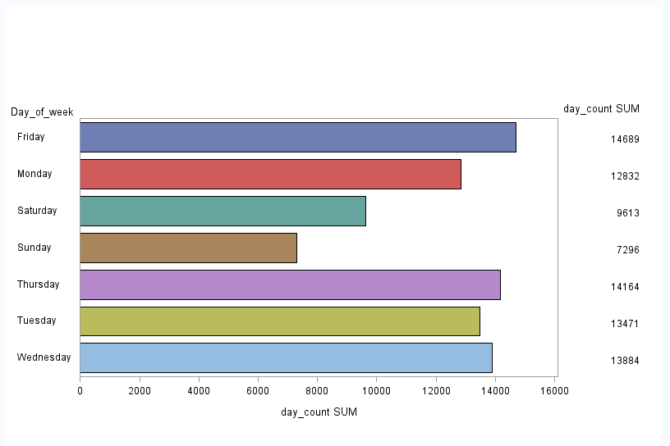
Accidents by Day
Written: Manav A. Presenter: Manav A.
Notes:
SAS Output 2: We found that Fridays tends to be the day with most number of accidents in Barcelona. This could be because of the following reasons: i. More number of people stepping out as the it marks the end of the week. ii. Barcelona’s active nightlife iii. Owing to more number of people going out, this can lead to more traffic iv. Similar to (iii), this can lead to increased pedestrian movement v. As Friday marks the end of the week and beginning of the weekend, possible reasons for accidents could be drunk driving as well. i.

Slide 6
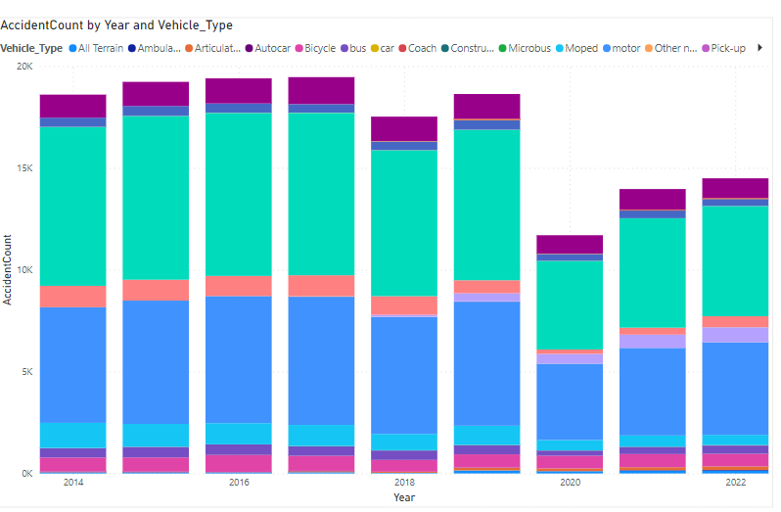
Written: Qingyang Z. Presenter: Qingyang Z
Accidents by Vehicle & Year
Notes:
Optional Output 3 using Power BI: Lets take an aggregate view of accidents by vehicle and year before we dive deep into analysing each of them. We analyse how each vehicle has fared in relation to its total accidents over years. The COVID 19 cause (discussed in slide 7) holds prevalence here as well, as proved by the visualisation.

Slide 7
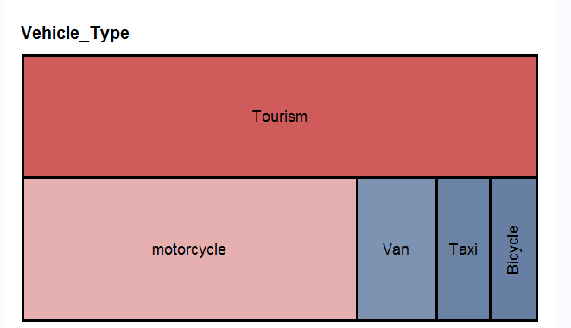
Written: Qingyang Z. Presenter: Qingyang Z
Accidents by Vehicle
Notes:
SAS Output 4: We created a tile graph to analyse which kind of vehicles have the most and least number of accidents. Vehicles used for tourism have the most number of accidents and accidents occurred through bicycles are the least. This can be because: - Unfamiliarity of tourists with local traffic rules - More distracted while travelling - Language barriers, as many traffic signs and boards can be in a language they don’t understand. - High volume of tourists especially post the pandemic

Slide 8
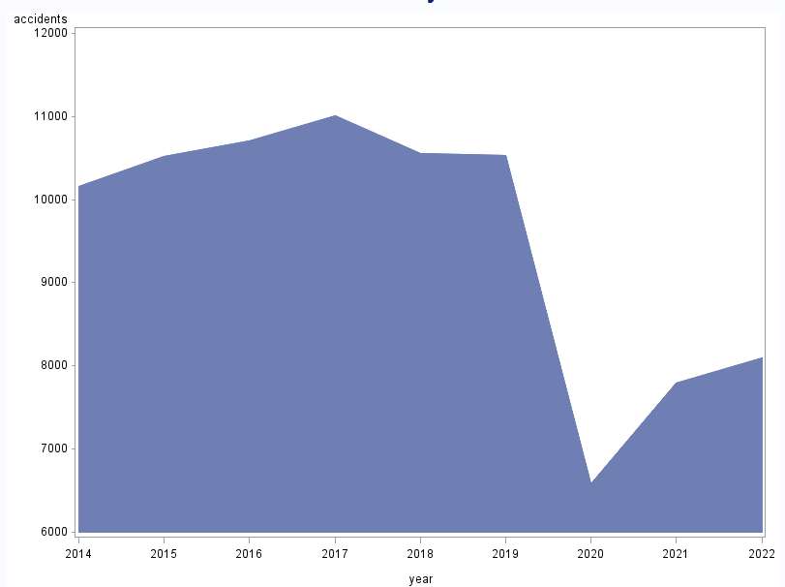
Written: Vaishnav G. Presenter: Vaishnav G.
Accidents by Year
Notes:
SAS Output 5: We built an area plot analysis accidents by year in Barcelona and found consistency in the years 2014-2019. However, there was a steep drop later on. We believe the cause for this to be the COVID-19 pandemic, leading to country wide lockdowns and insignificant vehicle activity.

Slide 9
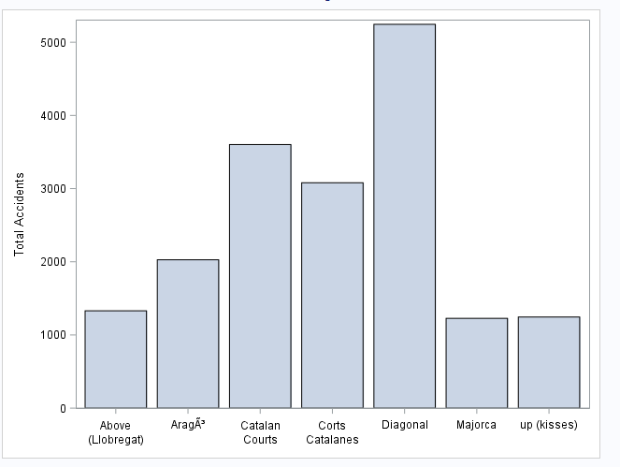
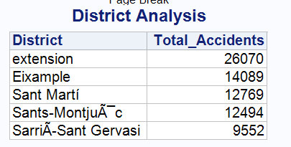
Written: Vaishnav G. Presenter: Vaishnav G.
Blackspot Analysis
Notes:
SAS Output 6: Using a bar graph, we analysed black spots. A black spot is the place where there are most number of accidents. Potential causes for these could be popular streets (becoming so because of high retail activity which leads to more commercial activity in those particular areas), as they attract more people. Other infrastructural reasons could be poor road lighting, poorly built roads, etc.

Slide 10

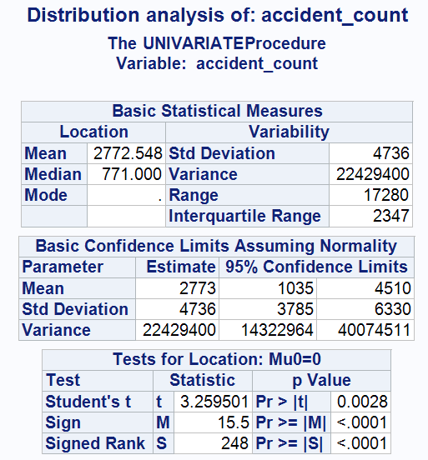
Written: Vaishnav G. Presenter: Vaishnav G.
Analysing Accident Distributions
Notes:
We performed descriptive analysis using SAS Enterprise Guide.

Slide 11
Recommendations to Mitigate Accidents
Written: Manav A. Presenter: Manav A.
01
CapEx on traffic infrastructure and promotion of public transport
02
Improved Signage via smart visuals
03
Assigning designated routes
04
Stricter traffic rules and laws
05
Leveraging technology
Notes:
To our target audience, i.e., the mayor, the police chief, and the Victims Association, we propose the following 5 implementable recommendations to ensure future reduction in accident happenings in Barcelona, Spain. However, It is important that these strategies are tailored to Barcelona's specific circumstances, guided by local traffic studies and expert advice.

Slide 12
Thank You

Slide 13
Appendix

Slide 14
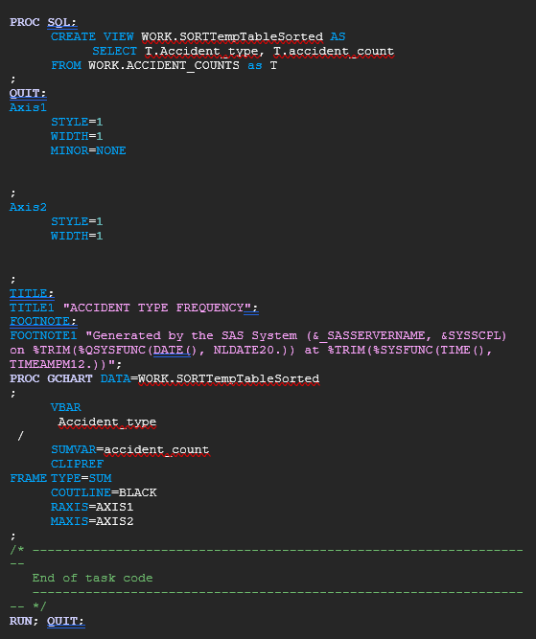
SQL Codes & Queries
Slide 3:

Slide 15
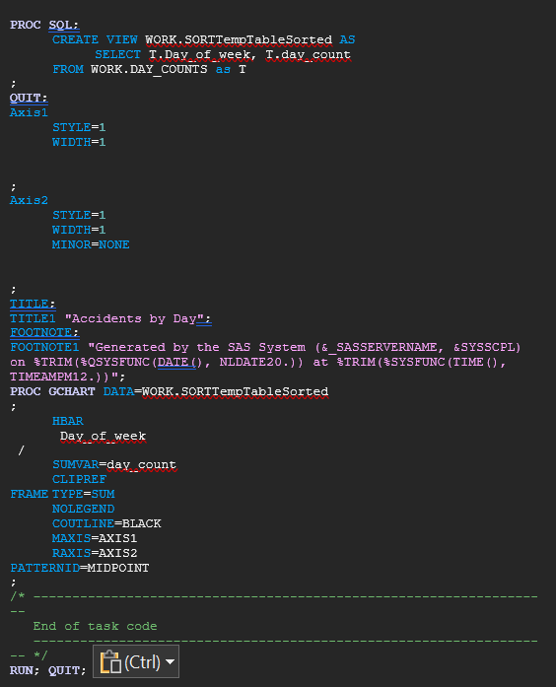
Slide 4:

Slide 16
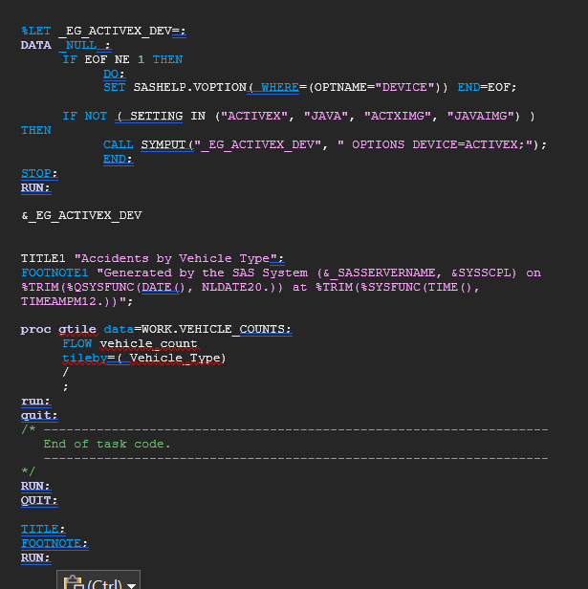
Slide 6:

Slide 17
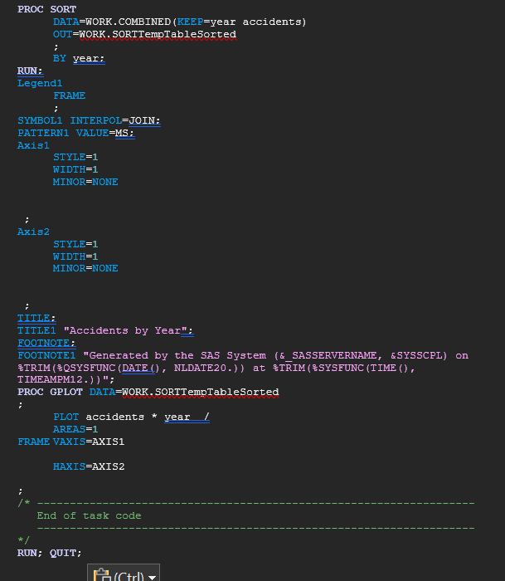
Slide 7:

Slide 18
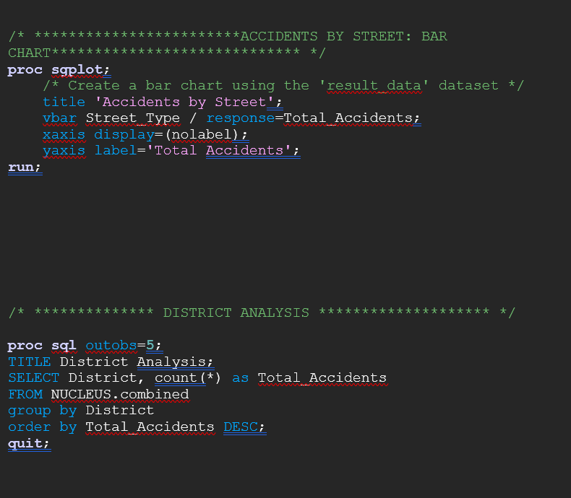
Slide 8:

Slide 19
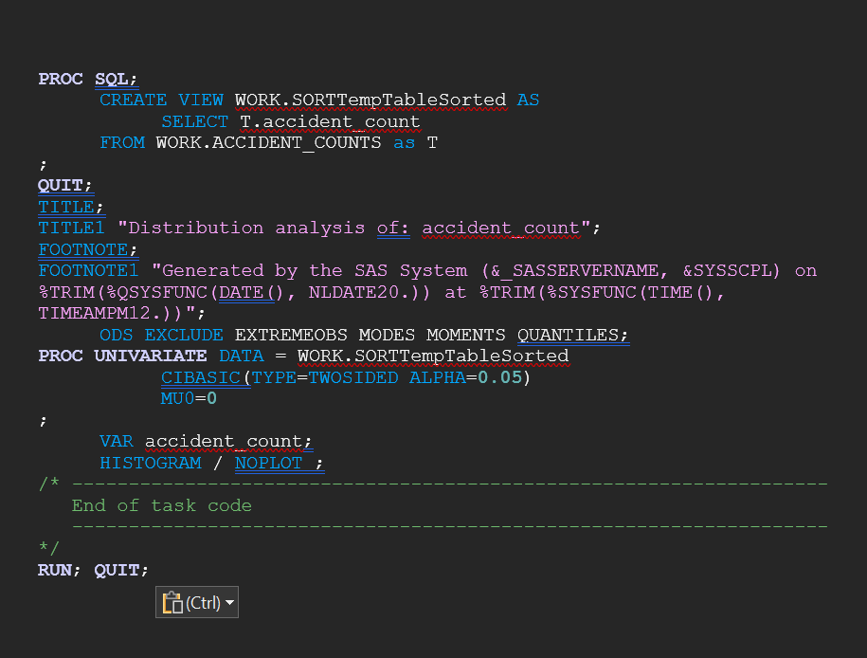
Slide 9:

Slide 20
Notes
External dataset used: https://opendata-ajuntament.barcelona.cat/data/en/dataset/est-vehicles-nacionalitat-propietari/resource/8589601c-5eee-4914-9080-d0fe13f57498
Columns not used in data sets hidden, not deleted as per relevance.
Blank values replaced with “Unknown”, wherever necessary
Created S_No as primary key.
Power BI used for optional output contained in slide 6
Notes:
SAS Output 1: We analysed accidents by Type and found that side collisions are the most common type of accidents which occur in Barcelona, Spain. Potential causes for these could be: i. High Traffic volume; as Barcelona is a densely populated city with a lot of vehicle traffic. ii. Narrow street width iii. Side street parking accepted as a common practice

