Slide 1
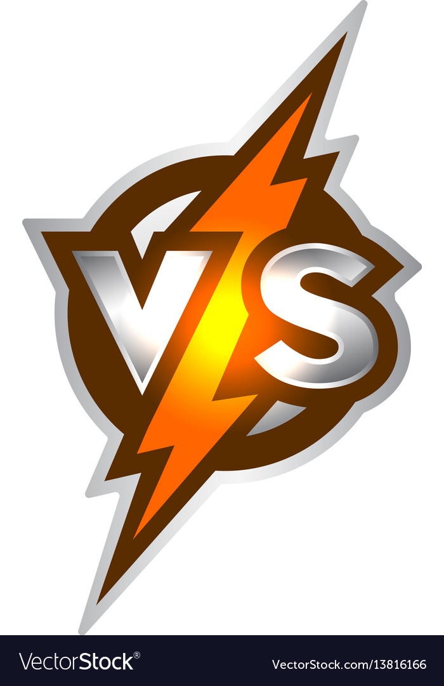
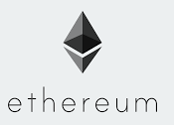
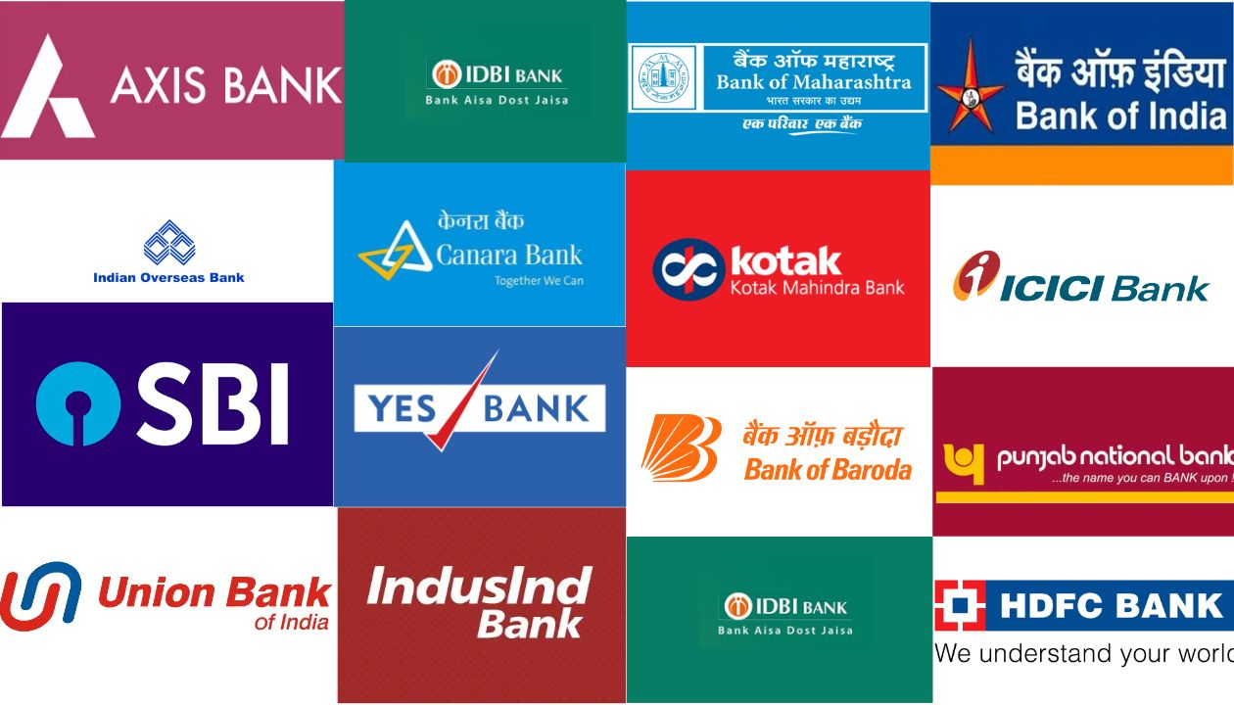

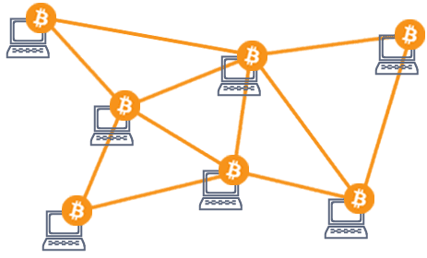
Creating A
BLOCKCHAIN ACCOUNT
Creating A BANK
ACCOUNT

Slide 2
CONTENT
THIS POST
40 %
Slide 1. Blockchain Accounts
DIY : Create A Blockchain Account Yourself
MetaMask Wallet Use and Setup
Difference Between a bank account and blockchain account
What is a Blockchain Account ?
I intend to condense the Ethereum blockchain's core concepts into just two slides, with a special focus on its inner workings.
NEXT LINKEDIN POST
60 %
Slide 2. What is Ethereum
1. Compare a conventional web service to Blockchain
Make Your Own Currency (How to issue your own currency).
How to join Blockchain Network ?
What is a “World Computer”?
4. Congrats Now You Know What Ethereum Blockchain Truly Is….

Slide 3
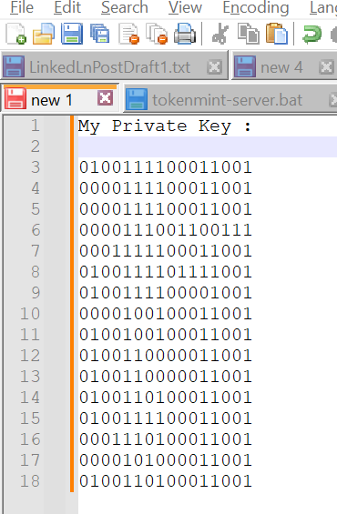
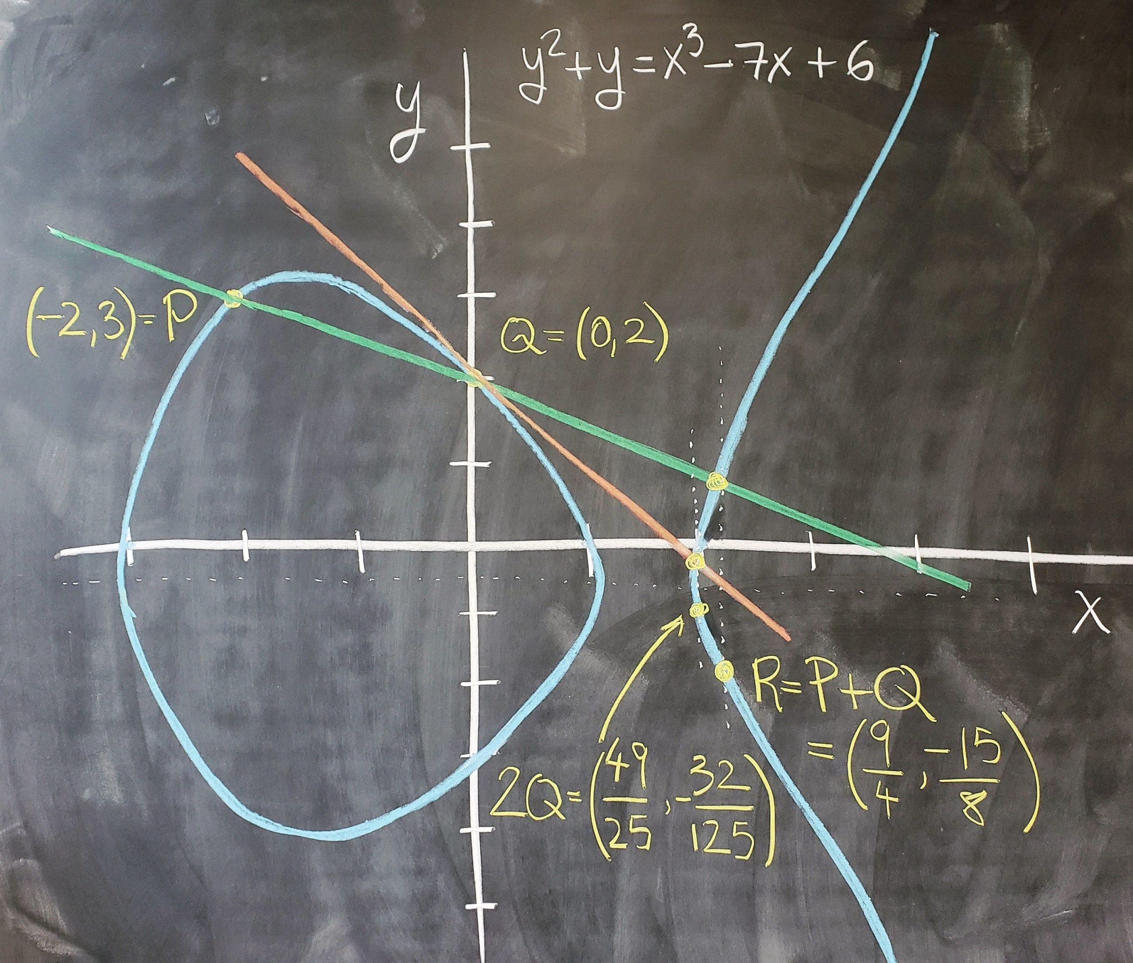
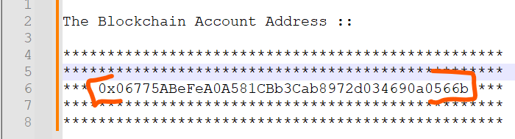

DO IT YOURSELF : Making A Ethereum Blockchain Account
STEP 1 : 1. Open a notepad and start writing random 256 bits (0100111…. 256 times), as they come to your mind.
*** This is your private key, never lose it, if you forget this key your funds are lost..... forever...
STEP 2 : 1. Get account address from your PRIVATE KEY that you generated in step1
PRIVATE KEY (010....0111 ) --->> (Lots Of Complicated Math) ------>> Account Address (0x1bc2732---f781eg).
My Ethereum Account Address (It’s a number in hexadecimal format)
Some Maths
STEP 2 : The Private Key (I typed random 0-1s)

Slide 4

THAT’S IT
You Have Successfully Created You Blockchain Account

Slide 5
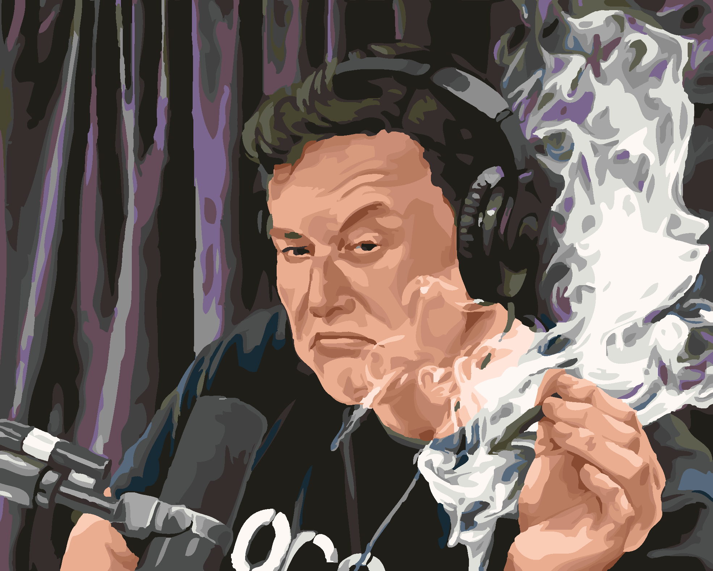
How Anonymous Can You Be On Blockchain ?
CASE STUDY
We're familiar with Elon Musk's Dogecoin involvement. Some blockchain accounts amassed substantial Dogecoins right before Musk's tweets. Additionally, certain accounts consistently acquired more coins before Musk mentioned them. This has led to speculation that these accounts might be associated with Elon Musk.
While these theories may hold some truth, we may never know for sure. In fact, there's a substantial bounty for anyone who can uncover Elon Musk's blockchain address.
Some Believe This Is Elon Musk’s Account Address
DH5yaieqoZN36fDVciNyRueRGvGLR3mr7L
Your blockchain address stays confidential unless you choose to Declare and Validate ownership.

Slide 6
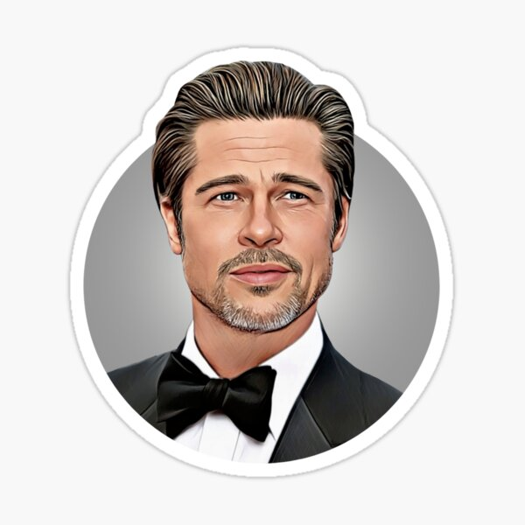
Meet My Blockchain Address : “0x2a2954f3989a83cc43dd58b0f038d5f276f21333”
Hey everyone, here's my blockchain address with a balance of 20 MATIC coins (Approximately 200 INR). If you check out this link, you can trace all the transactions I've ever made throughout my lifetime and see where my funds have moved.
Click here to Check My
Account Statement

Slide 7
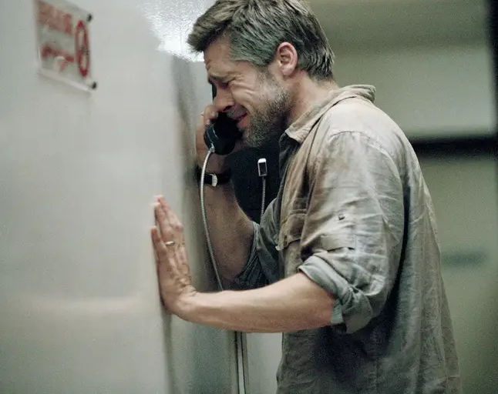
Click here to Check My
Account Statement
PLEASEEEE.

Slide 8
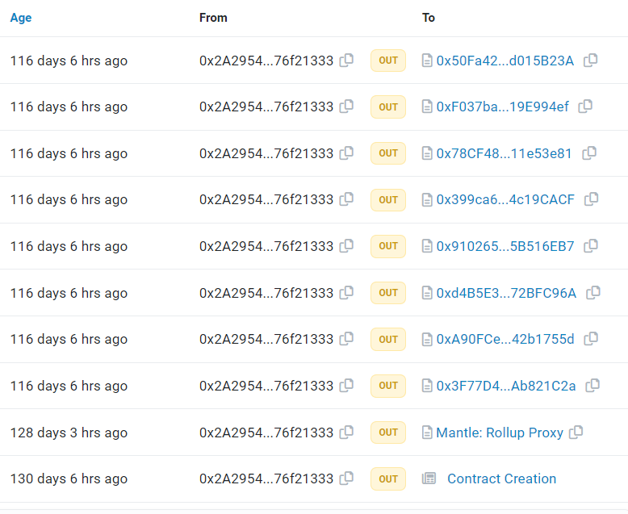
My Account Statement
It is like you have access to my Bank Account Statement for lifetime. If You conclude from our earlier discussion, we see Blockchain is Highly Anonymous as well as Highly Transparent

Slide 9
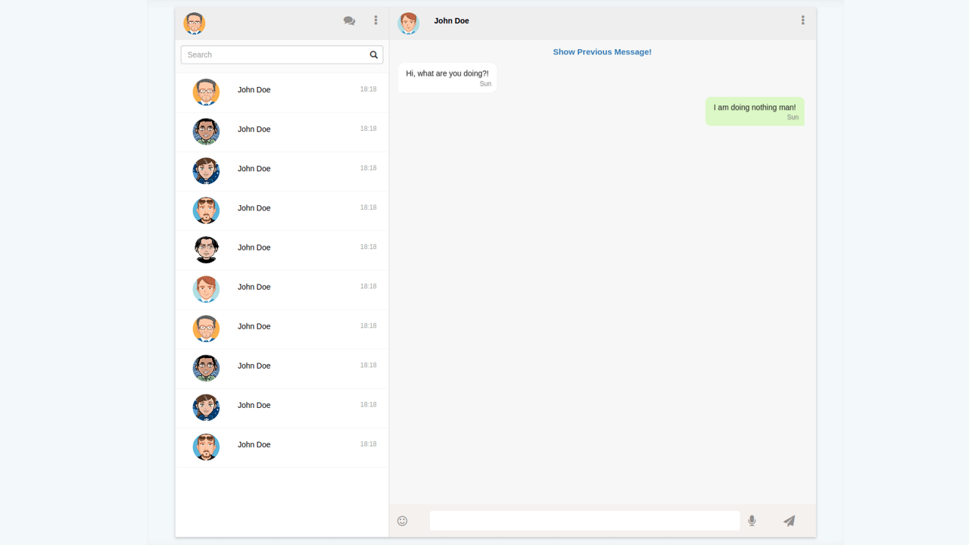
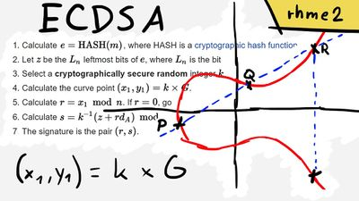
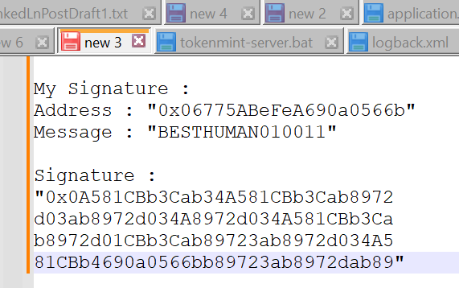
HERE IS THE PROOF OF MY OWNERSHIP OF THE ACCOUNT
YOU
VAISHNAV
Hi Vaishnav, You own this account {0x06775ABeFeA0A581CBb3Cab8972d034690a0566b} right?
Message
Hi Bhavesh, Yes, I do whyyy ?
BESTHUMAN010011
Signed Message :
0x0A581CBb3Cab34A581CBb3Cab8972d03ab8972d034A8972d034A581CBb3Cab8972d01CBb3Cab89723ab8972d034A581CBb4690a0566bb89723ab8972dab89
Nothing, just wanted to validate once.
Hi can you do one task, Just “SIGN” this message once with the private key of this account Message : “BESTHUMAN010011”
My Private Key
Okkk, give me a minute…
Signed Message :
0x0A581CBb3Cab34A581CBb3Cab8972
d03ab8972d034A8972d034A581CBb3Cab8972d01CBb3Cab89723ab8972d034A581CBb4690a0566bb89723ab8972dab89
Some Maths
Some Maths
Oh, Thanks Let Me check….
Signer Address : 0x06775ABeFeA0A581CBb3Cab8972d034690a0566b
Yes bro, correct .. this one is yours…
😒
Message : BESTHUMAN010011

Slide 10
How's opening an SBI account different from getting yourself an Ethereum account?
When you open a bank account, like with SBI for instance, it's the bank that provides you with the account. Nowadays, some banks even let you choose it yourself, but in any case, “The Bank Issues You a Bank Account.”
Centralization Detected
However, when it comes to creating an Ethereum blockchain account, “It's us who create it for ourselves”.
DECENTRALIZED
Certainly, even when we utilized MetaMask to generate an account address, the private key and address were generated exclusively on your local device. This process entailed running JavaScript code within your browser to create them, as opposed to a MetaMask Server generating an address and assigning it to you.

Slide 11
Your "Ethereum Account" isn’t just like a regular bank account,
it's your UNIQUE IDENTITY within the blockchain world.

Slide 12
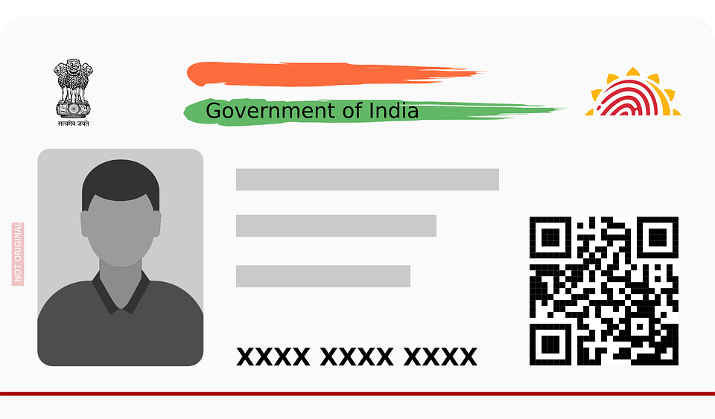

The Peer-To-Peer Community Of The World
Why “Peer-To-Peer Community”??? Will cover in next post
Name : Anonymous
DOB : TODAY
I won’t know your address as long as you don’t thell me explicitly…
0x06775ABeFeA0A581CBb3Cab8972d034690a0566b
Just like Aadhar serves as your identification within a country, your identification in the blockchain will be represented by THE ACCOUNT ADDRESS.
Reading the address directly can be challenging, which is why we use a QR code to represent your ID.

Slide 13
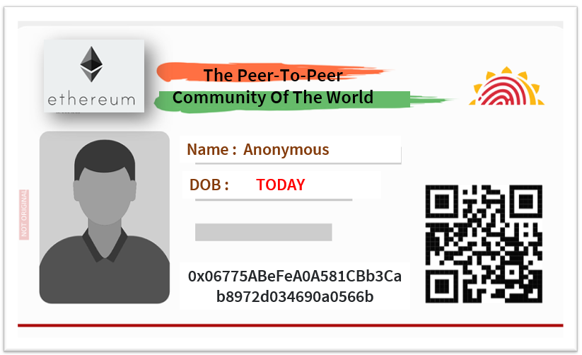
One Person (Entity) Multiple IDs
YOU CAN CREATE AS MANY ACCOUNTS AS YOU WANT FOR YOURSELF THOUSANDS,
MILLIONS, BILLIONS

Slide 14

Okk… So here we are after so many slides, with random 256 bits , a hexadecimal value derived from it, which we call an ID on blockchain…. BUT WHAT BLOCKCHAIN TRULY IS ?????
Understanding what Blockchain Account is a prerequisite to understanding Ethereum, as whenever you interact with Blockchain You cannot… as long as you don’t have a Blockchain Address :
You Need Account Id to:
Send Funds
Receive Funds
Make Server Calls ( SPOILER FOR THE NEXT POST)

Slide 15
THE END
YOU MAY OR MAY NOT WANT TO SEE NEXT SLIDES

Slide 16

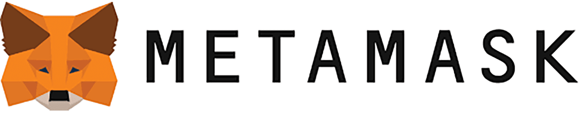
Recommended Approach To Make A Blockchain Account : METAMASK
Forget about the way I mentioned earlier – there's a much easier way to make a Blockchain Account. Give it a shot yourself, trust me, it'll only take 5-6 minutes tops.
MEET
METAMASK !
MetaMask serves as a browser plugin that handles the tasks of creating a private key, performing complex mathematical operations, and obtaining an account address.

Slide 17
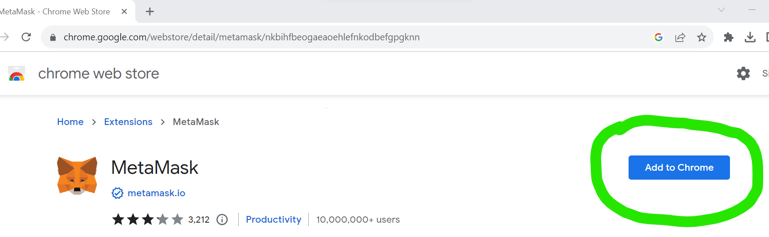
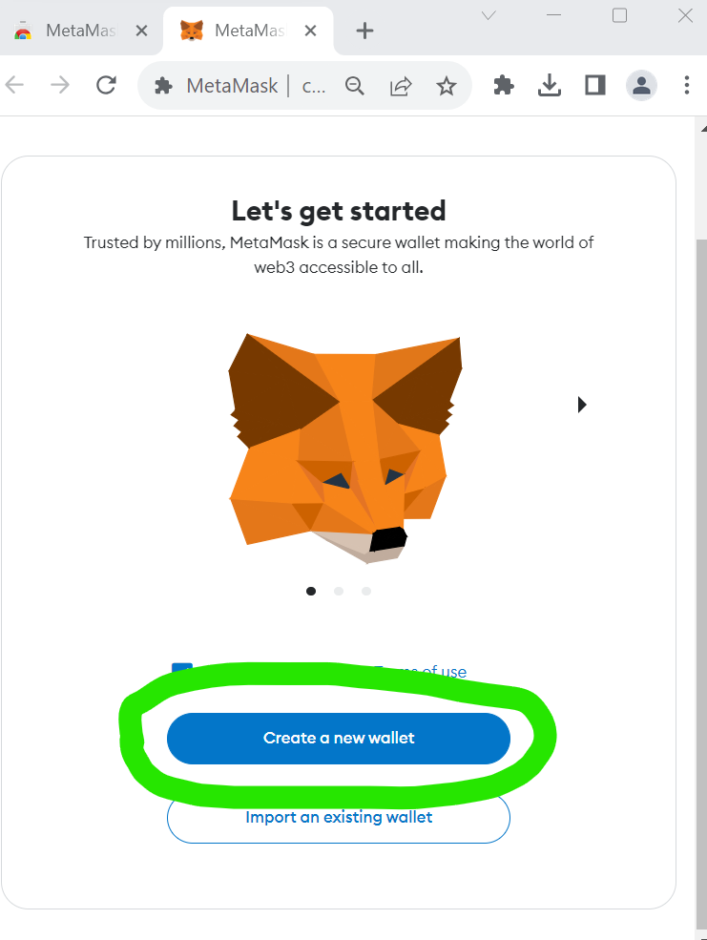
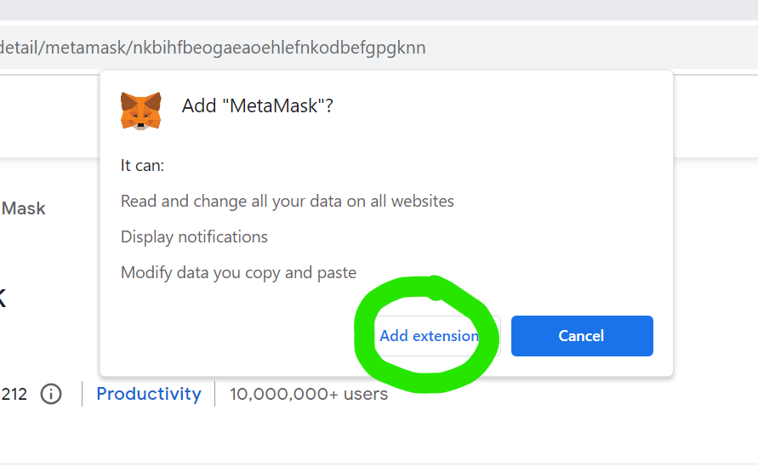
METAMASK
STEP 1 : Visit chrome webstore to Add MetaMask Extension to the browser
Link To Install MetaMask Browser Extension
STEP 2 : Select create new wallet and proceed.

Slide 18
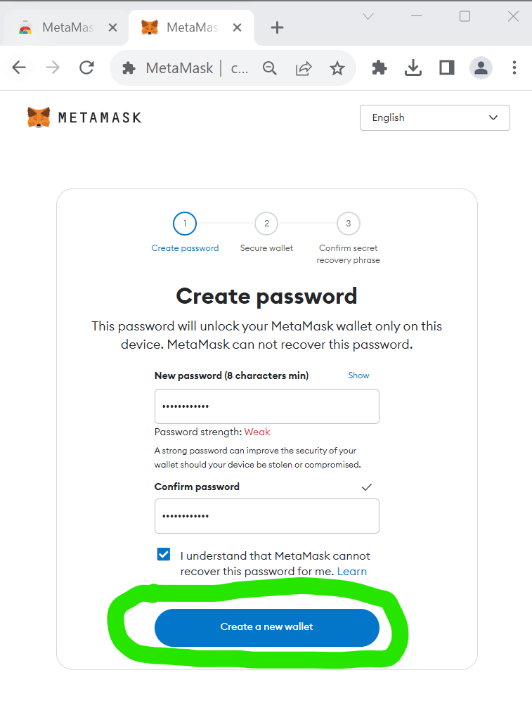
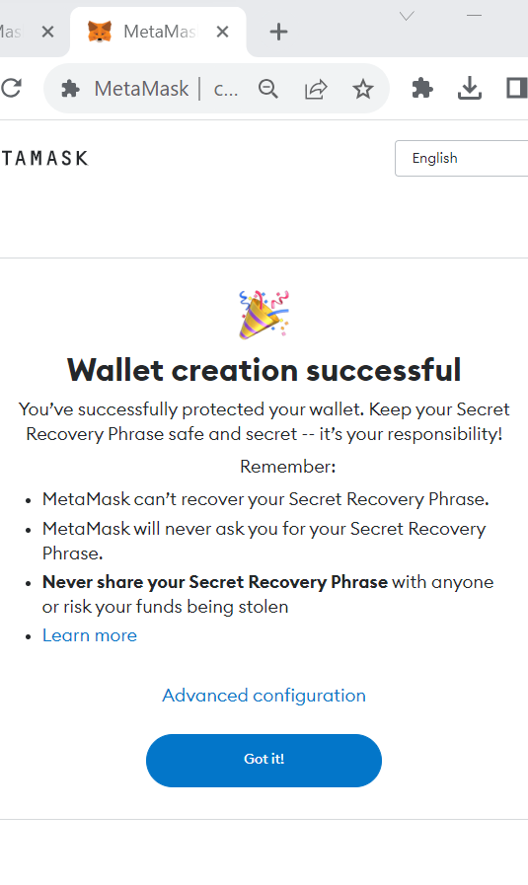
METAMASK
STEP 3 : Complete your wallet creation, A wallet manages all your Ethereum Blockchain Accounts at one place

Slide 19
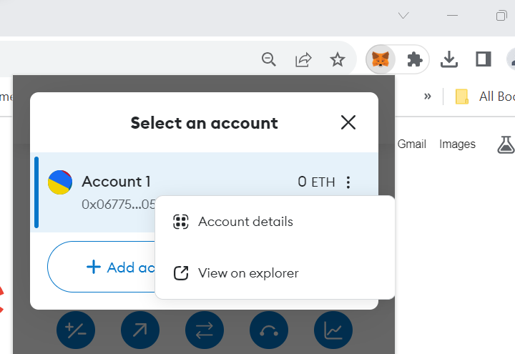
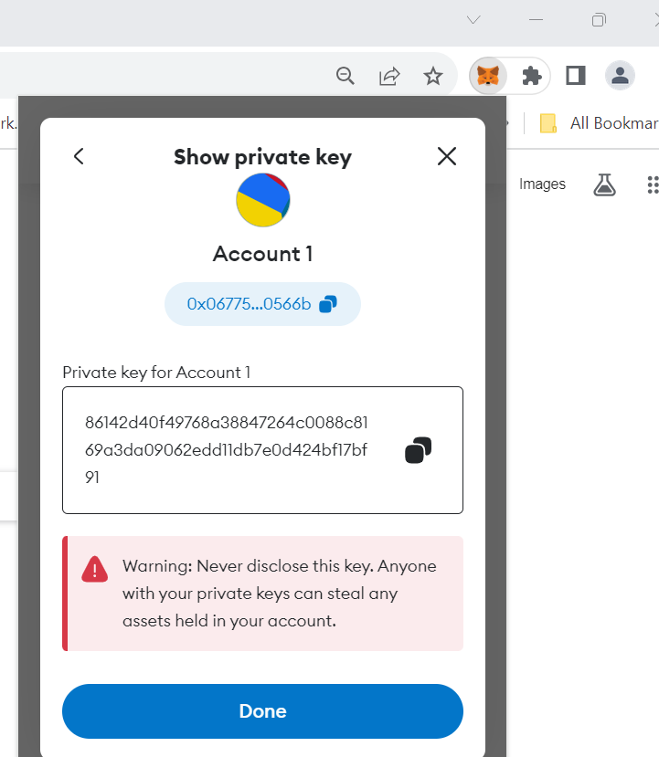
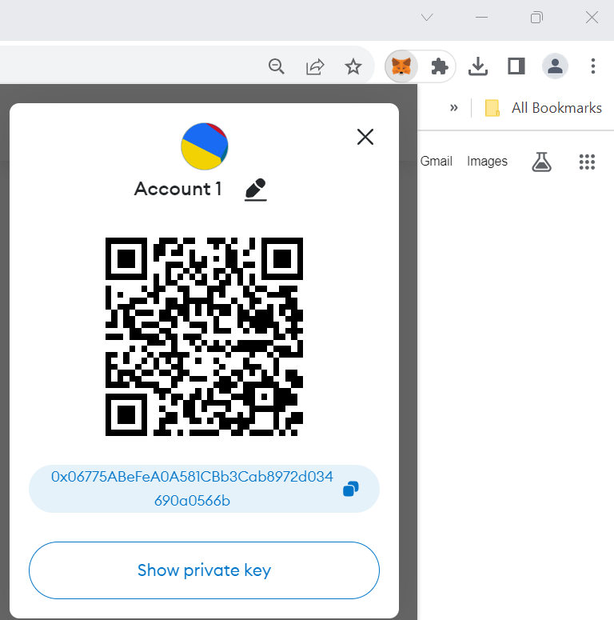
METAMASK
DIY : Setting Up MetaMask Wallet
STEP 4 : Once the wallet is created, you will see an account created by MetaMask (“Account 1”), You can ask MetaMask to create as many accounts as you can.
1. If you explore a bit more, you can check the account details for “Account 1”
2. You'll have a QR code for your account address, just like UPI QR codes for PhonePe or Google Pay. Use it to receive payments in different currencies like Matic, Ether, or Solana through specific apps.
4. You can also see the private key corresponding to your account
3. You will also find you account address on Blockchain.

Slide 20
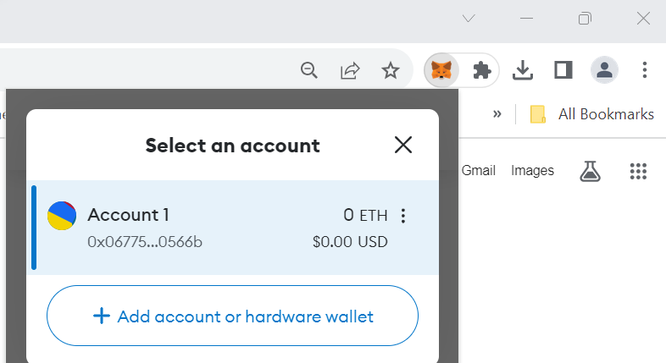
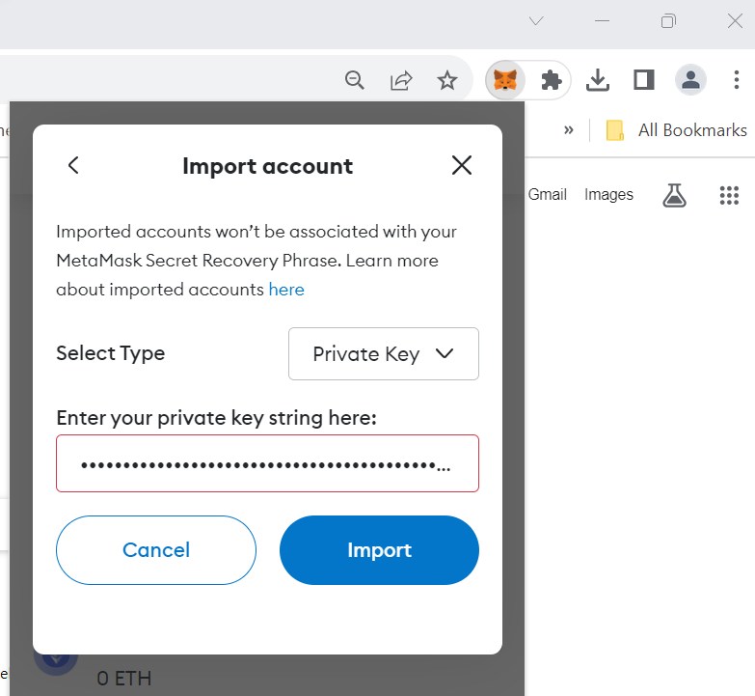
DIY : Setting Up MetaMask Wallet
STEP 4 : If you recall, in the initial slide, we generated a Private Key and its corresponding Account address by manually writing 256 bits. You can also include this account in your MetaMask wallet by converting those 256 bits into their hexadecimal form and adding them in MetaMask.
The Private Key (I entered a sequence of random 0s and 1s).

Slide 21
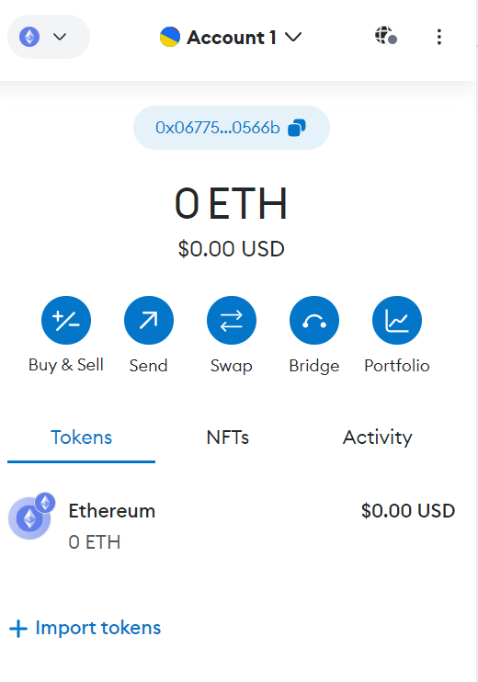
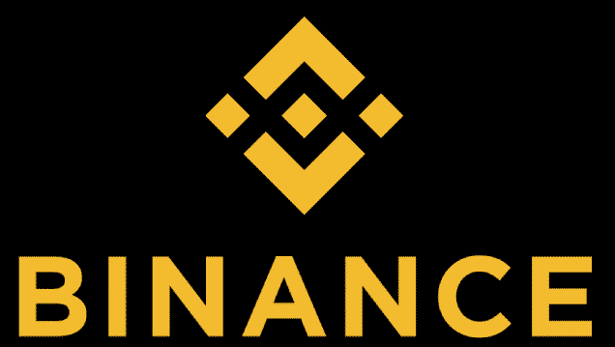
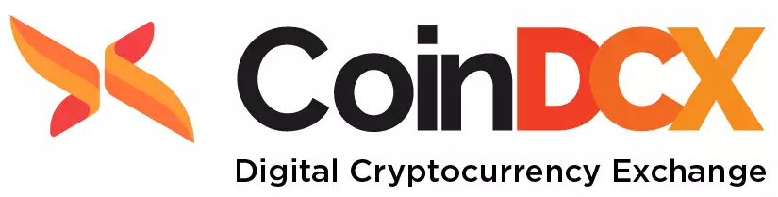
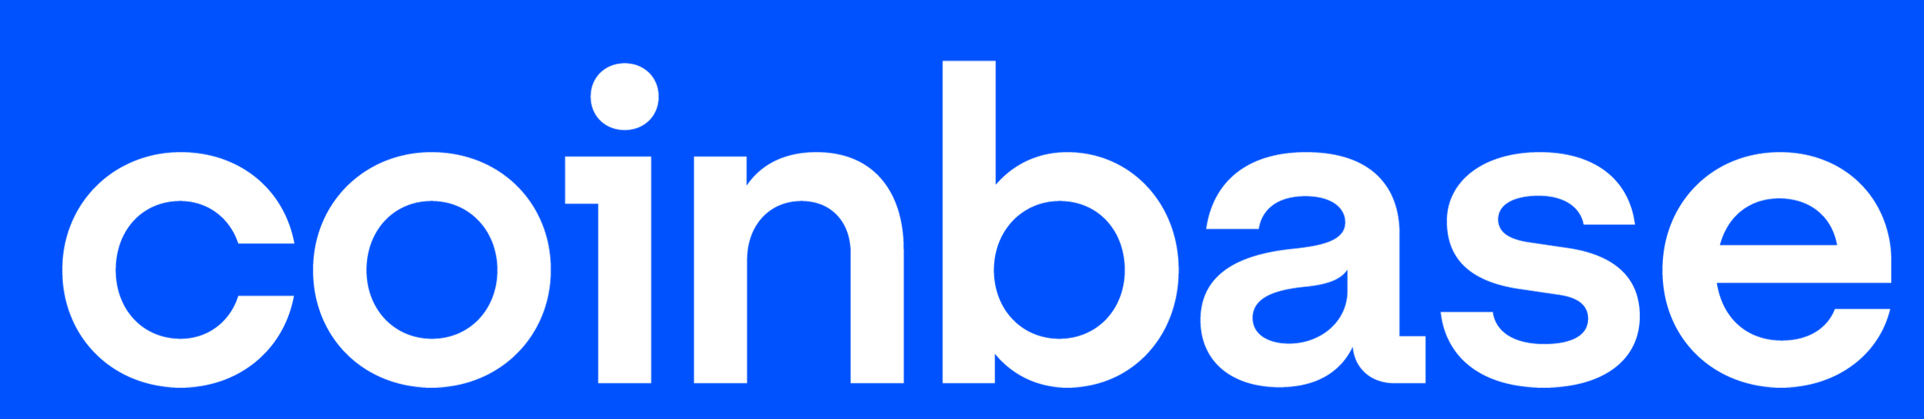
DIY : How To Add Crypto Currency- NFTs to Account
Alright, so now that I have my Ethereum account, the next question is: where do I obtain the funds? The answer includes platforms like Binance and CoinDCX, but let's save that discussion for another time. If you're eager to delve into it now, here's the link to learn more.
Account But With Zero Balance

