Slide 1
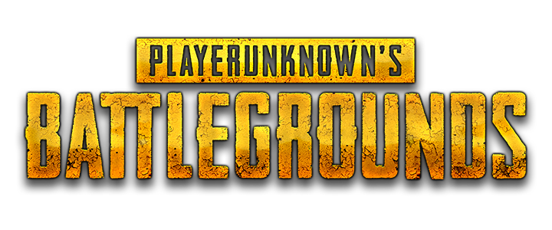
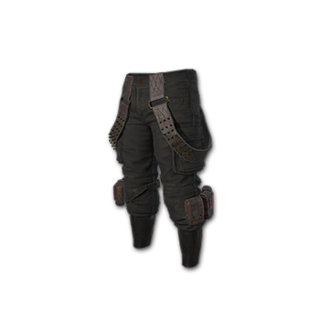
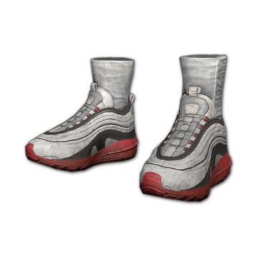
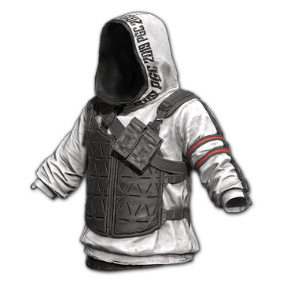
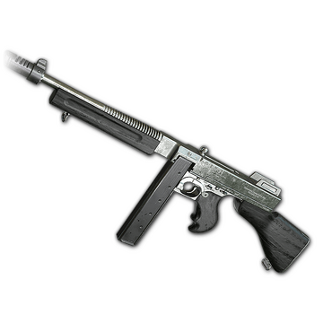
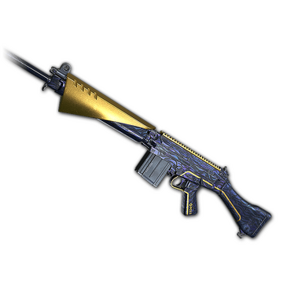
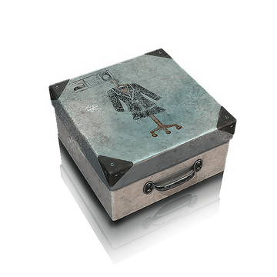
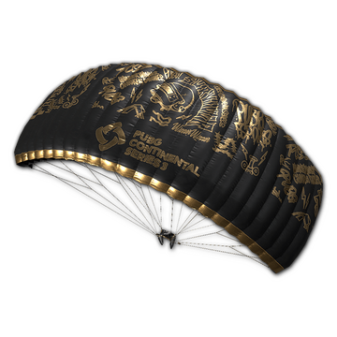
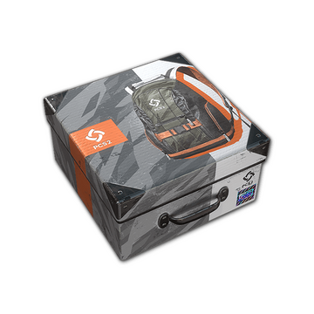
DIGITAL COLLECTIBLES
PROBLEM STATEMENT :
The upcoming slides examines the issue of major platforms such as Steam, Google Playstore, and iOS Store dominating the game asset market.
A proposed solution involves using Ethereum blockchain to make buying and selling assets fairer.
The project aims to address this problem and explain the workings of Ethereum blockchains in a simple manner

Slide 2
The Code
Player Initiates Purchase Request
public String buyInGameAsset(String playerId, int quantity, int purchaseAmount) {
if (purchaseAmount >=
quantity * Inventory.getsellingPriceFor_PCGParachutes_()
&& Inventory.getTotalSupply_PCGParachutes_() >= quantity) {
boolean paymentSuccess =
PaymentService.transferMoneyToGame(purchaseAmount);
/**
* Will Initiate transfer of money from player to game, using UPI, card payment
*/
if (!paymentSuccess) {
return "FALIURE";
}
Inventory.reduceTotalSupply(quantity);
/** Reduce totalSupply of _PCGParachutes_ */
Inventory.add_PCGParachutes_ForPlayer(playerId, quantity);
/** Add "quantity" amount of _PCGParachutes_ to playerId */
return "SUCCESS";
} else {
return "FALIURE";
}
}
Completes the Card Payment
The Item is transferred to player’s account

Slide 3
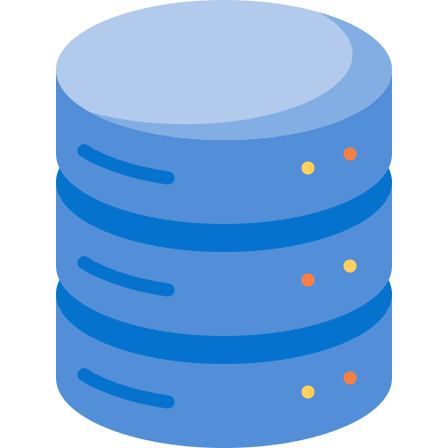


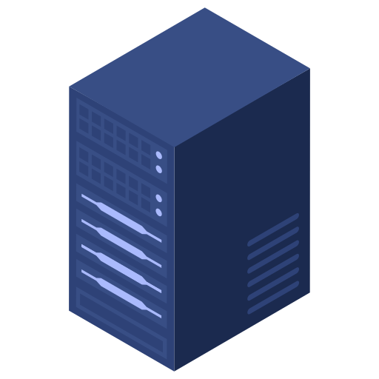
BUYING IN-GAME COLLECTIBLES
PLAYER
1. Buy Asset Request
2. Card, Wallet, UPI Payment
3. Buy Asset Response

Slide 4
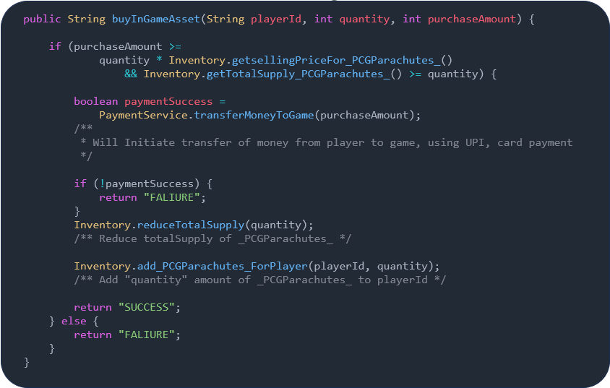
How to deploy code on “Ethereum Chains”
Web2/Centralized Servers {Owned by an entity}.
Code is deployed on finite servers owned by entity.
YOUR CODE.java

Slide 5
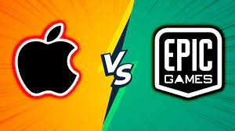
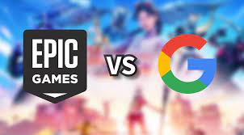
What are the Blockers For The Game.
The game must go through a lot of blockers:
Make a website, write a backend code.
Acquire infrastructure resources such as databases and servers, ensuring both their security and continuous uptime.
Comply with rules and regulations of different countries.
Handling different currencies , payment methods, and ensuring the security of financial information.
Depositing and withdrawing funds from the marketplaces.
https://www.youtube.com/watch?v=Q-0H7QU9hs8
https://www.youtube.com/watch?v=k_1Z3WEzLj4

Slide 6
BUYING IN-GAME COLLECTIBLES
PLAYER
1. Buy Asset Request
2. Card, Wallet, UPI Payment
3. Buy Asset Response

Slide 8
contract SimpleStorage is ERC1155, Ownable {
uint256 private sellingPrice = 100;
address private initialOwner = 0x1234567890123456789012345678901234567890;
// Buyer can purchase a token by sending the required amount of Ether
function purchase(uint256 assetId,uint256 quantity) external payable {
require(msg.value >= sellingPrice*quantity, "Incorrect Ether amount sent");
_mint(msg.sender, assetId, 1, "");
/** Add "quantity" amount of tokens to "playerBlockchainAddress" */
payable(initialOwner).transfer(msg.value);
/** Transfer "purchaseAmount == msg.value" worth of
"Ether" to the owner's Blockchain Address */
}
// Get the amount of tokens owned by an address
@override
function balanceOf(address account, uint256 id) external view returns (uint256) {
return balanceOf(account, id);
}
}
THE CODE THAT EXECUTES SALE AND KEEP TRACK OF OWNERSHIP OF ITEMS
Moves the token to buyer’s address (“msg.sender”)
When the funds sent by the buyer gets transferred to owner address. {It’s like payment method embedded in the Ethereum infrastructure}

Slide 9

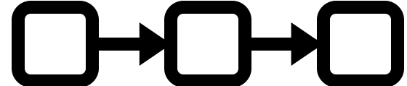
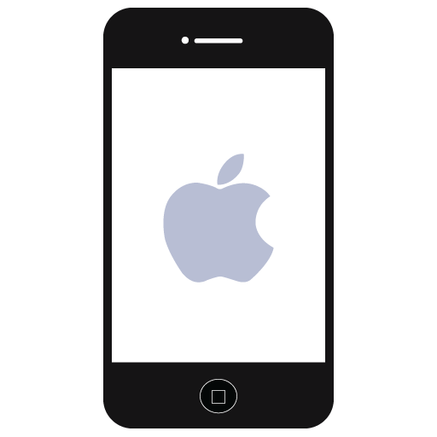
How to deploy code on “Ethereum Chains”
Web3/Decentralized “Owned by everyone” code is deployed on thousands of servers owned by individuals or entities.
The deployed code is assigned a unique address uniform across all servers.
CODE WRITTEN BY YOU.solidity

Slide 10
Make a Request on Ethereum Chain
1
2
All nodes execute the same code
4
2

Slide 11
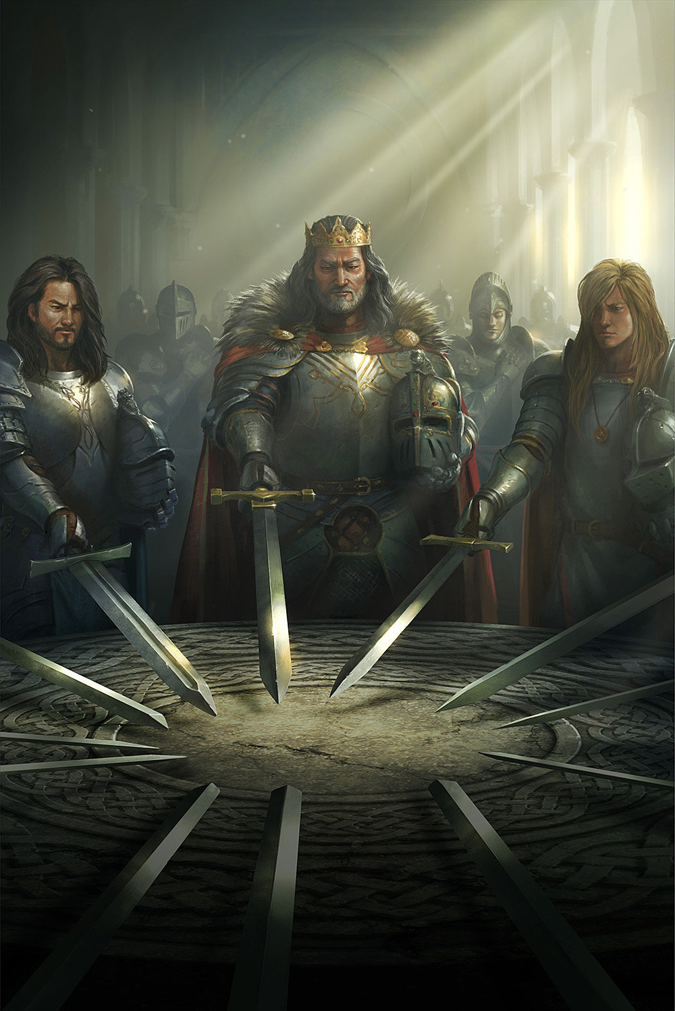
CONSENSYS
INITIAL STATE =
FINAL STATE
The transaction will complete only when all the initial states and final states of the code you have deployed.

Slide 12
GAS FEES AND MINING REWARD
1. What is the incentive for nodes/people to join the blockchain network ?
Since running a server costs electricity and internet, there must be some mechanism which compensates the nodes. 2. There are two stream of revenue for a node
GAS FEES
Whenever we make an Api call to the blockchain, what we are doing is essentially running a block of code in the server, in this case all the nodes on blockchain are running the same lines of code, this requires processing power (electricity/gas).
So, whenever we make an Api call to the blockchain we need to send some processing fee to the chain, the processing fee depends on two factors
a. the complexity of code to be executed
b. the traffic on the blockchain at the given point of time.
MINING REWARD:
For some other day…..

Slide 13
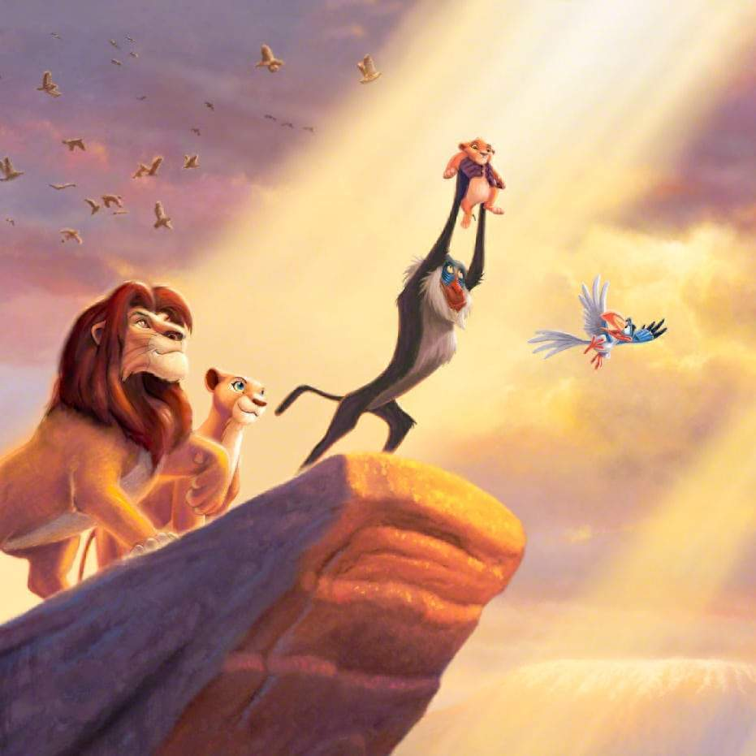
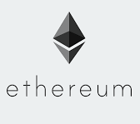
THE BIRTH OF ETHER CRYPTO CURRENCY
Lots of cryptocurrencies today are born out of the concepts as discussed previously
Here is the list of some of them you might own
Matic (Polygon)
Avalanche (AVAX)
Tron (TRX)
Note that Bitcoin does not belong to this group nor do the concepts we are discussion applies to Bitcoin, it is simpler and more basic blockchain, read the story here

Slide 14

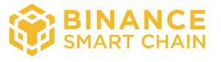
What are Chains ?
All the above chains can run the same Solidity code, with the same behavior.
Different chains have different currencies to pay gas fees and as MINING reward.
All these chains run the code on Ethereum Virtual Machine (Similar to Java Virtual Machine to run java code).
You Might own one of these currency in you Binance/CoinDCX exchanges. (Matic – Polygon, Ether – Ethereum Mainnet and Binance Smart Chain Girl – Binance Smart Chain )

Slide 15

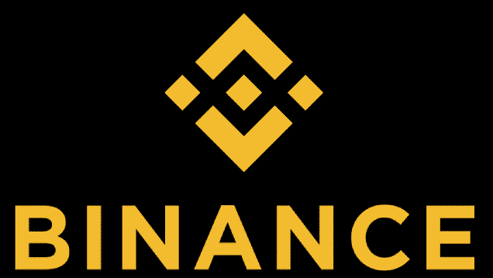
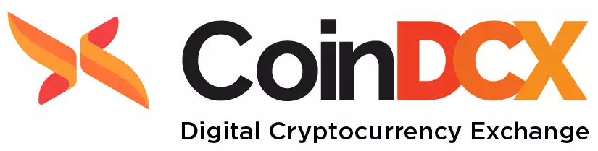
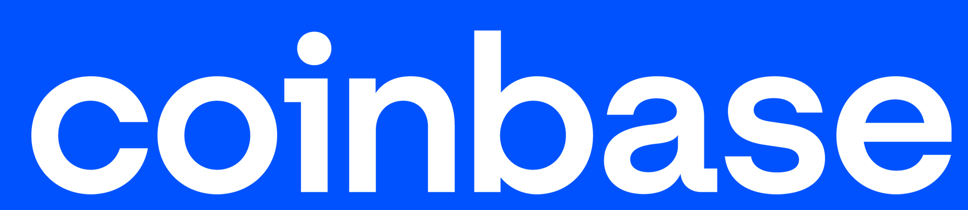
Blockchain Economy
Exchange (Ethers) with (Dollars) and vice versa
+ Mining reward (Ethers)
Exchange (Dollars) with (Ethers) and vice versa
0x0CBb3ab897C03Cab897CBb6ab897Cab897Cab897Cab897Cb
0x06775ABeFeA0A581CBb3Cab8972d034690a0566b
+ Gas Fees(Ethers)

Slide 16

Ethers as a Mode Of Payment
Peer-to-peer payment
0xsdsd4ABeFeA0A581CBb3Cab8972d034690a05dsds
0x06775ABeFeA0A581CBb3Cab8972d034690a0566b
0x06775ABeFeA0A581CBb3Cab8972d034690a0566b
To buy in-game assets

Slide 17
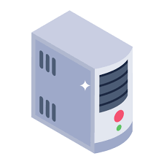
How to become a part of the blockchain ?
Hey, I would like to participate in the “Ethereum Mainnet” chain
Sure, please connect to this IP 197.12.12.223
Connect with mine 223.12.12.273
Connect with mine 123.12.12.223

Slide 18
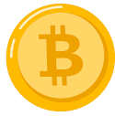
How Does the request to the Ethereum chain look like?
To : Address of the deployed code
THE MESSAGE IS SIGNED BY THE SENDER
Request Name : buyPCGParachute()
{
"quantity" : "1"
}
The payload required to the request name
Gas fee : the request processing fee that needs to be paid to the nodes
The sender signs the complete payload, including the intent to transfer "purchaseAmount" and "Gas Fee," using his private key.
If any amount I want to send :
The “purchaseAmount ” to buy the item. (Funded by the account sending the request)

Slide 19
NOT JUST ANOTHER PAYMENT OPTION
Ethereum Is not just a mode of payment, It is a NETWORK OF SERVER + PAYMENT METHOD bundled together.
It is a network of servers that runs some code and accepts crypto currency as a mode of payment.

Slide 20
contract SimpleStorage is ERC1155, Ownable {
uint256 private sellingPrice = 100;
address private initialOwner = 0x1234567890123456789012345678901234567890;
// Buyer can purchase a token by sending the required amount of Ether
function purchase(uint256 assetId,uint256 quantity) external payable {
require(msg.value >= sellingPrice*quantity, "Incorrect Ether amount sent");
_mint(msg.sender, assetId, 1, "");
/** Add "quantity" amount of tokens to "playerBlockchainAddress" */
payable(initialOwner).transfer(msg.value);
/** Transfer "purchaseAmount == msg.value" worth of
"Ether" to the owner's Blockchain Address */
}
// Get the amount of tokens owned by an address
@override
function balanceOf(address account, uint256 id) external view returns (uint256) {
return balanceOf(account, id);
}
}
MOVING FUNDS (ETHERS) AND ASSETS IN THE SAME CODE
Moves the token to buyer’s address (“msg.sender”)
When the funds sent by the buyer gets transferred to owner address. {It’s like payment method embedded in the Ethereum infrastructure}

Slide 22

NODE SERVICE PROVIDER
Visit Alchemy
To make any transaction or API calls, to the blockchain, you need to be connected to a node, there are 100’s and 1000’s of nodes available to be connected to, but there are a few nodes used widely. One of them is Alchemy

Slide 23
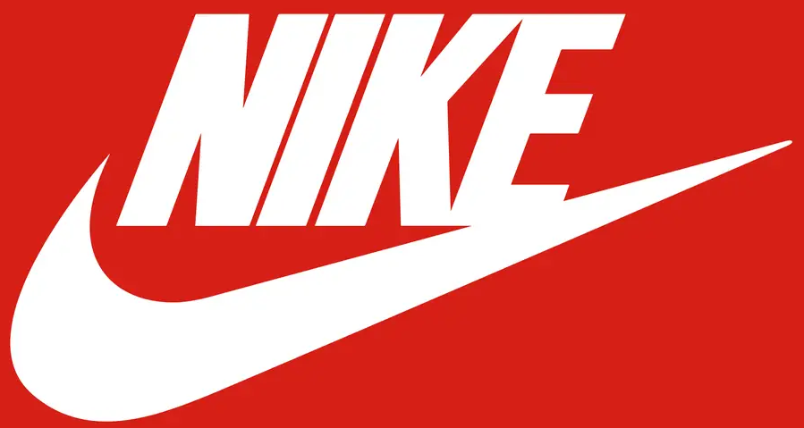
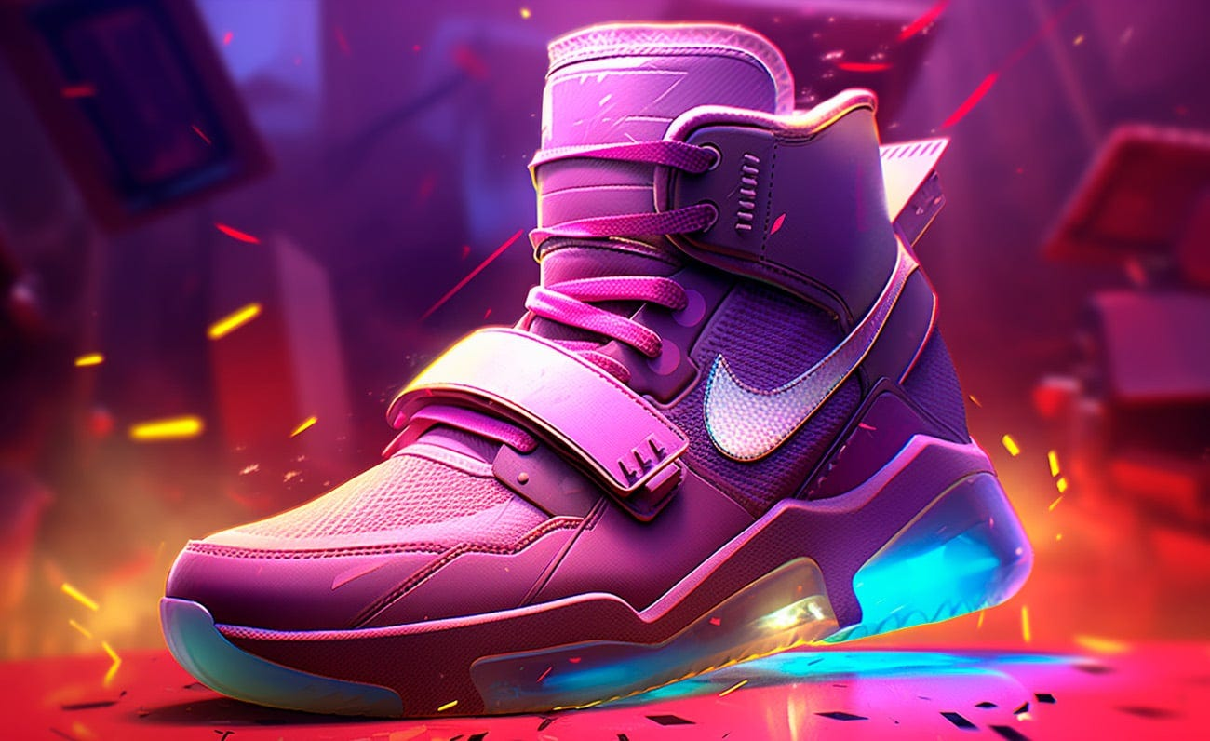



NFT MARKETPLACES
NIKE NFT
Solidity Code to issue the tokens
Code Deployment Address Link
Buy Nike NFTs Here

Slide 24
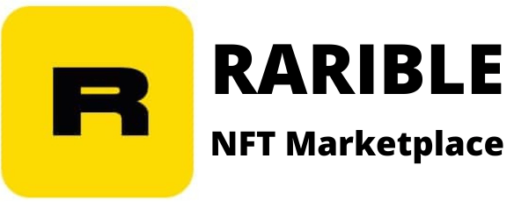
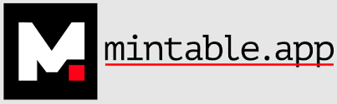
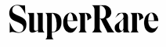
NFT MARKETPLACES
Ok, so now the game has deployed its code that keeps track of ownership of different assets, and also sells it to the buyers
But still the costumers needs a User Interface and a trusted Marketplace to buy the tokens
Deployed
ECR1155
Compliant Code

Slide 25
HOW WILL A PLAYER BUY IN GAME ASSETS
Existing Marketplaces for NFTs.
These marketplaces charge a commission on every sale.
Code deployed on Ethereum that transfers the units of items to buyer's address, and handles payments made in cryptocurrencies
A player what to buy the item on his account
0x06775ABeFeA0A581CBb3Cab8972d034690a0566b
The player can also buy the assets directly by connecting to the blockchain network

Slide 26
What are the Blockers For The Game.
The game must go through a lot of blockers:
Make a website, write a backend code.
Acquire infrastructure resources such as databases and servers, ensuring both their security and continuous uptime.
Comply with rules and regulations of different countries.
Handling different currencies , payment methods, and ensuring the security of financial information.
Depositing and withdrawing funds from the marketplaces.
https://www.youtube.com/watch?v=Q-0H7QU9hs8
https://www.youtube.com/watch?v=k_1Z3WEzLj4

Slide 27
Blockers to start a new Marketplace | How Ethereum Can Solve It?
Make a website, write a backend code. | Deploy smart-contract code, and make an interface to interact with the smart contract, {significantly less development effort}
Acquire infrastructure resources such as databases and servers, ensuring both their security and continuous uptime. | No infrastructure required Blockchain Is the Infrastructure.
Comply with rules and regulations of different countries. | No Country/Entity Owns it, no regulations can be put in place. Only the design/code is the regulator.
Handling different currencies , payment methods, and ensuring the security of financial information. | Making payments on chain is easy if you own the crypto-currency.
Depositing and withdrawing funds from the marketplaces. | The crypto-currency are the funds, 10 crore Indians own crypto-currencies, so getting crypto funds from crypto-exchanges should not be a blocker.

Slide 28
PROBLEM STATEMENT :
Consider this, the player has bought some Game Item tokens on Blockchain, now he wants to unlock and use these items inside game.
Similarly, the player has won/unlocked an asset inside the game and he wants a token corresponding to the assets on his blockchain address, so that he can trade it in future
This requires a Bridge that connects between the Blockchain World and the Game.

Slide 29

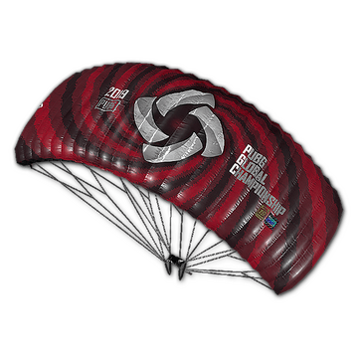
BLOCKCHAIN WORLD
INSIDE GAME: PUBG
Account 1
Account 2
0x06775ABeFeA0A581CBb3Cab8972d034690a0566b
0x0CBb3ab897C03Cab897CBb6ab897Cab897Cab897Cab897Cb
Player Id : Vaishnav012
A player owns 3 units of “Sneakers”, 2 units of “Gun” , 1 unit of “Parachute” and “Kit” each on blockchain, on his two different addresses.
The player plays “PUBG : Battlegrounds” as “Vaishnav012”.

Slide 30

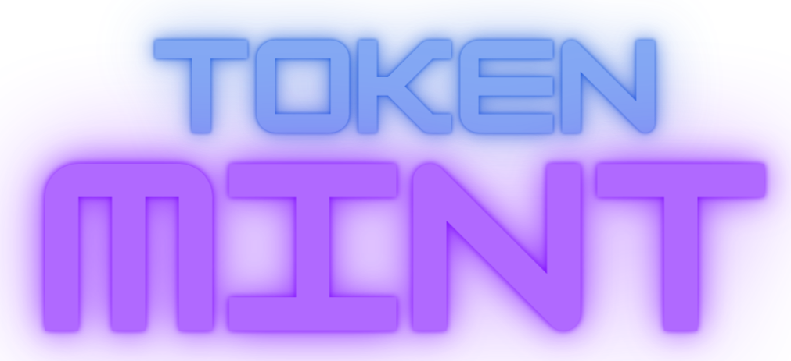
MY PROJECT
Blockchain : WEB3
Game : WEB2
The Bridge : TokenMint

Slide 31
class PCGParachutes {
private Integer totalSupply = 9999;
private Integer sellingPrice = 100;
private HashMap<String, Integer> ownershipDetails = new HashMap<>();
private String gameBlockchainAddress = "0x21xasa1ff12xgdfhay23273xv3hsdg3d7g3ydg38g3jwegdy2";
public String buyInGameAsset(String buyerBlockChainAddress, int quantity, int purchaseAmount) {
if (purchaseAmount >= quantity * sellingPrice && totalSupply >= quantity) {
totalSupply = totalSupply - quantity;
/** Reduce The Total supply of the tokens */
ownershipDetails.put(buyerBlockChainAddress, quantity);
/** Add "quantity" amout of tokens to "playerBlockchainAddress" */ // "
transferMoney(gameBlockchainAddress, purchaseAmount);
/**
* Transfer "purchaseAmount" worth of "Ether" to the owner's Blockchain Address
*/
} else {
transferMoney(buyerBlockChainAddress, purchaseAmount);
/** Return amount to "playerBlockChainAddress" */
}
return "Ok";
}
public Integer totalAssetsOwned(String blockchainAddress) {
return ownershipDetails.get(blockchainAddress);
}
private void transferMoney(String ownerBlockchainAddress2, int purchaseAmount) {
}
}

Slide 32
public String buyInGameAsset(String playerId, int quantity, int purchaseAmount) {
if (purchaseAmount >=
quantity * Inventory.getsellingPriceFor_PCGParachutes_()
&& Inventory.getTotalSupply_PCGParachutes_() >= quantity) {
boolean paymentSuccess =
PaymentService.transferMoneyToGame(purchaseAmount);
/**
* Will Initiate transfer of money from player to game, using UPI, card payment
*/
if (!paymentSuccess) {
return "FALIURE";
}
Inventory.reduceTotalSupply(quantity);
/** Reduce totalSupply of _PCGParachutes_ */
Inventory.add_PCGParachutes_ForPlayer(playerId, quantity);
/** Add "quantity" amount of _PCGParachutes_ to playerId */
return "SUCCESS";
} else {
return "FALIURE";
}
}

Slide 33
public String buyInGameAsset(String playerId, int quantity, int purchaseAmount) {
if (purchaseAmount >=
quantity * Inventory.getsellingPriceFor_PCGParachutes_()
&& Inventory.getTotalSupply_PCGParachutes_() >= quantity) {
boolean paymentSuccess =
PaymentService.transferMoneyToGame(purchaseAmount);
/**
* Will Initiate transfer of money from player to game, using UPI, card payment
*/
if (!paymentSuccess) {
return "FALIURE";
}
Inventory.reduceTotalSupply(quantity);
/** Reduce totalSupply of _PCGParachutes_ */
Inventory.add_PCGParachutes_ForPlayer(playerId, quantity);
/** Add "quantity" amount of _PCGParachutes_ to playerId */
return "SUCCESS";
} else {
return "FALIURE";
}
}

Slide 35
https://www.youtube.com/watch?v=9N-GfdPm4Rc

Slide 37
https://www.theregister.com/2023/04/24/apple_antitrust_win_over_epic/
Various Marketplaces : https://www.youtube.com/watch?v=s5_6pUHjW4c
“Project Hug,” Read more at: http://timesofindia.indiatimes.com/articleshow/105100600.cms?utm_source=contentofinterest&utm_medium=text&utm_campaign=cppst
https://www.ccl.nluo.ac.in/post/app-store-play-store-billing-policy-controversy-antitrust-violation-international-perspective
Various Marketplaces : https://www.youtube.com/watch?v=s5_6pUHjW4c

