Slide 1
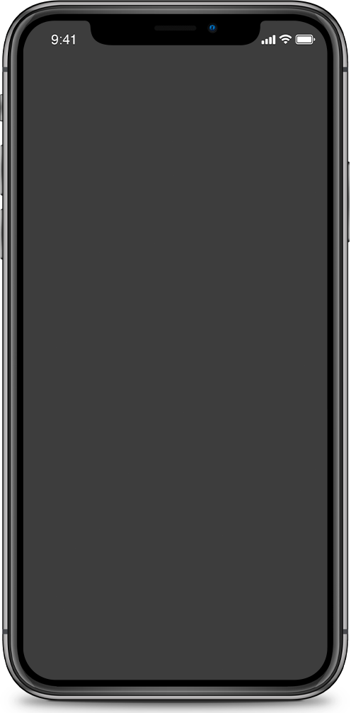
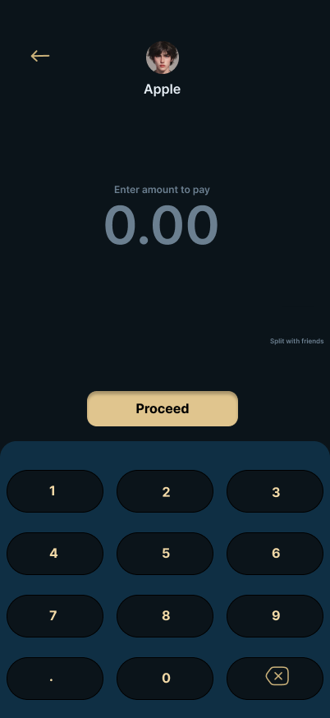
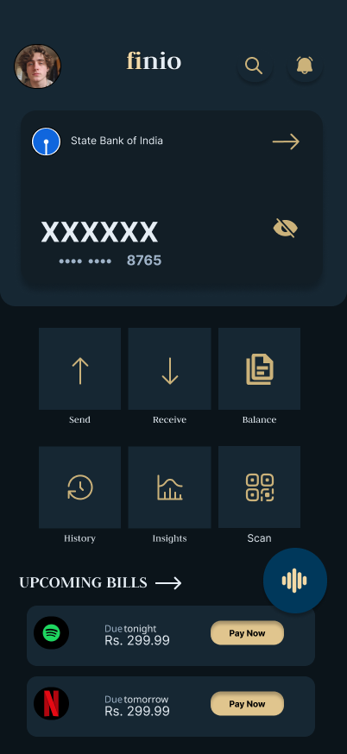
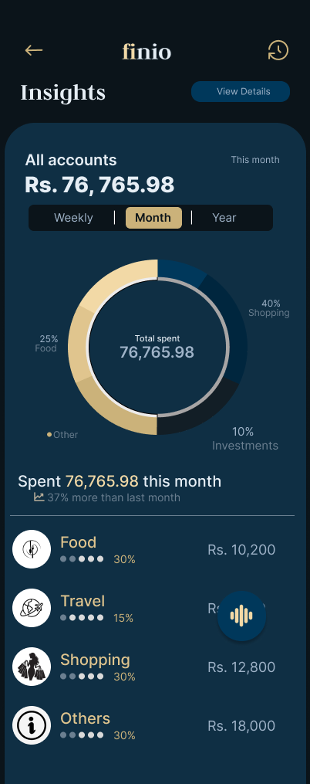

finio
Start with Easy finance
A unified fintech experience for managing transactions, cards, and financial insights

Slide 2

PROBLEMS
Introduction
Design Thinking
Prototypes

Slide 3


PROBLEMS
Existing apps feel cluttered or overly complex
faced by the users
Users struggle to manage multiple financial services in one place
ELack of clear insights into spending and investments

Slide 4
PROBLEMS
Hard to find statements
faced by the users
Unable to track monthy spendings
Lack of invoice and reciepts

Slide 5
The Solution?

Slide 6
This app I just designed makes managing money a little less confusing and a little more manageable.

Slide 7
Introducing finio

Slide 8
A clean, structured interface for financial management!

Slide 9

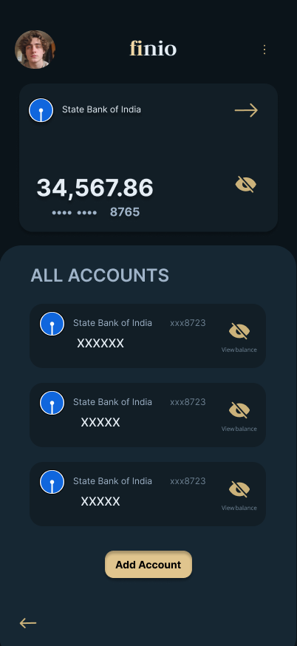
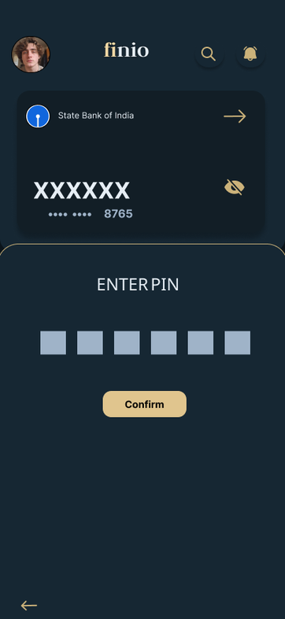
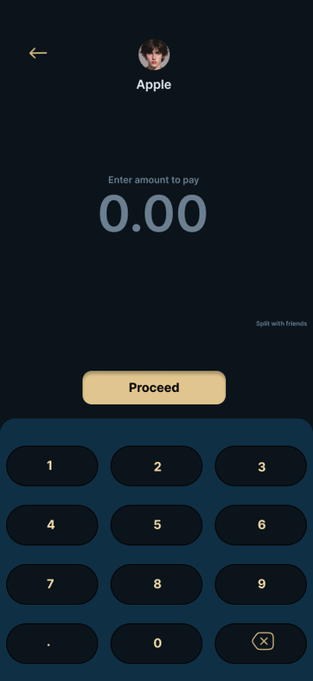

Slide 10
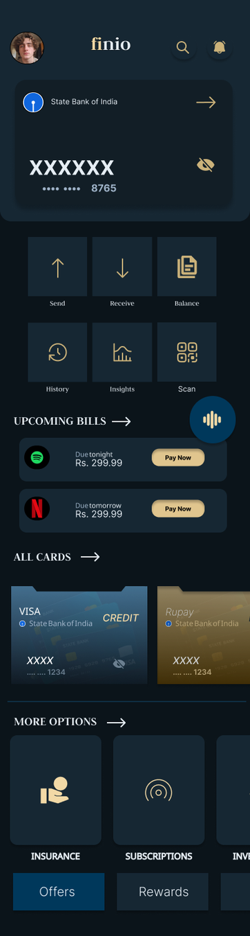
• Designed to make financial management feel simple and straightforward
• Users can quickly access important actions without searching or overthinking
• A clear layout helps users understand their finances at a glance

Slide 11
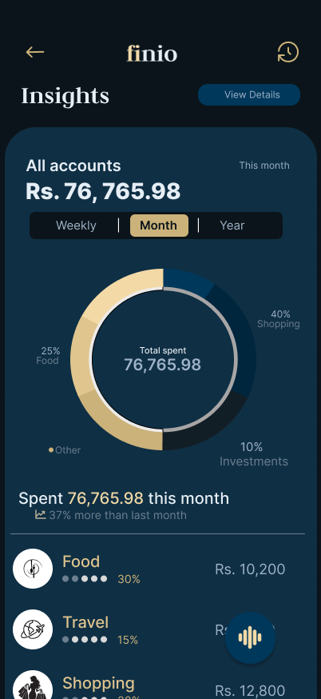
Visual insights to help users make informed decisions
SEE YOUR MONEY, CLEARLY
Break down your expenses with intuitive visuals and actionable insights.
Stay in control, optimize your spending, and plan smarter for the future.

Slide 12
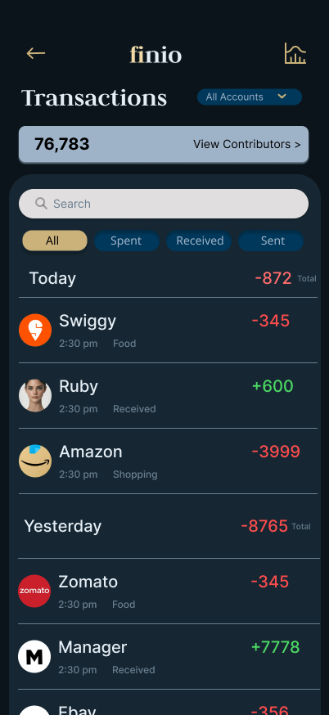
EASY NAVIGATION FOR THE PAYMENTS
• Everything is organized so users don’t have to scroll endlessly trying to make sense of it
• Filters and search make finding transactions quick and painless
• Spending and income are clearly highlighted , no guessing required

Slide 13
DESIGN GOALS
Finance is already stressful, anyone would like a UI that isn’t.
SIMPLE UI
Users should feel like they’re managing their money.
CLEAR IDEA
CONSISTENT DESIGN
Same patterns everywhere so users don’t feel lost.
CLEARLY HANDLED
Users shouldn’t have to “figure things out” like it’s a puzzle.
Notes:
• Make it simple → Finance is already stressful, the UI shouldn’t be.
• Make it clear → Users shouldn’t have to “figure things out” like it’s a puzzle.
• Keep it consistent → Same patterns everywhere so users don’t feel lost.
• Give control → Users should feel like they’re managing their money, not guessing.
• Keep it clean → If it looks messy, it feels messy (and no one trusts messy money apps).
• Dark theme → Easy on the eyes, especially for long usage (and it just looks cooler).
• Teal base → Feels calm, stable, and trustworthy (exactly what you want from a finance app).
• Gold accents → Used sparingly to highlight important things (not everything deserves gold).
• Minimal components → Cards, buttons, lists. Kept it simple so it’s easy to scale.
• Typography → Clean and readable. Important stuff is big, less important stuff stays quiet.
• Dark theme → Easy on the eyes, especially for long usage (and it just looks cooler).
• Teal base → Feels calm, stable, and trustworthy (exactly what you want from a finance app).
• Gold accents → Used sparingly to highlight important things (not everything deserves gold).
• Minimal components → Cards, buttons, lists. Kept it simple so it’s easy to scale.
• Typography → Clean and readable. Important stuff is big, less important stuff stays quiet.

Slide 14

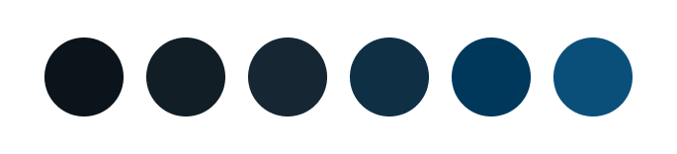
DESIGN SYSTEM
Notes:
• Make it simple → Finance is already stressful, the UI shouldn’t be.
• Make it clear → Users shouldn’t have to “figure things out” like it’s a puzzle.
• Keep it consistent → Same patterns everywhere so users don’t feel lost.
• Give control → Users should feel like they’re managing their money, not guessing.
• Keep it clean → If it looks messy, it feels messy (and no one trusts messy money apps).
• Dark theme → Easy on the eyes, especially for long usage (and it just looks cooler).
• Teal base → Feels calm, stable, and trustworthy (exactly what you want from a finance app).
• Gold accents → Used sparingly to highlight important things (not everything deserves gold).
• Minimal components → Cards, buttons, lists. Kept it simple so it’s easy to scale.
• Typography → Clean and readable. Important stuff is big, less important stuff stays quiet.
• Dark theme → Easy on the eyes, especially for long usage (and it just looks cooler).
• Teal base → Feels calm, stable, and trustworthy (exactly what you want from a finance app).
• Gold accents → Used sparingly to highlight important things (not everything deserves gold).
• Minimal components → Cards, buttons, lists. Kept it simple so it’s easy to scale.
• Typography → Clean and readable. Important stuff is big, less important stuff stays quiet.

Slide 15
BECASUE...
IT’S AESTHETIC
anyway....I’ll explain ->
Notes:
• Make it simple → Finance is already stressful, the UI shouldn’t be.
• Make it clear → Users shouldn’t have to “figure things out” like it’s a puzzle.
• Keep it consistent → Same patterns everywhere so users don’t feel lost.
• Give control → Users should feel like they’re managing their money, not guessing.
• Keep it clean → If it looks messy, it feels messy (and no one trusts messy money apps).
• Dark theme → Easy on the eyes, especially for long usage (and it just looks cooler).
• Teal base → Feels calm, stable, and trustworthy (exactly what you want from a finance app).
• Gold accents → Used sparingly to highlight important things (not everything deserves gold).
• Minimal components → Cards, buttons, lists. Kept it simple so it’s easy to scale.
• Typography → Clean and readable. Important stuff is big, less important stuff stays quiet.
• Dark theme → Easy on the eyes, especially for long usage (and it just looks cooler).
• Teal base → Feels calm, stable, and trustworthy (exactly what you want from a finance app).
• Gold accents → Used sparingly to highlight important things (not everything deserves gold).
• Minimal components → Cards, buttons, lists. Kept it simple so it’s easy to scale.
• Typography → Clean and readable. Important stuff is big, less important stuff stays quiet.

Slide 16
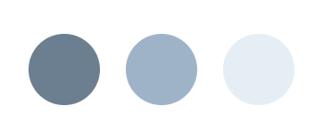
DESIGN SYSTEM
Dark theme reduces visual strain and keeps focus on content
Teal + Slight gold makes the app
look attractive and draws
attention
Notes:
Teal provides a calm and trustworthy base
Consistent layout improves usability and reduces confusion
Gold highlights guide attention to important actions
A slight ligher blue for text to be readable

Slide 17
Teal provides a calm and trustworthy base
Gold highlights guide attention to important actions

Slide 18
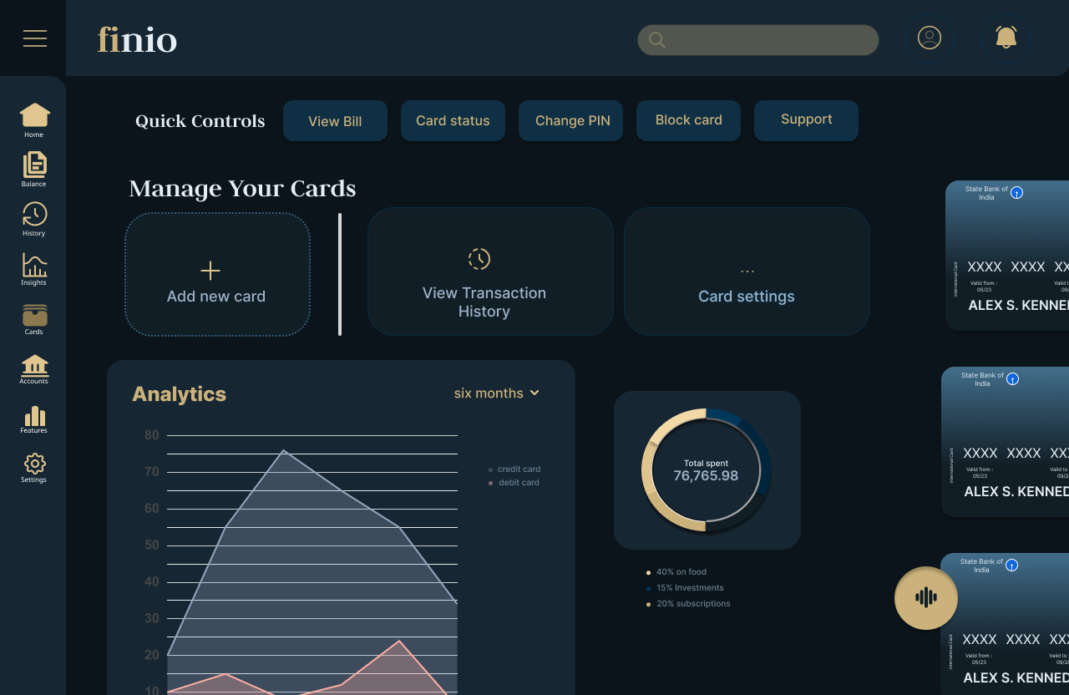
+
Together the two colors not only look visually appealing
But they also provide a premium and trustworthy feel
Notes:
Teal provides a calm and trustworthy base
Consistent layout improves usability and reduces confusion
Gold highlights guide attention to important actions
A slight ligher blue for text to be readable

Slide 19
TYPOGRAPHY...
...INTER
Inter was used for body text and UI elements due to its high readability and clean, modern structure, making it ideal for digital interfaces.

Slide 20
...TYPOGRAPHY
JUDSON...
Judson was used for headings to introduce contrast and add a subtle sense of elegance and personality to the interface.

Slide 21
TYPOGRAPHY
The combination balances functionality (Inter) with visual character (Judson)
I also used a pairing of sans-serif + serif pairing to create hierarchy and visual contrast without relying heavily on color or size

Slide 22
A sneak peek at the desktop designs

Slide 23
ACCESS YOUR FINANCE AND YOUR CARDS ANYTIME, ACROSS ALL DEVICES

Slide 24
ACCESS YOUR CARDS ACROSS ALL DEVICES
VIEW ALL CARDS IN ONE PLACE
REAL-TIME TRANSACTION TRACKING
INSTANTLY LOCK OR BLOCK CARDS

Slide 25
YOUR FINANCIAL OVERVIEW, SIMPLIFIED

Slide 26
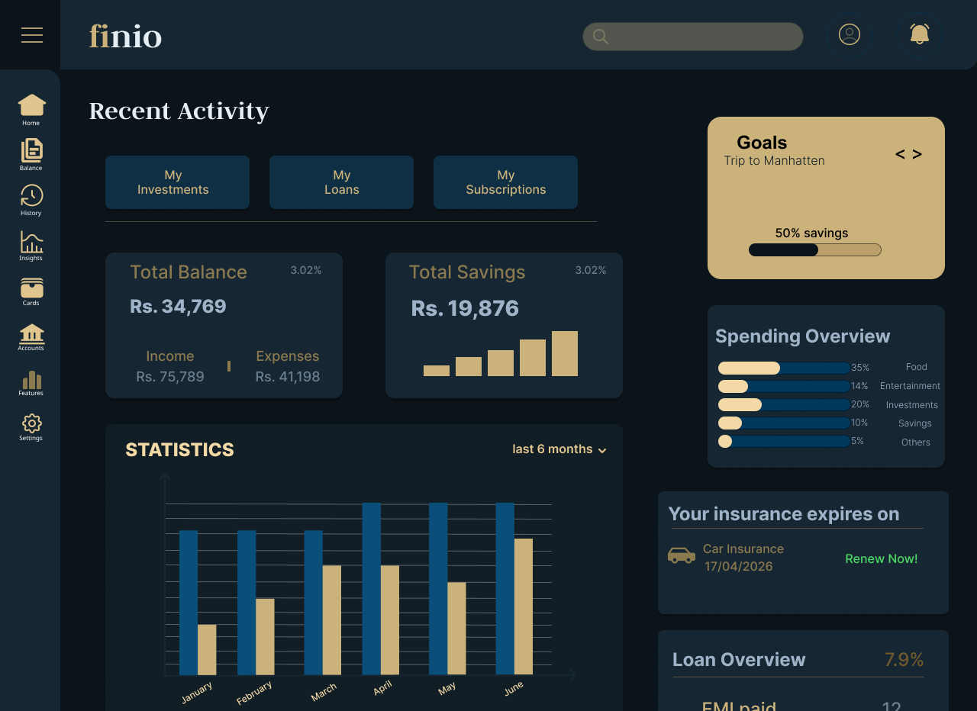
Unified view of all financial activities
Smart insights through visual analytics
Real-time tracking of goals and spending
Timely updates for better decision-making

Slide 27
Prototype Link
Try out the prototype!
Finio!

Slide 28
THANK YOU!

