Slide 1
PROJECT EXPO • DIGITAL LOGIC DESIGN
8-BIT SIPO
SHIFT REGISTER
8
Serial-In → Parallel-Out
A compact digital circuit that receives data one bit at a time
and presents an 8-bit word simultaneously.
STAGES • 8 OUTPUTS
SHIFT | STORE | READ
TEAM - 7
2620030442 - M.N.P. Vaishnavi
2620030495 - K. Keerthipriya
2620030455 - T. Abhigna
2620030474 - K. Rishabh Reddy

Slide 2
Why an 8-bit SIPO register?
THE IDEA
One wire in. Eight bits out.
Digital systems often receive data serially to reduce the number of wires. A SIPO register collects those bits across clock pulses and makes them available together.
01 INPUT
02 STORE
03 OUTPUT
Serial input SI supplies one bit per active clock edge.
Eight D flip-flops hold the bits as they arrive.
Q0–Q7 expose the stored word in parallel.
PROJECT OBJECTIVE
Design, implement and verify an 8-bit serial-to-parallel converter in Logisim.
02 / 06

Slide 3
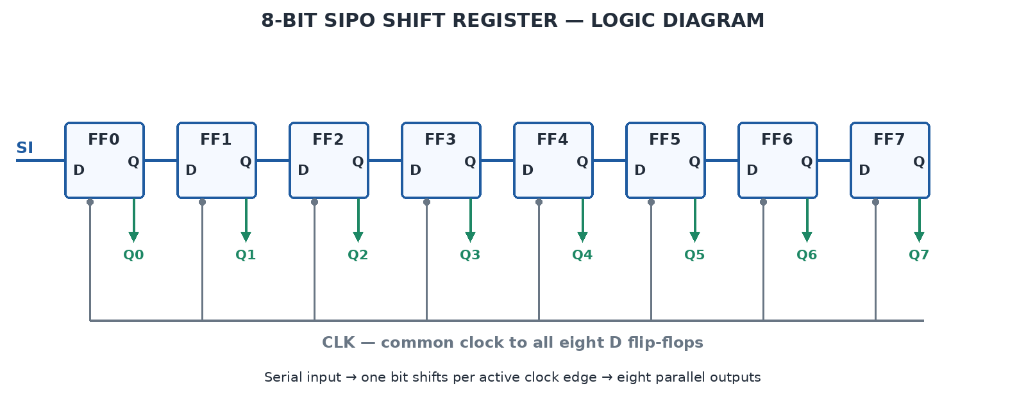
Theory + Logic Circuit
D FLIP-FLOP
COMMON CLOCK
SHIFT CHAIN
Stores one bit.
All stages update together.
Q of one stage feeds next D.
03 / 06

Slide 4
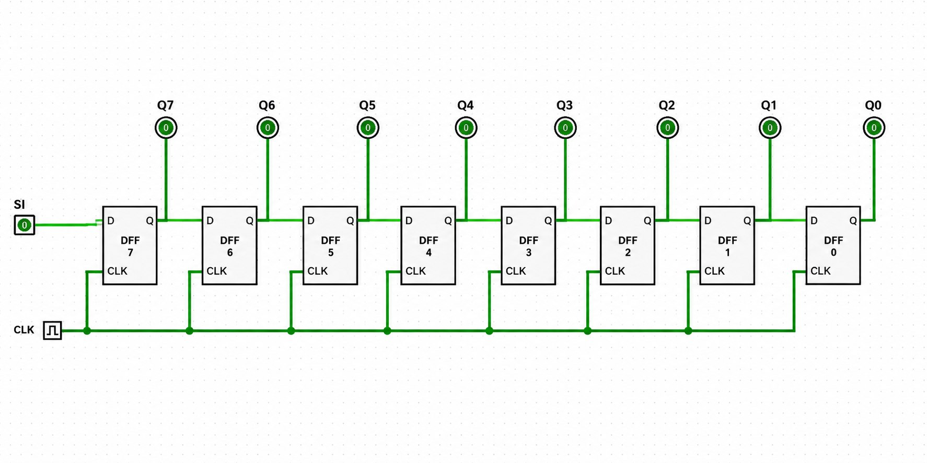
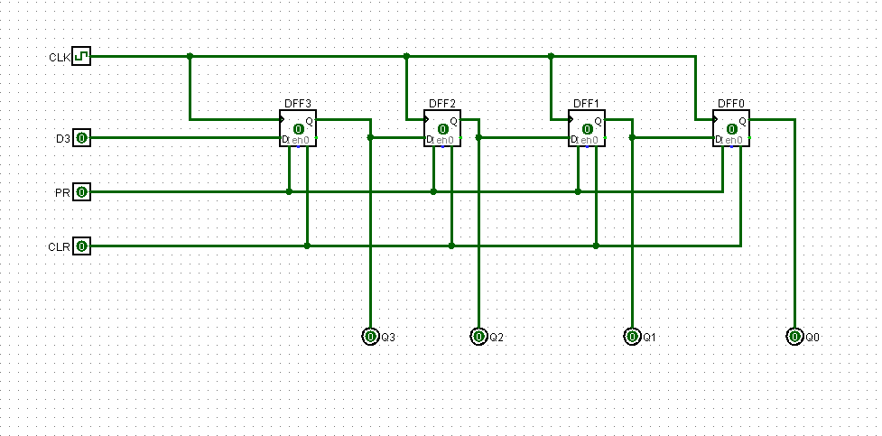
Build It in Logisim
CIRCUIT CHECKLIST
• Place eight D flip-flops in a row.
• Connect SI to the first D input.
• Wire each Q to the next flip-flop’s D input.
• Connect one shared clock to all eight stages.
• Label Q0–Q7 as the parallel outputs.
WIRING GUIDE
ON EACH RISING EDGE
Q0 ← SI • Q1 ← old Q0 • … • Q7 ← old Q6
Use the clock control in Logisim to step through the input sequence one bit at a time.
04 / 06

Slide 5
Simulation Results
TEST SEQUENCE
SI = 1, 0, 1, 1, 0, 0, 1, 0
Assume the register starts at 00000000. Values below are written as Q7…Q0 after each rising edge.
Clock | SI | Register Q7…Q0
Initial | — | 00000000
1 | 1 | 00000001
2 | 0 | 00000010
3 | 1 | 00000101
4 | 1 | 00001011
5 | 0 | 00010110
6 | 0 | 00101100
7 | 1 | 01011001
AFTER EDGE 8
Q7…Q0 = 10110010
EXPECTED BEHAVIOR
Each new bit enters Q0; older bits move toward Q7.
Final row after edge 8: SI = 0 → 10110010
05 / 06

Slide 6
Conclusion + Applications
WHAT WE ACHIEVE
WHERE IT IS USED
An 8-bit serial stream is collected over eight clock edges and made available as a parallel word.
• Serial-to-parallel conversion
• Microcontroller interfaces
• Expanding digital outputs
• Communication and data acquisition
POSSIBLE IMPROVEMENTS
• Add reset/clear to initialize all stages.
• Add enable control to pause shifting.
• Test multiple input patterns and verify every output.
THANK YOU
Questions?
06 / 06

