Slide 1
Library Management system
Priti Patel
Vaishnavi Bhambure

Slide 2
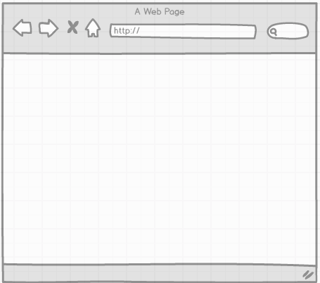
LAYERED ARCHITECTURE
AngularJS, HTML, CSS
JAVA Application
Service Layer
Database Object Layer
User Interface
Database
MySQL

Slide 3
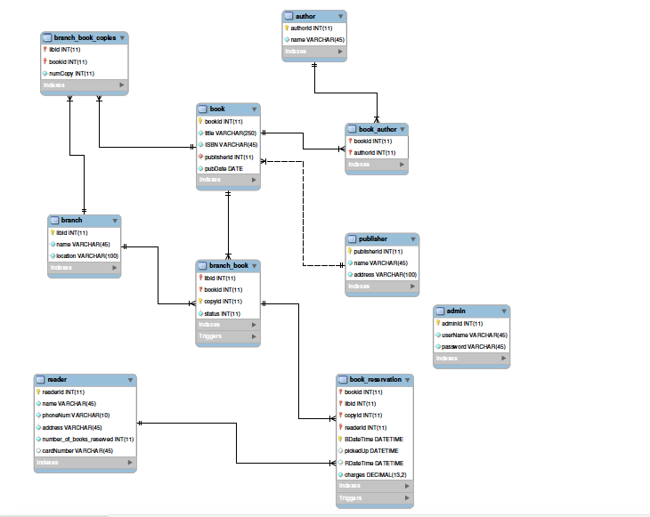
E-R DIAGRAM

Slide 4

Demonstration

Slide 5
Thank You

