Slide 1

PES’s Modern College of Engineering Shivajinagar, Pune -5
Department of Electrical Engineering
Year: 2022-2023
Study and analysis of shape of electrode implemented in super capacitor with focus on design and fabrication for application in load
Name of student | Seat Number | Name of project guide
Vaishnavi Jitendra Chirmade | B190312525 | Prof. M. P. Bhajekar
Sohan Sanjay Dalvi | B190312527
Sanket Sanjay Mahajan | B190312587
Ojesh Vijaykumar Patil | B190312617
Notes:
Design and fabrication of supercapacitor for generalized application of the load.

Slide 2
CONTENT
Aim & Objective
Introduction
Literature Survey
Methodology
Simulation
Block Diagram
Experimental Setup
Circuit diagrams
Specifications
Results and graphs
Future scope and applications
Conclusion
Project planner
References

Slide 3
Aim & Objective
Aim:
Study and analysis of shape of electrode implemented in super capacitor with focus on design and fabrication for application in load
Objectives:
To create the super capacitors of different shapes and of different materials.
Obtaining highest capacitance using various shapes of Super capacitors.

Slide 4
Introduction
The charge is stored electrostatically at the surface of two electrodes that are separated by an electrolyte in supercapacitors, which are electrochemical energy storage devices. They are perfect for a range of applications, including electric vehicles, hybrid vehicles, and grid storage, because to their high power density and long cycle life.
There are two categories of supercapacitors: symmetric and asymmetric. Asymmetric supercapacitors feature two electrodes with differing characteristics as opposed to symmetric supercapacitors' two identical electrodes. Asymmetric supercapacitors are more expensive than symmetric ones but have a higher energy density.
Activated carbon, carbon nanotubes, or graphene are common examples of carbon-based materials used to make the electrodes in supercapacitors. These substances can store more charge because of their large surface areas.
Supercapacitor technology is developing quickly, and new uses for them are always being created. Supercapacitors are anticipated to be used more frequently as technology progresses.

Slide 5
Literature survey
Sr. No | Name of the paper | Abstract
1 | Effect of Electrode Shape on the Parameters of Super capacitor (Adarsh Pal Singh, P. B. Karandikar , Nitesh Kumar Tiwari, Arnan Dubey) | Circular, strip and rectangular shaped electrodes can have more application where high power density is required.
2 | Flexible Solid-State Fibre-shaped Super capacitors Based on Organic-inorganic Hybrid Electrodes for Wearable Energy Storage (H.Y. Jin, Y. Liu, H.T. Huang, W.M. Tang* and H.L. Chan) | The as-prepared FSC(Fibre shaped capacitors) device revealed excellent performance such as high volumetric capacitance, good rate capability and excellent mechanical stability in both electrochemical test and bending test.
3 | Flexible solid-state super capacitors using paper-based electrodes for energy storage (Kun Yu, W.M. Tang* and J.Y. Dai) | The as-prepared Paper-CNTs-NCS electrode shows excellent electrochemical performance such as high areal capacitance and good rate capability.

Slide 6
Sr. No | Name of the paper | Abstract
4 | Sustainable Materials for Solid Flexible Supercapacitors (Keryn Lian, Haoran Wu , Matthew Genovese, Alvin Virya, Jak Li, Kevin Ton) | The performance of these solid flexible devices was systematically compared to commercial activated carbon (AC) and liquid electrolyte baseline
5 | Modeling and Simulation of Effect of Double Layer Capacitance on PEM Fuel Cell Performance. (Sudarshan L. Chavan, Dhananjay B. Talange) | Fuel cell technology is one of the most promising, emissions free, environment friendly energy conversion technology popularly used for various commercial applications like electrical vehicles, building cogeneration and standby power supply
6 | Environmentally Friendly Electrolyte Type Electric Double Layer Supercapacitor for Wireless Sensor Network System (Yukito Fukushima, Masumi Fukuma, Satoru Kishida, Sang-Seok Lee and Katsumi Yoshino) | Environmentally friendly charcoal EDLC is one of solutions for a reliable and safe power supply for the WSN system.

Slide 7
Methodology
Design of super capacitor using various shapes of electrode viz. rectangular strip, rectangular, circular, semi-circular, rhombus, triangular, square.
Shape selection of electrode to obtain maximum specific capacitance.
Fabrication of super capacitor of selected shapes of electrode to calculate maximum specific capacitance.
Finding out specific capacitance through experimental setup.

Slide 8

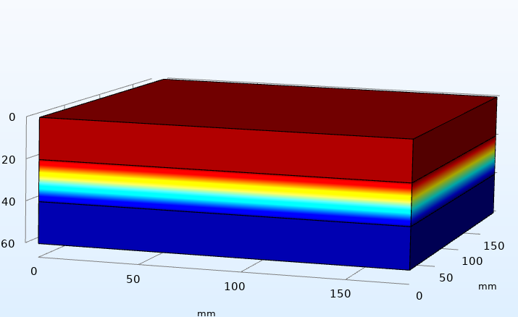
Simulation
Simulation:
Software used: Comsol multiphysics
Simulation of multiple shape of super capacitor:
1. Rectangular shaped super capacitor :
Activated charcoal/ carbon
High density polyethylene
Manganese dioxide (MnO2)
Fig. rectangular shaped super capacitor

Slide 9
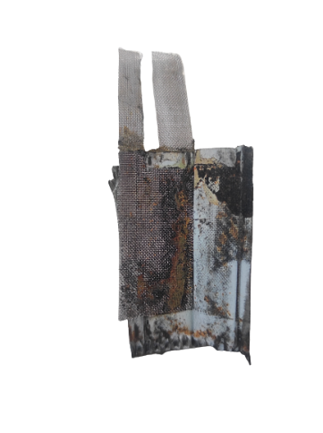
Actual Super capacitor
Positive electrode
Negative electrode
Rectangular shaped electrode
Seperator
Fig. Internal structure of a supercapacitor

Slide 10
Block Diagram
Power source (2v dc source)
Charging circuit
Supercapacitor
Discharging circuit

Slide 11
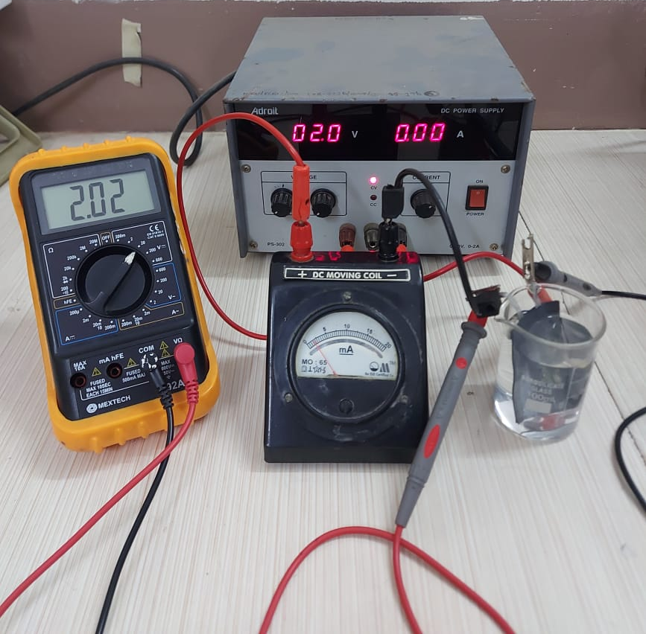
Experimental setup

Slide 12
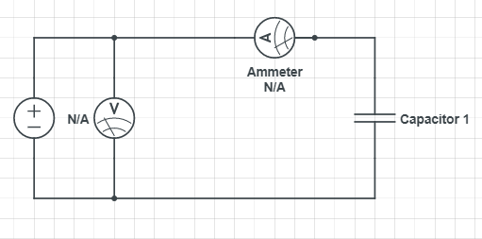
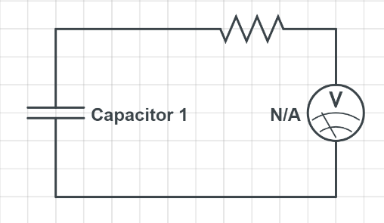
Circuit Diagram
Charging Condition
Discharging Condition

Slide 13
Specifications
1. Capable of storing large amount of energy. 2. Bridge the gap between conventional capacitors and rechargeable batteries. 3. Handle very high current rates. 4. Charge time of device is about 1-10 sec. 5. Used for energy storage undergoing frequent charge and discharge cycles at high current and short duration
.

Slide 14
Comparative results
Time | Voltage (in volts)
in seconds | Rectangle | Square | Triangle | Semi circle
0 | 2.16 | 2.16 | 2.15 | 2.17
5 | 0.85 | 0.37 | 0.7 | 0.31
10 | 0.7 | 0.32 | 0.5 | 0.26
15 | 0.59 | 0.29 | 0.41 | 0.23
20 | 0.48 | 0.28 | 0.36 | 0.22
25 | 0.43 | 0.26 | 0.33 | 0.21
30 | 0.38 | 0.25 | 0.3 | 0.2
35 | 0.35 | 0.24 | 0.28 | 0.19
40 | 0.33 | 0.23 | 0.27 | 0.18
45 | 0.32 | 0.22 | 0.226 | 0.18
50 | 0.31 | 0.21 | 0.25 | 0.17
55 | 0.3 | 0.21 | 0.24 | 0.17
60 | 0.3 | 0.2 | 0.23 | 0.16
.

Slide 15
Graph
.

Slide 16
Future scope & Applications
Electric vehicles: Supercapacitors can be used to store energy in electric vehicles, which can help to improve the performance and range of the vehicles.
Hybrid vehicles: Supercapacitors can be used in hybrid vehicles to store energy that is generated during braking. This energy can then be used to power the vehicle's electric motor.
Grid storage: Supercapacitors can be used to store energy in the power grid. This can help to improve the reliability and efficiency of the grid.
Electronic devices: Supercapacitors can be used to power electronic devices, such as laptops and cell phones.
Wearable devices: Supercapacitors can be used to power wearable devices, such as smart watches and fitness trackers.
Industrial applications: Supercapacitors can be used in a variety of industrial applications, such as manufacturing, robotics, and automation.
.

Slide 17
Conclusion
Various electrode shapes, including rectangular, square, semi-circular, and triangular, were explored in the project.
The rectangular-shaped electrode demonstrated valuable characteristics in terms of performance and efficiency in supercapacitors.
The rectangular electrode had the ability to store large charges, resulting in a high energy storage capacity.
It produced the largest amount of capacitance among the tested electrode shapes due to its slow discharge rate.
The rectangular electrode had a capacitance value of 4.60 microfarads.
The rectangular design of the electrode allowed for faster execution compared to other shapes.

Slide 18
Project planner
Month/ activity | July 2022 | August 2022 | Sep 2022 | Oct 2022 | Nov 2022 | Dec 2022 | Jan 2023 | Feb 2023 | March 2023 | April 2023 | May 2023
Title fixation | ✔
Literature survey and review |  | ✔ | ✔
Study of super capacitor |  |  | ✔ | ✔
Simulation on comsol multiphysics |  |  |  | ✔ | ✔
Material Purchase |  |  |  |  |  | ✔
Different shapes of super capacitor (Hardware) |  |  |  |  |  |  | ✔ | ✔
Conference paper |  |  |  |  |  |  |  |  | ✔ | ✔
Report |  |  |  |  |  |  |  |  |  | ✔ | ✔

Slide 19
Reference
.
Adarsh Pal Singh, P. B. Karandikar , Nitesh Kumar Tiwari, Arnan Dubey “SUSTAINABLE MATERIALS FOR SOLID FLEXIBLE SUPERCAPACITORS”
H.Y. Jin, Y. Liu, H.T. Huang, W.M. Tang* and H.L. Chan “FLEXIBLE SOLID-STATE FIBRE-SHAPED SUPER CAPACITORS BASED ON ORGANIC-INORGANIC HYBRID ELECTRODES FOR WEARABLE ENERGY STORAGE”
Kun Yu, W.M. Tang* and J.Y. Dai “FLEXIBLE SOLID-STATE SUPER CAPACITORS USING PAPER-BASED ELECTRODES FOR ENERGY STORAGE”
Keryn Lian, Haoran Wu , Matthew Genovese, Alvin Virya, Jak Li, Kevin Ton “SUSTAINABLE MATERIALS FOR SOLID FLEXIBLE SUPERCAPACITORS”
Sudarshan L. Chavan, Dhananjay B. Talange “MODELING AND SIMULATION OF EFFECT OF DOUBLE LAYER CAPACITANCE ON PEM FUEL CELL PERFORMANCE”
Yukito Fukushima, Masumi Fukuma, Satoru Kishida, Sang-Seok Lee and Katsumi Yoshino “ENVIRONMENTALLY FRIENDLY ELECTROLYTE TYPE ELECTRIC DOUBLE LAYER SUPERCAPACITOR FOR WIRELESS SENSOR NETWORK SYSTEM”

Slide 20


