Slide 1


SHIVNAGAR VIDYA PRASARAK MANDAL, Malegaon (BK) Department of Electronics &Telecommunication Engineering
“BIDIRECTIONAL VISITORS COUNTER USING
PIC 16F877A “
GROUP NO:-7
Student Names:- Seat Nos:-
1. Vaishnavi Dhumal T150193010
2. Rutuja Gaikwad T150193011
3. Manisha Gambhire T150193012
GUIDED BY
NAME OF GUIDE:- Prof. K.G.JAGTAP

Slide 2
CONTENTS
Introduction
Literature Survey
Problem Statement
Proposed System
Block Diagram
Design and Implementation
Circuit Diagram
Flow Chart
Results
Advantages, Disadvantages and Application
Conclusion
Future Scope
References

Slide 3
INTRODUCTION
Many times, we need to monitor the person/people visiting some place like Seminar Hall, conference room or shopping mall or temple.
This project can be used to count and display the number of visitors entering inside any conference room or seminar hall
Microcontroller is a reliable circuit that takes over the task of counting the number of persons/ visitors in the room very accurately.
An IR sensor issued to monitor the person entering and exiting the room.
We will be showing both the in count i.e. number of people entering the room and out count i.e. number of people exiting the room on a16x2 Alphanumeric LCD.
PIC 16F877A microcontroller can be used and applied in real world application.

Slide 4
LITERATURE SURVEY
In recent times, the number of visitors to protected and recreational areas have almost doubled during the past ten years throughout the whole world
During the past two years, appreciable efforts have begun to count visitors to public areas more systematically and consistently
Furthermore, reliable visitor statistics are needed, together with other information gathered from visitor surveys, for evaluating the effectiveness of the area’s own activities and for monitoring changes.
This will help to keep accurate information on population density per time, ,identify potential structural and social risks and effective decision making on issues related to population.

Slide 5
PROBLEM STATEMENT
A primary method for counting the visitors involves hiring human auditors to stand and manually tally the number of visitors who pass by a certain location. But human-based data collection comes at great expense.
With human handling the manual counting of visitors, there are tendencies of inefficiencies, misrepresentation, time wastage and unnecessary financial implications.
With this in mind, it is imperative to develop and promote a digital visitor counter which will be bidirectional in nature and utilise the microcontroller
A sensor will be used to detect a person enter and out from the door and send signal to microcontroller.
Microcontroller will count up and down based on the programming that been embedded on the PIC.
An LCD display will inform the total occupant inside the laboratory and at the same time will display the counting data when a person enters or leave the room.

Slide 6
PROPOSED SYSTEM
This system, the traffic or agents or human follow a certain route or door or some threshold to enter into and to exit from the place.
While entering to the system, there are two sensors are installed which are connected with each other via infrared network
While a visitor crosses the infrared bar or line, it is disconnected and at that time Microcontroller increase its count by one.
When someone crosses the bar in opposite direction, the infrared line is again interrupted and then Microcontroller decreases its count by one to signify that one visitor is entered and one is gate away from the place.

Slide 7
SOFTWARE REQUIRED
Keil uVision5 as Compiler.
Proteus 8 Professional for Circuit Designing.
HARDWARE REQUIRED
PIC Microcontroller
LCD 16X2
IR Sensors

Slide 8
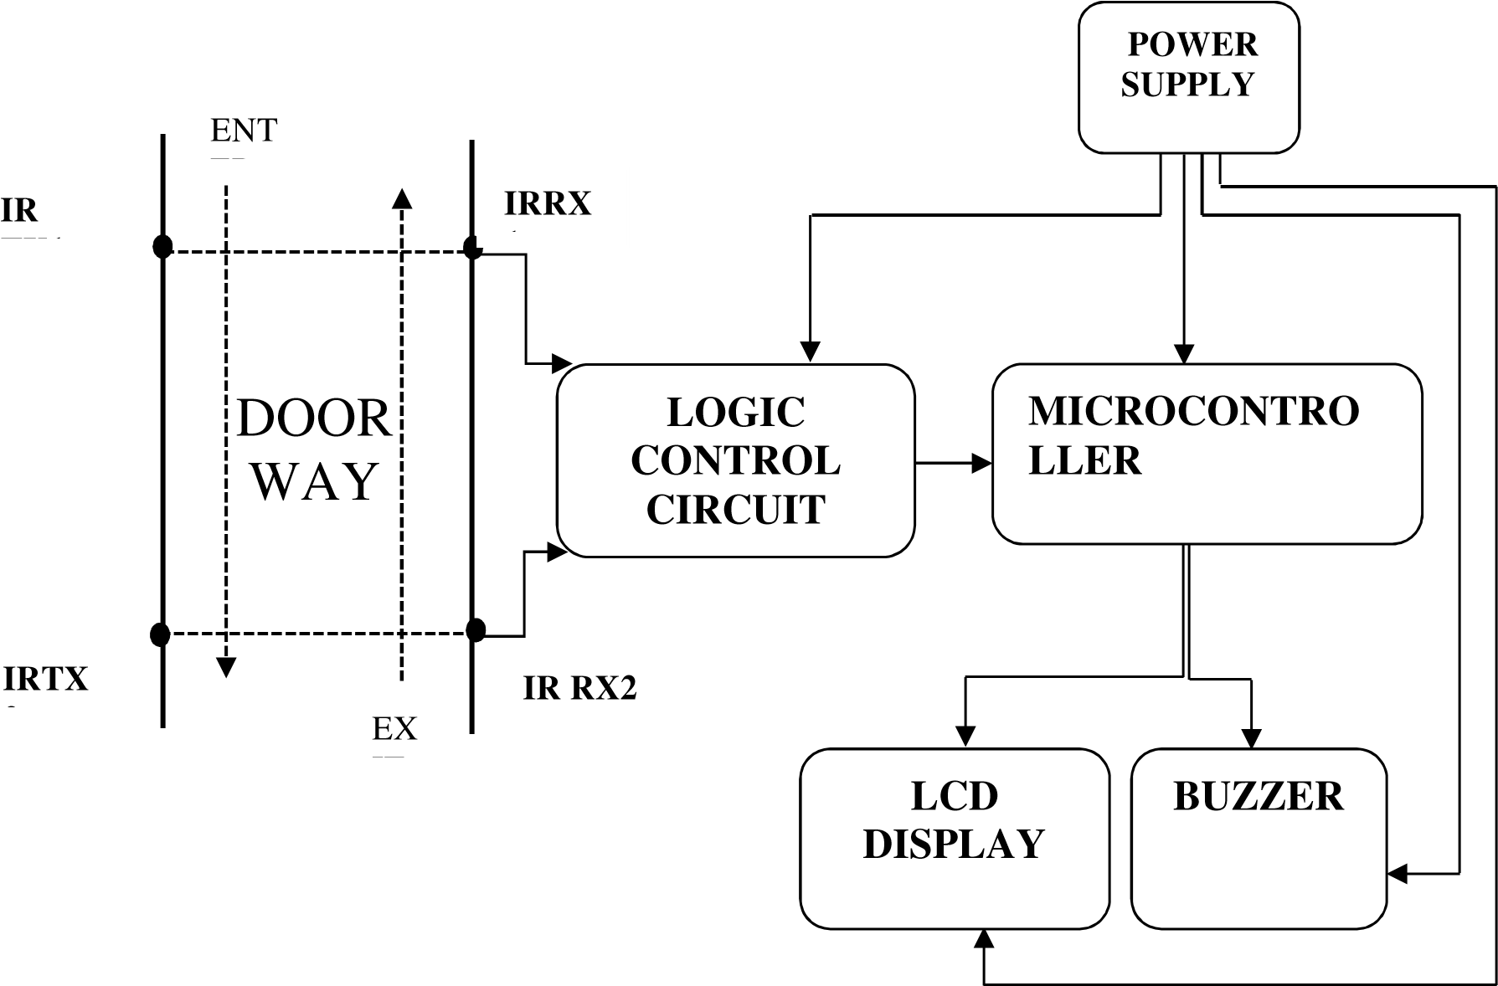
BLOCK DIAGRAM
BVC

Slide 9
SPECIFICATIONS
Sr | Component | Item | Specification
1 | Microcontroller | 1 | PIC16F877A
2 | Crystal oscillator | 1 | 5MHZ
3 | Liquid Crystal Display(LCD) | 1 | 16x2
4 | Infrared sensor | 2 pair | TSAL6100
5 | Buzzer | 1 | 70dB, at 2kHz, 5V
6 | Resistor | 12 | 1k,100k,270k
7 | Variable Resistor | 1 | 4.7k,50k
8 | Transistor | 3 | BC546AP,BC557
9 | Voltage Regulator | 1 | 7805
10 | Transformer | 1 | 240/6v
11 | DIODE | 1 | IN4007
12 | FUSE | 1
13 | Main Switch | 1 | 5mm
14 | Reset Button | 1

Slide 10
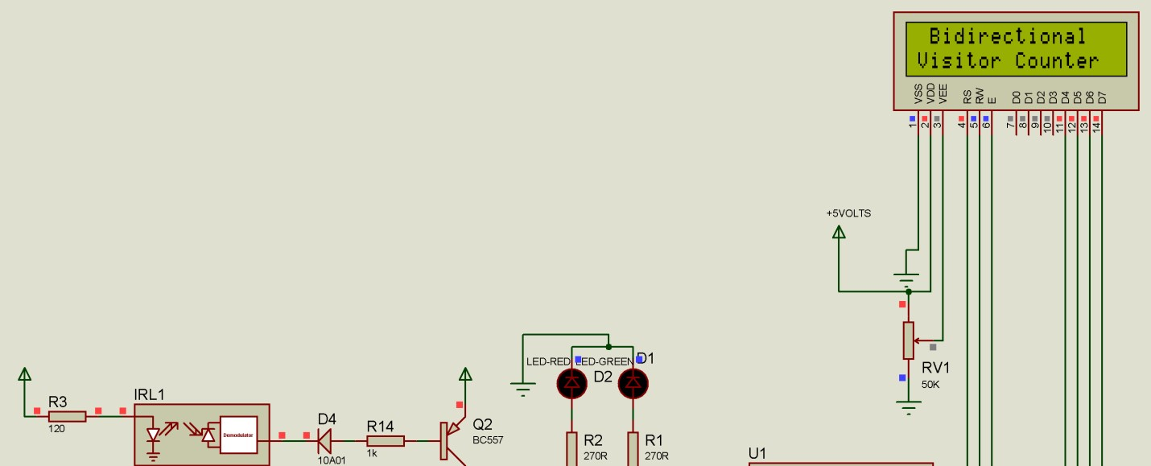
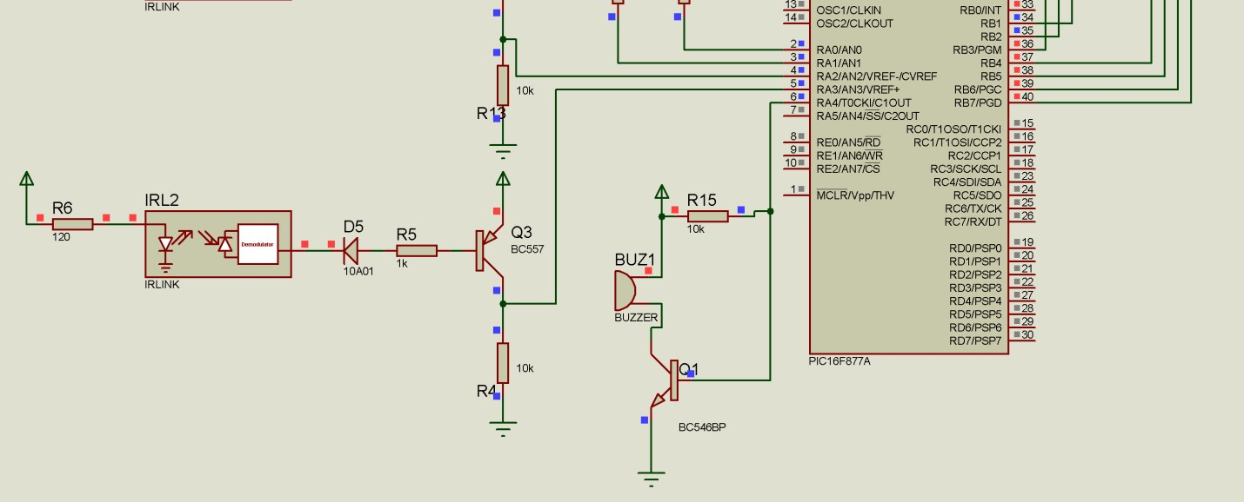
DESIGN AND IMPLEMENTATION

Slide 11
ALGORITHM AND FLOWCHART
AL
Start
Clear LCD
NO
If s1 is
YES
If
s2 is
NO
NO
If s2 is
YES
YES
If s1 is
NO
YES
Take no action
On Red LED
On Green LED
Decrement count
Increment count
Update LCD
If
NO
No >10
YES
Display “MAXIMUM CAPACITY EXCEEDED
BY: XXX” and beep buzzer

Slide 12
RESULT
A preview to the entirety of this project establishes the essence and need for embedded systems towards technological advancement.
The output of the receiver circuit sends high or low signals in a form of voltage to the microcontroller
The programmed microcontroller follows the set of instructions (C language) written on it. The tally computation (addition and subtraction) is done when it receives low signals from the two IR receivers.
It is after this command, which the microcontroller is made to send control signals to the other I/O devices.
The microcontroller also sends a data signal to the LCD to visually display the exact number of visitors remaining in the building.
The buzzer is activated when the microcontroller detects that the room capacity is exceeded.

Slide 13
ADVANTAGES
More Efficient.
No need of human Intervention.
Can work 24x7 without any interruption.
It is very easy to install in offices, malls etc.
Low installation cost.
Less maintenance.
It can be easily operated.

Slide 14
DISADVANTAGES
If the proper load resistance is not used the circuit will not operate.
It is used only if one person cuts the rays of sensor.
APPLICATIONS
Offices.
Public Places.
Used for counting the numbers of traffic if it will be installed on the road or highway.

Slide 15
FUTURE SCOPE
Metal detector can be added for security reasons.
We can check the ambient light intensity and then decide if the light needs to be turn on or not.

Slide 16
CONCLUSION
In demonstration of the project, the infrared sensing part used to detect the passage of visitors worked .
Also, the LCD, led and the buzzer were effective in alerting and notifications.
Hence the whole purpose of the bidirectional visitor counter was successfully achieved and is applicable in the wider scope.
Microcontroller was very efficient in its task performance, thus computation of counts and controlling I/O devices
Finally, we conclude that the proposed system will count visitors effectively and efficiently by reducing the rate at which error occurs when counting visitors.

Slide 17
REFERENCES
PIC 16F87X A data sheet.
40 PIN 8-bit CMOS Flash Microcontroller. (n. d.). Retrieved from http://www.mantec.be/en/pic-s/2722040pin-8-bit-cmos-flash-microcontroller-5410329355951.html .
Architecture and Programming of 8050 MCU’S. (n. d.). Retrieved from http://www.mikroe.com/chapters/view/64/chapter-1-introduction-to-microcontrollers/
“Design with PIC Microcontroller” Book by J B Peatman.

Slide 18
THANK YOU

