Slide 1
JAVA COLLECTION
Collections in java is a framework that provides an architecture to store and manipulate the group of objects.
All the operations that you perform on a data such as searching, sorting, insertion, manipulation, deletion etc. can be performed by Java Collections.
Java Collection framework provides many interfaces (Set, List, Queue, Deque etc.) and classes (ArrayList, Vector, LinkedList, PriorityQueue, HashSet, LinkedHashSet, TreeSet etc) and Algorithm.
The Collection framework represents a unified architecture for storing and manipulating a group of objects. It has:
Interfaces
Classes
Algorithm

Slide 2
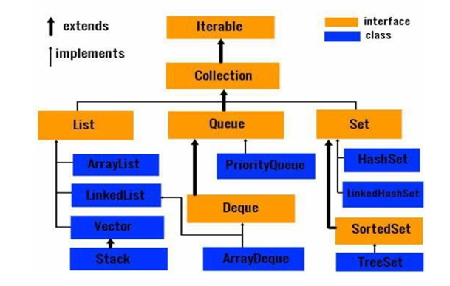
COLLECTION FRAMEWORK HIERARCHY

Slide 3
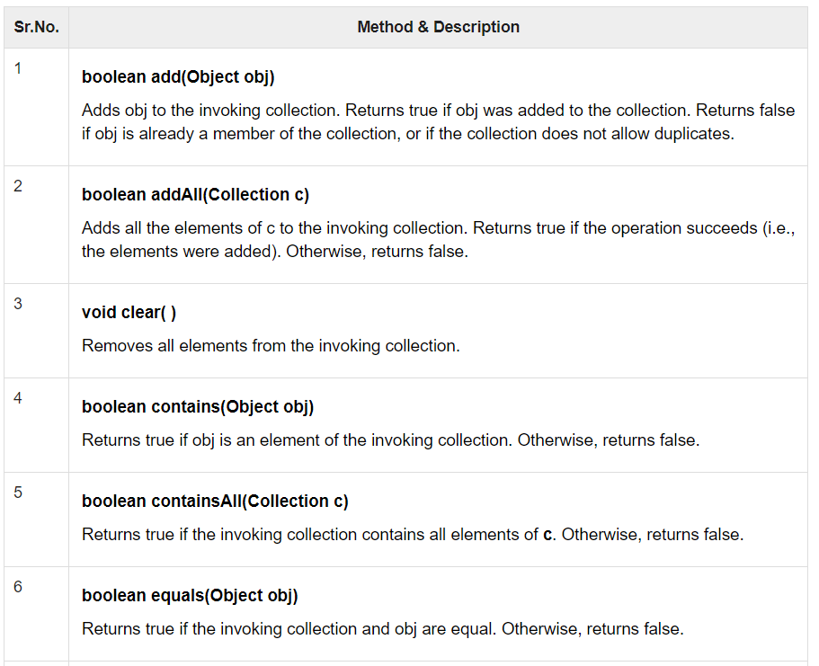
COLLECTION INTERFACE
The Collection interface is the foundation upon which the collections framework is built.

Slide 4
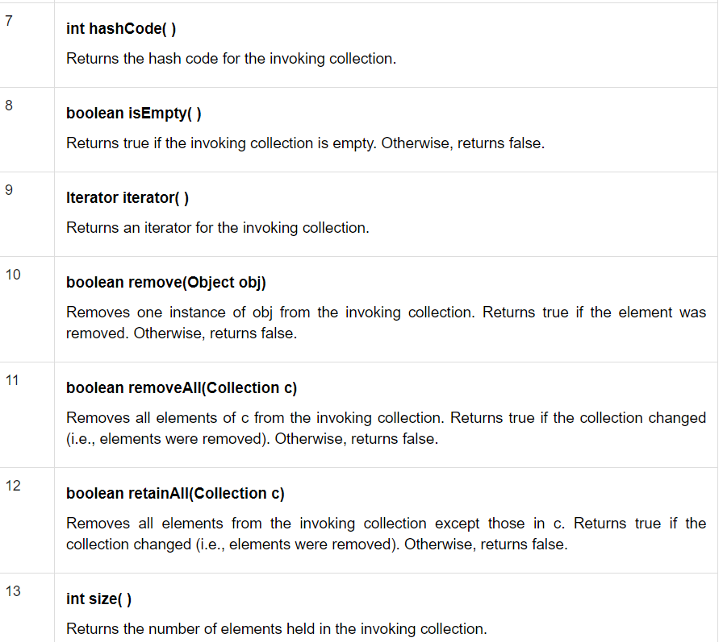
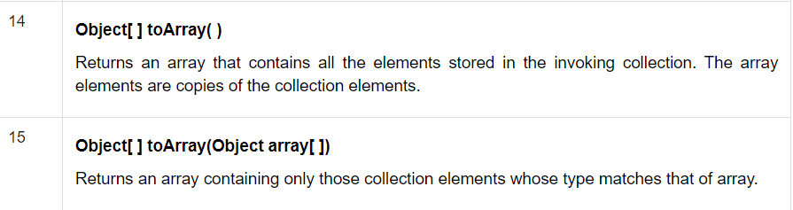

Slide 5
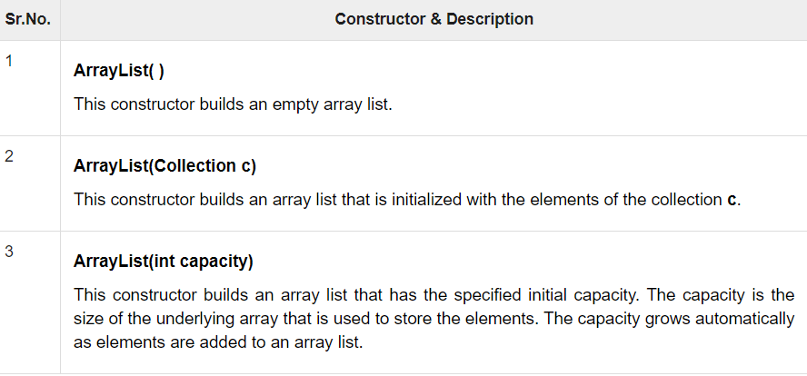
ARRAYLIST
The ArrayList class extends AbstractList and implements the List interface.
ArrayList supports dynamic arrays that can grow as needed.
When this size is exceeded, the collection is automatically enlarged. When objects are removed, the array may be shrunk.
It uses a dynamic array to store the duplicate element of different data types.

Slide 6
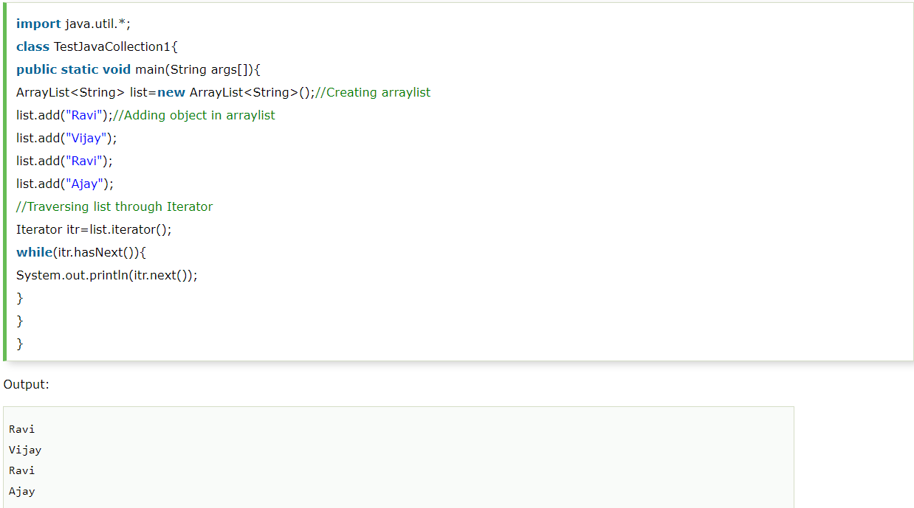
ARRAYLIST EXAMPLE-USING ITERATOR

Slide 7
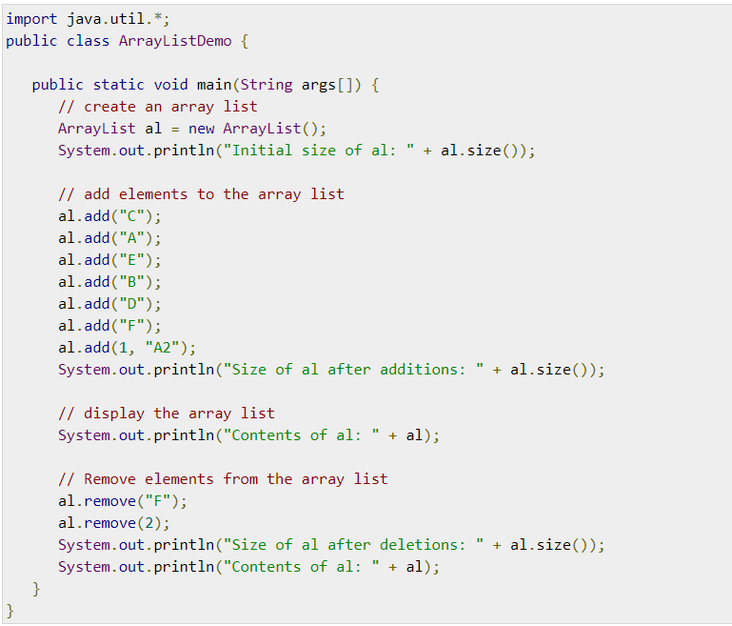
ARRAYLIST EXAMPLE

Slide 8
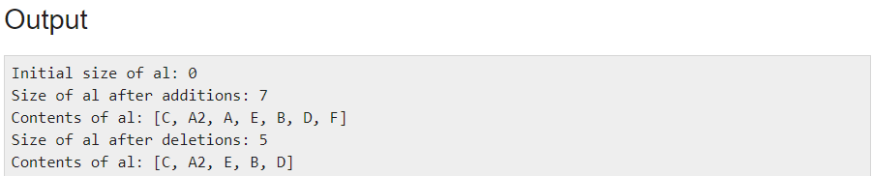

Slide 9
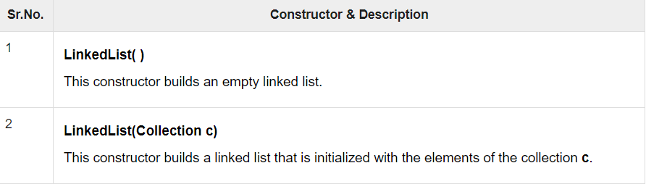
LINKED LIST
LinkedList implements the Collection interface.
It uses a doubly linked list internally to store the elements.
It can store the duplicate elements. It maintains the insertion order and is not synchronized.
In LinkedList, the manipulation is fast because no shifting is required.

Slide 10
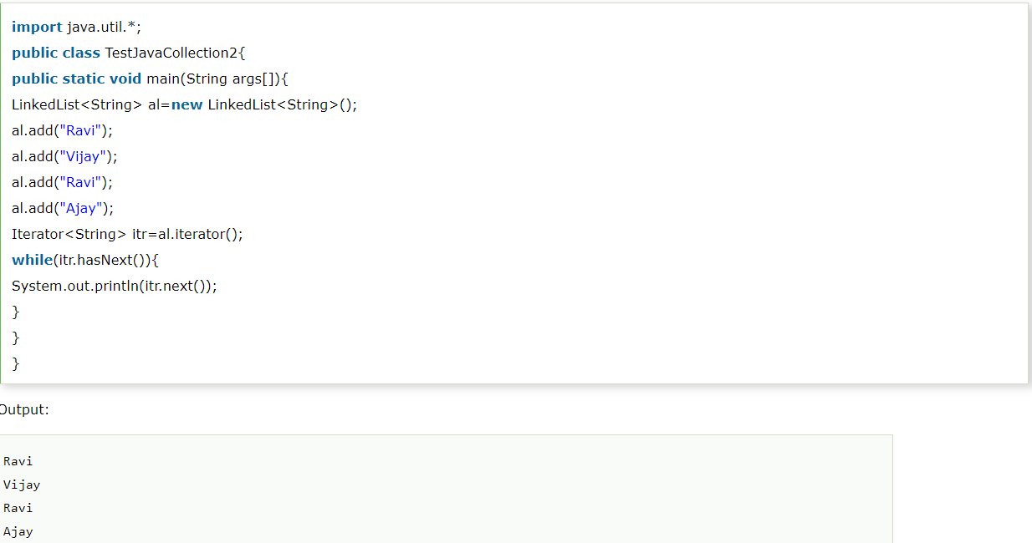
EXAMPLE-1

Slide 11
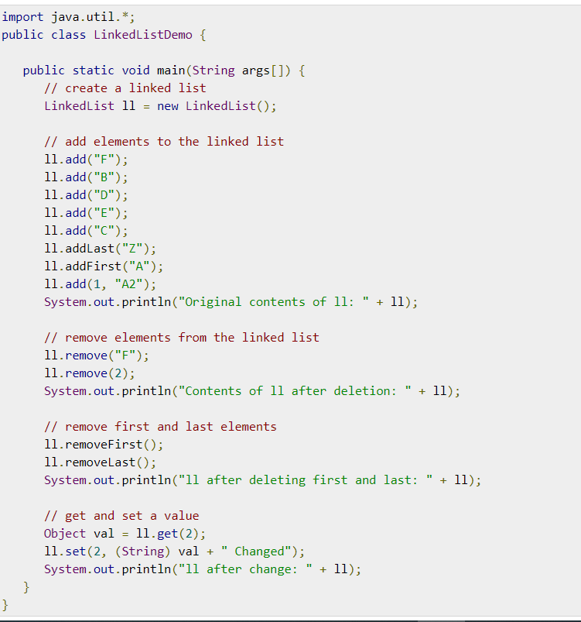
EXAMPLE-2

Slide 12
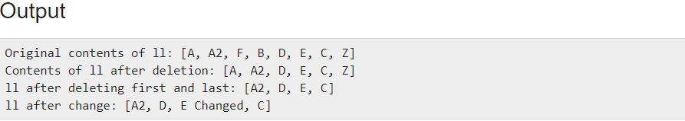

Slide 13
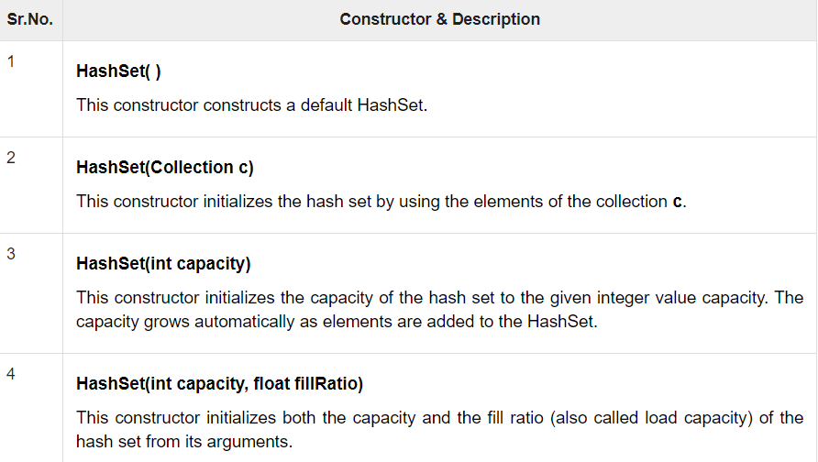
HASH SET
HashSet extends AbstractSet and implements the Set interface.
It creates a collection that uses a hash table for storage.
Hashing is used to store the elements in the HashSet.
It contains unique items.

Slide 14
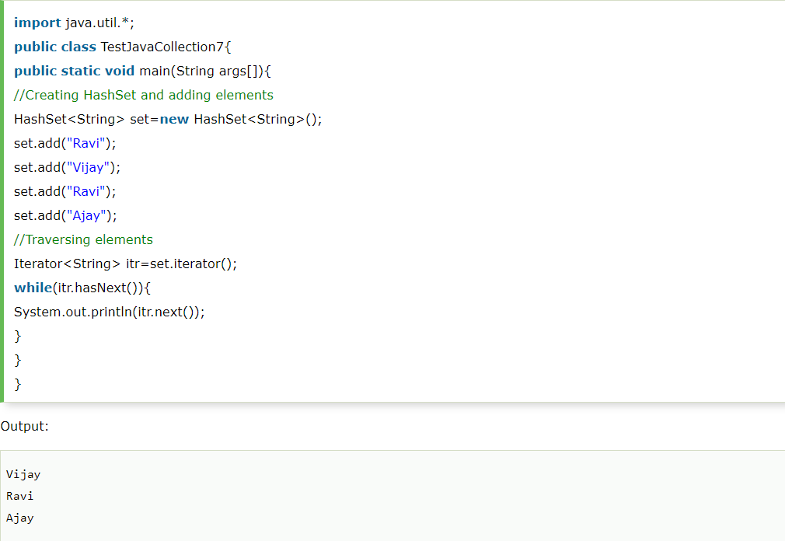

Slide 15
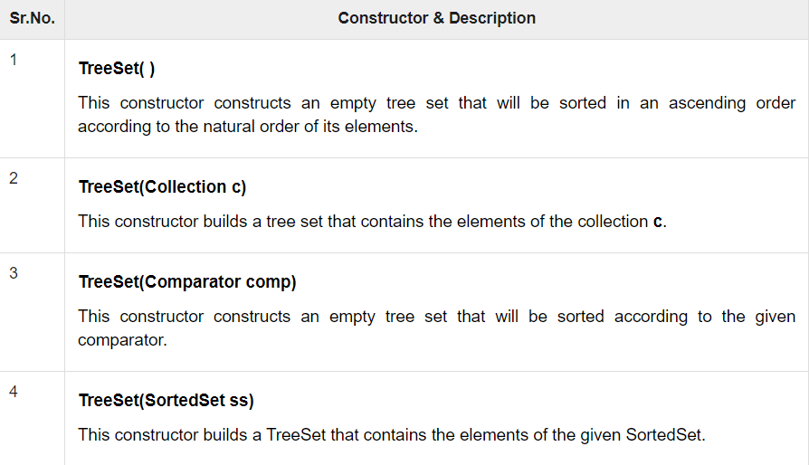
TREESET
TreeSet provides an implementation of the Set interface that uses a tree for storage.
Objects are stored in a sorted and ascending order.
Access and retrieval times are quite fast, which makes TreeSet an excellent choice when storing large amounts of sorted information that must be found quickly.
Like HashSet, TreeSet also contains unique elements.

Slide 16
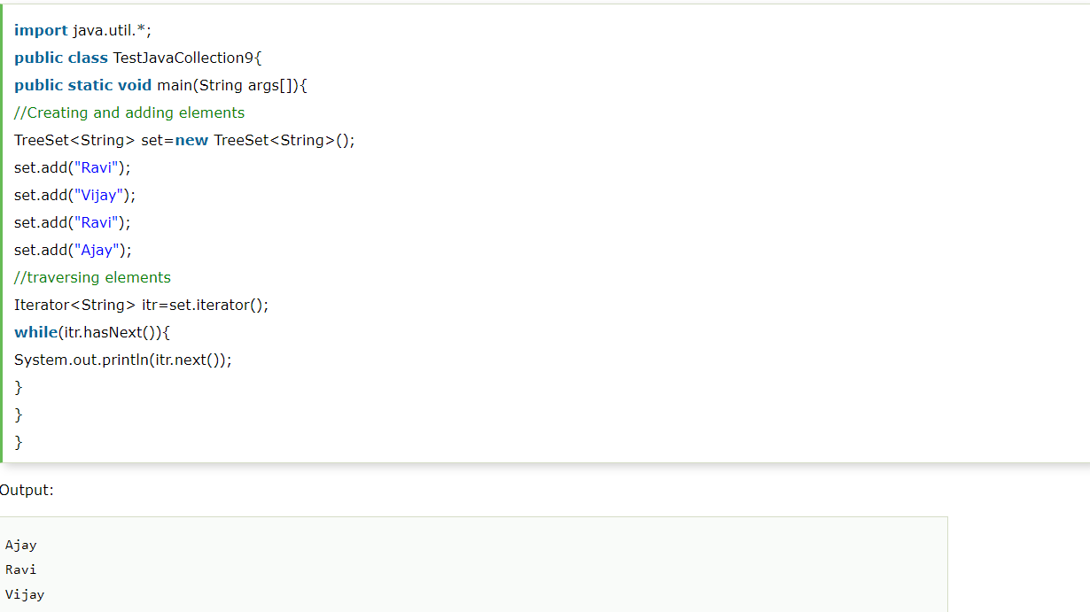

Slide 17
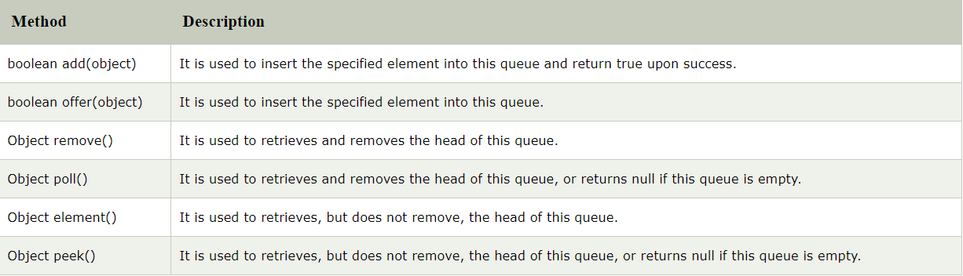
PRIORITY QUEUE
The PriorityQueue class provides the facility of using queue.
It does not orders the elements in FIFO manner.
It inherits AbstractQueue class.

Slide 18
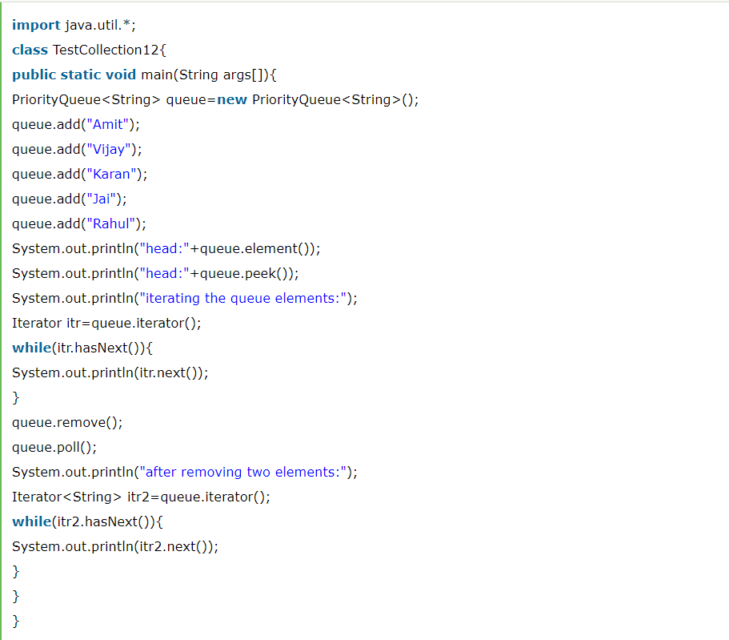

Slide 19
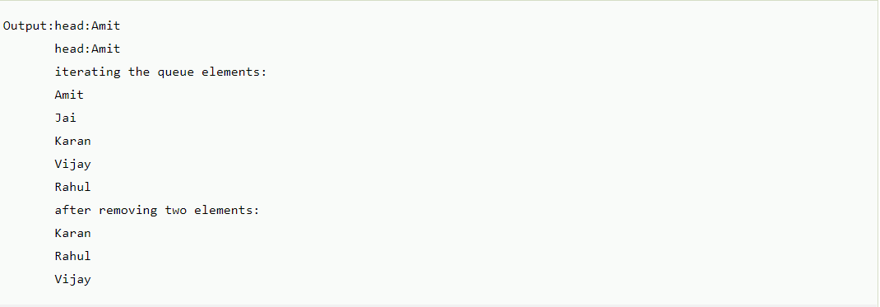

Slide 20
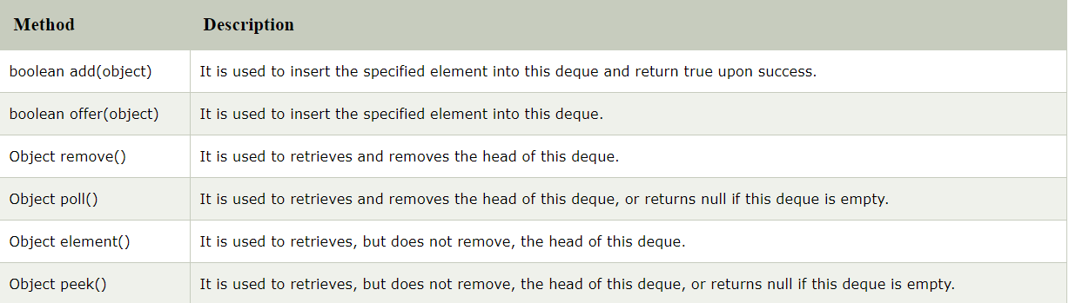
ARRAY DEQUEUE
The ArrayDeque class provides the facility of using deque and resizable-array.
The important points about ArrayDeque class are:
Unlike Queue, we can add or remove elements from both sides.
Null elements are not allowed in the ArrayDeque.
ArrayDeque is not thread safe, in the absence of external synchronization.
ArrayDeque has no capacity restrictions.
ArrayDeque is faster than LinkedList and Stack.

Slide 21
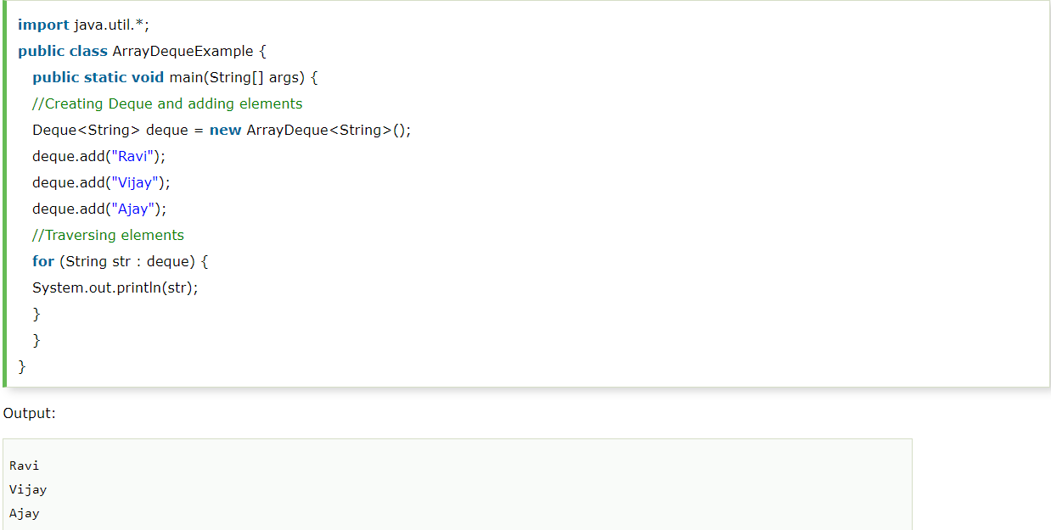

Slide 22
ITERATOR
Iterator enables you to cycle through a collection, obtaining or removing elements.
ListIterator extends Iterator to allow bidirectional traversal of a list, and the modification of elements.
Before you can access a collection through an iterator, you must obtain one.
Each of the collection classes provides an iterator( ) method that returns an iterator to the start of the collection.
By using this iterator object, you can access each element in the collection, one element at a time.
In general, to use an iterator to cycle through the contents of a collection, follow these steps
Obtain an iterator to the start of the collection by calling the collection's iterator( ) method.
Set up a loop that makes a call to hasNext( ). Have the loop iterate as long as hasNext( ) returns true.
Within the loop, obtain each element by calling next( ).

Slide 23
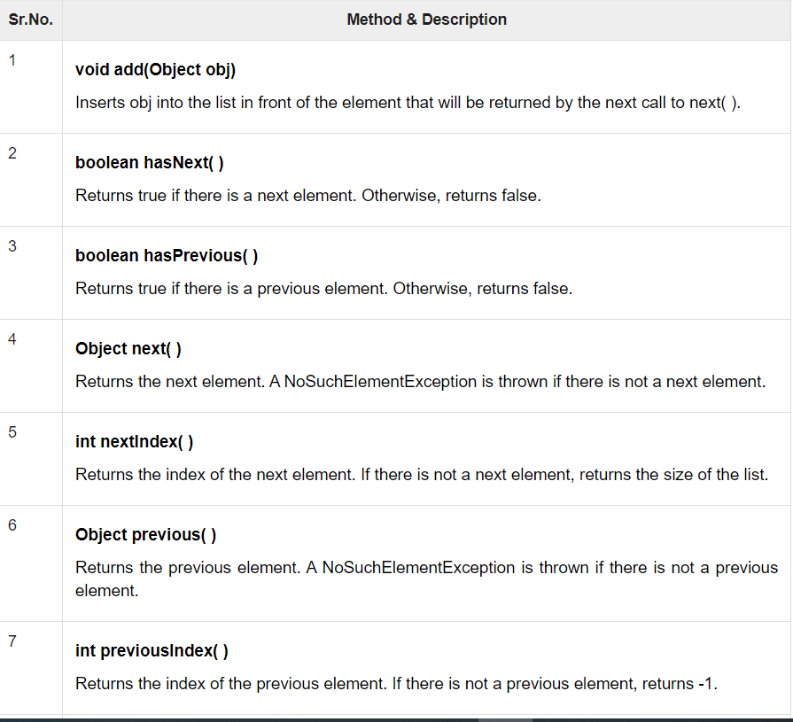
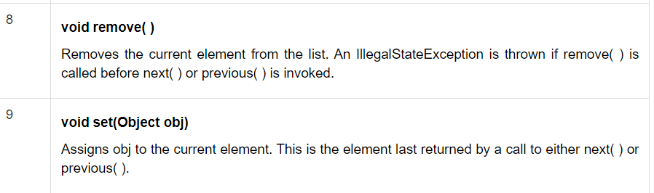

Slide 24
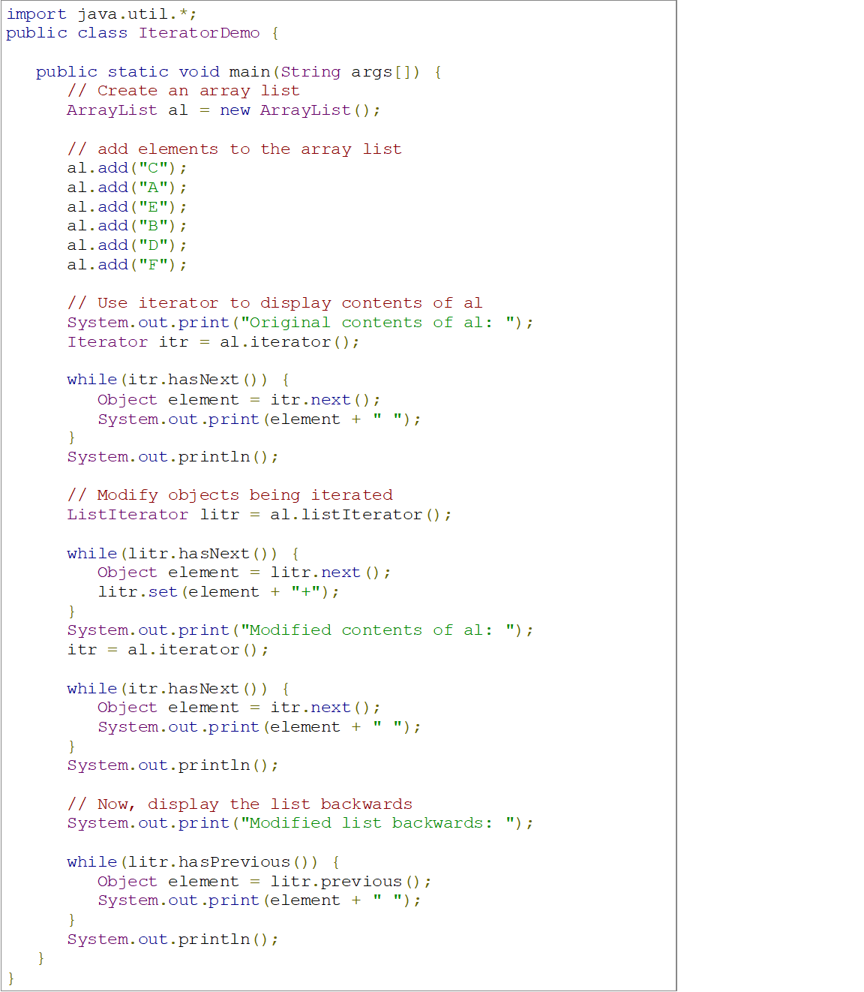

Slide 25
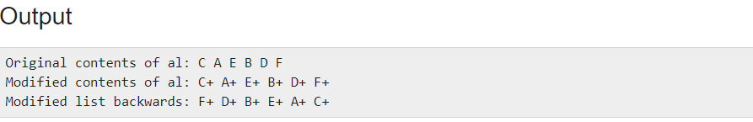

Slide 26
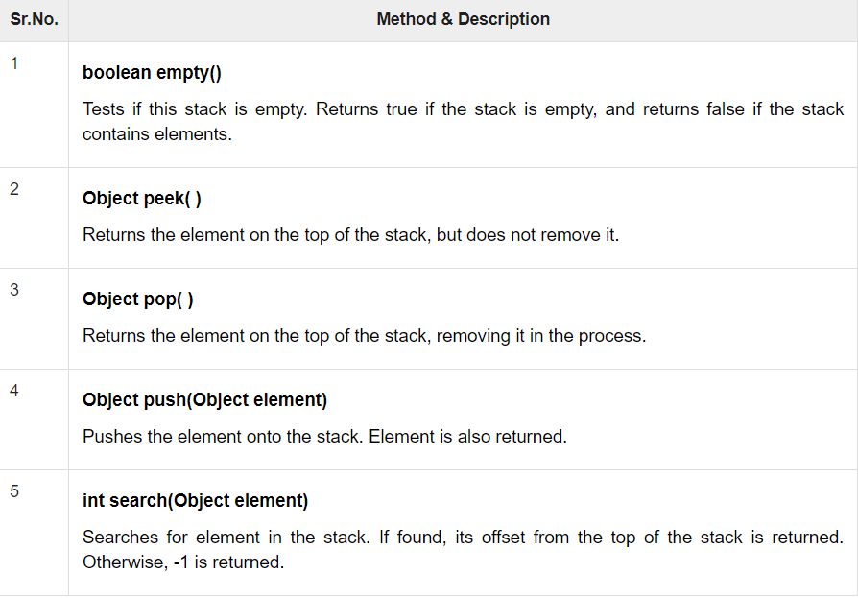
STACK
Stack is a subclass of Vector that implements a standard last-in, first-out stack.
Stack only defines the default constructor, which creates an empty stack.
Stack includes all the methods defined by Vector, and adds several of its own.

Slide 27
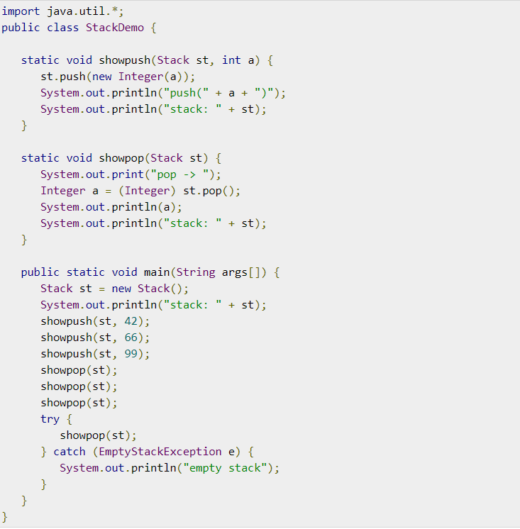

Slide 28
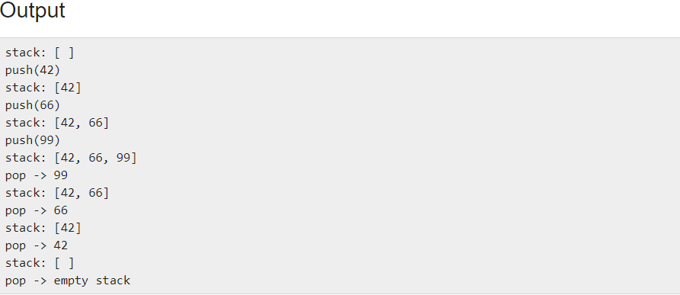

Slide 29
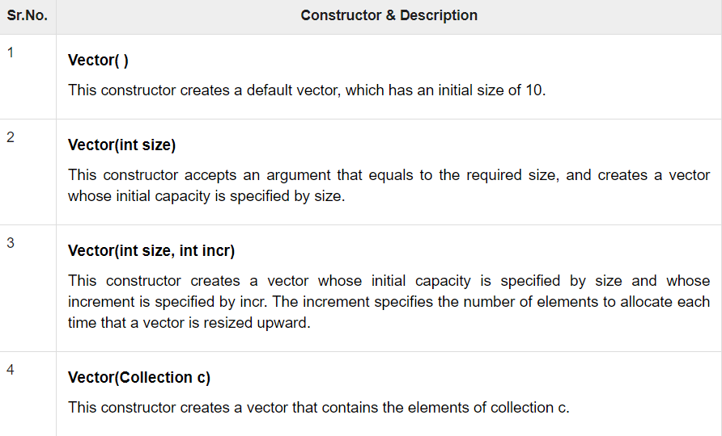
VECTOR
Vector implements a dynamic array. It is similar to ArrayList, but with two differences −
Vector is synchronized.
Vector contains many legacy methods that are not part of the collections framework.
Vector proves to be very useful if you don't know the size of the array in advance or you just need one that can change sizes over the lifetime of a program.

Slide 30
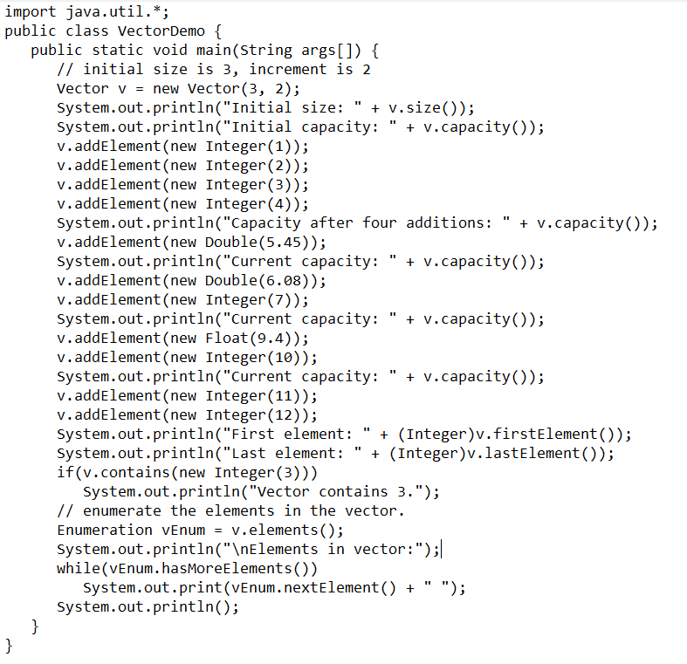

Slide 31
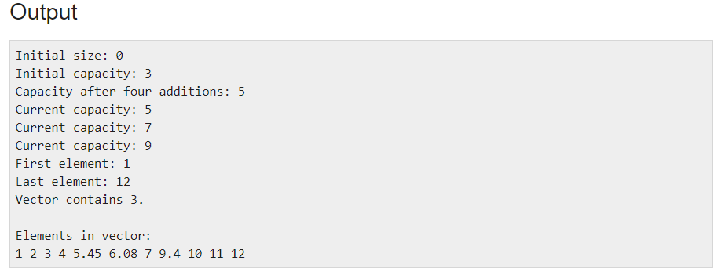

Slide 32
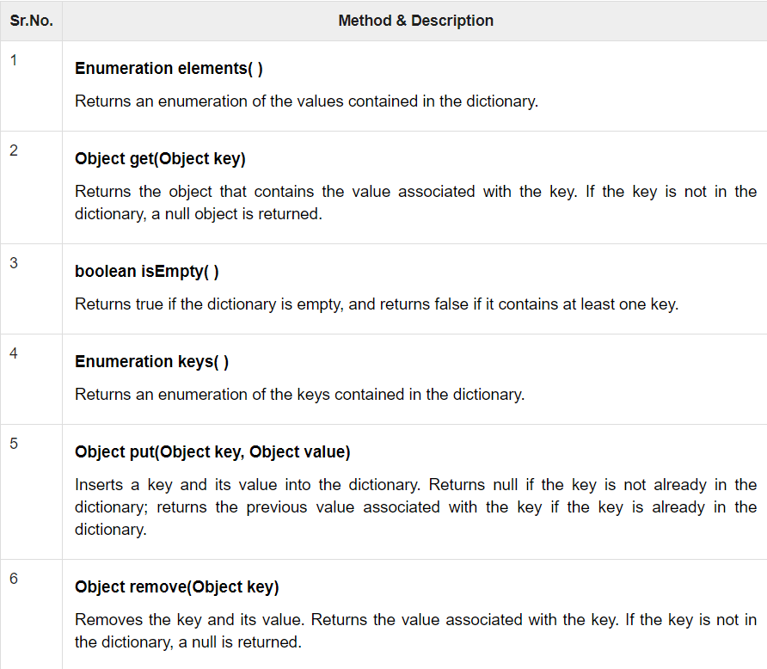
DICTIONARY
Dictionary is an abstract class that represents a key/value storage repository and operates much like Map.
Given a key and value, you can store the value in a Dictionary object.
Once the value is stored, you can retrieve it by using its key.
Thus, like a map, a dictionary can be thought of as a list of key/value pairs.

Slide 33
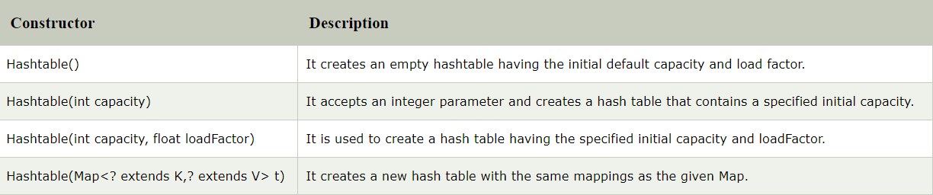
HASHTABLE
Java Hashtable class implements a hashtable, which maps keys to values.
It inherits Dictionary class and implements the Map interface.
Like HashMap, Hashtable stores key/value pairs in a hash table.
It is similar to HashMap, but is synchronized.
When using a Hashtable, you specify an object that is used as a key, and the value that you want linked to that key.
The key is then hashed, and the resulting hash code is used as the index at which the value is stored within the table.
Java Hashtable class contains unique elements.

Slide 34
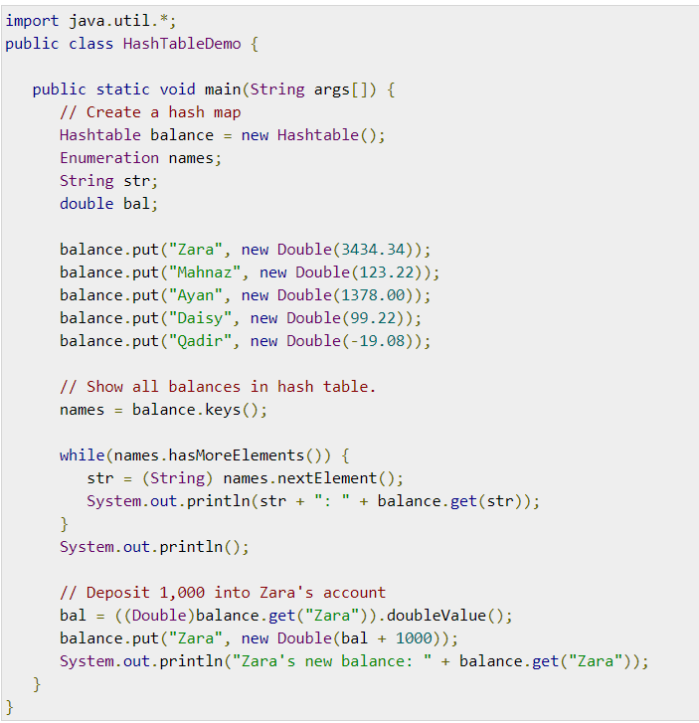

Slide 35
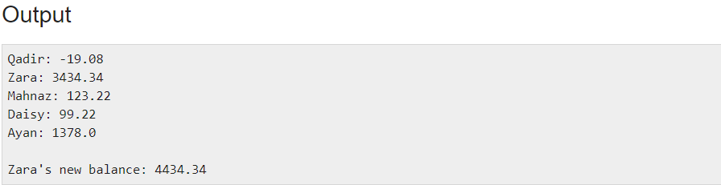

Slide 36
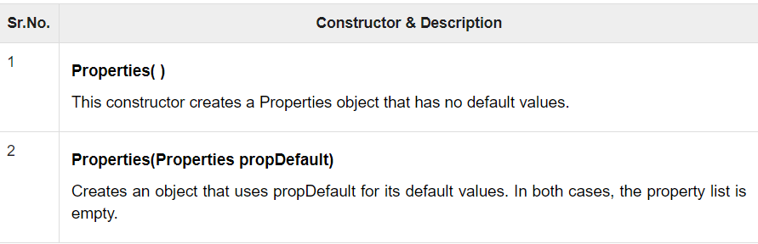
PROPERTIES
Properties is a subclass of Hashtable.
It is used to maintain lists of values in which the key is a String and the value is also a String.

Slide 38
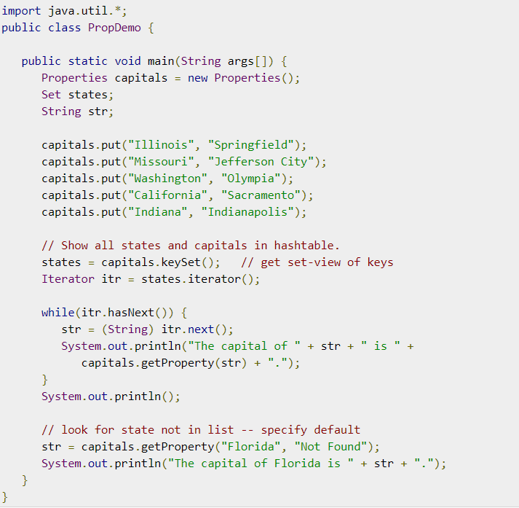

Slide 39
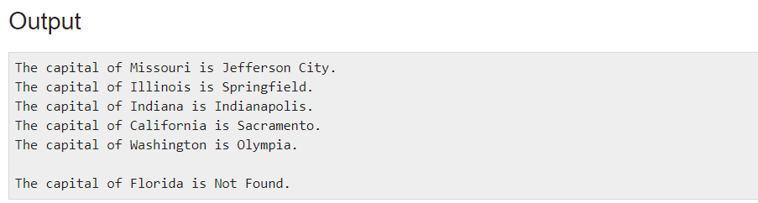

Slide 40
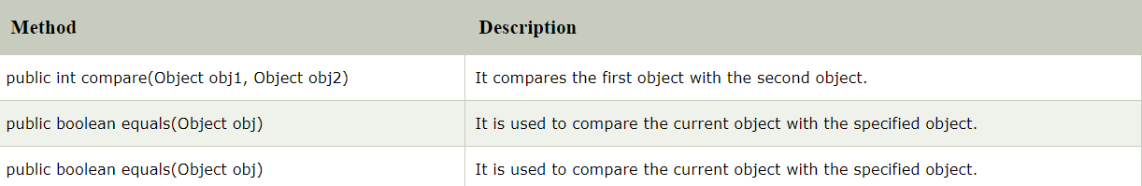
COMPARATOR
Java Comparator interface is used to order the objects of a user-defined class.
This interface is found in java.util package and contains 2 methods compare(Object obj1,Object obj2) and equals(Object element).
It provides multiple sorting sequences, i.e., you can sort the elements on the basis of any data member, for example, rollno, name, age or anything else.
Collections class provides static methods for sorting the elements of a collection-
public void sort(List list, Comparator c): is used to sort the elements of List by the given Comparator.

Slide 41
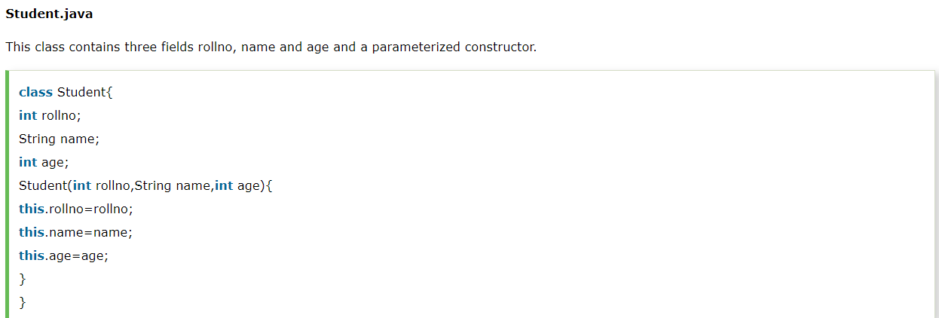
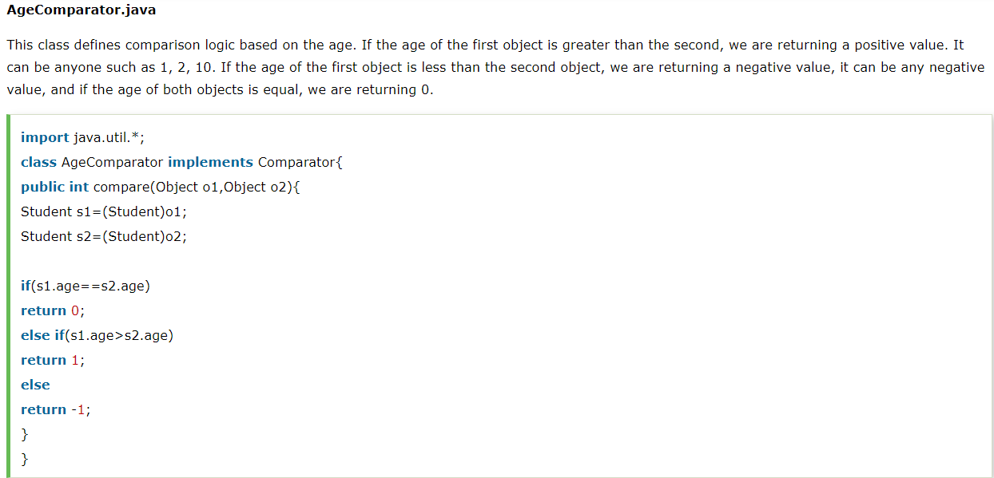

Slide 42
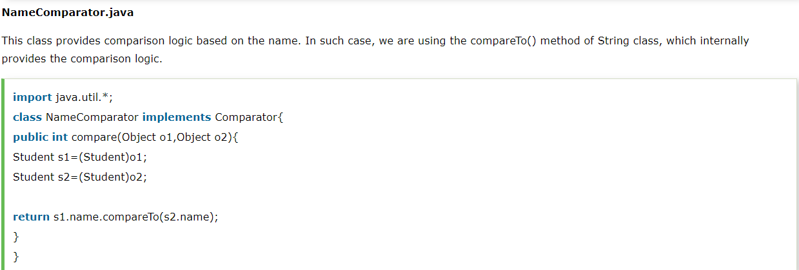

Slide 43
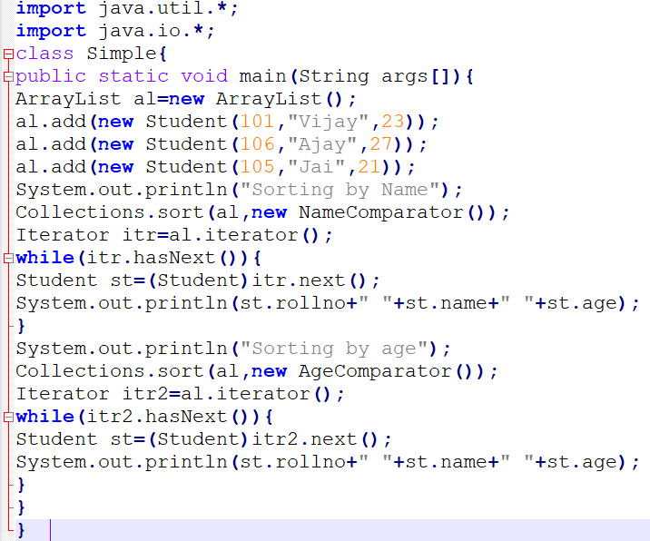

Slide 44
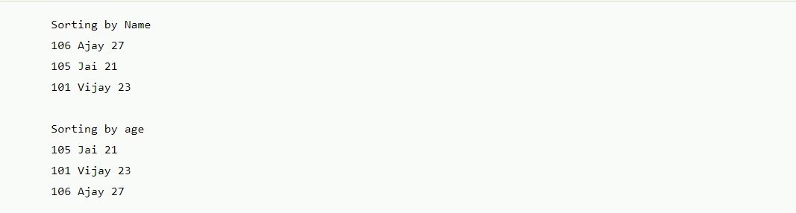

Slide 45
For..Each
Iterator is an interface provided by collection framework to traverse a collection and for a sequential access of items in the collection.
For eachloop is meant for traversing items in a collection.
for (<TYPE> e: C)
System.out.println(e);
We read the ‘:’ used in for-each loop as “in”.
So loop reads as “for each element in C collection”, here C is the collection which stores elements of datatype <type>.
If we have to modify collection, we can use Iterator.
While using nested for loops it is better to use for-each loop.

Slide 46
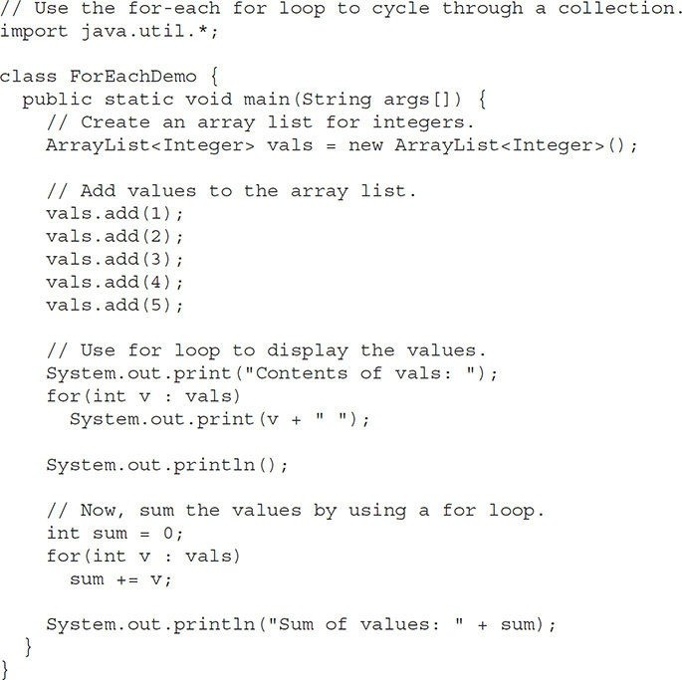

Slide 47
The output from the program is shown here:
Contents of vals: 1 2 3 4 5
Sum of values: 15

Slide 48
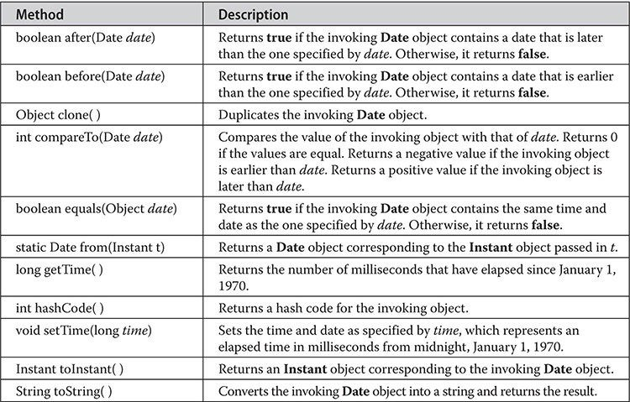
DATE
The Date class encapsulates the current date and time.
Date supports the following non-deprecated constructors:
Date( )
Date(long millisec)
The first constructor initializes the object with the current date and time.
The second constructor accepts one argument that equals the number of milliseconds that have elapsed since midnight, January 1, 1970.

Slide 49
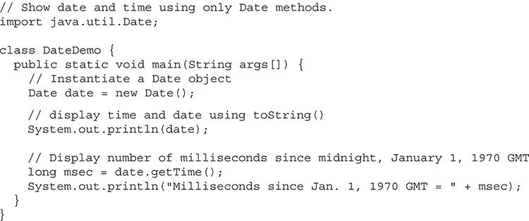
output :
Mon Jan 01 10:52:44 CST 2018
Milliseconds since Jan. 1, 1970 GMT = 1514825564360

Slide 50
CALENDAR
Java Calendar class is an abstract class that provides methods for converting date between a specific instant in time and a set of calendar fields such as MONTH, YEAR, HOUR, etc.
It inherits Object class and implements the Comparable interface.
public abstract class Calendar extends Object implements Serializable, Cloneable, Comparable<Calendar>

Slide 51
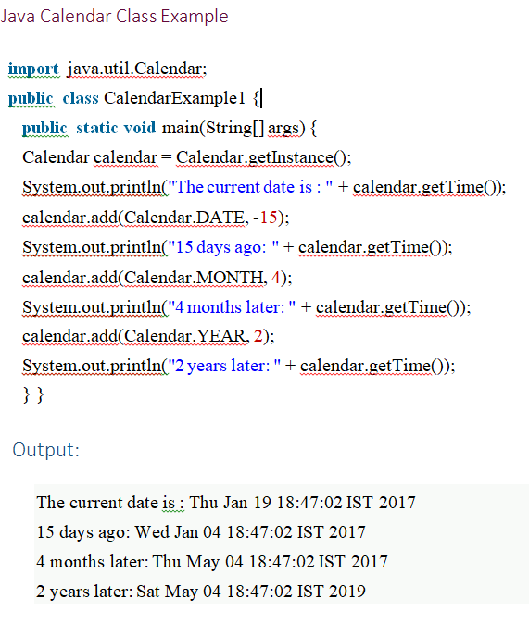

Slide 52
RANDOM CLASS
For using this class to generate random numbers, we have to first create an instance of this class and then invoke methods such as nextInt(), nextDouble(), nextLong() etc using that instance.
We can generate random numbers of types integers, float, double, long, booleans using this class.
We can pass arguments to the methods for placing an upper bound on the range of the numbers to be generated. For example, nextInt(6) will generate numbers in the range 0 to 5 both inclusive.

Slide 53
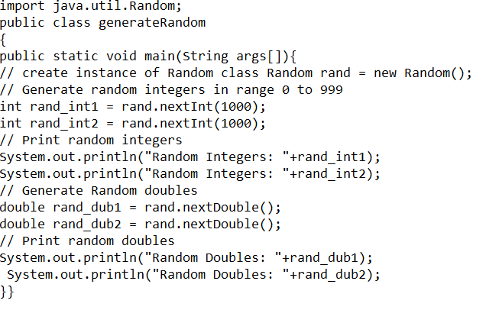
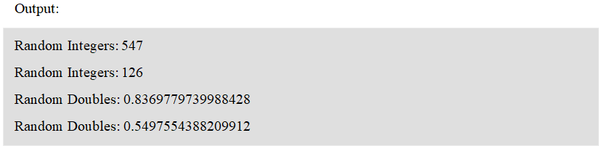

Slide 54
SCANNER
There are various ways to read input from the keyboard, the java.util.Scanner class is one of them.
The Java Scanner class breaks the input into tokens using a delimiter that is whitespace bydefault.
It provides many methods to read and parse various primitive values.
Java Scanner class extends Object class and implements Iterator and Closeable interfaces

Slide 55


Slide 56
GENERICS
We could write a single sort method that could sort the elements in an integer array, a string array, or an array of any type that supports ordering.
Java generic methods and generic classes enable programmers to specify, with a single method declaration, a set of related methods, or with a single class declaration, a set of related types, respectively.
Generics also provide compile-time type safety that allows programmers to catch invalid types at compile time.
Using java generic concept, we might write a generic method for sorting an array of objects, then invoke the generic method with integer arrays, double arrays, string arrays and so on, to sort the array elements.

Slide 57
GENERIC PROGRAMMING RULES
All generic method declarations have a type parameter section delimited by angle brackets (< and >) that precedes the method's return type ( < E > in the next example).
Each type parameter section contains one or more type parameters separated by commas. A type parameter, also known as a type variable, is an identifier that specifies a generic type name.
The type parameters can be used to declare the return type and act as placeholders for the types of the arguments passed to the generic method, which are known as actual type arguments.
A generic method's body is declared like that of any other method. Note that type parameters can represent only reference types, not primitive types (like int, double and char).

Slide 58



Slide 59
GENERIC CLASS
A generic class declaration looks like a non-generic class declaration, except that the class name is followed by a type parameter section.
As with generic methods, the type parameter section of a generic class can have one or more type parameters separated by commas.
These classes are known as parameterized classes or parameterized types because they accept one or more parameters.

Slide 60



Slide 61
FORMATTER
At the core of Java’s support for creating formatted output is the Formatter class.
It provides format conversions that let you display numbers, strings, and time and date in virtually any format you like.
You can use Formatter to format output, you must create a Formatter object.
After you have created a Formatter, you can use it to create a formatted string.
To do so, use the format( ) method. (ie)Formatter format(String fmtString, Object ... args).
Formatter fmt = new Formatter();
fmt.format("Formatting %s is easy %d %f", "with Java", 10, 98.6);
Output:Formatting with Java is easy 10 98.600000

Slide 62
STRING TOKENIZER
It is a pre defined class in java.util package can be used to split the given string into tokens (parts) based on delimiters (any special symbols or spaces).
Methods of StringTokenizer:
hasMoreTokens()
nextToken()
hasMoreTokens()-It is predefined method of StringTokenizer class used to check whether given StringTokenizer having any elements or not.
nextToken()-Which can be used to get the element from the StringTokenizer.

Slide 63



Slide 64
BITSET
A BitSet class creates a special type of array that holds bit values in the form of boolean values.
This array can increase in size as needed.
The BitSet constructors are shown here:
BitSet( )
BitSet(int size)

Slide 65


Slide 66
Initial pattern in bits1:
{0, 2, 4, 6, 8, 10, 12, 14}
Initial pattern in bits2:
{1, 2, 3, 4, 6, 7, 8, 9, 11, 12, 13, 14}
bits2 AND bits1:
{2, 4, 6, 8, 12, 14}
bits2 OR bits1:
{0, 2, 4, 6, 8, 10, 12, 14}
bits2 XOR bits1:
{}

Slide 67



STRING HANDLING
In Java, string is basically an object that represents sequence of char values.
An array of characters works same as Java string.

Slide 68



Slide 69



Slide 70



Slide 71



Slide 72


Slide 73


Slide 74


Slide 75


Slide 76


Slide 77


Slide 78



Slide 79


Slide 80


Slide 81


Slide 82

STRING COMPARISON
There are three way to compare string object in java:
By equals() method
By == operator
By compreTo() method
equals() Method in Java-

Slide 83

== or Double Equals to Operator in Java

Slide 84

compareTo() Method in Java

Slide 85

STRING CONCATENATION
There are two way to concat string object in java:
By + (string concatenation) operator
By concat() method
By + operator

Slide 86

By concat() method

