Slide 1
PROJECT TITLE :
ECG Based Anomaly Detection
Presented By:
Vaishnavi R,
KGISL Institute Of Technology,
NM ID:au711721243119

Slide 2


AGENDA
Problem Statement
Project Overview
Who are the end users?
Solution and its value proposition
The wow in your solution
Modelling
Results
Conclusion
3/21/2024 Annual Review

Slide 3

PROBLEM STATEMENT
Detecting abnormal heart rhythms, or arrhythmias, from ECG signals is crucial for timely diagnosis and treatment of cardiac conditions. However, manual inspection of ECG signals is time-consuming and prone to errors. An automated system capable of accurately identifying anomalies in ECG signals is needed to aid healthcare professionals in diagnosis and monitoring of cardiac health.

Slide 4

PROJECT OVERVIEW
The project is focused on anomaly detection in electrocardiogram (ECG) signals using deep learning techniques. An ECG signal is a vital diagnostic tool used to monitor heart health, and anomaly detection in these signals can help in early detection of cardiac abnormalities. The project aims to build an auto encoder neural network model to identify abnormal ECG signals from normal ones.
Project Components:
Data Preprocessing:
Data is preprocessed to normalize and scale features.
Train-test split is performed to separate data for model training and evaluation.
Model Development:
An autoencoder-based neural network model is developed for anomaly detection.
The model comprises an encoder and a decoder, trained to reconstruct normal ECG signals accurately.
Training:
The autoencoder model is trained using normal ECG signals.
Training involves minimizing the reconstruction error between input and output signals.
Evaluation:
Model performance is evaluated on both normal and abnormal ECG signals.
Evaluation metrics such as precision, recall, and accuracy are computed to assess anomaly detection performance.
Visualization:
Visualization techniques are employed to illustrate model predictions and reconstruction errors.

Slide 5
WHO ARE THE END USERS?
Medical Professionals:
Cardiologists and healthcare practitioners can utilize this project to automate the process of detecting abnormal ECG signals.
The model can assist in diagnosing various heart conditions, enabling faster and more accurate patient assessments.
Researchers:
Researchers in the field of biomedical engineering and healthcare analytics can leverage the codebase to explore advanced techniques for anomaly detection in medical signals.
The project provides a foundation for further studies on deep learning-based diagnostic tools for cardiovascular diseases.
Developers:
Software developers interested in healthcare applications can integrate the developed model into medical devices or software platforms.
The project offers insights into implementing deep learning algorithms for real-time monitoring and analysis of ECG data.

Slide 6
YOUR SOLUTION AND ITS VALUE PROPOSITION
Data Preparation:
The data comes from the MIT-BIH Arrhythmia Database, which contains ECG signals.
Data preprocessing involves loading the ECG signals and annotations, and extracting beats from the signals.
Feature Engineering:
The beats are categorized as normal, abnormal, or non-beat based on their annotations.
Non-beat symbols are ignored.
Abnormal beat symbols are categorized as abnormal, while normal beat symbols are categorized as normal.
Dataset Creation:
Two datasets are created: one for normal beats and one for abnormal beats.
The dataset includes a specified number of seconds of signal before and after each beat.
Model Building:
An autoencoder neural network architecture is used for anomaly detection.
The autoencoder consists of an encoder and a decoder.
The encoder compresses the input data into a lower-dimensional representation.
Training and Evaluation:
The autoencoder is trained on normal beat data.
Both normal and anomalous test data are used for evaluation.
Visualization:
Loss curves during training are plotted to monitor model performance.
Reconstruction results are visualized for both normal and anomalous test data.

Slide 7

THE WOW IN YOUR SOLUTION
Comprehensive Approach:
The project addresses a critical healthcare challenge of detecting abnormal heartbeats using ECG signals.
It incorporates data preprocessing, feature engineering, model building, and evaluation in a single pipeline.
Deep Learning Model:
The use of an autoencoder neural network allows for unsupervised learning and efficient feature representation.
The model learns intricate patterns from the ECG signals to accurately identify anomalies.
Interactive Visualizations:
Through visualizations, users can easily interpret the model's performance and understand its ability to reconstruct normal and abnormal heartbeats.
Error plots highlight discrepancies between original and reconstructed signals, aiding in anomaly detection.
Potential Impact:
The successful deployment of this model could significantly enhance healthcare systems by providing early detection of cardiac abnormalities, potentially saving lives.
7

Slide 8
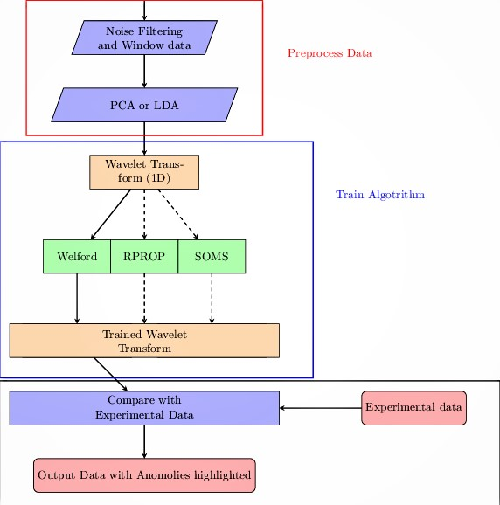
MODELLING
8

Slide 9
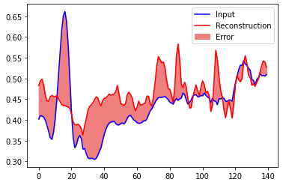
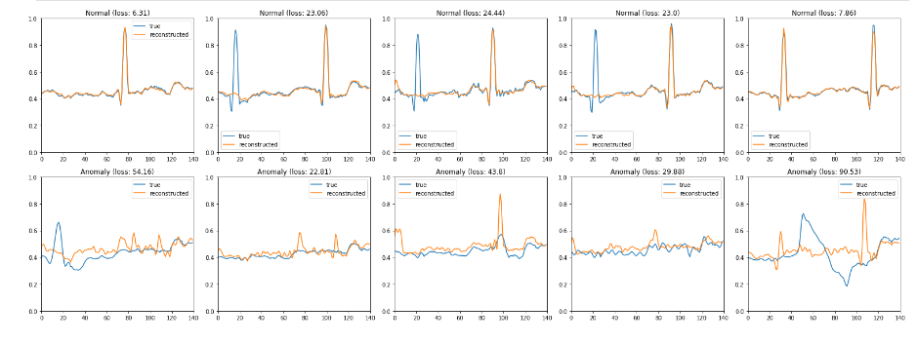
RESULTS
9

Slide 10
CONCLUSION
In conclusion, the developed anomaly detection system represents a significant advancement in the field of cardiac health monitoring. By harnessing the power of deep learning, the system offers a robust, automated solution for identifying abnormal ECG signals with impressive accuracy and efficiency. This technology has the potential to revolutionize cardiovascular healthcare by enabling early detection and intervention, ultimately improving patient outcomes and saving lives.

