Slide 1

Explainable AI Techniques for Student Academic Performance Analytics
Project Review-1
N Mokshita - 2420030551
Vaishnavi R- 2420030371
Usha Sri Sai - 2420030033
Dept
Computer Science & Engineering
Institution
KL University

Slide 2
Problem Statement
Machine learning models for predicting student academic performance have achieved high predictive accuracy but often function as "black boxes," providing little insight into the factors driving their predictions . This lack of interpretability limits trust among educators and administrators, hindering the adoption of data-driven decision-making in educational settings . While Explainable AI (XAI) techniques such as SHAP and LIME have emerged to address this gap, there remains a need for comprehensive comparative evaluations of these techniques across multiple machine learning models and educational datasets to determine which approaches provide the most actionable and trustworthy explanations for diverse educational stakeholders .

Slide 3
Literature Survey
S.No | Title | Source | Contributor
1. | "Model Interpretability in the Educational Data Mining Context: A Systematic Literature Mapping" – Carvalho, Mattos, & Aguiar (2026) | Revista Brasileira de Informática na Educação | Found that interpretability is frequently addressed as a post-hoc component rather than as a core objective; identified need for comparative studies across different ML techniques
2. | "Systematic Literature Review on Explainable Learning Analytics and Educational Data Mining" – IEEE Access (2025) | IEEE Access (Vol. 13) | Reviewed 212 studies; revealed researchers have increasingly adopted post-hoc methods—especially SHAP—from 2024 to 2025; identified gaps in quantifiable explainability metrics
3. | "Leveraging psychological data and transparent machine learning for student success prediction" – ScienceDirect (2026) | ScienceDirect | Evaluated six ML classifiers; XAI highlighted digital self-efficacy, perceived feedback usefulness, and discussion engagement as dominant predictors
4. | "Ensemble machine learning framework with SHAP and LIME for accurate early prediction of student success" – Almazroei (2026) | Scientific Reports / NIH | Integrated 7 datasets; XGBoost achieved 95.04% accuracy; SHAP/LIME revealed cumulative assessment performance and engagement as top predictors
5. | "Predicting student success with interpretable machine learning framework" – Frontiers in Education (2026) | Frontiers | CatBoost achieved 88.8% balanced accuracy; XAI enabled global and individual-level interpretation; emphasized socioeconomic factors

Slide 4
S.No | Title | Source | Contributor
6. | "Explainable student performance prediction models: A systematic review" – Alamri & Alharbi (2021) | IEEE Access | Comprehensive review of XAI in education; highlighted SHAP and LIME as dominant techniques; identified lack of fairness and interpretability metrics
7. | "Tracking student progress using clustering and explainable AI" – Springer (2026) | Universal Access in the Information Society | Proposed rule-based system transforming XAI rules into human-readable feedback; LLM-assisted recommendation generation
8. | "Explainable AI in education: A survey" – Khosravi et al. (2022) | Computers and Education: AI | Provided foundational framework for XAI in educational contexts; discussed stakeholder-specific explanation requirements
9. | "Analyzing dropout and explainable prediction using AI" – Paul et al. (2025) | Frontiers in Education | Logistic Regression found most effective for at-risk identification; XAI provided explainable insights into decision-making
10. | "Predicting academic performance through lifestyle factors using interpretable ML" – World Scientific (2026) | International Journal on AI Tools | Proposed hierarchical evolutionary feature selection framework balancing predictive accuracy with interpretability
11. | "A Novel Hybrid Feature Selection Framework for Enhancing Accuracy and Interpretability" – Bin Azmi et al. (2025) | International Journal of Applied Mathematics | Proposed LASSO + ACO hybrid feature selection to balance accuracy and interpretability; highlighted "black-box" decision transparency

Slide 5
Research Gaps
Interpretability as Post-Hoc Component – Most studies treat interpretability as an afterthought rather than a core objective of model design; limited systematic evaluation and comparative analysis of interpretability across models from different ML techniques
Limited Quantifiable Explainability Metrics – Only a few studies include quantified explanations using metrics like sensitivity and stability; lack of standardized evaluation frameworks for XAI in education
Lack of Comparative Studies – Need for studies comparing interpretability across multiple ML models (Logistic Regression, Decision Tree, Random Forest, XGBoost, CatBoost) using identical datasets and XAI techniques
Limited Fairness Integration – Fairness and equity considerations remain underexamined in XAI educational research; need to assess group-level fairness in predictive systems
Limited Multi-Dataset Integration – Most studies rely on single datasets; need for comprehensive comparison across multiple benchmark datasets (UCI, xAPI, OULAD)

Slide 6
Objectives
To evaluate and compare the predictive accuracy of five machine learning models (Logistic Regression, Decision Tree, Random Forest, XGBoost, CatBoost) for student academic performance classification
To apply and compare SHAP and LIME XAI techniques for providing global and local explanations across all models
To identify the most influential academic, behavioral, and demographic factors affecting student performance
To conduct a comparative analysis of models based on performance metrics (Accuracy, Precision, Recall, F1-Score, ROC-AUC) and interpretability scores

Slide 7
Innovation & Novelty
S.No | Innovation | Description
1. | Multi-Dataset Integration Pipeline | Integrating three benchmark datasets (UCI, xAPI, OULAD) into a unified preprocessing and analysis pipeline—rarely done in previous studies
2. | Comprehensive XAI Comparison Framework | Systematic side-by-side comparison of SHAP and LIME across 5 models using identical feature sets and evaluation criteria—addressing the gap identified by Carvalho et al. (2026)
3. | Feature-Level Interaction Analysis | Using SHAP dependence plots to reveal how features interact (e.g., attendance × GPA) in influencing predictions—beyond what previous studies have explored
4. | Explainability-Quantified Dashboard | Developing an interactive dashboard where explanations are paired with confidence metrics—addressing the gap in quantifiable explainability metrics identified by the IEEE SLR (2025)

Slide 8
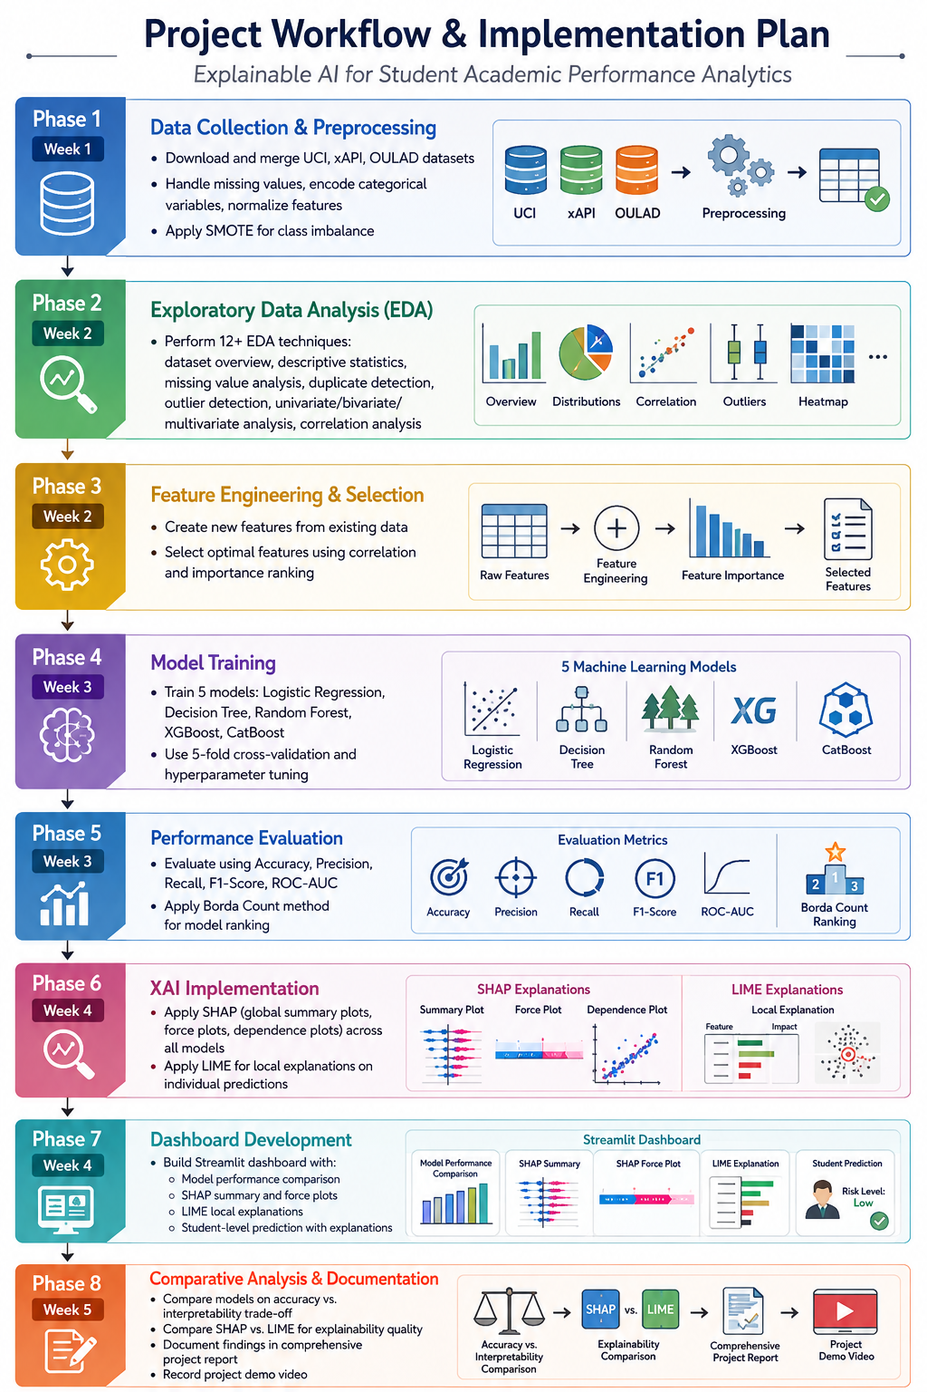

Slide 9
Project Plan
Phase 1: Data Collection & Preprocessing
Download and merge UCI, xAPI, OULAD datasets
Handle missing values, encode categorical variables, normalize features
Apply SMOTE for class imbalance
Phase 2: Exploratory Data Analysis (EDA)
Perform 12+ EDA techniques: dataset overview, descriptive statistics, missing value analysis, duplicate detection, outlier detection, univariate/bivariate/multivariate analysis, correlation analysis
Phase 3: Feature Engineering & Selection
Create new features from existing data
Select optimal features using correlation and importance ranking
Phase 4: Model Training
Train 5 models: Logistic Regression, Decision Tree, Random Forest, XGBoost, CatBoost
Use 5-fold cross-validation and hyperparameter tuning
Phase 5: Performance Evaluation
Evaluate using Accuracy, Precision, Recall, F1-Score, ROC-AUC
Apply Borda Count method for model ranking
Phase 6: XAI Implementation
Apply SHAP (global summary plots, force plots, dependence plots) across all models
Apply LIME for local explanations on individual predictions
Phase 7: Comparative Analysis & Documentation
Compare models on accuracy vs. interpretability trade-off
Compare SHAP vs. LIME for explainability quality
Document findings in comprehensive project report

