Slide 1

Explainable AI‑Based Student Academic Failure Prediction
Project Review‑2
Machine Learning + SHAP for Early Academic Risk Detection
Student
Student Name:
Naru Mokshita - 2420030551
Ramayanam vaishnavi - 2420030371
Thota Usha Sri Sai - 2420030033

Slide 2
Problem Statement & Objective
Problem: Identify students at risk of academic failure before final outcomes.
Objective: Build a classification model that predicts failure and explains individual predictions with SHAP.
Target use: Early‑warning support for educators and advisors.
Definition: fail = 1 if G3 < 10; pass = 0 if G3 ≥ 10. Grade scale: 0–20.

Slide 3
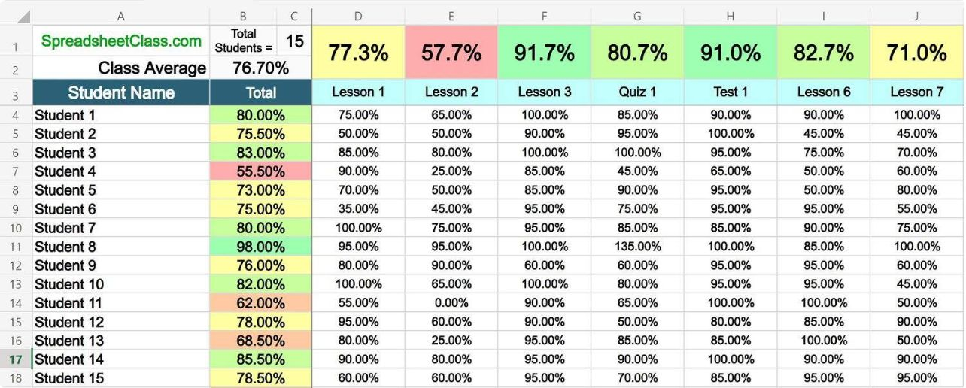
Dataset & Features
Primary sources:
UCI Student Performance Dataset (ID 320) — Mathematics & Portuguese records.
xAPI Educational Dataset (learning management system behavioral data)
Open University Learning Analytics Dataset (OULAD) (large-scale higher education learning analytics)
Key features: demographics, attendance, study time, prior grades (G1, G2), behavioral attributes.
Target: G3 (final grade). G3 excluded from predictors to avoid leakage.
Harmonization: Additional academic datasets can be mapped to a common schema.

Slide 4
Methodology — ML Pipeline
Emphasis:
Stratified train/test split to preserve class balance.
Preprocessing fitted only on training data — no data leakage.
Recall prioritized for at‑risk detection.

Slide 5
System Architecture
High‑level flow
Input
Preprocessing
Models
Output
Student records (G1, G2, sociodemographic, behavior)
Personal Inputs
Imputation • Encoding • Scaling
Ensemble & single classifiers
Risk score + SHAP explanations → Advisor dashboard

Slide 6








Tools & Technologies
Python
Pandas
Development and orchestration
Data wrangling
NumPy
Scikit‑learn
Numerical operations
Preprocessing, metrics, baseline models
XGBoost
CatBoost
Gradient boosting classifier
Categorical‑aware boosting
SHAP
Jupyter
Model interpretability (global & local)
Experimentation & reporting
Visualization: Matplotlib / Seaborn for plots and diagnostic charts.

Slide 7


Machine Learning Models Compared
Logistic Regression — interpretable baseline.
Decision Tree — simple rule inspection.
Random Forest — robust ensemble baseline.
XGBoost — gradient boosting (high performance option).
CatBoost — handles categorical features natively.
Evaluation metrics: Accuracy, Precision, Recall (priority), F1, ROC‑AUC.

Slide 8
Implementation — Stages & Code Flow
Concise pipeline steps
# Pseudo‑code (readable)
data = load_datasets()
data = harmonize_schema(data)
X, y = define_features_and_target(data) # G3 excluded from X
pipeline = make_pipeline(impute, encode, scale)
X_train, X_test, y_train, y_test = stratified_split(X,y)
pipeline.fit(X_train)
model.fit(pipeline.transform(X_train), y_train)
probs = model.predict_proba(pipeline.transform(X_test))
shap_values = shap.Explainer(model).shap_values(pipeline.transform(sample))
Load & harmonize datasets
Clean, validate, define target (G3 < 10 → 1)
Build preprocessing pipeline (fit on train only)
Train multiple classifiers; compute predicted probabilities
Evaluate; select best model; compute SHAP values

Slide 9
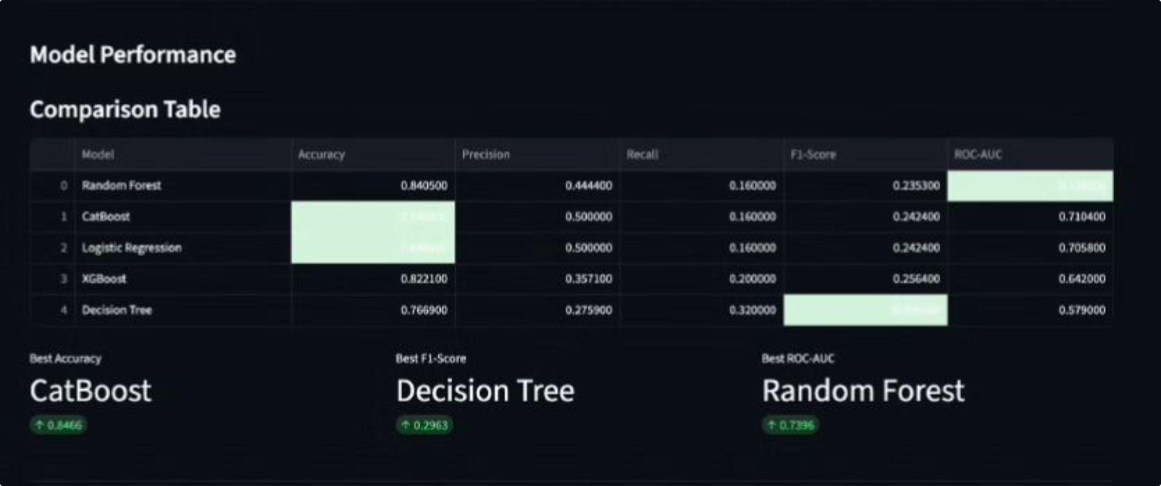
Results & Performance Evaluation
Comparison table
Model selection rule: weighted combination of ROC‑AUC, F1, and Recall — prioritize Recall to reduce missed at‑risk students.

Slide 10
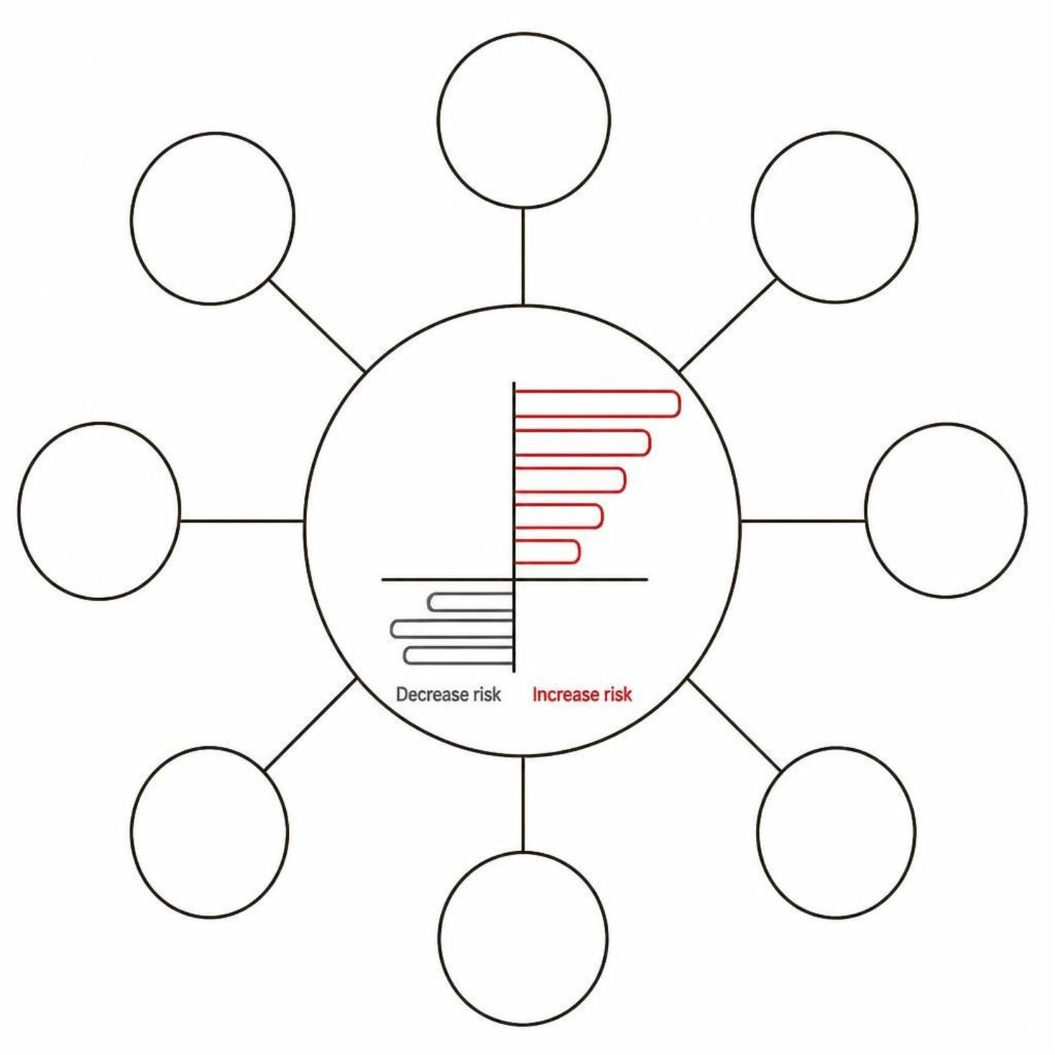
Explainable AI — SHAP
Key points
SHAP attributes each prediction to feature contributions (additive feature attributions).
Positive SHAP values → increase predicted failure risk; negative → decrease risk.
Supports global interpretation (feature importance) and local explanations (individual student).
One‑hot categorical contributions are aggregated back into readable feature labels for advisors.

