Slide 1
EduLens AI
Intelligent Student Dropout Prevention
for Google Classroom
Built by Vaishnavi Singasani | AI Engineer & Data Analyst
Published CNN Researcher | 10M-User App Developer

Slide 2
The Problem
Google Classroom has 170M+ users.
It knows who logged in.
It does NOT know who is about to quit.
1 in 5 online students drops out before completing
Teachers cannot monitor 40+ students individually
By the time dropout is noticed — it is too late
Google Classroom is missing an intelligence layer.

Slide 3
The Solution
EduLens AI — Real-Time Student Intelligence Platform
1
Cognitive State Detection
CNN model detects if student is engaged, confused, bored or frustrated
2
Dropout Prediction
XGBoost model predicts dropout 2 weeks before it happens — 80%+ accuracy
3
Personalized Recovery Path
AI engine auto-generates a learning plan tailored to each student's style

Slide 4
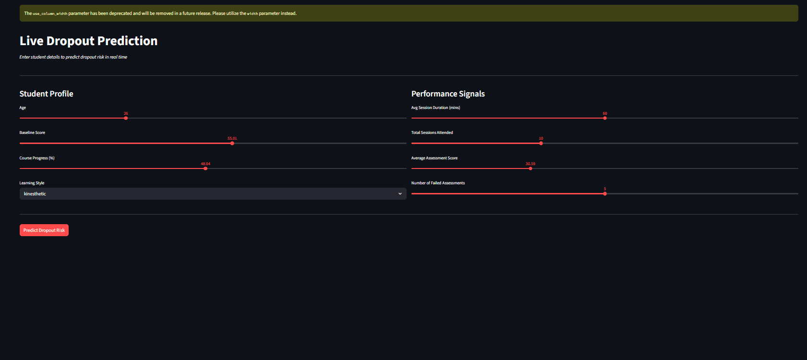
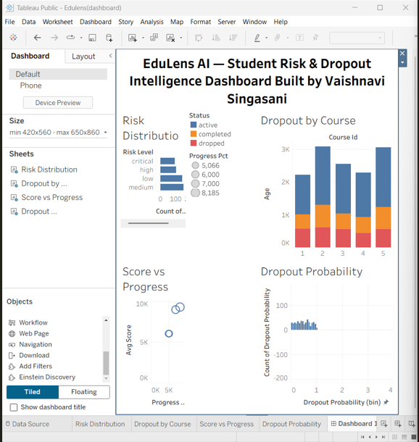
Live Demo
Streamlit Live Prediction App
Tableau Educator Dashboard
Real predictions. Real interventions. Built and running today.

Slide 5
How It Works
Student Sessions
SQL Database
XGBoost Model
Path Engine
Tableau Dashboard
→
→
→
→
Tech Stack: Python • SQL • XGBoost • Streamlit • Tableau • SQLite

Slide 6
Why Google
Google Classroom
170M+ users across 180 countries — EduLens plugs in directly
Google Meet
Perfect video input for CNN cognitive state detection
Gemini API
Powers dynamic, intelligent learning path generation
Google Cloud
Scales EduLens to every school on the planet
EduLens is what Google Classroom looks like with Gemini inside.

Slide 7
Market Opportunity
$340B
$30B
170M+
20%
Global EdTech market by 2025
Lost annually to online dropout
Google Classroom active users
Google for Education YoY growth
EduLens addresses the #1 unsolved problem in education technology.

Slide 8
Why I Built This
B.Tech CSE Data Science — Institute of Aeronautical Engineering, Hyderabad
Published CNN Research — JISEM Journal (84.73% accuracy, real deployment)
Built real-time AI app for 10M+ concurrent users — Kumbh Mela 2025
Skills: Python • TensorFlow • SQL • Tableau • Power BI • Flutter
Team Lead — Software Developer at Vershama Tech Pvt. Ltd.
I don't just design AI systems. I deploy them at scale.

Slide 9
What I Am Asking
Option 1
Integrate EduLens as a Google Workspace for Education add-on
Option 2
Deploy as a Gemini-powered analytics layer inside Google Classroom
Option 3
Pilot with 1 institution — I will lead the full build and deployment
Give me the resources. I will give you the product.

Slide 10
EduLens AI
"Google Classroom shows who attended.
EduLens shows who understood —
and who needs help before it's too late."
Vaishnavi Singasani
vaishnaviv0809@gmail.com
linkedin.com/in/singasani-vaishnavi0031

